Slide 1
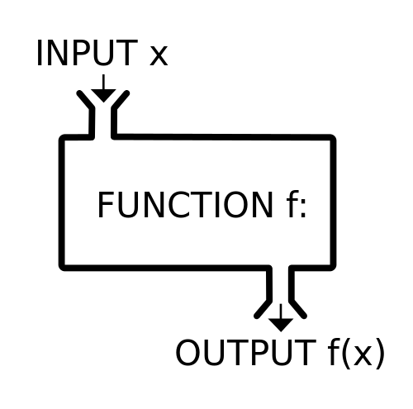
Functions
Abel Sanchez and John R. Williams

Slide 2
Functions: what are they good for?
Generalizing code
  Build something that allows you to process a range of inputs in a standard way
Compartmentalizing code
  Keeping the nitty-gritty functionality outside of the core architecture of the program
Streamlining code and increasing reusability
  Write something that you can use again and again – NO copy/paste!

Slide 3
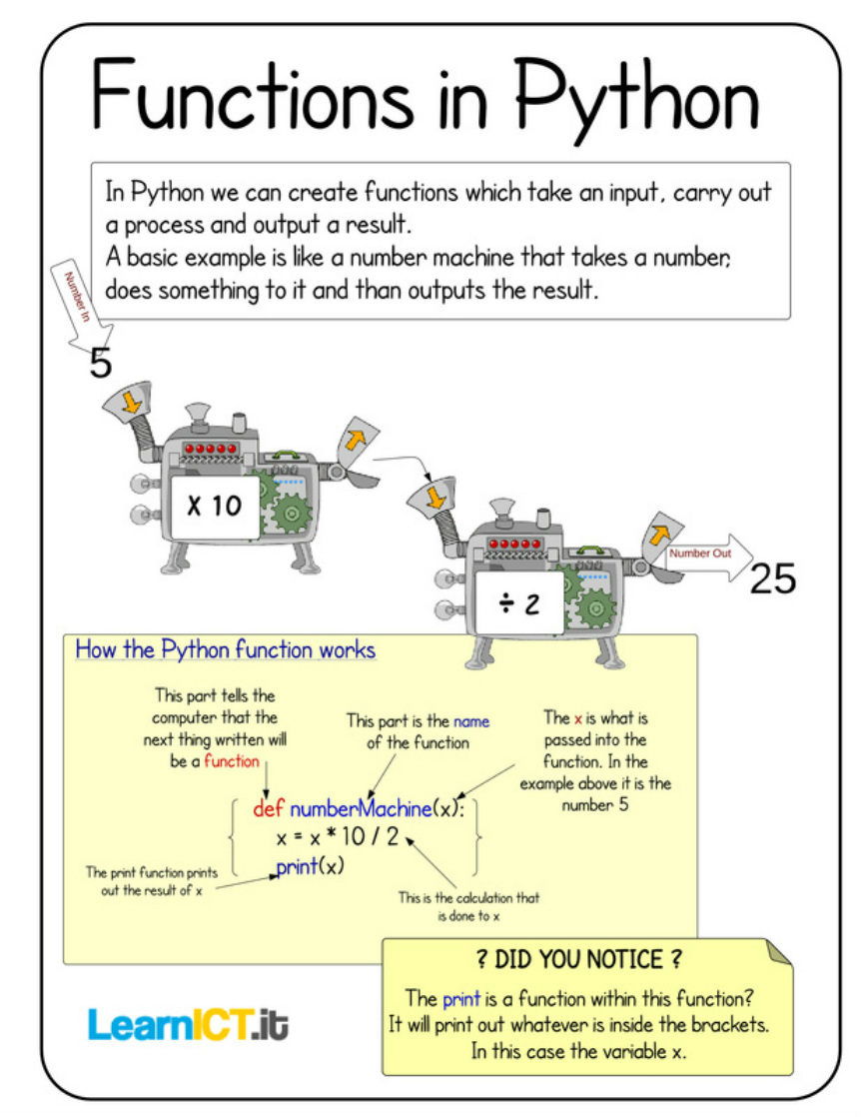

Slide 4
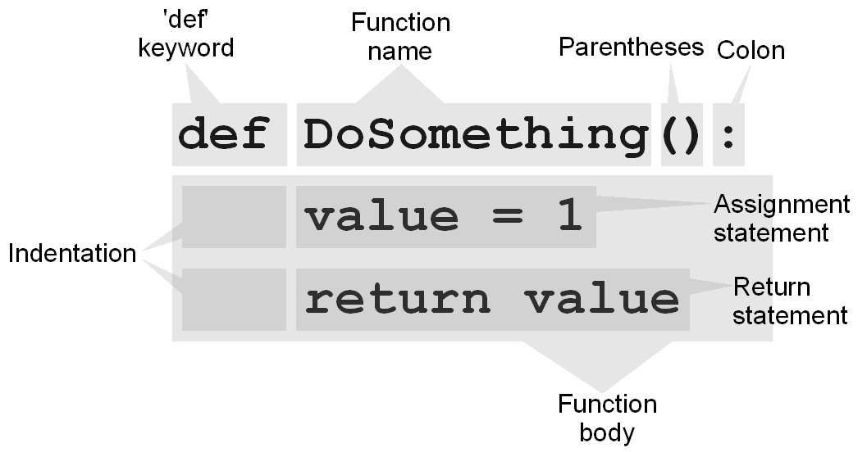
What do functions look like?
Holsworthy Comm. Coll.

Slide 5
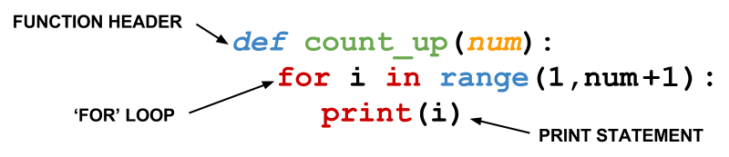
What do functions look like?
UC Berkeley

Slide 6
Let’s practice:
Def colored_dogs(color):
try:
print “My dog is ” + color
output_success = True
Except:
output_success = False
return output_success

Slide 7
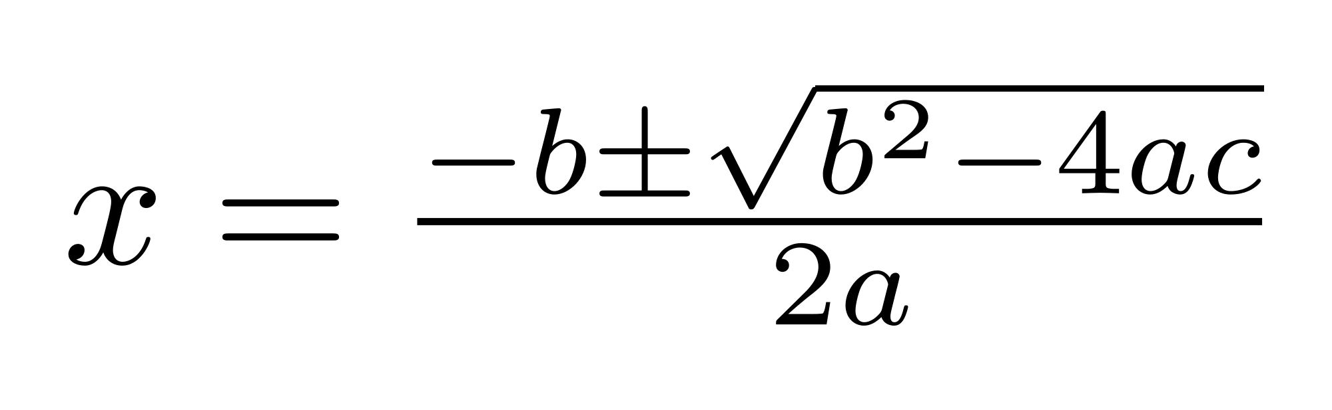
Now, let’s make a function together
Def quadratic(?):
?
?
?
return ?,?

Slide 8
Class activity
Form your old groups, and turn part of your previous code into a function... or add some new code in a function.
Note that your function must be defined somewhere above where it is called (needs to be defined before you can use it, and interpreter reads code from top to bottom: imperative programming paradigm)

