Slide 1
GeekNavi
M.Nikhil
22071A12G4
9059990769
mnikhil0904@gmail.com
VNRVJIET

Slide 2
The problem statement highlights significant gaps in current mental health support systems:
Absence of Tailored, Instantaneous Interventions: Although current wellness applications track stress and mood, they frequently fall short in offering quick, customized interventions that actively support people in enhancing their mental health.
Generalized Advice: The effectiveness of many remedies is limited by their general suggestions, which might not take into account each person's particular needs.
High Costs and Inaccessibility: Therapy and advanced mental health tools are often expensive, making them inaccessible to a large portion of the population.
Underutilization of Self-Help Strategies for Minor Issues: Many minor mental health concerns can be effectively managed through self-help techniques without professional intervention. However, current systems often overlook empowering individuals with these accessible strategies, potentially leading to the escalation of manageable issues into more serious conditions.
Mental Health Enhancement & Intervention System - ID002

Slide 3
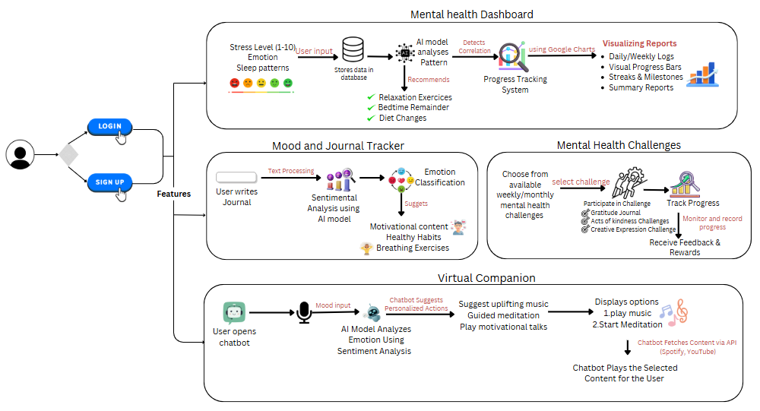
Idea

Slide 4
Scope
Feasiblity and Viability
Smart Device Integration: Leverage smart devices like watches to monitor stress levels, sleep patterns, and emotions, providing seamless and continuous mental health support.
Instant Emotional Relief: Provide instant support with meditation, relaxation techniques, or mood-boosting content.
Proactive Warnings & Alerts: Utilize historical data to spot trends and promptly notify individuals when stress, anxiety, or other mental health issues are noticed.
Inclusive & Affordable Care: Provide simply accessible, cost-effective alternatives to guarantee that mental health services are available to a larger population.
Easily achievable using APIs like Spotify (for music) and YouTube (for meditation, breathing exercises) with proper authentication.
Higher user retention due to interactive, AI-driven content recommendations.
Challenges
Data privacy and security
Accurate emotion detection and personalized recommendations.
Making interactions feel natural and human-like while keeping users engaged with meaningful conversations.

Slide 5
