Slide 1

Safe
She
Strengthening Women Safety

Slide 2

Team Members
Supervisor
Dr. Shahabuddin Ansari
M. Noshair Imtiaz 2021429
Abdullah Khan 2021035
M. Sarmad Shahzad 2020239
Co-supervisor
Miss Abinta Mehmood Mir
Faculty of Computer Sciences and Engineering Ghulam Ishaq Khan Institute of Engineering Sciences and Technology, Pakistan
2

Slide 3
Evaluation Criteria
PLO 3 | Design/Development of Solutions
PLO 4 | Investigation
Rubrics | PLO3 | PLO4 | - | Marks
Requirements Gathering Methodology |  | ✓ |  | 5
Requirements Specifications |  | ✓ |  | 10
Proposed Design | ✓ |  |  | 10
Requirements were mapped to the design adequately | ✓ |  |  | 5
Division of Tasks / Use of Project Management Tools | - | - | ✓ | 10
3

Slide 4
Recap

Slide 5
Recap-Problem statement
Women face persistent safety issues in various environments.
There is a shortage of integrated tools offering emergency assistance, location tracking, and community support specifically designed for women's safety.
Women need accessible resources to confidently navigate environments and report incidents without fear of exposure or retaliation.
Current safety measures often fail to effectively leverage technology and community efforts to create safer spaces for women.
5

Slide 6


Challenges Faced
93%
53%
72%
Workplace Harassment
Sexual assault
road stalking
Harassment
Frequent encounters in public and private spaces.
Physical Assault
High risk of physical harm in various settings.
Inadequate Safety Solutions
Lack of comprehensive tools and effective community support.
6

Slide 7
Requirements Gathering Methodology

Slide 8
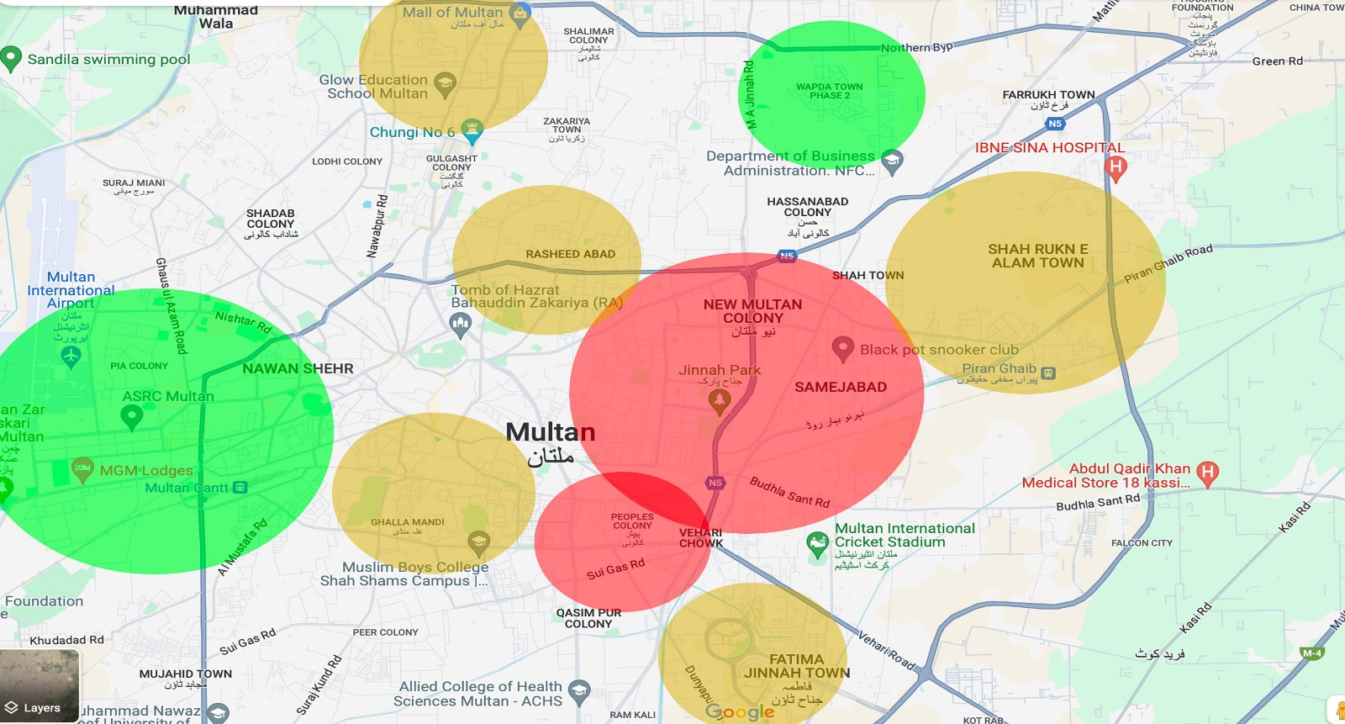
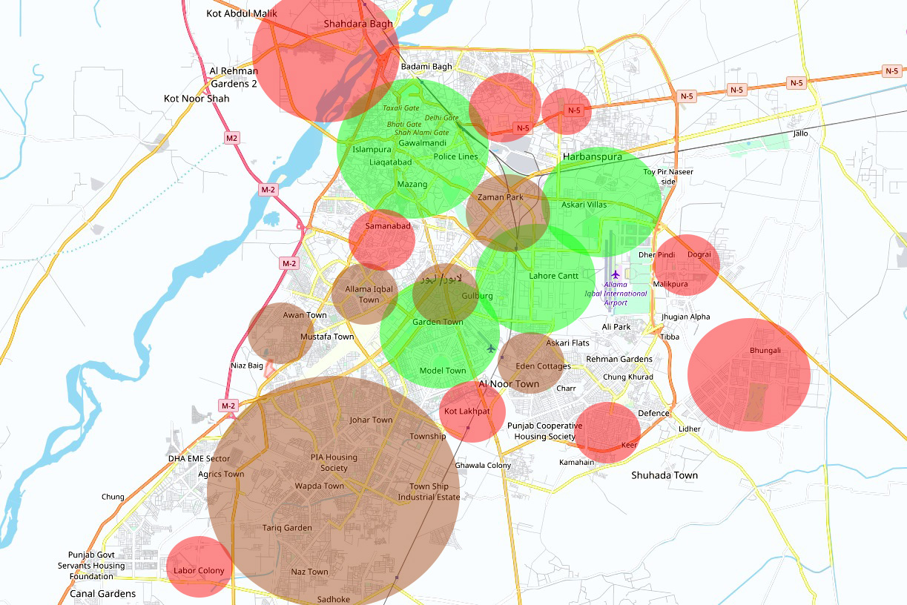
Requirements Elicitation Techniques Followed
User Observations: Gained real-world insights by observing how women interact with safety tools.
Made initial Zoning maps Based on the data collected from the police departments.
8

Slide 9
Requirements Specifications

Slide 10
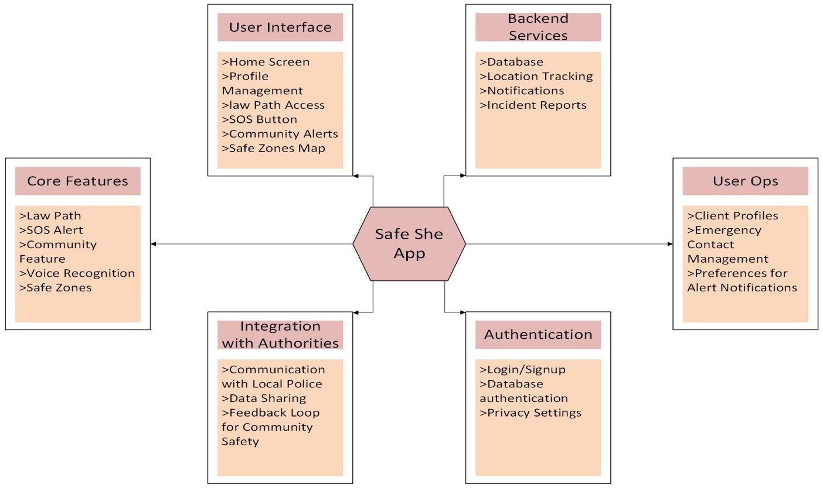
Context Diagram
10

Slide 11
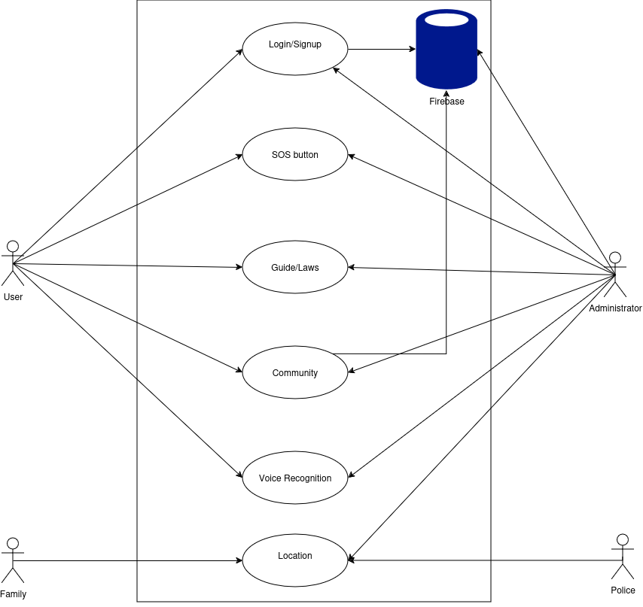
Use Case Diagram
11

Slide 12
Features / Use Case | Priority of Development | Dependencies
User Registration & Authentication | Essential, High | Firebase Authentication
SOS Alert System | Essential, High | GPS Module, Notification System
Real-Time Location Capture | Essential, High | Google Maps API
Safe Zone Identification | Essential, Medium | Based on Incident Reports, Google Maps API
Voice Command Activation | Essential, Low | Voice Recognition Module
Settings and Configuration | Essential, Medium | User Profile, Notification System
Privacy and Data Security | Essential, High | Firebase Encryption, User Profile Module
Incident Reporting | Essential, Medium | Firebase Real-Time Database
Feature Set Matrix
12

Slide 13
Distinguishing Functional Requirements
SOS Alert System
Real-Time Location Tracking
Safe Zone Identification
Voice Command Activation
Incident Reporting
13

Slide 14
Performance
Scalability
Reliability and Availability
Security
Usability
Interoperability
Compliance with Ethical Guidelines
Distinguishing Non-Functional Requirements
14

Slide 15

Mockups
Initial representations of interface on Figma.
The original is subject to change
15

Slide 16
User Interface Requirements
Simple and Intuitive Design
Quick Response and Accessibility
Prominent SOS and Location sharing
Real-Time Map
Emergency Alerts and Notifications
16

Slide 17
Project Design

Slide 18
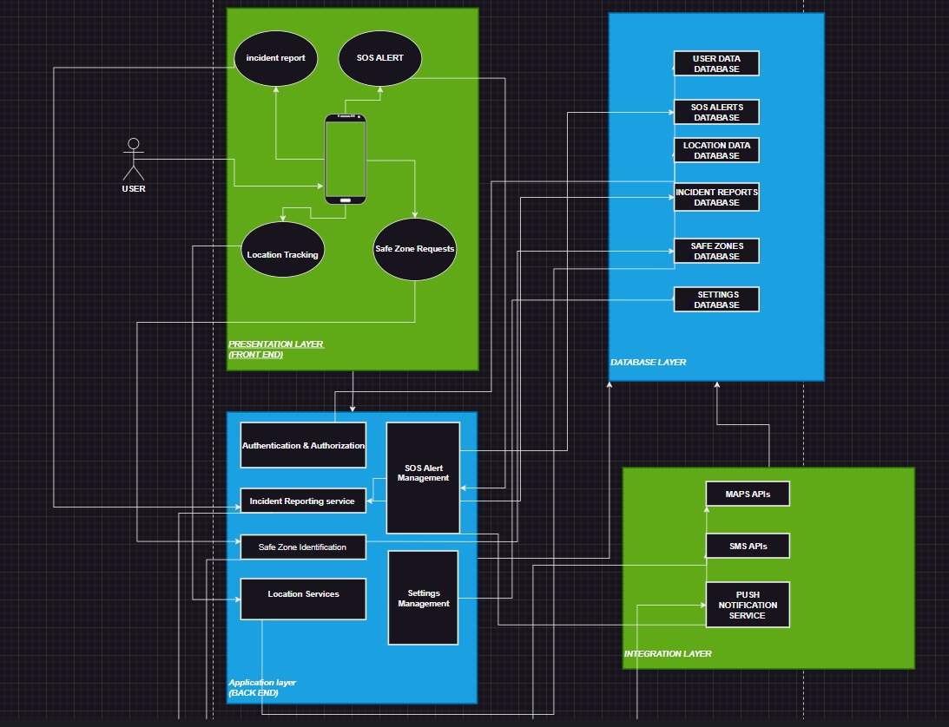
System Architecture
18

Slide 19
UML Diagrams

Slide 20
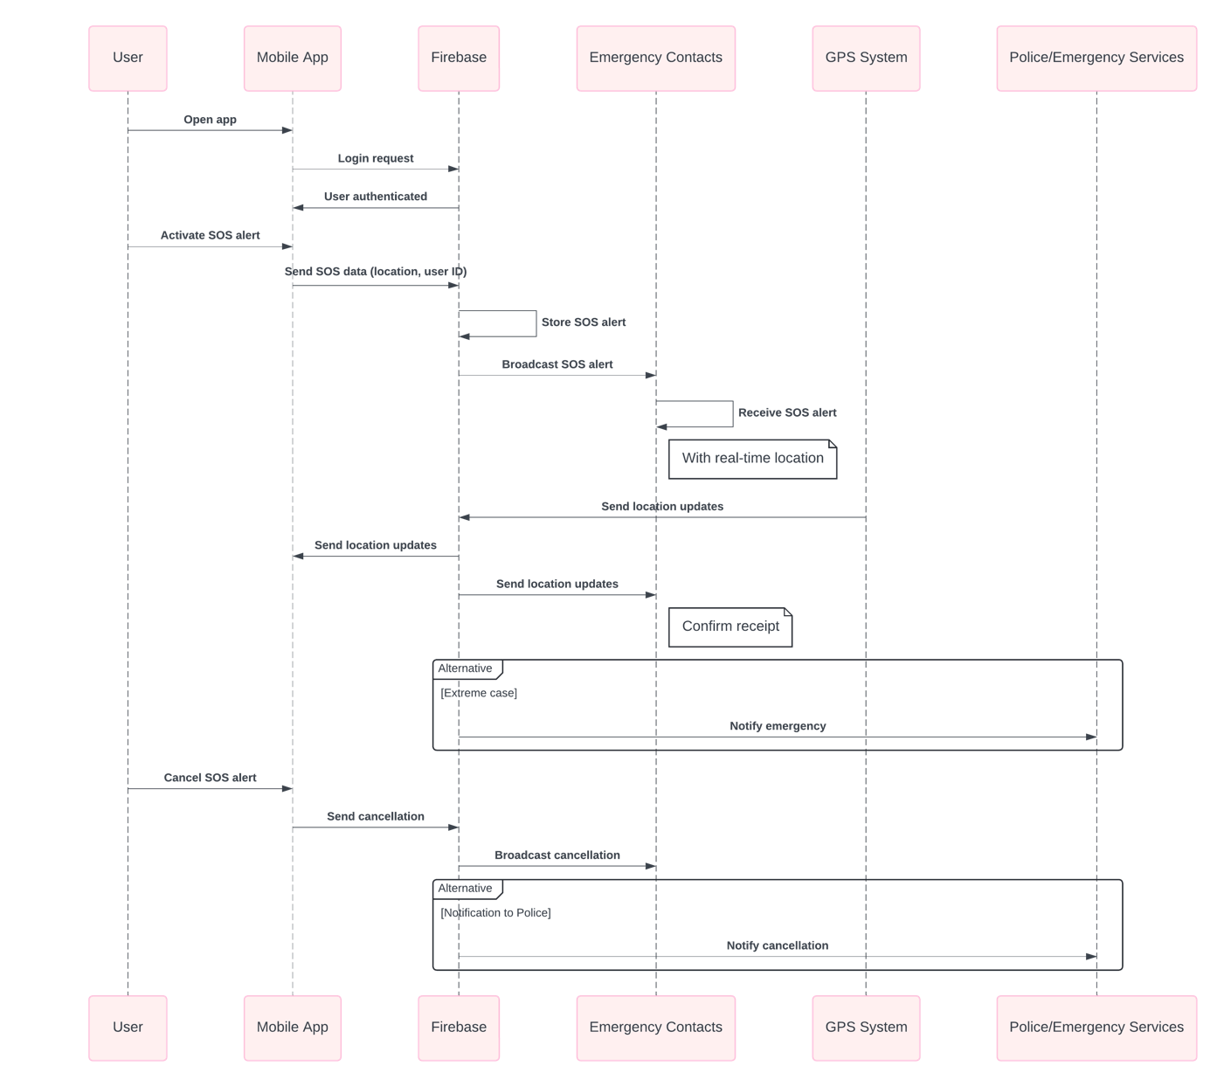
Sequence Diagram
20

Slide 21
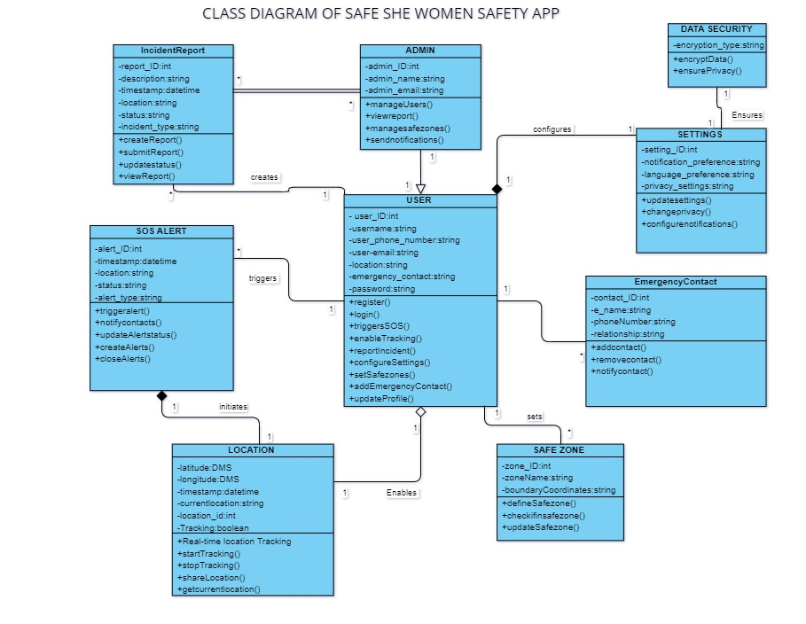
Class Diagram
21

Slide 22
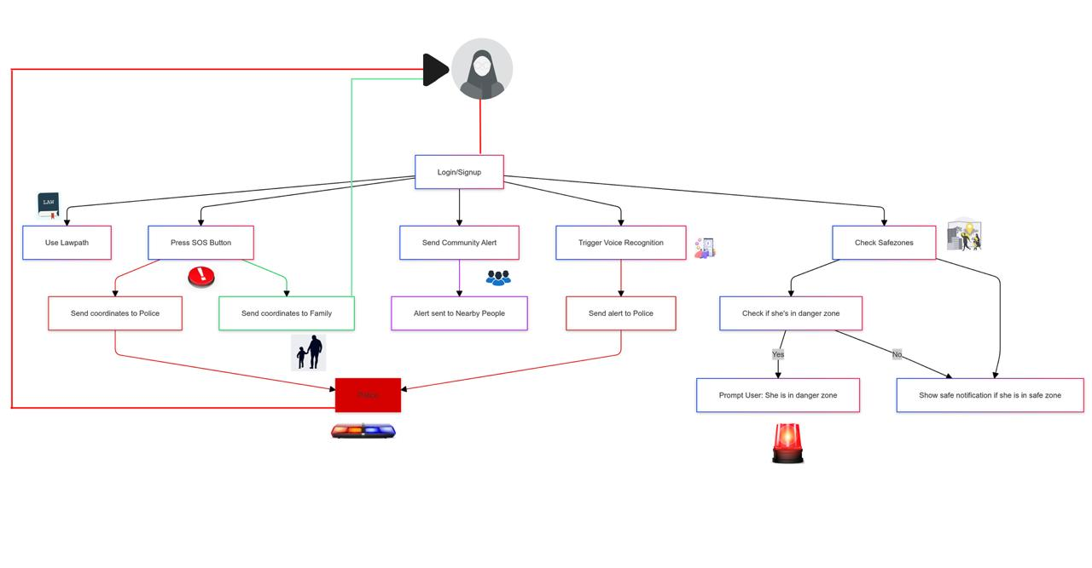
Activity Diagram
22

Slide 23
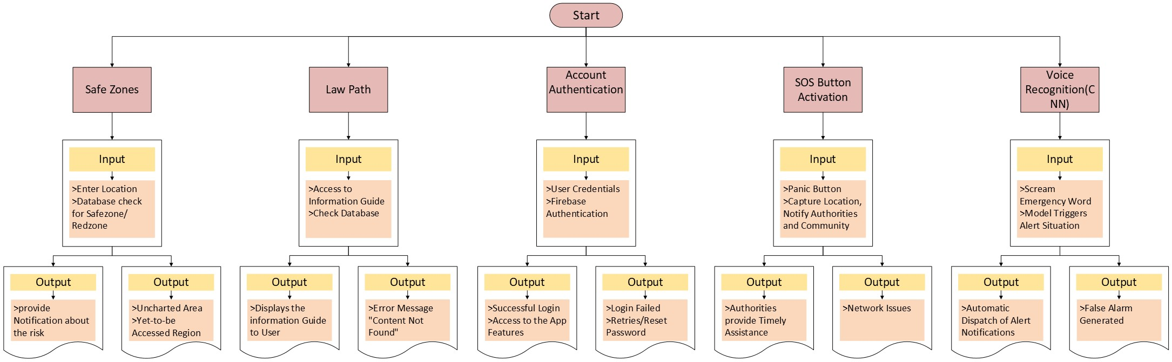
State Transition diagram
23

Slide 24
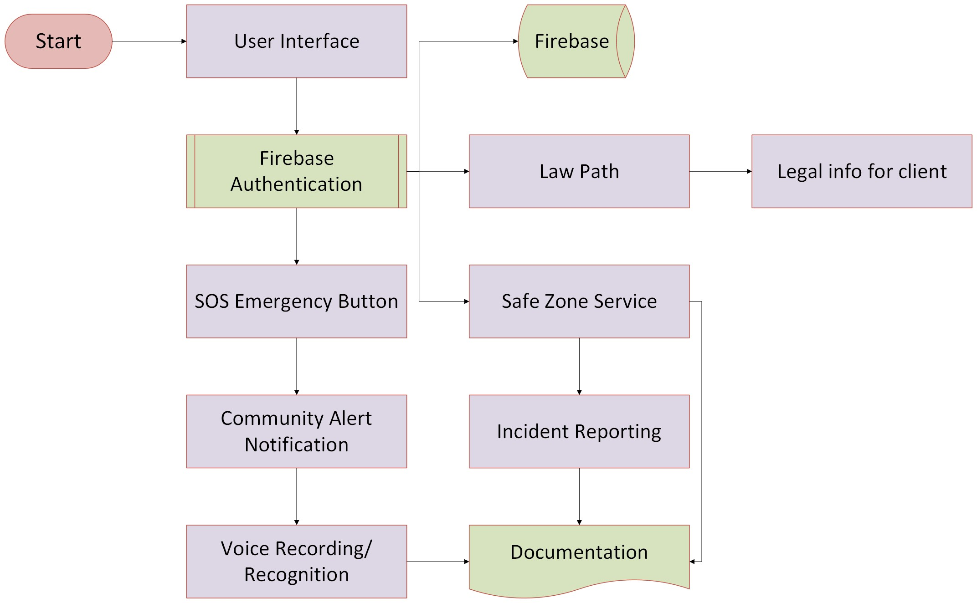
Component Diagram
24

Slide 25
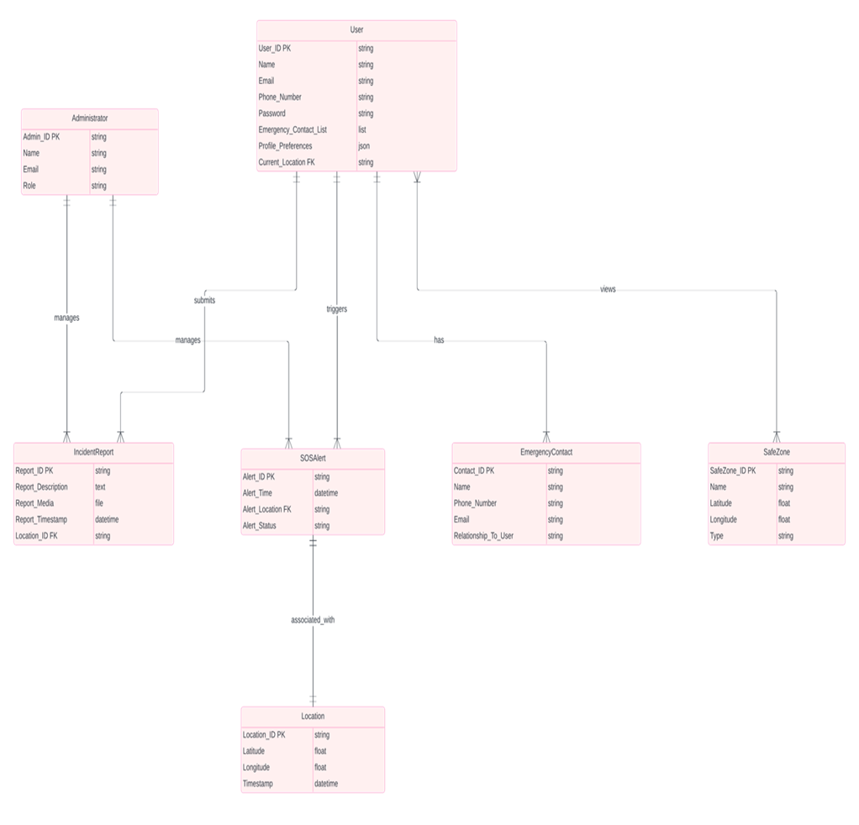
ER Diagram
25

Slide 26
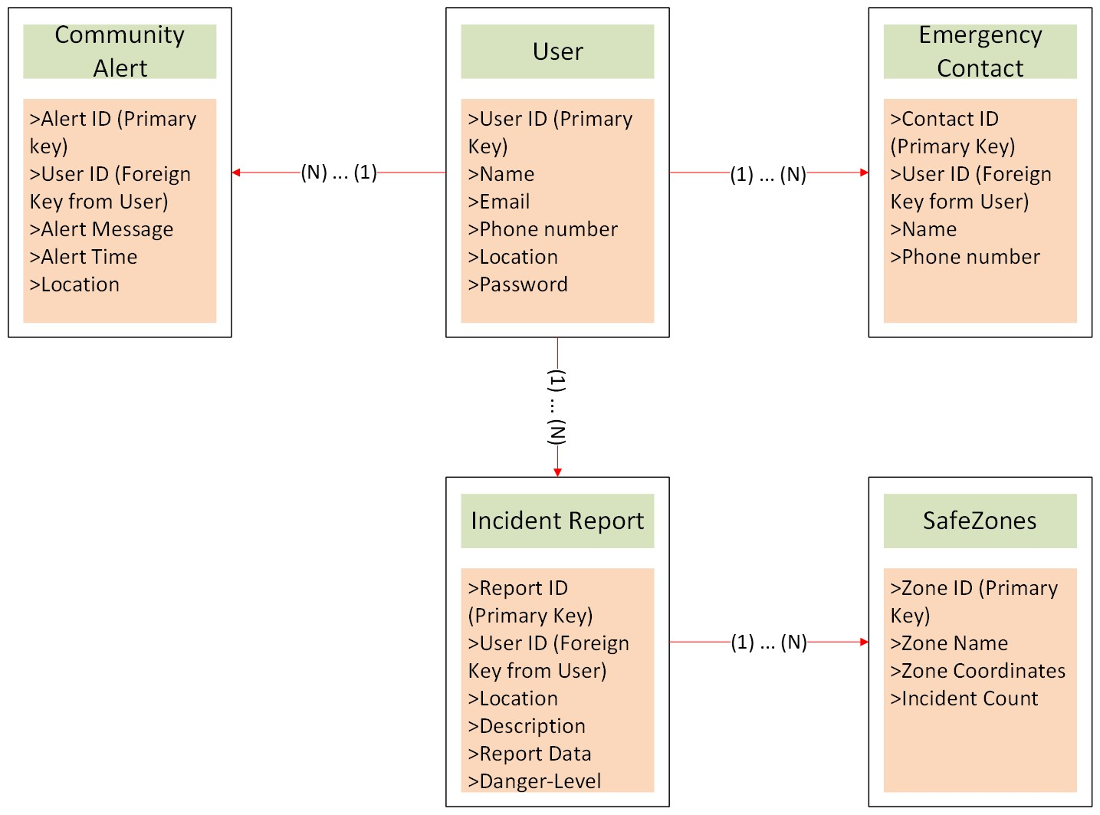
ER Diagram (2)
26

Slide 27
Project Management

Slide 28
Project Management Tool
Project Management tool: Jira
Reasons for using Jira:
Task Tracking
Custom Workflows
Collaboration
SCRUMS allow for easy collaboration
28

Slide 29
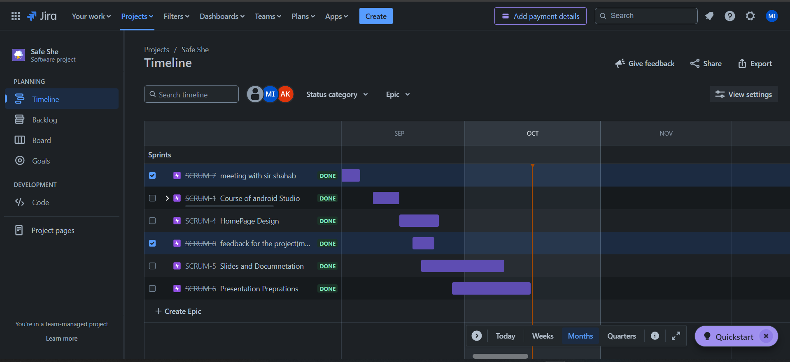

Slide 30
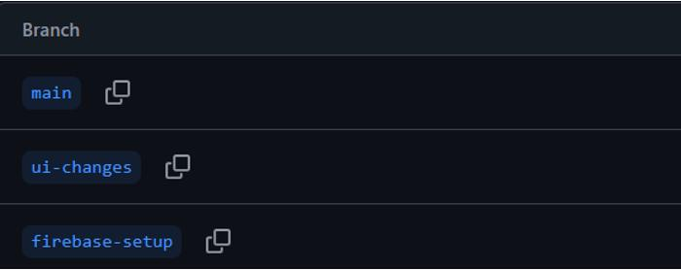
Project Repository
Project Repository: GitHub
Reasons for using Jira:
Code Management
Backup & Recovery
Open Source
30

Slide 31
Division of Tasks
M. Noshair Imtiaz
View Diagrams
Managed Work Breakdown on Jira
Abdullah Khan
Backend with Firebase
Figma simulation
M. Sarmad Shahzad
Perform User Observations
Class & Architecture diagrams
Login/Signup Page
Documentation
Front End
31

Slide 32


Thank You
Our Contact
+92-336-2238524
Khan.abdullahaha@gmail.com

