Slide 1
TATA POWER LTD.
Management Presentation
Equity Research, Valuation & Credit Risk Analysis — FY2017 to FY2026
Prepared for Executive Review
Educational Portfolio Project — Not Investment Advice
Notes:
Opening framing: this deck walks through a full equity research and credit risk workup on Tata Power, built to demonstrate methodology end-to-end. Emphasize upfront that this is a portfolio/educational exercise, not a live recommendation.

Slide 2
Objective — What Questions Are We Answering?
01
What is Tata Power actually worth?
Intrinsic value via DCF, cross-checked against peer trading multiples
02
Is the company's leverage a credit concern?
A utility-specific credit scorecard, benchmarked against the actual CRISIL rating
03
How much downside risk does the position carry?
Value-at-Risk across three independent methodologies
04
Where does the market price sit relative to every method?
A football field synthesis spanning DCF, peers, and 52-week range
Tata Power Ltd. — Management Presentation
2
Notes:
Four questions frame the whole deck. Use this slide to set expectations that we're triangulating across multiple independent methods rather than leaning on one model.

Slide 3
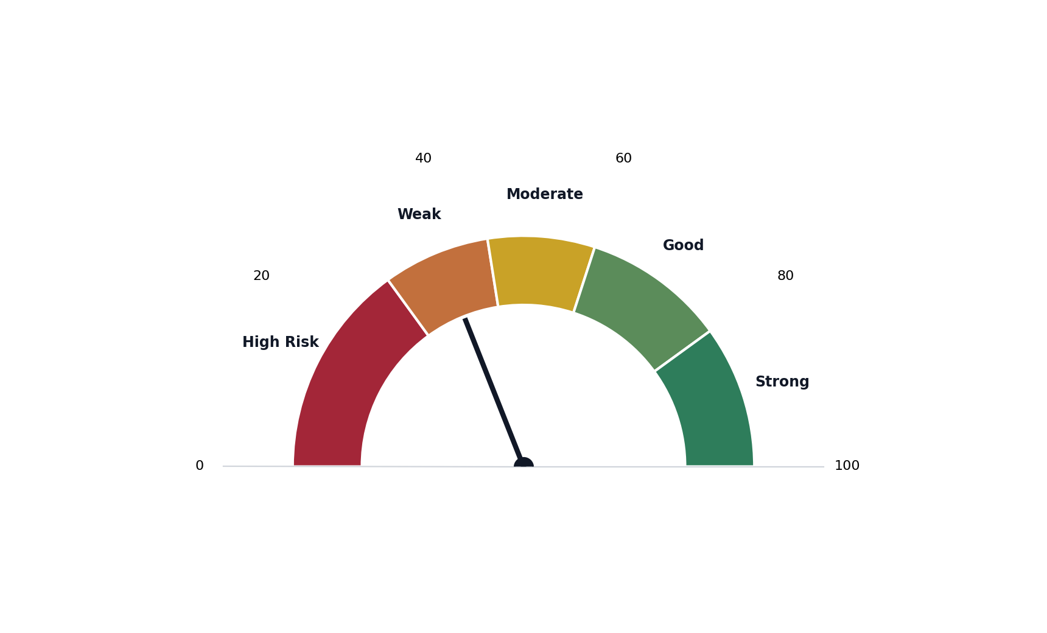
Company Overview — India's Largest Integrated Power Utility
Business
Generation, transmission, and distribution across India, Georgia, and Zambia. First Indian company to ship over 1 GW of solar modules (Feb 2017).
14,700+ MW
Installed Capacity
Segments
70%
Regulated Generation • Transmission & Distribution • Renewable Energy (TPREL) • International Assets
Clean Energy Target by 2030
46.9%
Market Position
Promoter Holding (Tata Sons)
India's largest integrated private power utility. CRISIL AA+/Stable and ICRA AA+/Stable, upgraded steadily from AA- (FY17) with zero downgrades.
Note: Revenue-by-segment and installed-capacity-by-fuel-type breakdowns are not available in the underlying data model and are not shown here rather than estimated.
Tata Power Ltd. — Management Presentation
3
Notes:
The gauge previews the credit scorecard finding developed fully on Slide 11. Revenue-by-segment and capacity mix aren't in the underlying data model, so they're honestly omitted rather than estimated.

Slide 4
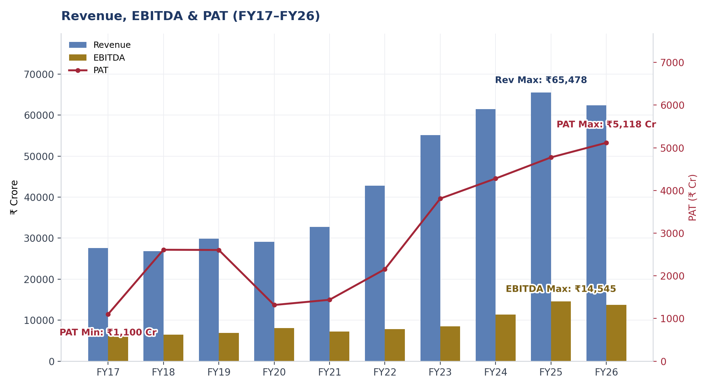
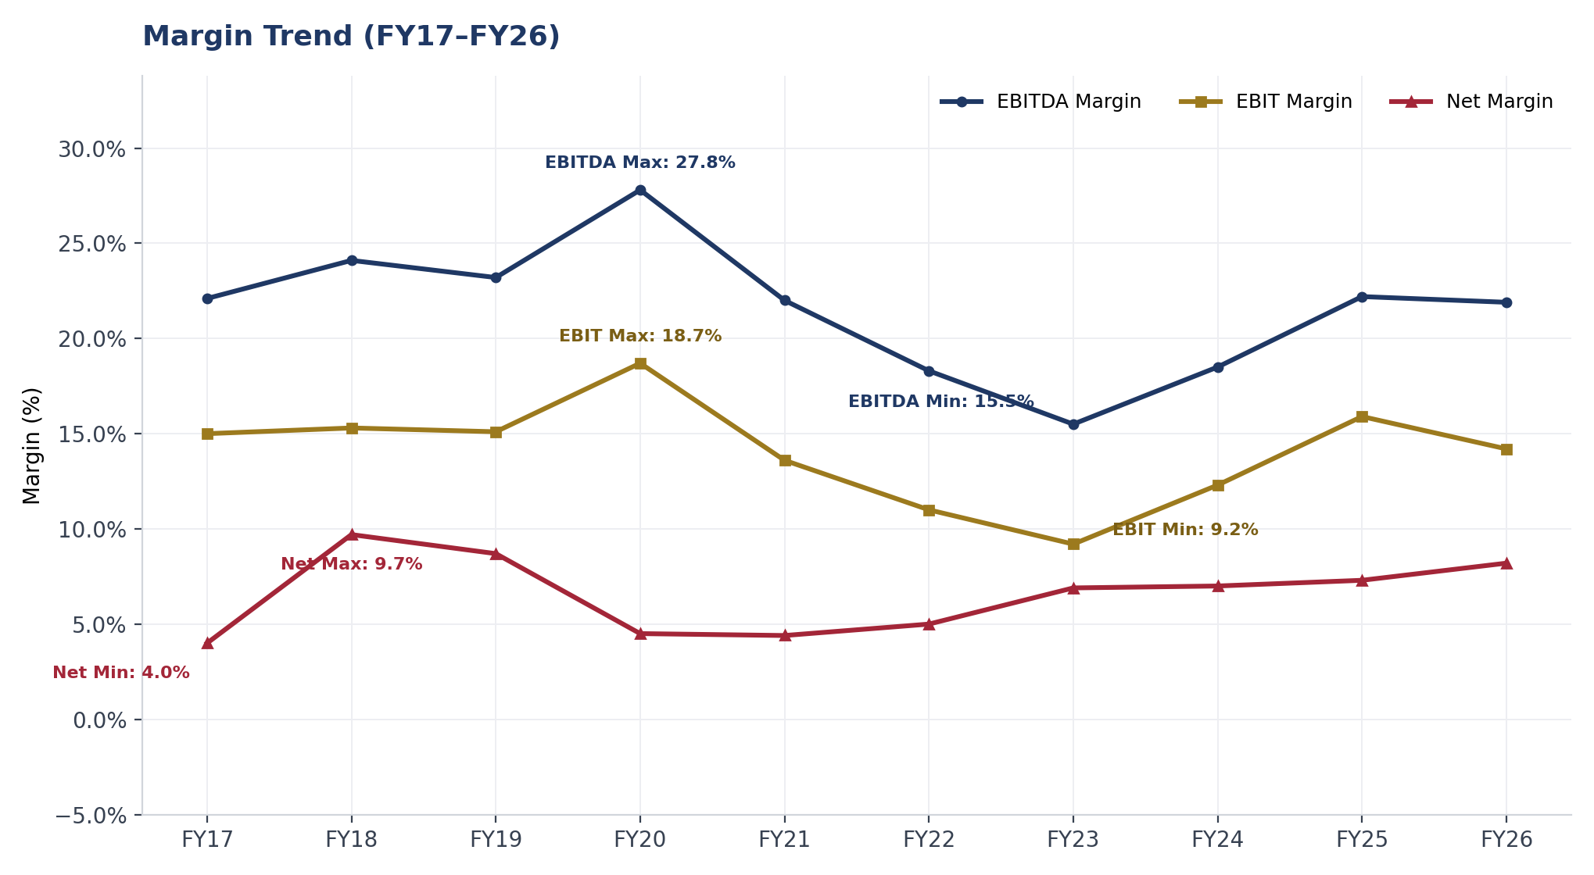
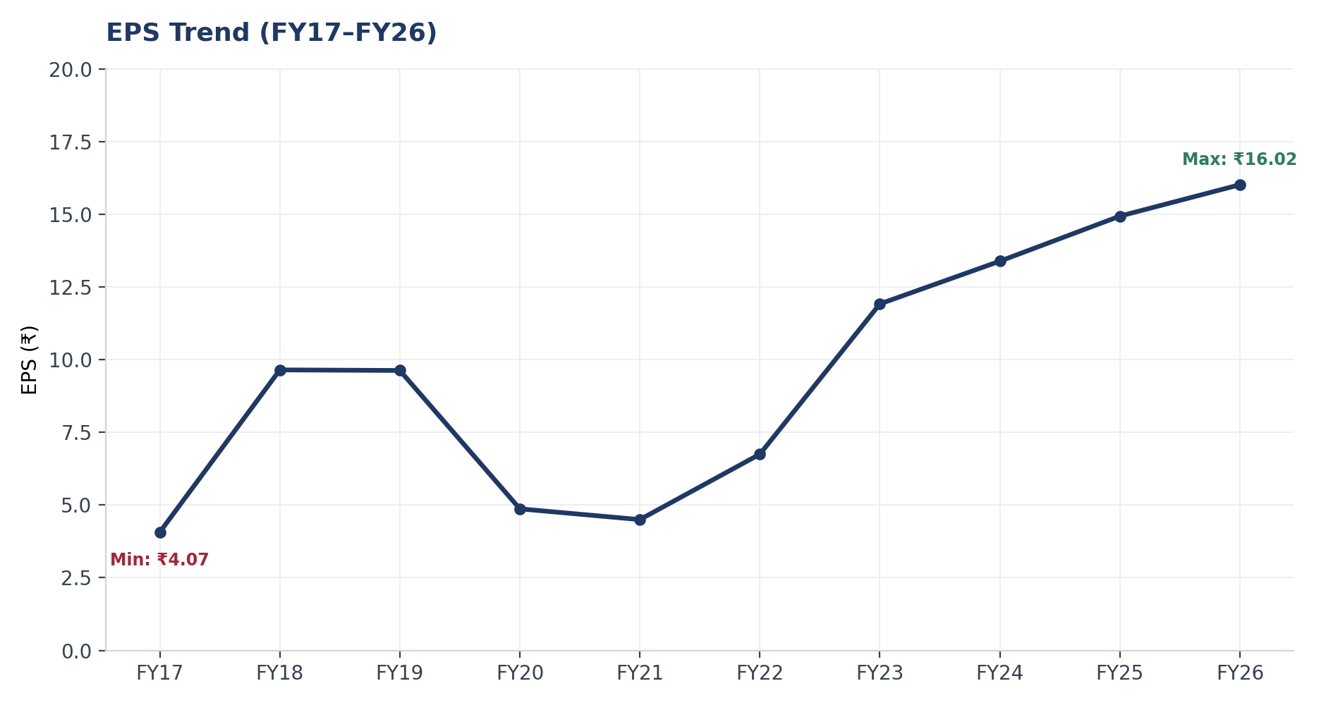
Historical Performance — Revenue, EBITDA, PAT & EPS
9.5%
9.4%
18.6%
Revenue CAGR (FY17-26)
EBITDA CAGR (FY17-26)
PAT CAGR (FY17-26)
Key Insight: PAT has grown faster than revenue (18.6% vs 9.5% CAGR) — margin recovery, not just top-line growth, is driving profitability.
Tata Power Ltd. — Management Presentation
4
Notes:
PAT CAGR outrunning Revenue CAGR is the headline: margin recovery post the FY22-23 fuel-cost squeeze, not just volume growth. EPS growth has been steadier than PAT alone thanks to a fixed share count.

Slide 5
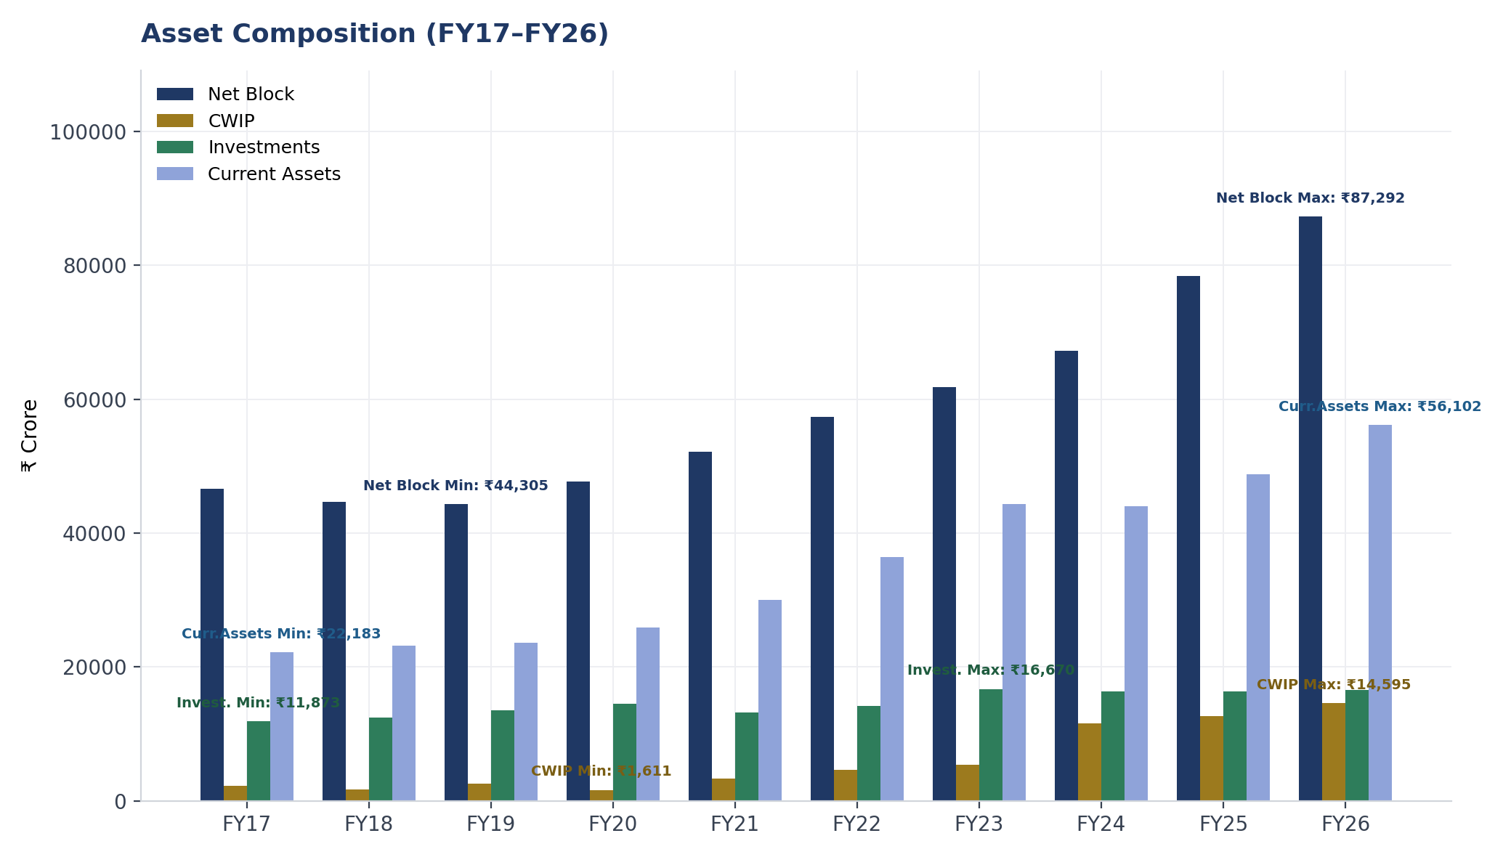
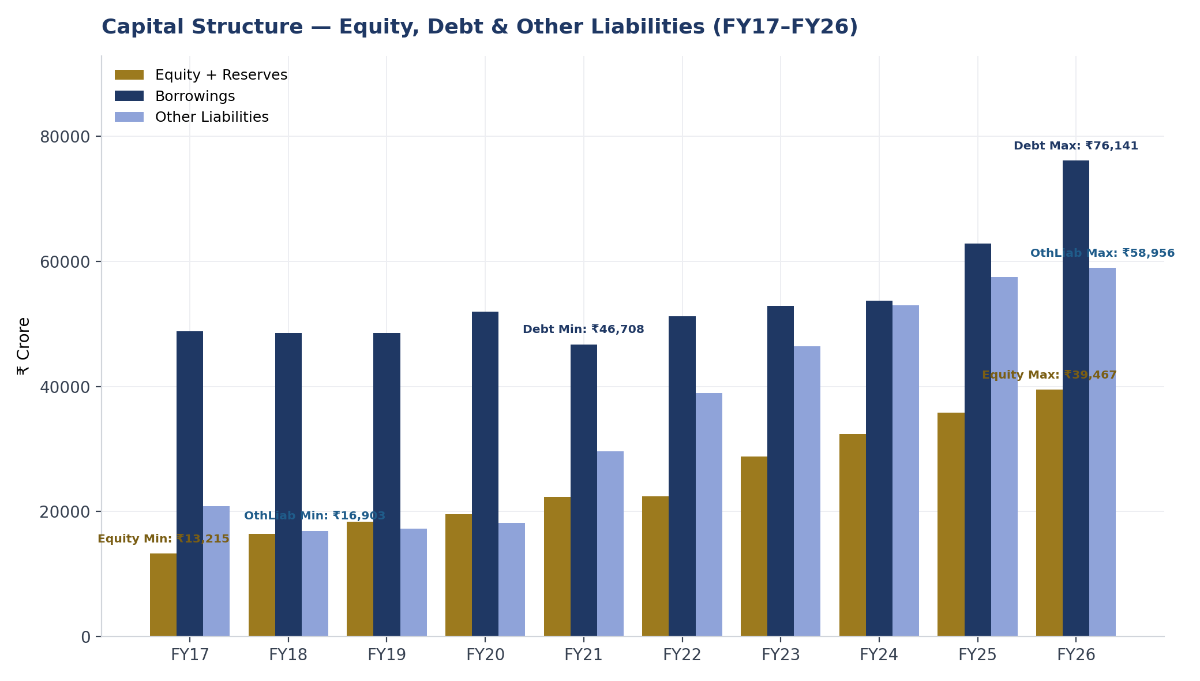
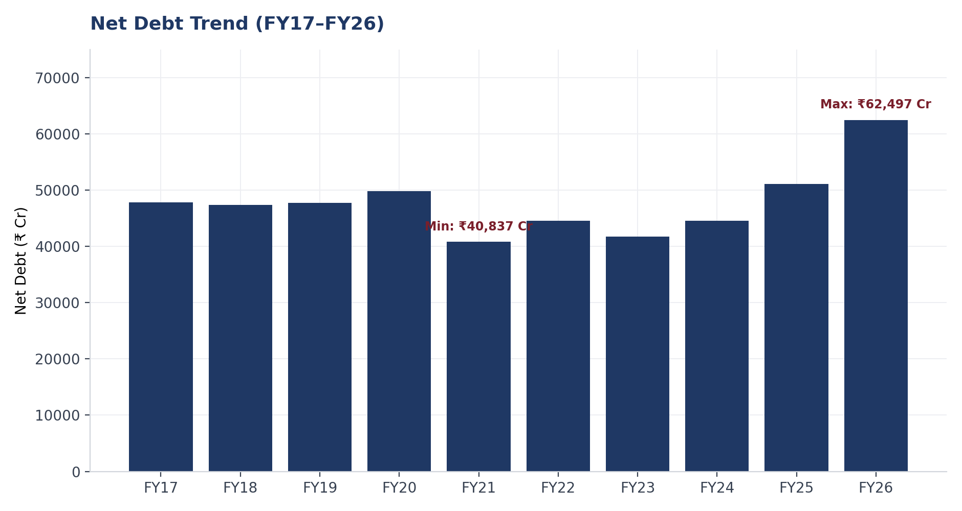
Balance Sheet — Assets vs. Liabilities & Capital Structure
₹62,497 Cr
₹1,74,564 Cr
Net Debt (FY26)
Total Capitalization (FY26)
Key Insight: Total assets grew 2.1x over the decade (₹82,829 Cr → ₹1,74,564 Cr), funded increasingly by debt — net debt has more than doubled since FY21.
Tata Power Ltd. — Management Presentation
5
Notes:
Assets and Liabilities & Equity always balance by construction (both total ₹1,74,564 Cr in FY26) — the two charts are mirror images of the same balance sheet. Net Block has grown steadily (renewable asset additions); CWIP jumped sharply from FY24 as more projects entered construction simultaneously. FY26 net debt spike is capex-funded — same story as Slide 6's leverage dip.

Slide 6
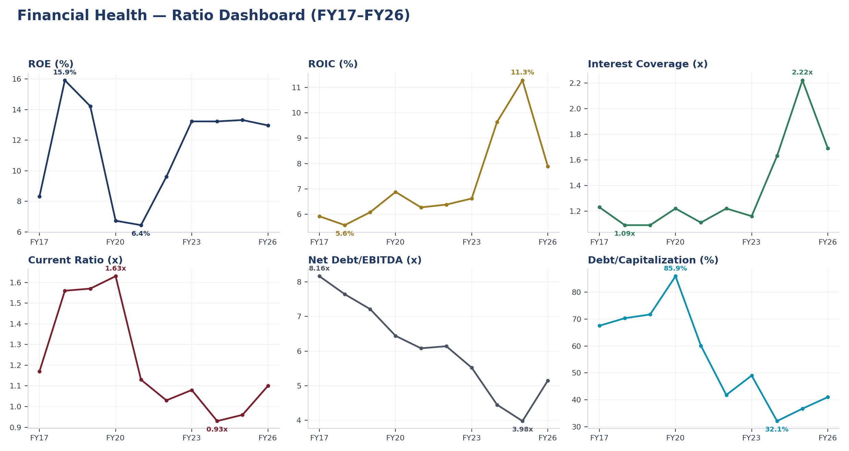
Financial Health — Ratio Dashboard
Key Insight: ROIC nearly doubled from FY17 (5.9%) to FY25 (11.3%) before pulling back to 7.9% in FY26 as fresh renewable capex diluted near-term returns.
Tata Power Ltd. — Management Presentation
6
Notes:
Six-panel dashboard: profitability (ROE, ROIC), coverage (Interest Coverage), balance-sheet health (Current Ratio, Net Debt/EBITDA, Debt/Cap). The FY26 dip across nearly every panel traces to the debt raise funding renewable capex (Slide 5, 7-8).

Slide 7
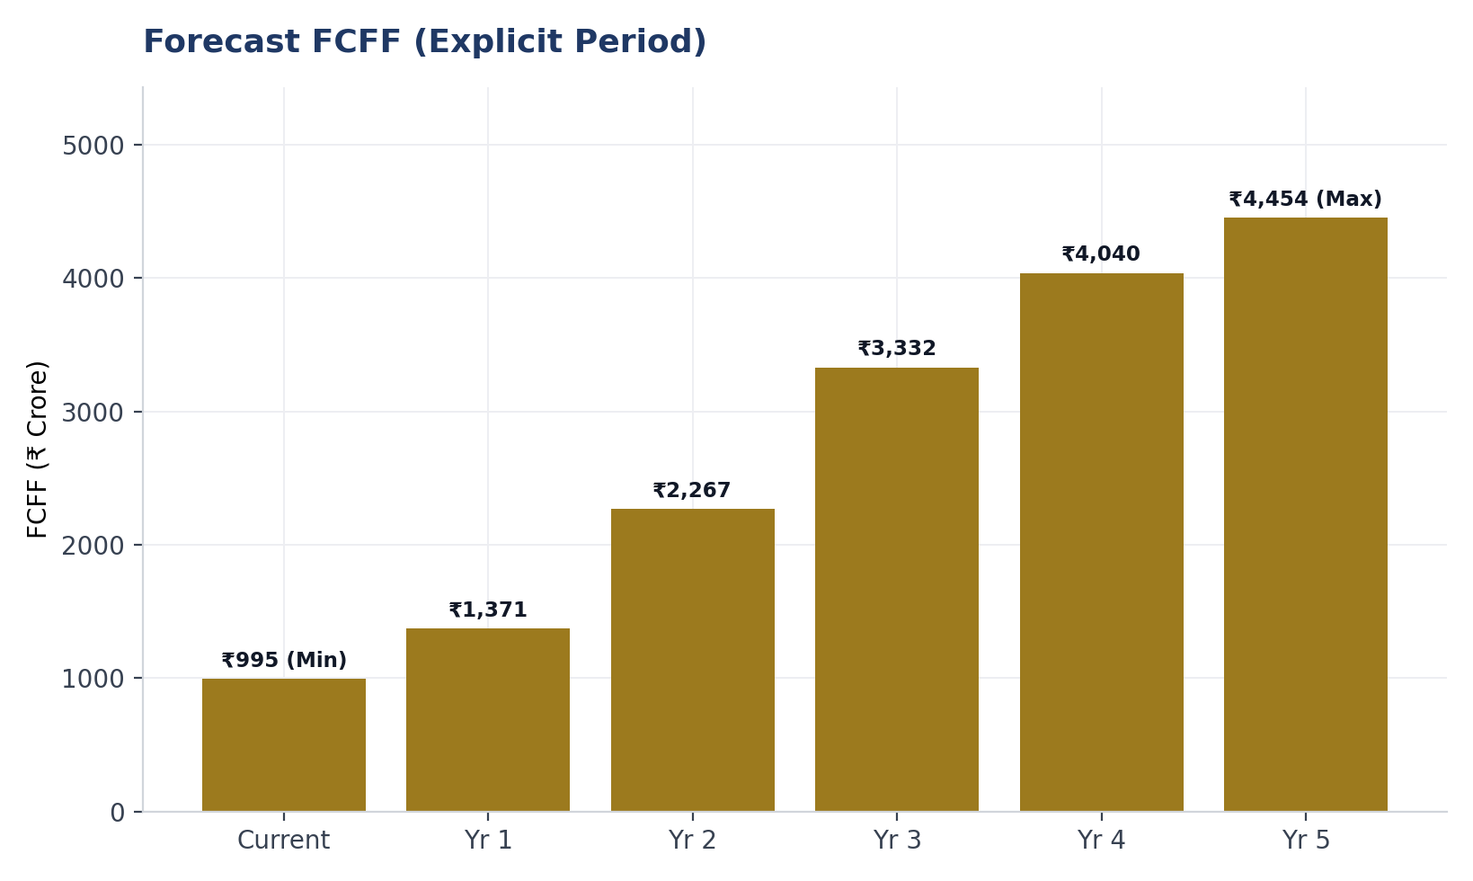
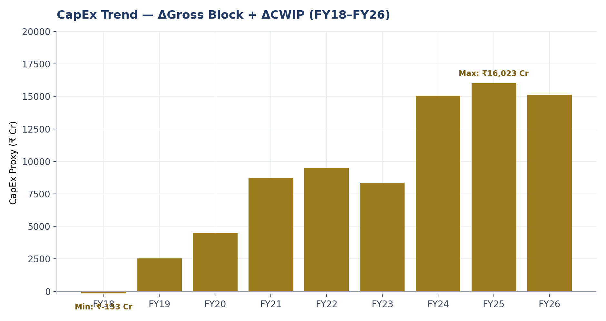
Forecast — Free Cash Flow & Capital Expenditure
Growth is driven by g = ROIC × Reinvestment Rate — not a separate top-line assumption. Reinvestment rate declines from 84% → 56% of NOPAT across the forecast as the capex cycle matures. Terminal growth is capped at 4.5%, below the 6.8% risk-free rate.
Key Insight: Near-term FCFF is deliberately suppressed by heavy reinvestment — this is the single largest driver of the DCF's discount to market price (Slide 8).
Tata Power Ltd. — Management Presentation
7
Notes:
CapEx trend (proxy: change in gross block + CWIP) shows the accelerating renewable buildout directly. FCFF grows ~4.5x from Current Year to Year 5 as reinvestment eases. This model doesn't build a separate Revenue/EBITDA-in-rupees forecast — growth flows through EBIT/NOPAT via the ROIC-reinvestment link instead.

Slide 8
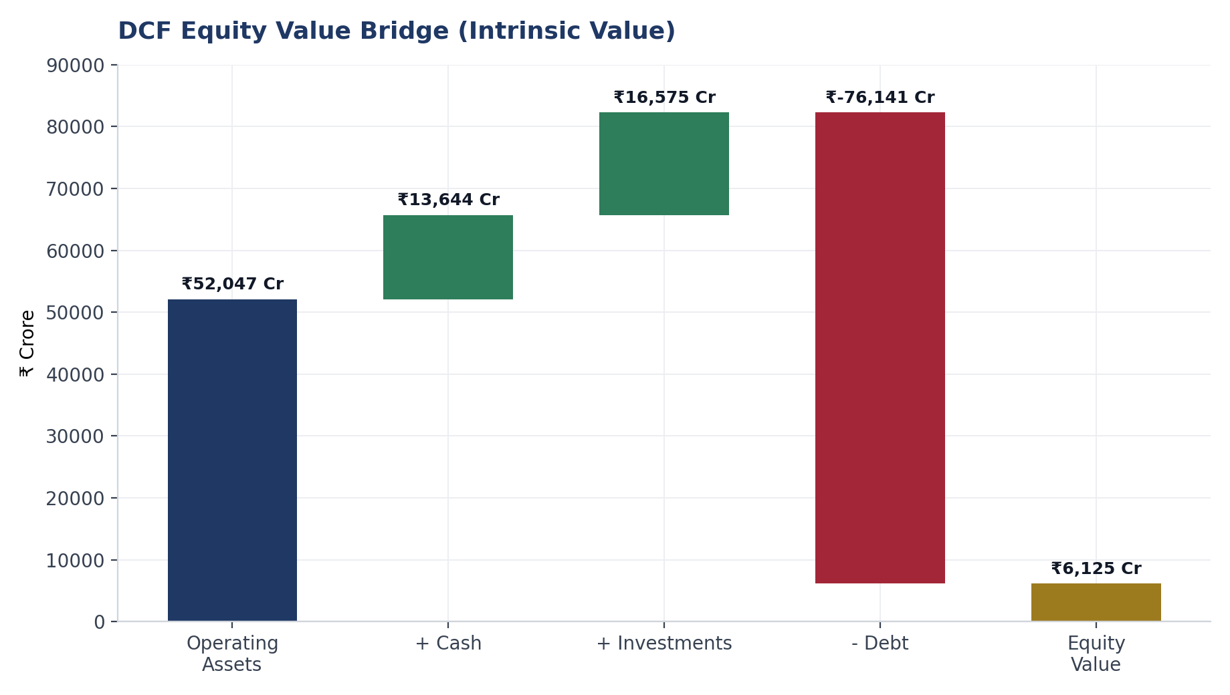
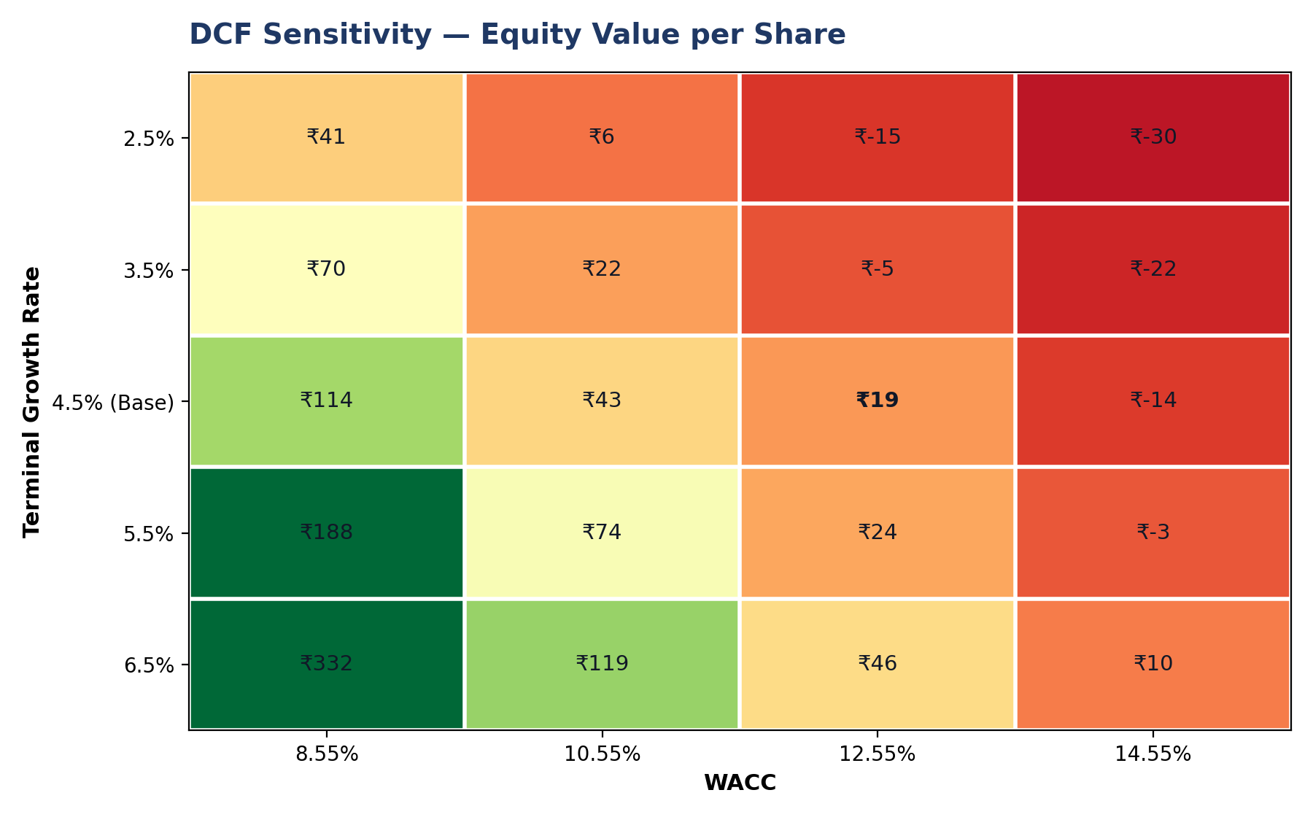
DCF Valuation — Intrinsic Value vs. Market Price
₹52,047 Cr
₹6,125 Cr
₹19.17
₹402.35
-95.2%
Operating (EV) Value
Equity Value
Intrinsic Value/Share
Market Price/Share
Discount to Market
Key Insight: Even the most favorable sensitivity case (WACC 8.55%, growth 6.5%) yields ₹332 — still below market price. The gap is structural, not a base-case artifact.
Tata Power Ltd. — Management Presentation
8
Notes:
Two named drivers for the gap: (1) reinvestment rate suppresses near-term FCFF, (2) consolidated model excludes TPREL's standalone growth-option value. The sensitivity heatmap preempts 'did you just pick unfavorable assumptions' — even the best-case cell undershoots market price.

Slide 9
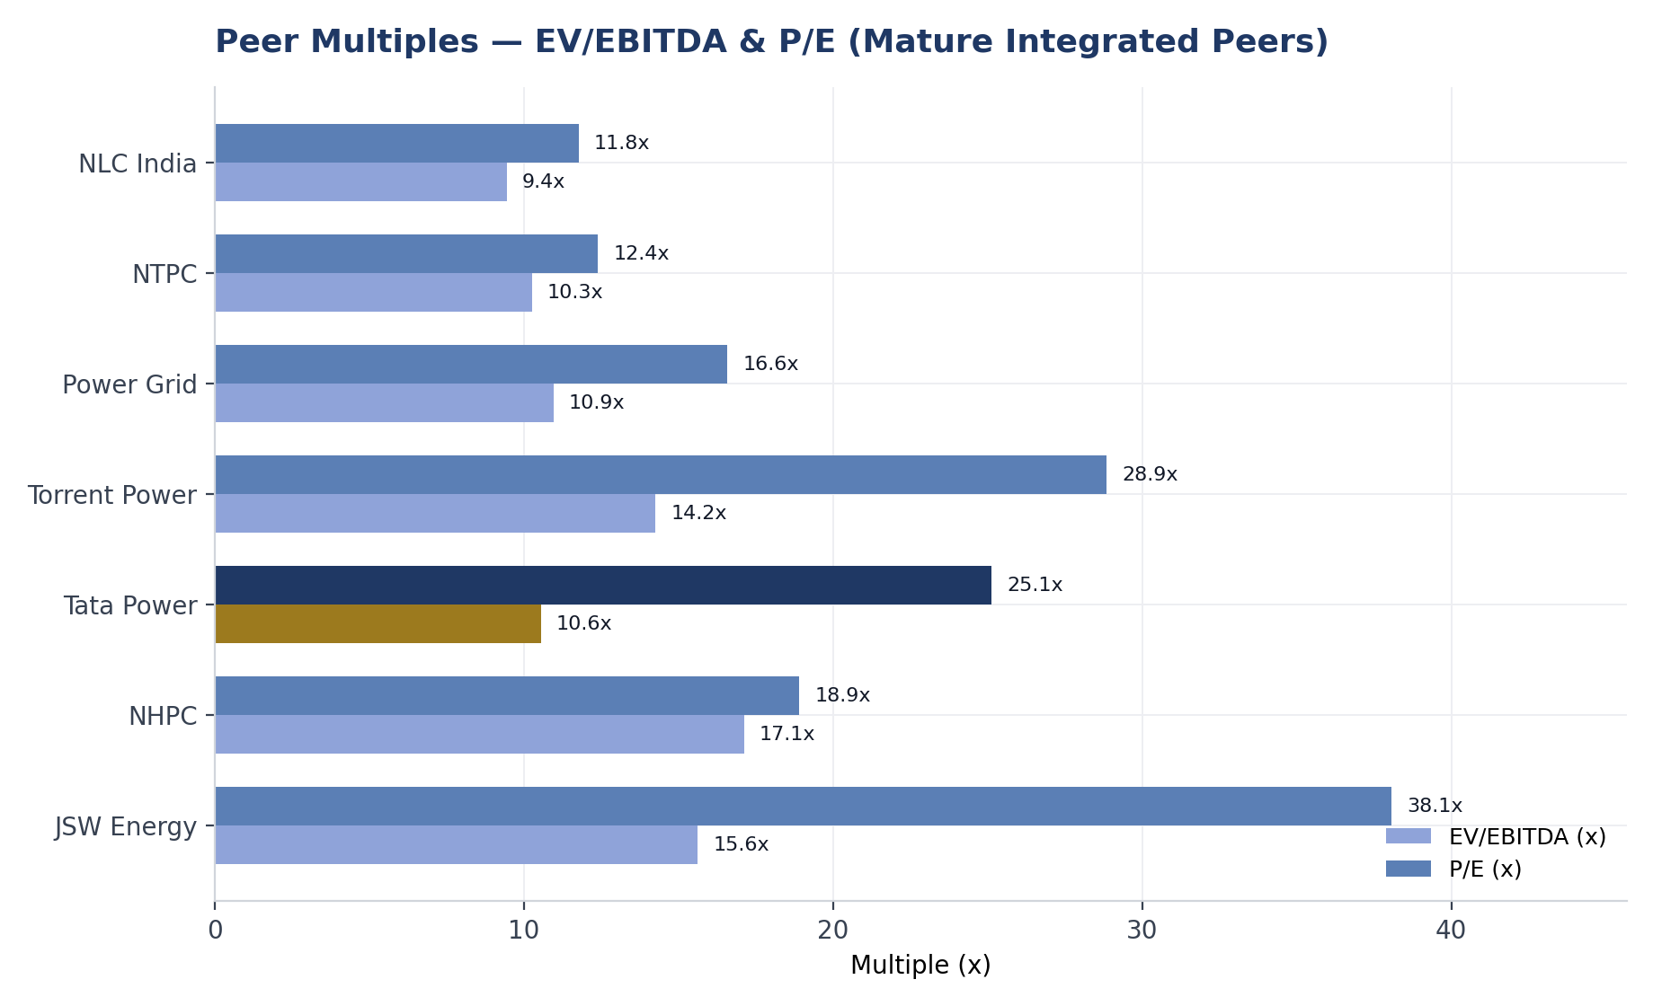
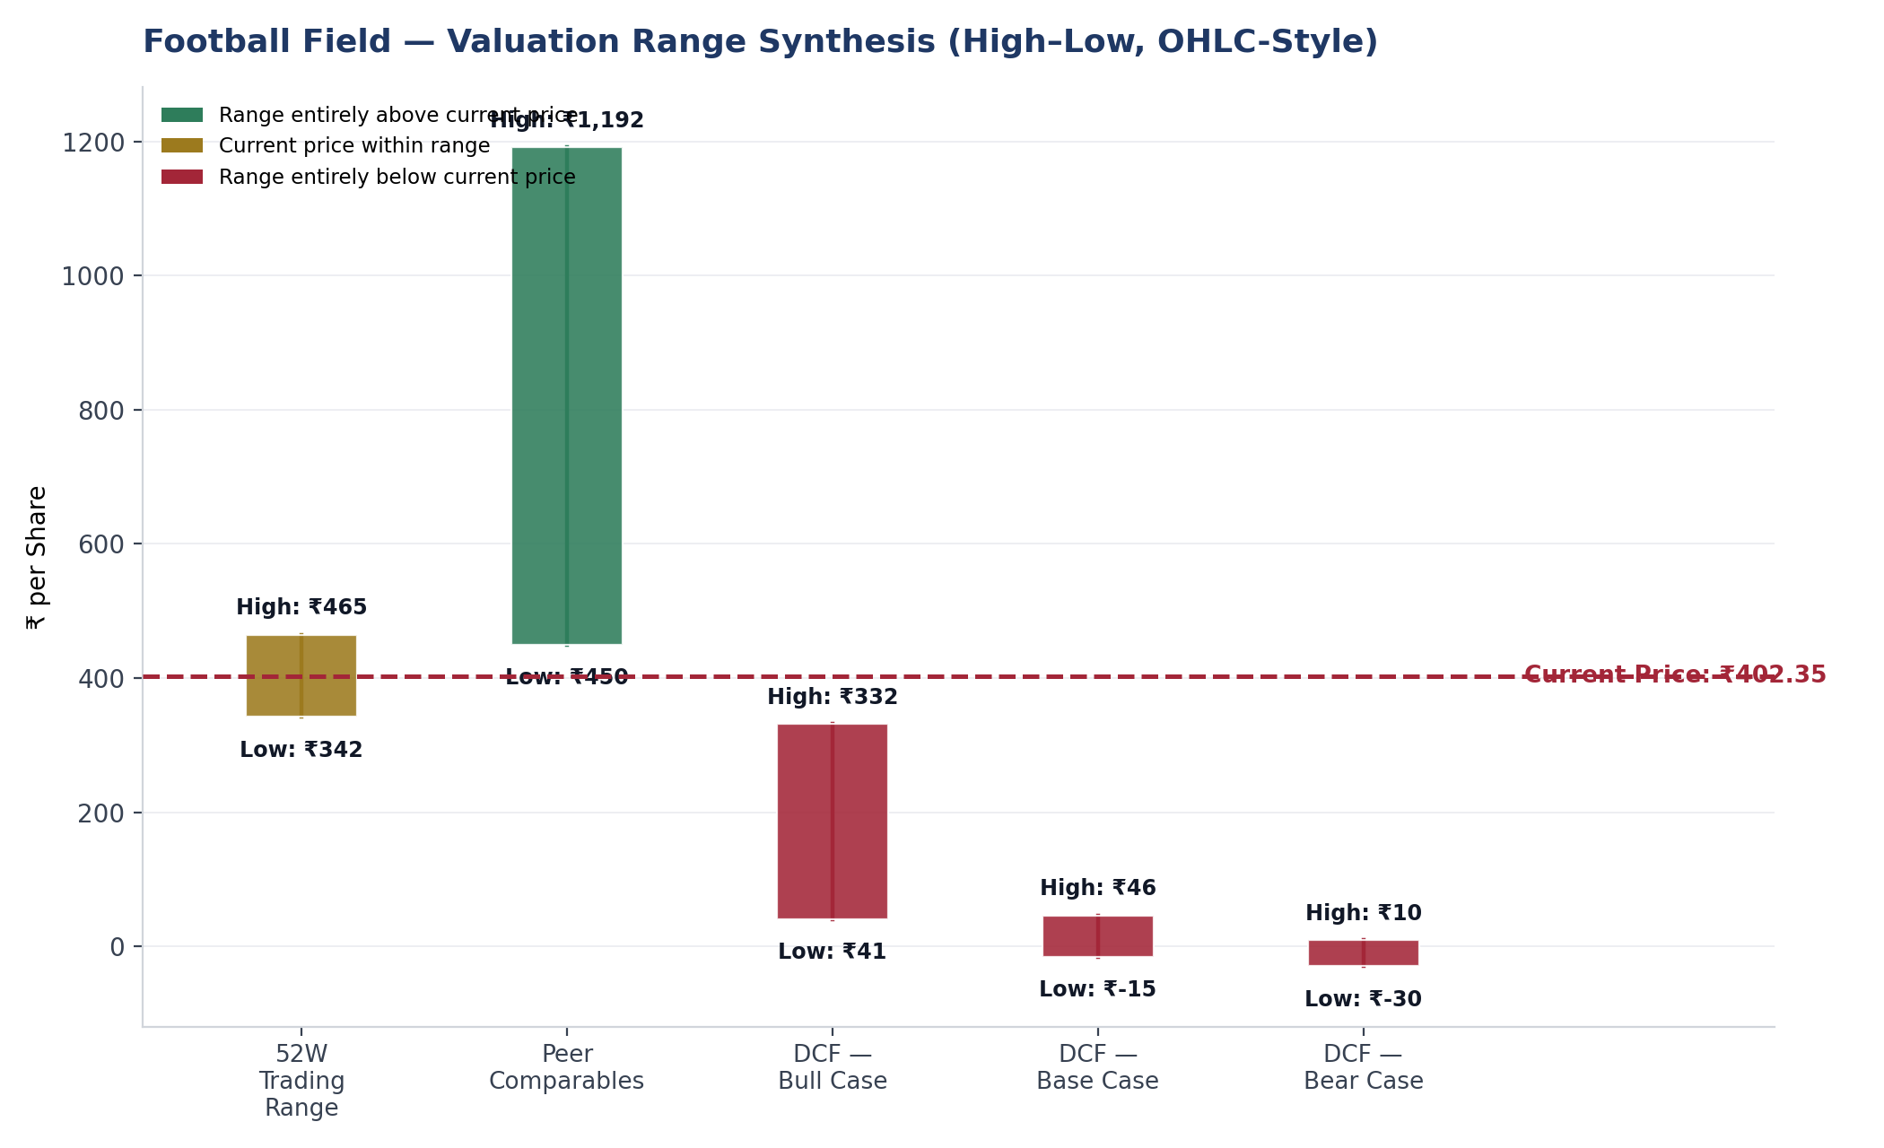
Relative Valuation — Peer Comparison & Football Field
Tata Power: 10.55x EV/EBITDA, 25.12x P/E
In line with mature integrated peers (NTPC, Power Grid ~10-11x EV/EBITDA)
Key Insight: Market price sits within the peer-implied range but above every DCF scenario — the market may be pricing in growth optionality this model doesn't capture.
Tata Power Ltd. — Management Presentation
9
Notes:
EV/EBITDA of 10.55x sits between mature peers (~10-11x) and richly-valued renewable pure-plays (excluded here as earnings-quality outliers). Football field: market price clears every DCF scenario but sits inside the peer range.

Slide 10
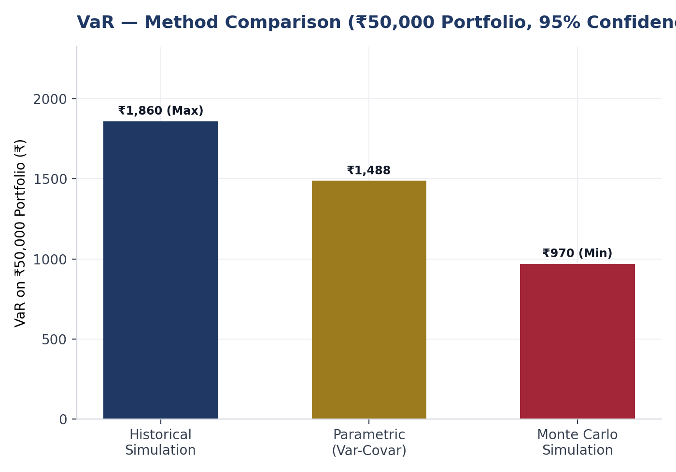
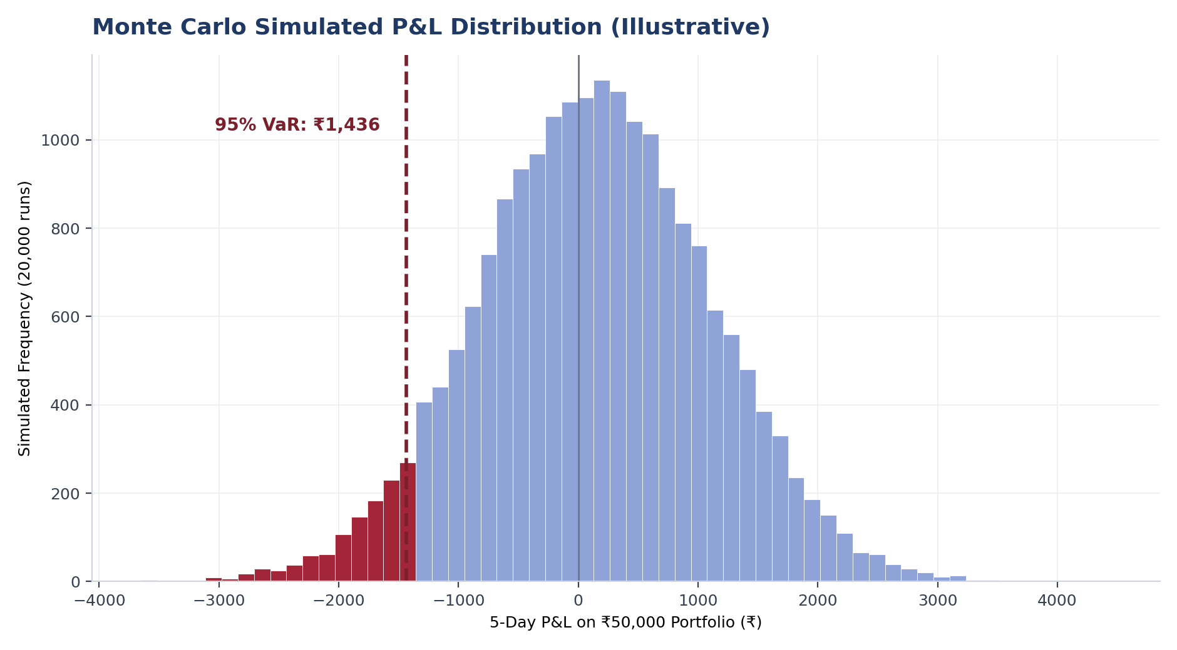
Risk Analysis I — Market Risk (VaR, Beta & Monte Carlo)
1.26
0.361
15.52%
11.78%
Beta (2yr Weekly Regression)
R² (Regression Fit)
Cost of Equity (CAPM)
WACC
Key Insight: Three independent VaR methods (Historical, Parametric, Monte Carlo) converge on a consistent downside-risk range — cross-validation, not reliance on one model.
Tata Power Ltd. — Management Presentation
10
Notes:
IMPORTANT CAVEAT: the Monte Carlo distribution is an illustrative simulation built from the workbook's portfolio variance/covariance figures, not a re-run of the original path-level simulation. Directionally consistent with the workbook's reported Monte Carlo VaR. Beta is highly statistically significant (p<0.001, t-stat 7.60).

Slide 11
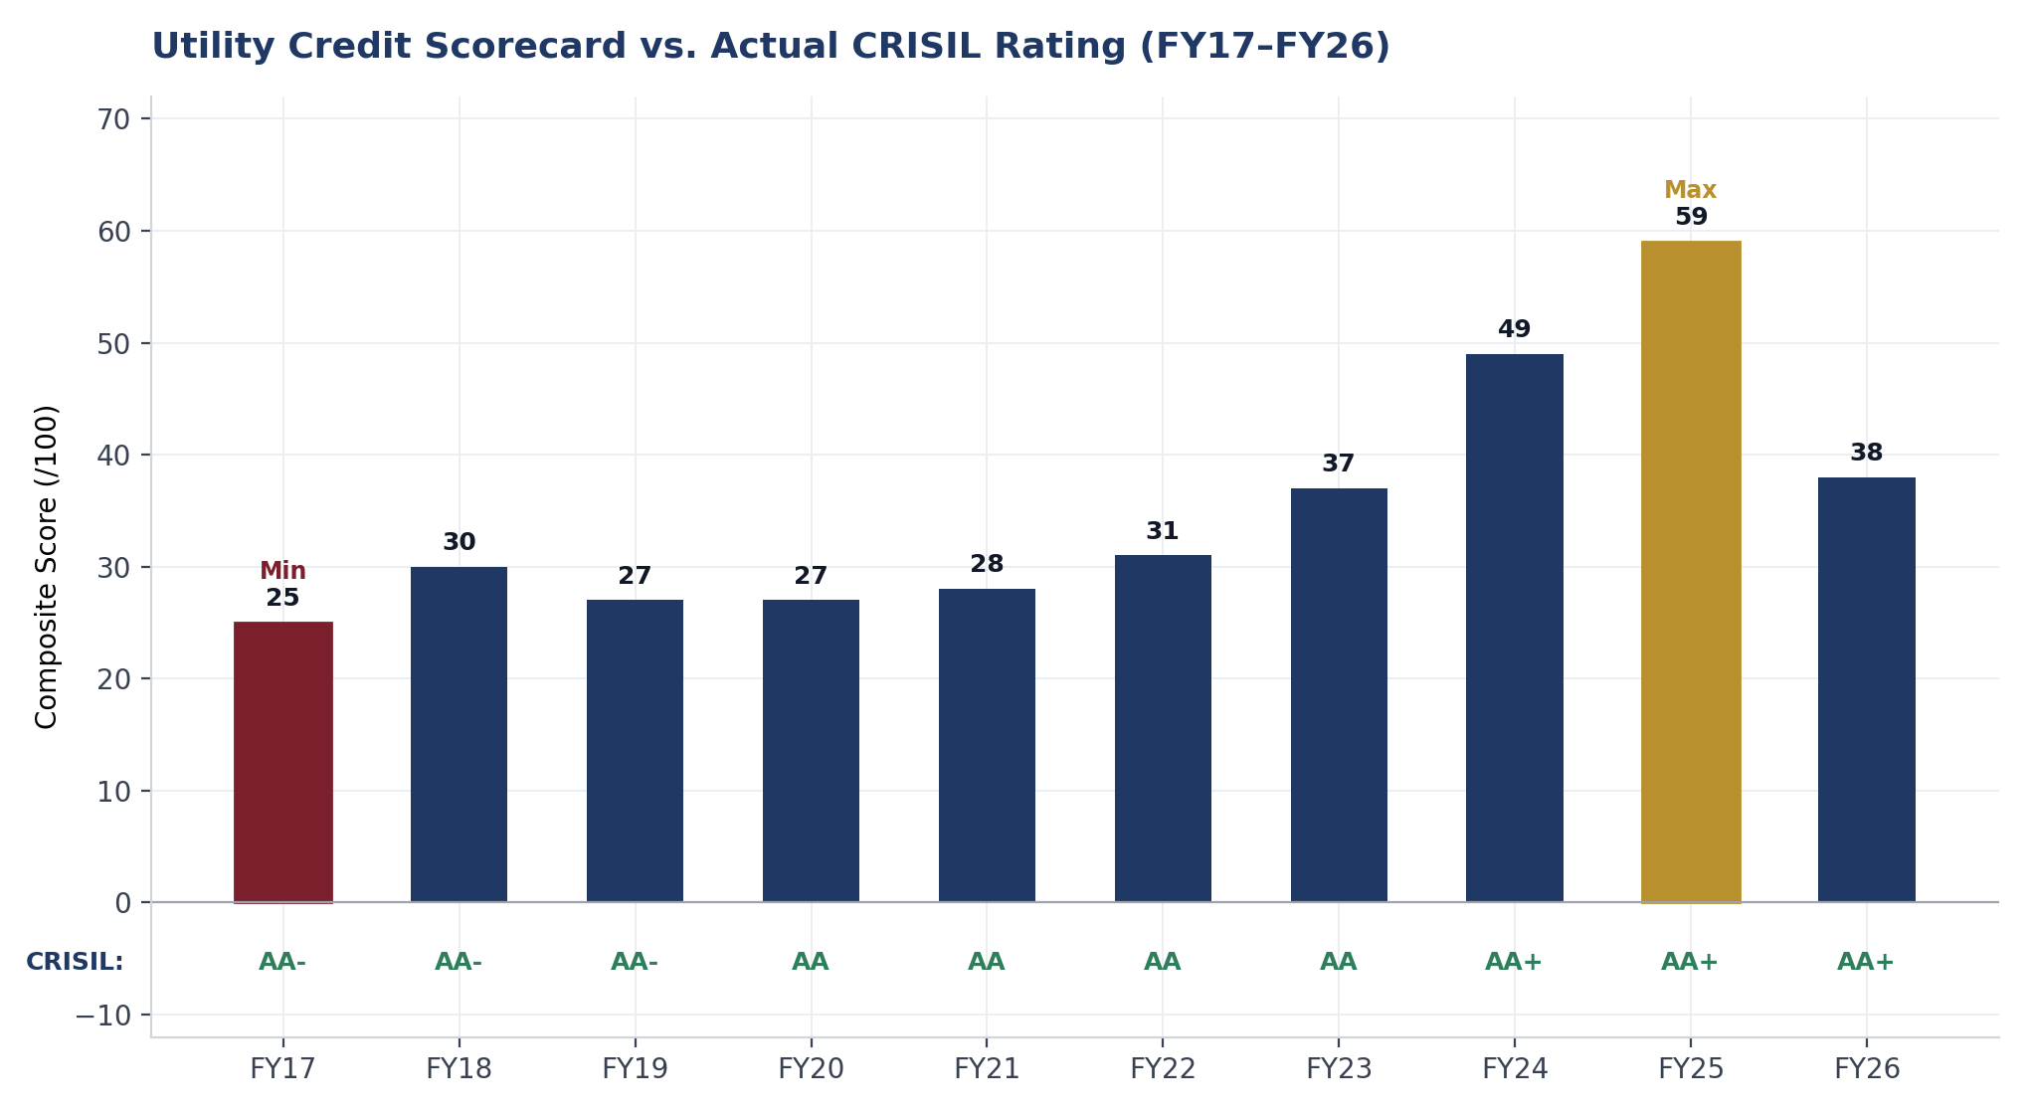
Risk Analysis II — Credit Risk (Utility Scorecard & Altman Z)
Altman Z-Score (FY26): 1.55 — “Distress” zone. A known model-fit issue for capital-intensive regulated utilities, not a genuine credit signal.
Key Insight: Both quantitative models flag risk the actual AA+ rating doesn't show — both exclude qualitative factors (regulatory strength, Tata Group support) the models can't easily score.
Tata Power Ltd. — Management Presentation
11
Notes:
This is the project's central finding. Scorecard: 38/100 'High Risk' in FY26, 'High Risk' in 7 of 10 years overall, while actual CRISIL rating rose from AA- to AA+ with zero downgrades over the same period.

Slide 12
Key Findings
1
DCF intrinsic value (₹19.17/share) sits ~95% below market price (₹402.35), driven primarily by an aggressive reinvestment-rate assumption and the exclusion of TPREL's standalone growth-option value from this consolidated model.
2
The custom Utility Credit Quality Scorecard classifies Tata Power as “High Risk” in 7 of 10 years, while the actual CRISIL rating rose steadily from AA- to AA+ with zero downgrades — a finding about model scope, not a contradiction.
3
Peer relative valuation (EV/EBITDA 10.55x) places Tata Power in line with mature integrated utilities, well below early-stage renewable pure-plays whose multiples reflect near-zero current earnings.
4
Three independent VaR methodologies (Historical, Parametric, Monte Carlo) converge on a consistent downside-risk range for the portfolio position, cross-validating rather than relying on a single model.
5
The standard Altman Z-Score misclassifies Tata Power as financially distressed in most years — a known model-fit issue for capital-intensive regulated utilities, not a genuine credit signal.
Tata Power Ltd. — Management Presentation
12
Notes:
Five findings, roughly in descending order of materiality. Findings 1 and 2 matter most for a CFO audience.

Slide 13
View, Key Risks & Future Outlook
View
Key Risks
Future Outlook
This analysis intentionally stops short of a Buy/Hold/Sell call. The DCF and market/peer valuations diverge too sharply (₹19 vs. ₹402) to responsibly compress into a single recommendation without the sum-of-the-parts work needed to reconcile them.
Execution risk on the renewable capex buildout
Rising leverage (Net Debt/EBITDA 3.98x → 5.15x in FY26)
Regulatory/tariff recovery lag in distribution business
DCF-market valuation gap remains unreconciled without SOTP
Sum-of-the-parts valuation to separately value TPREL
Track FY27 leverage — is the FY26 spike temporary?
Monitor next CRISIL/ICRA rating action for capex-funded-leverage read-through
Bottom Line
Tata Power holds a genuinely strong, improving credit profile (CRISIL AA+, zero downgrades in 10 years) executing a capital-intensive but strategically coherent renewable transition. Every quantitative model built here — DCF, Altman Z, the custom credit scorecard — runs more conservative than what the market and rating agencies conclude, and in each case a specific, named reason for the gap has been identified.
Educational portfolio project — not investment advice.
Tata Power Ltd. — Management Presentation
13
Notes:
Deliberately no Buy/Hold/Sell stamp. The 'Bottom Line' box is the closing message: every model here runs conservative relative to market/agency views, and each gap has a named, specific explanation.

