Slide 1
PROJECT DOCUMENTATION
Tesla, Inc.
Integrated Financial Model & DCF Valuation
A walkthrough of the full model — architecture, assumptions, and valuation
$24.23
$408.95
10.41%
DCF INTRINSIC VALUE (BASE CASE)
CURRENT MARKET PRICE
WACC
Version 1.0 | July 2026 | Not investment advice — prepared for portfolio purposes

Slide 2
SECTION 01
Project Overview
Objective
Estimate Tesla's intrinsic value using a bottom-up, driver-based DCF, compared against market price
Scope
Automotive (5 vehicle lines) + Energy & Other segments; FY2026–FY2032 explicit forecast on 5 years of 10-K history
Model Type
Fully integrated three-statement model with explicit Best/Base/Worst scenario logic
Valuation Method
DCF (FCFF), bottom-up Hamada beta, CAPM cost of equity, Gordon Growth terminal value
1

Slide 3
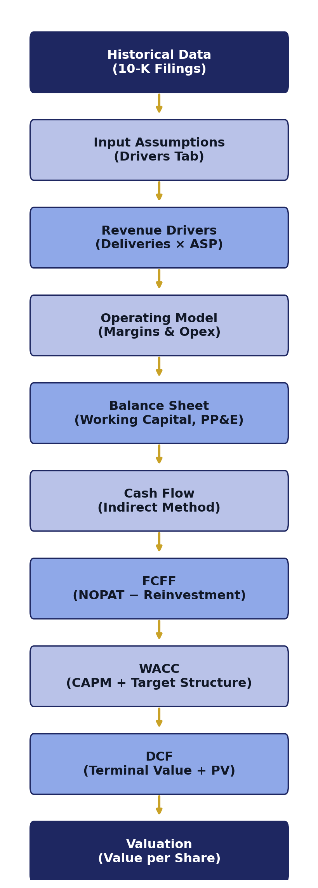
SECTION 02
Model Architecture
The model flows in cross-sheet/checks.
2

Slide 4
SECTION 03
Workbook Structure
Section | Purpose
Cover | Project title and identification
Drivers | Global assumptions: risk-free rate, beta, tax rate, scenario toggle
Inputs | Historical data as reported in Tesla's 10-K filings
Workings — Automotive | Deliveries, pricing, revenue, and margin build-up by vehicle line
Workings — Energy & Other | Energy generation/storage and services revenue build-up
Workings — Opex / Balance Sheet | Operating expenses, PP&E, working capital, financing schedules
Output | Fully integrated P&L, Balance Sheet, Cash Flow
Valuation | WACC and DCF Valuation
38 sheets total, including labeled section-divider tabs for navigation.
3

Slide 5
SECTION 04
Color Coding Convention
Blue
Hardcoded input
Black
Formula (same sheet)
Purple
Link to another sheet
Orange / Bold
Check cell
Grey / Navy Bold
Header / label
blue cells identify hardcoded assumptions/inputs.
4

Slide 6
SECTION 05
Assumptions
Assumption | Value | Basis
Risk-free rate | 4.55% | 10-year U.S. Treasury yield
Equity risk premium | 5.50% | U.S. market risk premium
Beta (relevered) | 1.19 | Hamada unlever/relever at target D/E
Marginal tax rate | 21.0% | U.S. federal statutory rate
Target D/E | 11.4% | 5-yr average debt weight, 2022–26
Terminal growth rate | 4.55% | = risk-free rate
Capex basis | % of prior-year PP&E | Toggle available for % of revenue
Working capital | 5-yr avg DSO/DIO/DPO | Held flat across all scenarios
5

Slide 7
SECTION 06
Revenue Model
Total revenue is built bottom-up from two segments, each forecast independently:
Automotive Revenue
Deliveries × Average Selling Price, by 5 vehicle lines (Model 3, S/X, Y, Cybertruck, Semi)
Energy & Other Revenue
Energy generation and storage + Services and other, forecast on a Y-o-Y growth basis
Model S and Model X are modeled as one combined delivery line (blended ASP average).
6

Slide 8
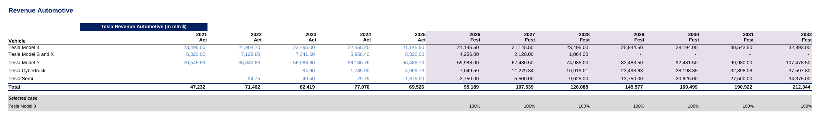
SECTION 07
Automotive Segment
▪ Vehicle Deliveries — 5 lines, CHOOSE() scenario-driven
▪ Gross Margin — benchmarked to auto peers by line
▪ Average Selling Price — held flat in nominal terms
▪ Revenue — Σ(Deliveries × ASP)
7

Slide 9
SECTION 08
Energy Segment
Tesla reports Energy & Other as one segment — The model follows that reporting structure.
Line Item | Basis
Base case margin | 11.4% — FY21–25 historical median, held flat despite a trend (−3.5% → 18.7%)
Growth trajectory | Decelerates from 18% (FY2026) to a 6% long-run rate by FY2030
Scenario band | Best/Worst flex by ± the inflation assumption (3.1%)
8

Slide 10
SECTION 09
Operating Expenses
Modeled as a single blended line (% of revenue) — matching Tesla's reported income statement detail rather than an unsupported R&D/SG&A split.
FORECAST LOGIC
The Base case converges opex toward a peer-benchmarked “Adjusted Average” of 13.05%.
9

Slide 11
SECTION 10
Working Capital, PP&E & Financing
Schedule | Key Assumption | Detail
Working Capital | DSO / DIO / DPO | 14.5 / 60.2 / 72.8 days (5-yr avg), flat across scenarios
PP&E | Capex basis | % of prior-year PP&E (28% Base case); 10-yr straight-line, vintage schedule
Financing | Debt/equity plug | 50/50 split funds any negative FCF period; dormant under Base case
Financing | Cost of debt | 5.45% market bond yield (not historical effective rate)
Net PP&E = Prior-year Net PP&E + Capex − Depreciation, rolling forward into the Balance Sheet each year.
10

Slide 12
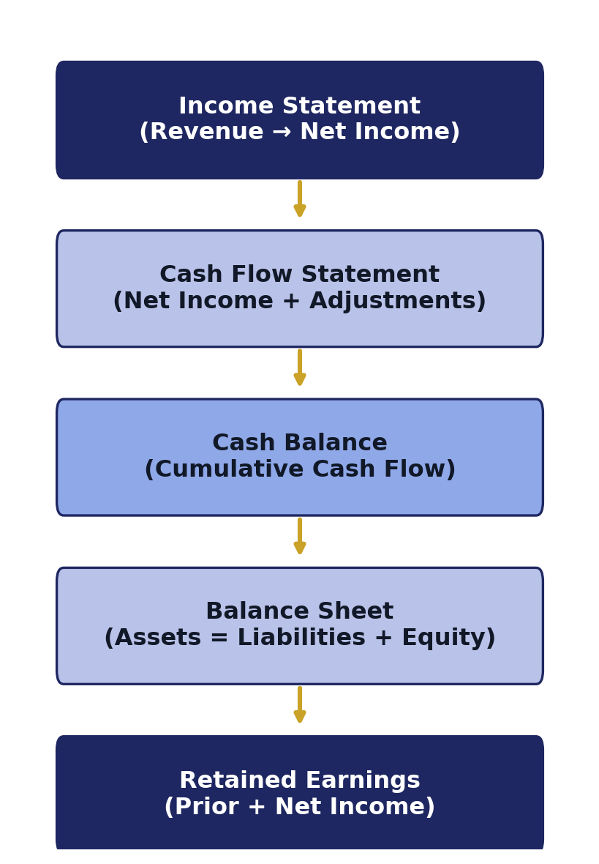
SECTION 11
Three-Statement Integration
VERIFIED INTEGRITY
Balance Sheet and Cash Flow check rows both equal exactly zero in every period, FY2021–FY2035.
11

Slide 13
SECTION 12
Free Cash Flow
Component | Definition
EBIT | Operating income before interest and taxes
NOPAT | EBIT × (1 − 21% marginal tax rate)
+ D&A | Added back as a non-cash expense
− Capex | Cash reinvested per the vintage-based PP&E schedule
− Δ Working Capital | Cash absorbed/released by receivables, inventory, payables
= FCFF | Cash available to all capital providers
12

Slide 14
SECTION 13
Cost of Capital (WACC)
TARGET CAPITAL STRUCTURE
89.1%
Equity Weight
10.9%
Debt Weight
WACC = 10.41%
13

Slide 15
SECTION 14
DCF Valuation
Output | Base Case
Terminal Value (undiscounted) | $154,658M
Enterprise Value | $82,800M
Value of Equity | $90,937M
Diluted Shares Outstanding | 3,752.43M
Value per Share | $24.23
Current Market Price | $408.95
Implied Multiple | 16.9x
14

Slide 16
SECTION 15
Sensitivity Analysis
Terminal Value = FCFF(n+1) ÷ (WACC − Terminal Growth). Terminal value is sensitive to the WACC–terminal-growth spread.
WACC \ Growth | 3.55% | 4.55% | 5.55% | 6.55% | 7.55%
8.41% | $186,512 | $234,891 | $317,157 | $488,108 | $1,058,827
10.41% | $132,098 | $154,658 | $186,512 | $234,891 | $317,157
12.41% | $102,263 | $115,281 | $132,098 | $154,658 | $186,512
14.41% | $83,422 | $91,886 | $102,263 | $115,281 | $132,098
16.41% | $70,443 | $76,385 | $83,422 | $91,886 | $102,263
18.41% | $60,959 | $65,359 | $70,443 | $76,385 | $83,422
Base case (WACC 10.41%, Terminal Growth 4.55%)
15

Slide 17
SECTION 16
Model Checks & Integrity
Check | Result
Balance Sheet balances (Assets = Liab. + Equity) | ✓ Zero variance, every period FY21–FY35
Cash Flow reconciles to Balance Sheet cash | ✓ Zero variance, every period FY21–FY35
Circular references | ✓ None detected
Broken formulas (#REF!, #VALUE!, #DIV/0!) | ✓ 0 errors across 3,357 formulas
Scenario toggle consistency across driver tabs | ✓ CHOOSE() pattern verified
16

Slide 18
SECTION 17
Model Limitations
Scope: core business only
Excludes FSD, robotaxi, Optimus, and energy storage optionality — these items are outside the model scope
Peer data vintage
Opex and working capital benchmarks use 2019 peer data and therefore may not reflect current cost structures.
Working capital doesn't flex by scenario
DSO/DIO/DPO held constant across Best/Base/Worst while volumes and margins do flex
Scenario bands vary by driver
Deliveries ±5% (relative), margins ±1.5pp, opex ±2pp, Energy ±inflation — the scenario adjustments vary by driver.
17

Slide 19
SECTION 18
Conclusion
Base Case DCF intrinsic value: $24.23/share vs. market price $408.95 (16.9x implied multiple)
Investment Implication
The Base Case DCF value is substantially below the current market price within the model's defined scope.
Key Value Drivers
Delivery volume (Model Y/3), automotive gross margin trajectory, and pace of opex convergence to peer benchmarks
Major Risks
Terminal value sensitivity to WACC–growth spread, peer data vintage, and excluded revenue optionality
18

Slide 20
Thank You
Tesla, Inc. — Integrated Financial Model & DCF Valuation
This presentation was prepared as part of an independent financial modeling and valuation portfolio project. It does not constitute investment advice, a research report from a registered investment adviser or broker-dealer, or a recommendation to buy, sell, or hold any security. Historical data is sourced from Tesla, Inc.'s public SEC filings; forward-looking figures are model estimates only.

