Slide 1



Introduction to
VsCode, Git and Anaconda

Slide 2

But first. Who am I?
Feedback: who are you?
Econ bachelor student (5. semester)
Completed multiple online Computer Science courses from Harvard
I highly recommend CS50 if you are interested in how computers work
Student assistant at Danmarks Nationalbank (+1year) | Financial statistics
Machine learning and api work in python and R, data manipulation and analysis in R and SQL. Developed multiple tools we use for quality assessments of data.
TA in ProgEcon (my first class)
Very very open to feedback / critique. Please do not hold back! I can take it

Slide 3

Also…
I just quit for a research assistant position at ROCKWOOL Fonden
Come talk to me if you are interested in my former position at DN’s department for financial statistics (I would be happy to tell them about your programming skills!)

Slide 4

Visual Studio Code - Overview
IDE (Integrated Developer Environment)
A ”shell” to edit and debug source code
Source code is what you write (e.g. print(”i don’t like mondays”))
More info on python intepreter (from source code to machine code): What is the Python Interpreter? (How does Python Work?)
Extensions
Integrate functionality into vscode (one application for everything!)
Python, R, SQL, C++,…
Copilot (ai assistant)
Git (version control)

Slide 5


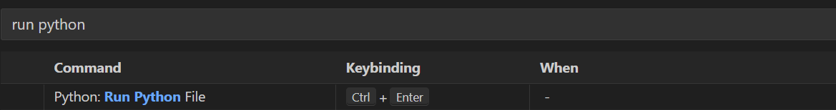
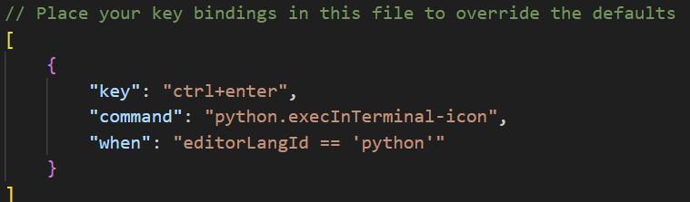
Visual Studio Code - Settings
Point and Click
Ctrl+shift+p
Find the shortcut / setting
Change keybinding by clicking
JSON (JavaScript Object Notation)
Ctrl+shift+p
Change shortcut using commands / code
Separate different keybindings by a ,

Slide 6
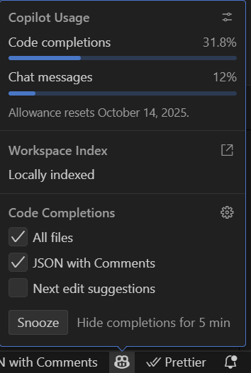

Visual Studio Code – Snooze the frog!
The frog have many great ideas, which can be frustrating – or even worse: Get in the way of learning!!!
To stop the frog:
Click on him / her ( ) in the down right corner, and click ”Snooze”

Slide 7
Let’s try it out!
Demonstration…

Slide 8

Git and Github
Working directory
Staging area
Local Repository
Remote Repository
git add
git commit
git push
git pull
git fetch
git pull
Local
Remote (Github)

Slide 9
Git commands (the most used)
Command | Decription
git checkout “branchname” | Switches working branch to “branchname”
git add “filename_to_add.py” (or add .) | Stages the specified file, so these later can be commited
git commit –m “describe the commit” | Creates a snapshot of the repository with the committed changes
git push
git merge “branchname to merge with” | Tries to merge the “branchname to merge with” into the current working branch you have “checked out”
git fetch | downloads the remote repository into the local repository (usually named origin/main)
git pull origin main | Fetches and merges the remote repository’s main branch into the current working branch
git remote (-v / add origin “URL” / …) | Changing / viewing / initializing the remote repositories url
Note: Always prefix git command with “git”

Slide 10

Merge conflicts
If two contributors / students edit the same lines of code, the merge command will not know what to do.
You will be prompted to “resolve the conflict”
Therefore: Don’t work on the same aspects of the code on multiple devises.
Plan with your group what functions / features you each work on.

Slide 11
Let’s try it out!
Demonstration…

Slide 12
Anaconda?
In short: Anaconda manages and stores your python interpreter, and downloaded modules (pandas, numpy, matplotlib,…)
To install new packages use
conda install <package_name> or pip install <package_name>

Slide 13

Let’s code
problem_set_1
From Jeppe and Brigittas
Github repository
Always remember that
I am here to help!
I don’t care if your question is
“good” or “bad”! – just ask, even if it’s about something from t > 2
weeks ago

Slide 14

QUESTIONS?

