Slide 1


All India Research Scholar Summit-2024
ORAL PRESENTATION
PARTICIPATION ID: BOP004
Live & Personalised
AI recommendation algorithms to find the hidden gems of streaming
Mohit Chakraborty and Aarya Motiwala

Slide 2
Contents
Introduction
Research Gap
Methodology
Results
Conclusion

Slide 3
Introduction
AI recommendation algorithms uncover great, lesser-known streamers, improving discovery in a crowded online space.
The rise in online viewership increases the need for personalized suggestions, especially where content is vast and varied.
Despite high online consumption, India lacks a major native streaming app; AI can bridge this gap, offering tailored content recommendations.

Slide 4
Research Gap
The existing system does not incorporate user interaction data, which could provide valuable insights into user preferences and behaviors.
It lacks the capability to adapt to the dynamic nature of live content, which is crucial for maintaining relevance in real-time streaming environments.
The evaluation metrics employed during the training phase do not effectively capture the impact or success of the model in practical, real-world applications. [link]

Slide 5
Methodology
Step 1: Data Collection
Streaming Data from Twitch and Youtube Live.
Streamer Data: We will extract data relating to their subscriber count, stream time per category, viewer demographics.
User Data: We extract features such as past visiting history, subscriptions and follows, and their demographic information.

Slide 6
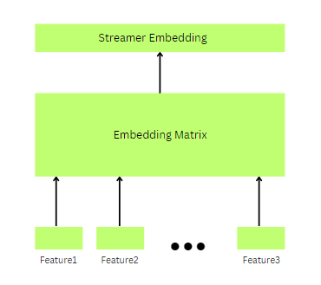
Methodology
Step 2: Recommendation Model - Input Embeddings
Feature Vectors: Each streamer is represented as a feature vector.
Embedding Matrix: We pass the streamer feature vector through an embedding matrix to get new representations. These streamer representations are fed into our model to generate our user representations.

Slide 7
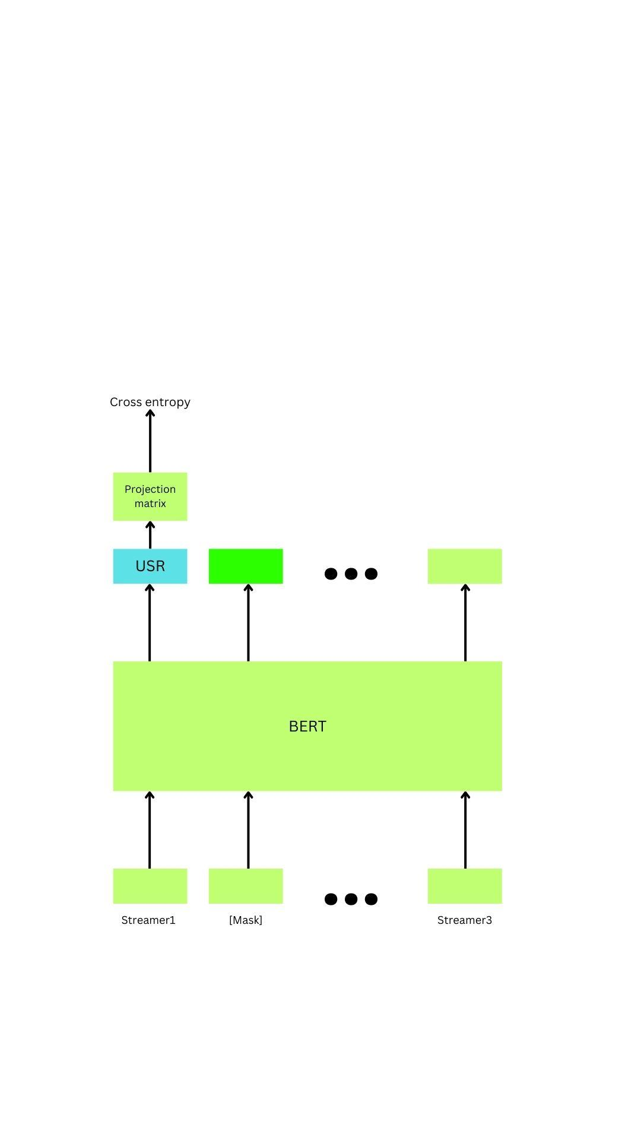
Methodology
Step 3: Constructing User Embeddings
Initial Representation: Users are represented as a matrix of channels based on their watch history.
Self-Attention Mechanism: These user embeddings are passed through BERT model with some channels masked. One of the aims of this model is to predict the masked channels.
Training a Classifier (USR) Token: We also learn a context aware USR token.

Slide 8
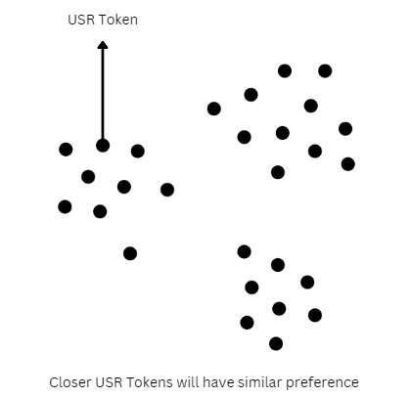
Methodology
Step 4: User Clusters
Node Representation: In the cluster, each node represents the embedding of a user. Closer nodes represent similar preferences.
Interest Clusters: As a result of this organization, users naturally form clusters that represent collective interest groups.
Recommendation Sampling: Each cluster will have a set of streamers. We sample from this set to give our recommendation.

Slide 9
Results
Improvement in Recommendation Relevance : This model will help in user engagement by more accurately aligning recommendations with individual user interests and preferences.
Increased Discovery of New Content : Cluster based model will help increase Users experience with exposure to diverse content, broadening their viewing experiences by introducing them to new streamers and categories.
Cross-Cluster Exploration : Analysis will help us understand users frequently explored content across different interest clusters, indicating a complex web of preferences and the system's adaptability to these nuances.

Slide 10
Conclusion
In conclusion, our research demonstrates the effectiveness of AI-driven algorithms in delivering personalized content recommendations by leveraging real-time analytics and user interactions.

