Slide 1
Voicemoji: Emoji Entry Using Voice for Visually Impaired People
Notes:
https://dl.acm.org/doi/pdf/10.1145/3411764.3445338

Slide 2
Introduction
Emojis have become an essential element of all forms of online communication and are widely used in everyday social interaction.
93.1% of Blind or low vision (BLV) users encounter emojis once a month.
82.7% of BLV users utilize emojis once a month
However, there still lacks a lot of support for emoji search and entry, which makes it a time-consuming process for BLV users.

Slide 3
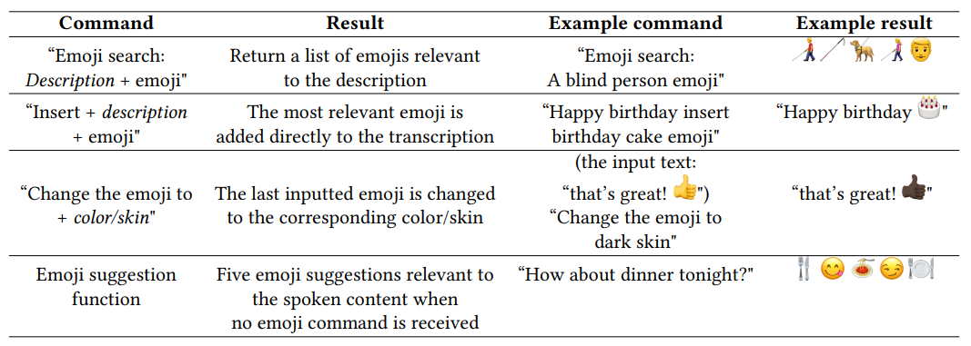
VOICEMOJI
Introducing Voicemoji, a voice emoji entry system that supports context-sensitive emoji suggestion, as well as manipulation of emoji with voice commands.

Slide 4
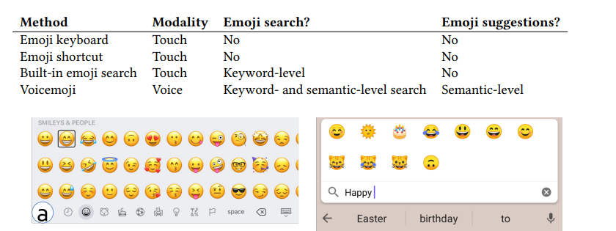
EXISTING WORK
There are a couple of alternatives that support BLV users on emoji entry, such as Gboard and Apple’s voice control, but both require the user knowing the exact emoji name (e.g. “fire emoji” would input 🔥)
In the emoji keyboard, BLV users navigate through the options one by one with their finger, and the screen reader will read their name one by one. Despite its inefficiency, it’s the most typically used method to input emojis.
iOS emoji keyboard
Emoji Search

Slide 5
EXISTING WORK
The predominant way to select an emoji is to scroll through an emoji keyboard, which groups its options by theme, which sometimes is inefficient even for sighted users.
Recent mobile keyboards are starting to add emoji suggestions when users type certain keywords. For instance, typing “bear” would cause the emoji 🐻 to show up.
Still, many emojis have complex descriptions, such as, 😸 (Grinning Cat Face with Smiling Eyes), and may have strong similarities between them, for example 😄 (Grinning Face with Smiling Eyes) and 😊 (Smiling Face with Smiling Eyes. That issue makes the solution rather incomplete.

Slide 6
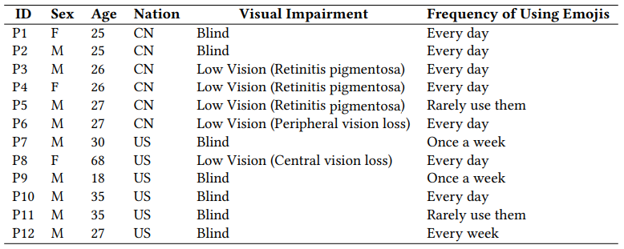
UNDERSTANDING CURRENT EMOJI USAGE BY BLV
12 participants were recruited, 7 of which were blind and 5 identified as low vision.
Many of the participants, regardless of their lack of vision, still use emojis in their daily life. When asked about why, all mentioned “enriching the expressiveness of their communication”.

Slide 7
CHALLENGES FOR BLV USERS
Users reported the following challenges:
Time-consuming, inconvenient
Inconsistent with user’s expectations
Difficult emoji discovery
Difficult to find the right emoji
Which Voicemoji addresses with these features
Direct emoji entry, via speech
Natural Language Queries (e.g., to input the emoji 👨‍🦯 instead of saying “Man with Probing Cane”, users can simply say “blind person emoji”)
Offer various emoji suggestions
Suggest emojis related to message content
Allow skin tone modification

Slide 8
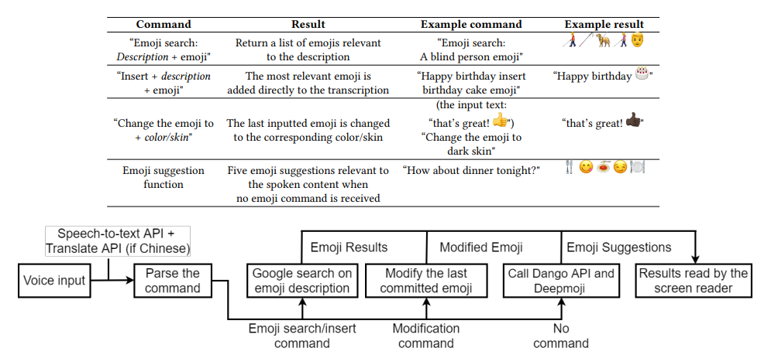
Implementation
Voicemoji can be used with speech only, or together with a screen reader.

Slide 9
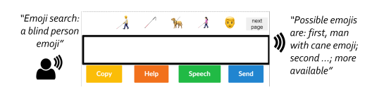
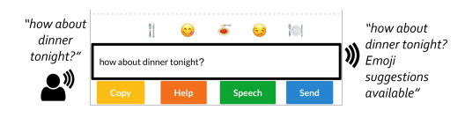
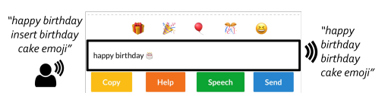
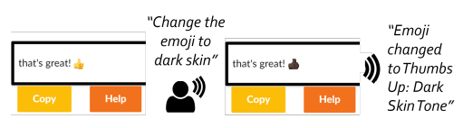
implementation
Voicemoji is targeted at improving the communication efficiency.

Slide 10
EVALUATION
The same 12 BLV participants were invited, and all used an iOS phone. The first phase was a tutorial where Voicemoji was introduced, and each participant tried the available options. They were encouraged to keep using it for their daily communication needs for three days.
In the second phase there were two sessions:
Emoji Entry session: Participants were told to input 25 predefined phrases with emojis and text, well a couple of original phrases with text and emojis. After finishing all 27 phrases with one method, they would start again with the other one (iOS Keyboard / Voicemoji)
Emoji Suggestion Session: Participants were told to speak 8 predefined phrases using Voicemoji and then asked to select one of the suggested emojis.

Slide 11
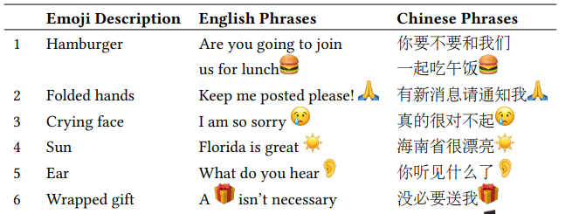
RESULTS
For the emoji entry session, there was one independent variable, the entry method (Voicemoji vs iOS keyboard), and the total entry time (time to input the whole phrase) and emoji entry time (time to input the emojis) were measured.

Slide 12
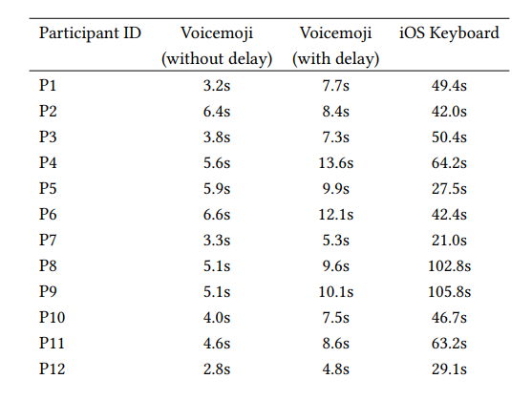
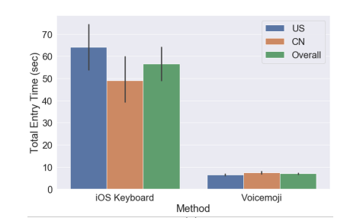
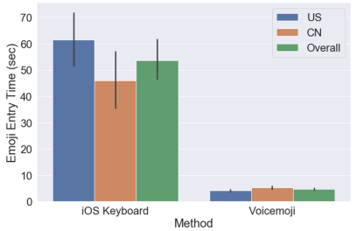
RESULTS
“The average emoji entry time for Voicemoji was 4.7 seconds, which was 91.2% shorter than the 53.7 seconds for the Apple iOS”
keyboard

Slide 13
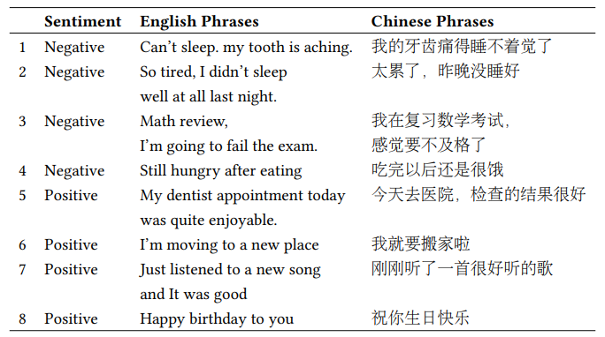
RESULTS
For the emoji suggestion session, the authors recorded the number of emoji suggestions that were considered relevant by the participants and used that to calculate the pick-1 accuracy, which determines whether any suggested emoji was relevant, as well as overall accuracy, which examines how many suggested emojis were relevant.

Slide 14
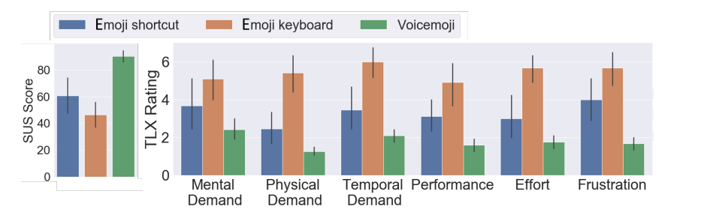
RESULTS
“The pick-1 accuracy for Voicemoji was 100% for each phrase. (…) The overall accuracy was 76.0% for the Chinese group, and 72.2% for the American group.”

Slide 15
RESULTS
When asked about feedback regarding Voicemoji, the participants mentioned the following:
Convenient way to enter emojis
Helpful suggestions
Supports emoji exploration
Enriches communication

Slide 16
Limitations & Future work
Only iOS users participated
Due to the COVID-19 pandemic, sessions were held remotely, which allows for a less controlled study (e.g., participants each used their own iPhone models, which could be different)
Google’s speech-to-text API would often cut off the speech after long pauses
In the future, build Voicemoji into an actual keyboard, instead of having it as a web application

