Slide 1
C++ Programming: From Problem Analysis to Program Design
Chapter 6: User-Defined Functions I

Slide 2
Objectives
In this chapter, you will:
Learn about standard (predefined) functions and discover how to use them in a program
Learn about user-defined functions
Examine value-returning functions, including actual and formal parameters
Explore how to construct and use a value-returning, user-defined function in a program

Slide 3
Introduction
Functions are like building blocks
They allow complicated programs to be divided into manageable pieces
Some advantages of functions:
  A programmer can focus on just that part of the program and construct it, debug it, and perfect it
  Different people can work on different functions simultaneously
  Can be re-used (even in different programs)
  Enhance program readability

Slide 4
Introduction (cont'd.)
Functions
  Called modules
  Like miniature programs
  Can be put together to form a larger program

Slide 5
Predefined Functions
In algebra, a function is defined as a rule or correspondence between values, called the function’s arguments, and the unique value of the function associated with the arguments
  If f(x) = 2x + 5, then f(1) = 7, f(2) = 9, and f(3) = 11
    1, 2, and 3 are arguments
    7, 9, and 11 are the corresponding values

Slide 6
Predefined Functions (cont'd.)
Some of the predefined mathematical functions are:
  sqrt(x)
  pow(x, y)
  floor(x)
Predefined functions are organized into separate libraries
I/O functions are in iostream header
Math functions are in cmath header

Slide 7
Predefined Functions (cont'd.)
pow(x,y) calculates x^{y}
  pow(2, 3) = 8.0
  Returns a value of type double
  x and y are the parameters (or arguments)
    The function has two parameters
sqrt(x) calculates the nonnegative square root of x, for x >= 0.0
  sqrt(2.25) is 1.5
  Type double

Slide 8
Predefined Functions (cont'd.)
The floor function floor(x) calculates largest whole number not greater than x
  floor(48.79) is 48.0
  Type double
  Has only one parameter

Slide 9
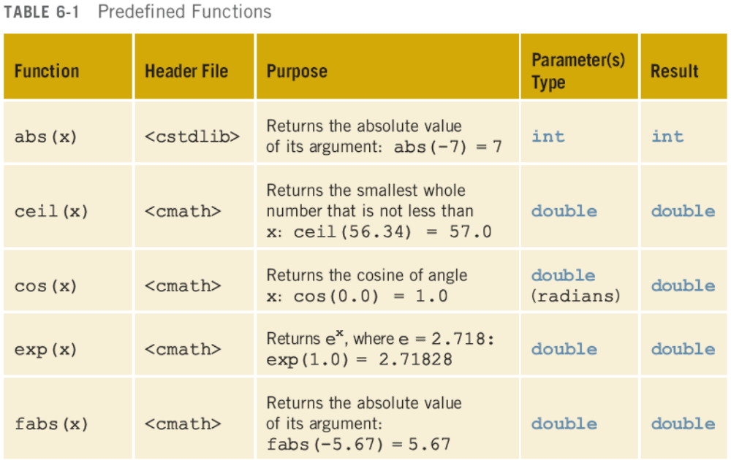
Predefined Functions (cont'd.)

Slide 10
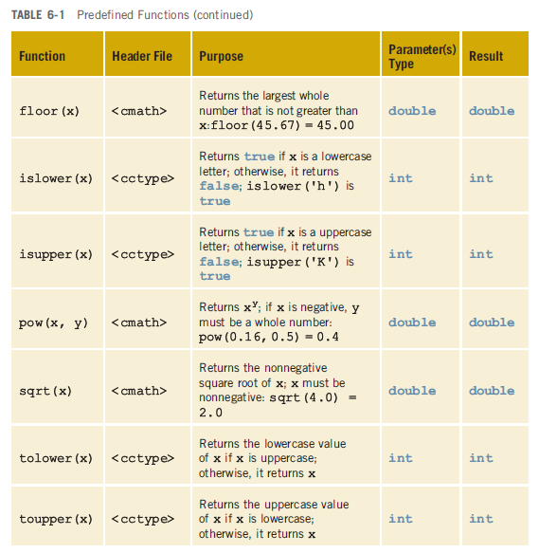
Predefined Functions (cont'd.)

Slide 11
Predefined Functions (cont'd.)
// How to use predefined functions.
#include <iostream>
#include <cmath>
#include <cctype>
using namespace std;
int main(){
int x;
double u, v;
cout << "Line 1: Uppercase a is " << static_cast<char>(toupper('a')) << endl;
u = 4.2;
v = 3.0;
cout << "Line 4: " << u << " to the power of “ << v << " = " << pow(u, v) << endl;
cout << "Line 5: 5.0 to the power of 4 = “ << pow(5.0, 4) << endl;
u = u + pow(3.0, 3);
cout << "Line 7: u = " << u << endl;
x = -15; /
cout << "Line 9: Absolute value of " << x << " = " << abs(x) << endl;
return 0;
}

Slide 12
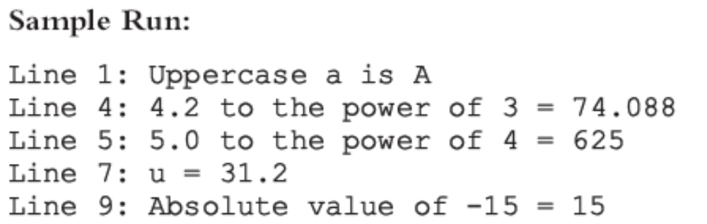
Predefined Functions (cont'd.)
Example 6-1 sample run:

Slide 13
User-Defined Functions
Value-returning functions: have a return type
  Return a value of a specific data type using the return statement
Void functions: do not have a return type
  Do not use a return statement to return a value

Slide 14
Value-Returning Functions
To use these functions you must:
  Include the appropriate header file in your program using the include statement
  Know the following items:
    Name of the function
    Number of parameters, if any
    Data type of each parameter
    Data type of the value returned: called the type of the function

Slide 15
Value-Returning Functions (cont'd.)
Because the value returned by a value-returning function is unique, must:
  Save the value for further calculation
  Use the value in some calculation
  Print the value
A value-returning function is used in an assignment or in an output statement
One more thing is associated with functions:
  The code required to accomplish the task

Slide 16
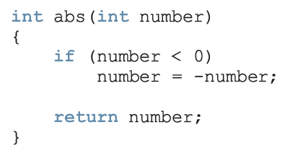
Value-Returning Functions (cont'd.)

Slide 17
Value-Returning Functions (cont'd.)
Heading: first four properties above
  Example: int abs(int number)
Formal Parameter: variable declared in the heading
  Example: number
Actual Parameter: variable or expression listed in a call to a function
  Example: x = pow(u, v)

Slide 18
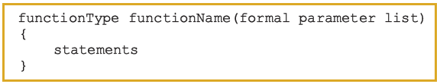
Syntax: Value-Returning Function
Syntax:
functionType is also called the data type or return type

Slide 19
Syntax: Formal Parameter List

Slide 20
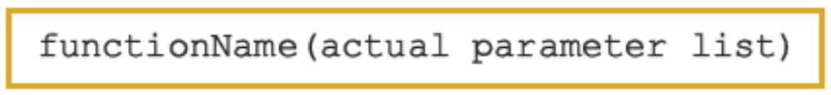
Function Call

Slide 21
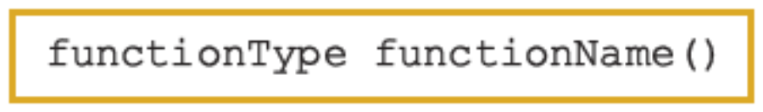
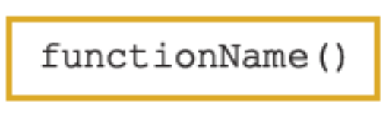
Syntax: Actual Parameter List
The syntax of the actual parameter list is:
Formal parameter list can be empty:
A call to a value-returning function with an empty formal parameter list is:

Slide 22
return Statement
Once a value-returning function computes the value, the function returns this value via the return statement
  It passes this value outside the function via the return statement

Slide 23
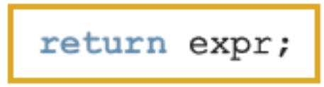
Syntax: return Statement
The return statement has the following syntax:
In C++, return is a reserved word
When a return statement executes
  Function immediately terminates
  Control goes back to the caller
When a return statement executes in the function main, the program terminates

Slide 24
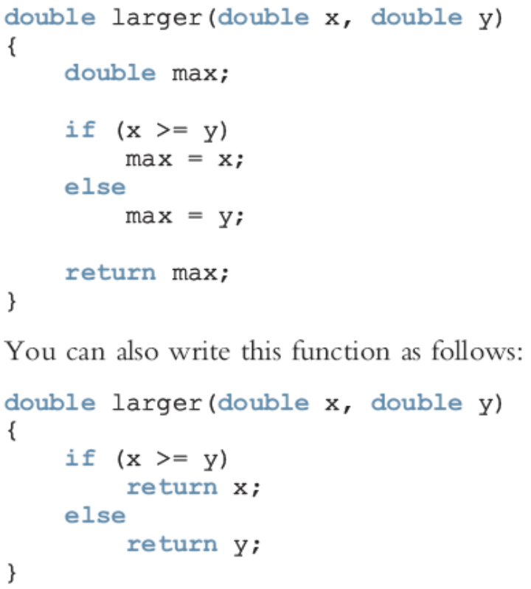
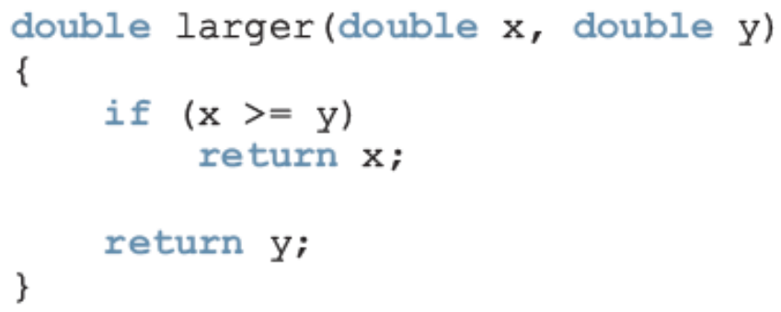
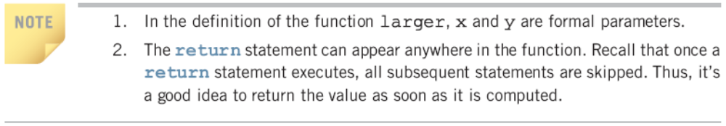
Syntax: return Statement (cont’d.)

Slide 25
Function Prototype
Function prototype: function heading without the body of the function
Syntax:
It is not necessary to specify the variable name in the parameter list
The data type of each parameter must be specified

Slide 26
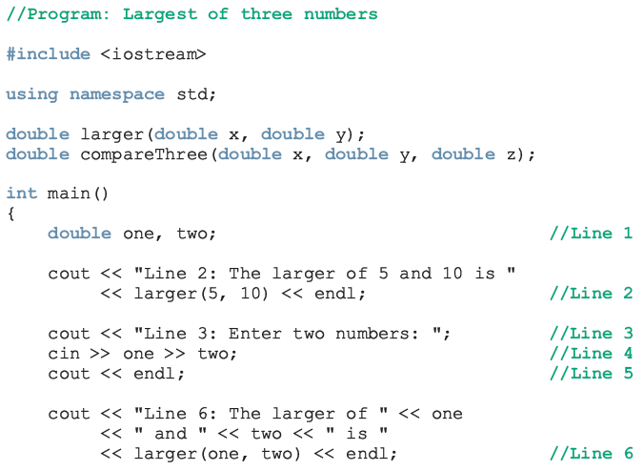
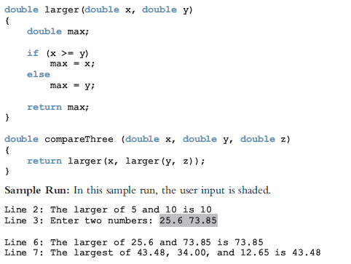
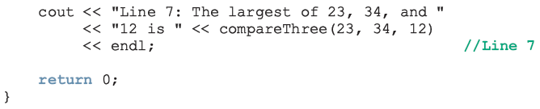
Function Prototype (cont'd.)

Slide 27
Function Prototype (cont'd.)

Slide 28

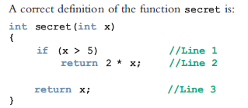
Value-Returning Functions: Some Peculiarity

Slide 29
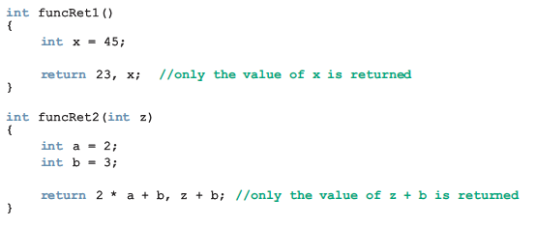
Value-Returning Functions: Some Peculiarity (cont'd.)

Slide 30
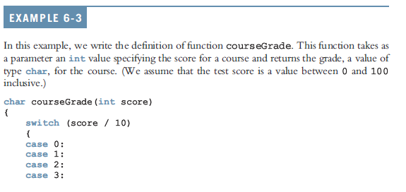
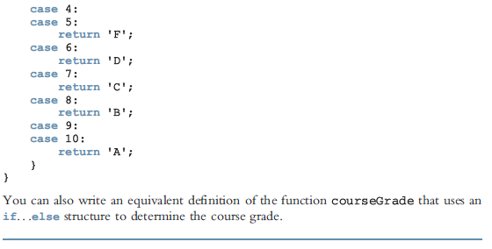
Value-Returning Functions: Some Peculiarity (cont'd.)

Slide 31
Example 6-5: Palindrome Number
A nonnegative integer is a palindrome if it reads forward and backward in the same way
  Examples: 5, 44, 789656987

Slide 32
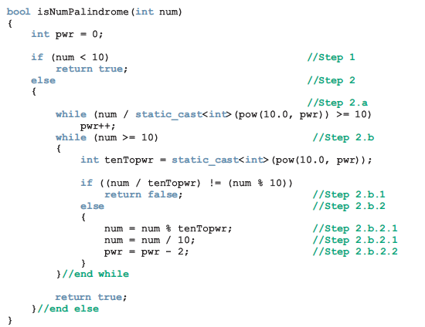
Example 6-5: Palindrome Number (cont’d.)

Slide 33
Flow of Execution
Execution always begins at the first statement in the function main
Other functions are executed only when they are called
Function prototypes appear before any function definition
  The compiler translates these first
The compiler can then correctly translate a function call

Slide 34
Flow of Execution (cont'd.)
A function call results in transfer of control to the first statement in the body of the called function
After the last statement of a function is executed, control is passed back to the point immediately following the function call
A value-returning function returns a value
  After executing the function the returned value replaces the function call statement

Slide 35
Programming Example: Largest Number
The function larger is used to determine the largest number from a set of numbers
Program determines the largest number from a set of 10 numbers
Input: a set of 10 numbers
Output: the largest of 10 numbers

Slide 36
Programming Example: Program Analysis
Suppose that the input data is:
15 20 7 8 28 21 43 12 35 3
Read the first number of the data set
  Because this is the only number read to this point, you may assume that it is the largest number so far and call it max
Read the second number and call it num
  Compare max and num, and store the larger number into max

Slide 37
Programming Example: Program Analysis (cont'd.)
Now max contains the larger of the first two numbers
Read the third number and compare it with max and store the larger number into max
  max contains the largest of the first three numbers
Read the next number, compare it with max, and store the larger into max
Repeat this process for each remaining number in the data set

Slide 38
Programming Example: Algorithm Design
Read the first number
  Because this is the only number that you have read, it is the largest number so far
  Save it in a variable called max
For each remaining number in the list
  Read the next number
  Store it in a variable called num
  Compare num and max

Slide 39
Programming Example: Algorithm Design (cont'd.)
For each remaining number in the list (cont'd.)
  If max < num
    num is the new largest number
    update the value of max by copying num into max
  If max >= num, discard num; that is, do nothing
Because max now contains the largest number, print it

Slide 40
Summary
Functions (modules) are miniature programs
  Divide a program into manageable tasks
C++ provides the standard functions
Two types of user-defined functions: value-returning functions and void functions
Variables defined in a function heading are called formal parameters
Expressions, variables, or constant values in a function call are called actual parameters

Slide 41
Summary (cont'd.)
In a function call, the number of actual parameters and their types must match with the formal parameters in the order given
To call a function, use its name together with the actual parameter list
Function heading and the body of the function are called the definition of the function
A value-returning function returns its value via the return statement

Slide 42
Summary (cont'd.)
A prototype is the function heading without the body of the function; prototypes end with the semicolon
Prototypes are placed before every function definition, including main
User-defined functions execute only when they are called
In a call statement, specify only the actual parameters, not their data types

