Slide 1
C++ Programming:
From Problem Analysis to Program Design
Chapter 3: Input/Output

Slide 2
I/O Streams and Standard I/O Devices
I/O: sequence of bytes (stream of bytes) from source to destination
  Bytes are usually characters, unless program requires other types of information
Stream: sequence of characters from source to destination
Input stream: sequence of characters from an input device to the computer
Output stream: sequence of characters from the computer to an output device
C++ Programming: From Problem Analysis to Program Design

Slide 3
I/O Streams and Standard I/O Devices (continued)
Use iostream header file to extract (receive) data from keyboard and send output to the screen
  Contains definitions of two data types:
    istream - input stream
    ostream - output stream
  Has two variables:
    cin - stands for common input
    cout - stands for common output
C++ Programming: From Problem Analysis to Program Design

Slide 4
I/O Streams and Standard I/O Devices (continued)
To use cin and cout, the preprocessor directive #include <iostream> must be used
Variable declaration is similar to:
  istream cin;
  ostream cout;
Input stream variables: type istream
Output stream variables: type ostream
C++ Programming: From Problem Analysis to Program Design

Slide 5

cin and the Extraction Operator >>
The syntax of an input statement using cin and the extraction operator >> is:
The extraction operator >> is binary
  Left-side operand is an input stream variable
    Example: cin
  Right-side operand is a variable
C++ Programming: From Problem Analysis to Program Design

Slide 6
cin and the Extraction Operator >> (continued)
No difference between a single cin with multiple variables and multiple cin statements with one variable
When scanning, >> skips all whitespace
  Blanks and certain nonprintable characters
>> distinguishes between character 2 and number 2 by the right-side operand of >>
  If type char or int (or double), the 2 is treated as a character or as a number 2
C++ Programming: From Problem Analysis to Program Design

Slide 7
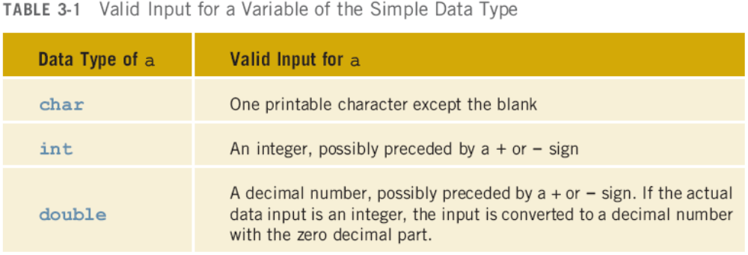
cin and the Extraction Operator >> (continued)
Entering a char value into an int or double variable causes serious errors, called input failure
C++ Programming: From Problem Analysis to Program Design

Slide 8
cin and the Extraction Operator >> (continued)
When reading data into a char variable
  >> skips leading whitespace, finds and stores only the next character
  Reading stops after a single character
To read data into an int or double variable
  >> skips leading whitespace, reads + or - sign (if any), reads the digits (including decimal)
  Reading stops on whitespace non-digit character
C++ Programming: From Problem Analysis to Program Design

Slide 9
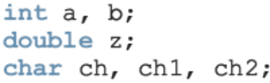
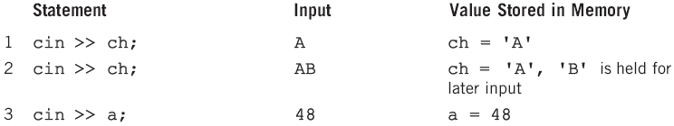
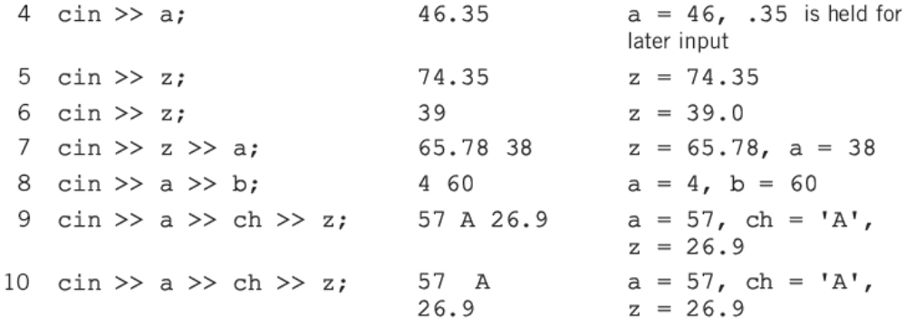
cin and the Extraction Operator >> (continued)
C++ Programming: From Problem Analysis to Program Design

Slide 10
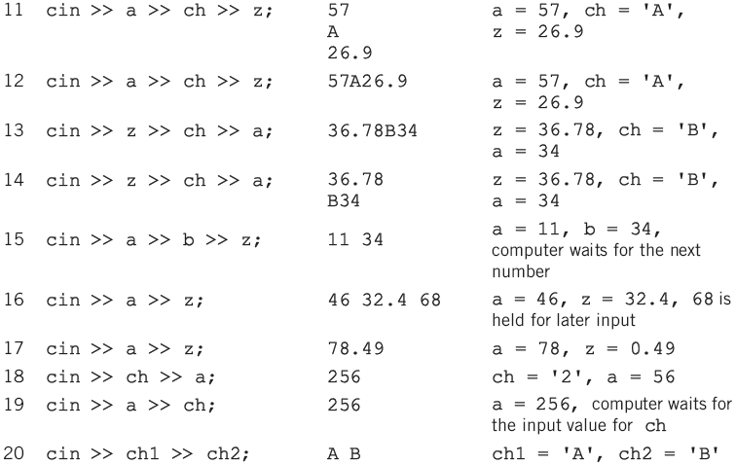

Slide 11
Using Predefined Functions in a Program
Function (subprogram): set of instructions
  When activated, it accomplishes a task
main executes when a program is run
Other functions execute only when called
C++ includes a wealth of functions
  Predefined functions are organized as a collection of libraries called header files
C++ Programming: From Problem Analysis to Program Design

Slide 12
Using Predefined Functions in a Program (continued)
Header file may contain several functions
To use a predefined function, you need the name of the appropriate header file
  You also need to know:
    Function name
    Number of parameters required
    Type of each parameter
    What the function is going to do
C++ Programming: From Problem Analysis to Program Design

Slide 13
Using Predefined Functions in a Program (continued)
To use pow (power), include cmath
  Two numeric parameters
  Syntax: pow(x,y) = x^{y}
    x and y are the arguments or parameters
  In pow(2,3), the parameters are 2 and 3
C++ Programming: From Problem Analysis to Program Design

Slide 14
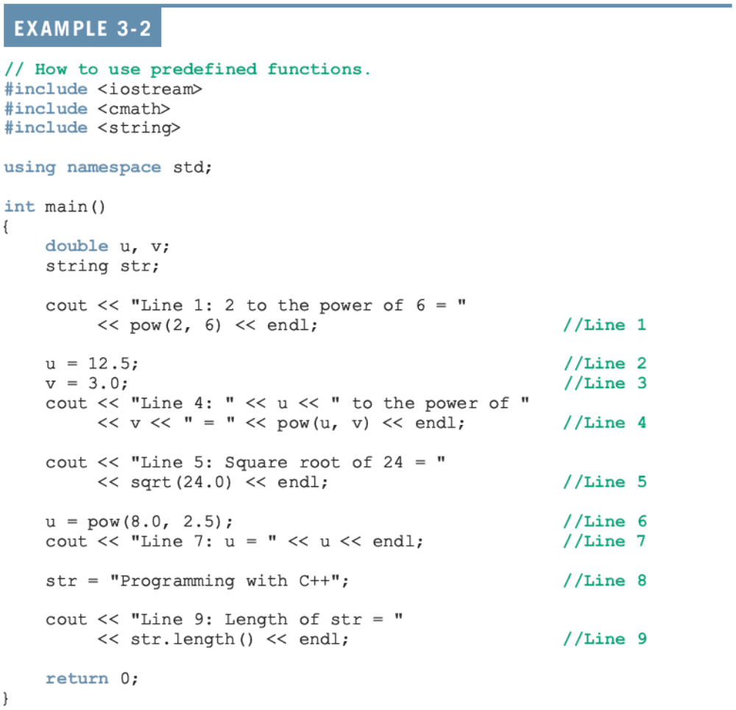

Slide 15
Using Predefined Functions in a Program (continued)
Sample Run:
  Line 1: 2 to the power of 6 = 64
  Line 4: 12.5 to the power of 3 = 1953.13
  Line 5: Square root of 24 = 4.89898
  Line 7: u = 181.019
  Line 9: Length of str = 20
C++ Programming: From Problem Analysis to Program Design

Slide 16
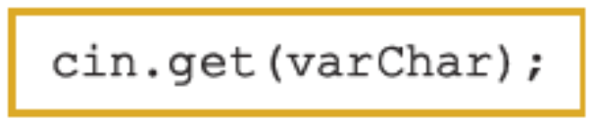
cin and the get Function
The get function
  Inputs next character (including whitespace)
  Stores in memory location indicated by its argument
The syntax of cin and the get function:
varChar
  Is a char variable
  Is the argument (parameter) of the function
C++ Programming: From Problem Analysis to Program Design

Slide 17
Summary
Stream: infinite sequence of characters from a source to a destination
Input stream: from a source to a computer
Output stream: from a computer to a destination
cin: common input
cout: common output
To use cin and cout, include iostream header
get reads data character-by-character
C++ Programming: From Problem Analysis to Program Design

