Slide 1
C++ Programming:
From Problem Analysis to Program Design
Chapter 5: Control Structures II (Repetition)

Slide 2
Objectives
In this chapter, you will:
Learn about repetition (looping) control structures
Explore how to construct and use count-controlled, sentinel-controlled, flag-controlled, and EOF-controlled repetition structures
Examine break and continue statements
Discover how to form and use nested control structures
C++ Programming: From Problem Analysis to Program Design

Slide 3
Why Is Repetition Needed?
Repetition allows you to efficiently use variables
Can input, add, and average multiple numbers using a limited number of variables
For example, to add five numbers:
  Declare a variable for each number, input the numbers and add the variables together
  Create a loop that reads a number into a variable and adds it to a variable that contains the sum of the numbers
C++ Programming: From Problem Analysis to Program Design

Slide 4
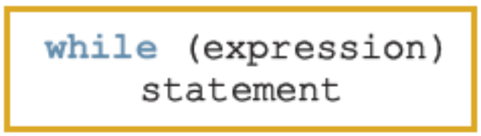
while Looping (Repetition) Structure
The general form of the while statement is:
while is a reserved word
Statement can be simple or compound
Expression acts as a decision maker and is usually a logical expression
Statement is called the body of the loop
The parentheses are part of the syntax
C++ Programming: From Problem Analysis to Program Design

Slide 5
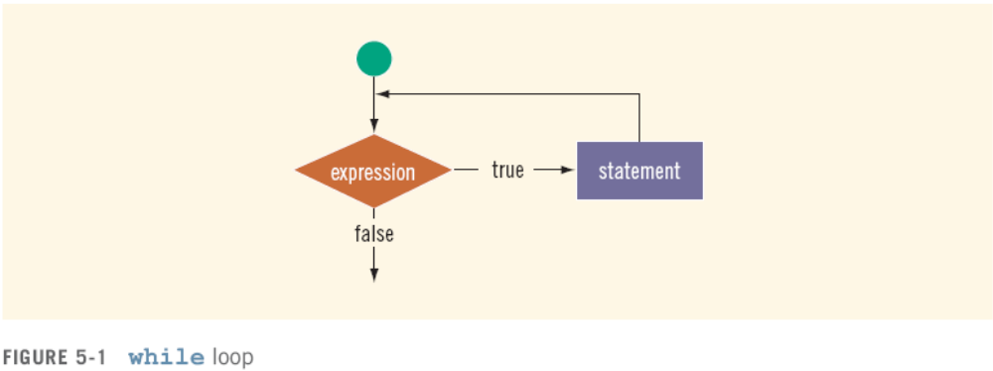
while Looping (Repetition) Structure (continued)
Infinite loop: continues to execute endlessly
  Avoided by including statements in loop body that assure exit condition is eventually false
C++ Programming: From Problem Analysis to Program Design

Slide 6
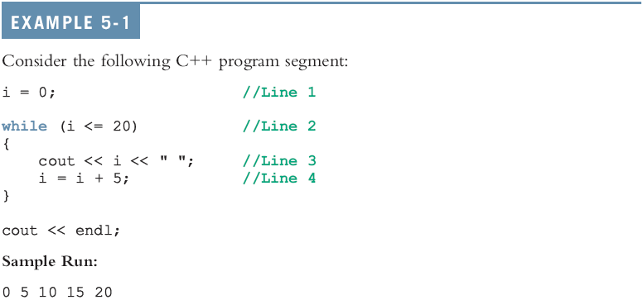
while Looping (Repetition) Structure (continued)
C++ Programming: From Problem Analysis to Program Design

Slide 7
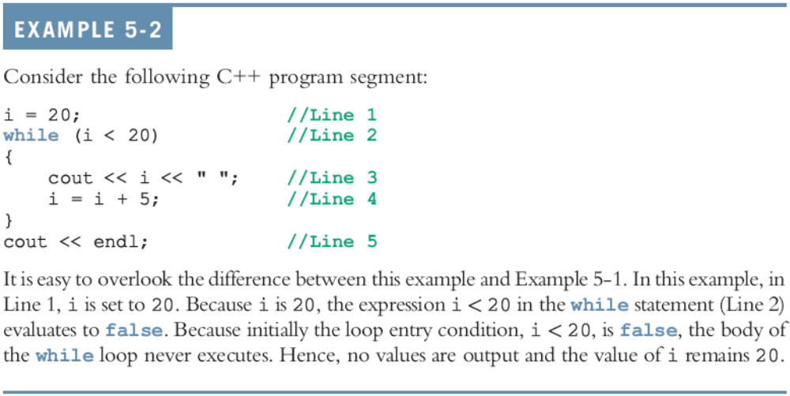
Designing while Loops
C++ Programming: From Problem Analysis to Program Design

Slide 8
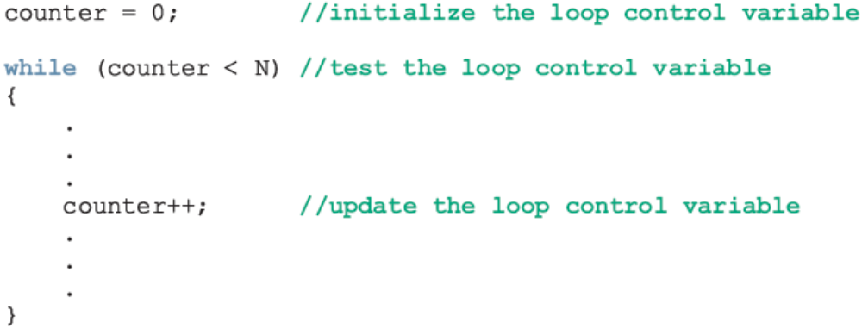
Case 1: Counter-Controlled while Loops
If you know exactly how many pieces of data need to be read, the while loop becomes a counter-controlled loop
C++ Programming: From Problem Analysis to Program Design

Slide 9
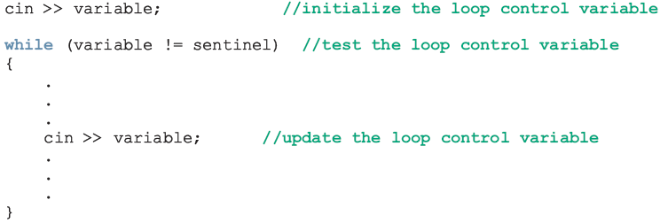
Case 2: Sentinel-Controlled while Loops
Sentinel variable is tested in the condition and loop ends when sentinel is encountered
C++ Programming: From Problem Analysis to Program Design

Slide 10
Telephone Digits
Example 5-5 provides an example of a sentinel-controlled loop
The program converts uppercase letters to their corresponding telephone digit
C++ Programming: From Problem Analysis to Program Design

Slide 11
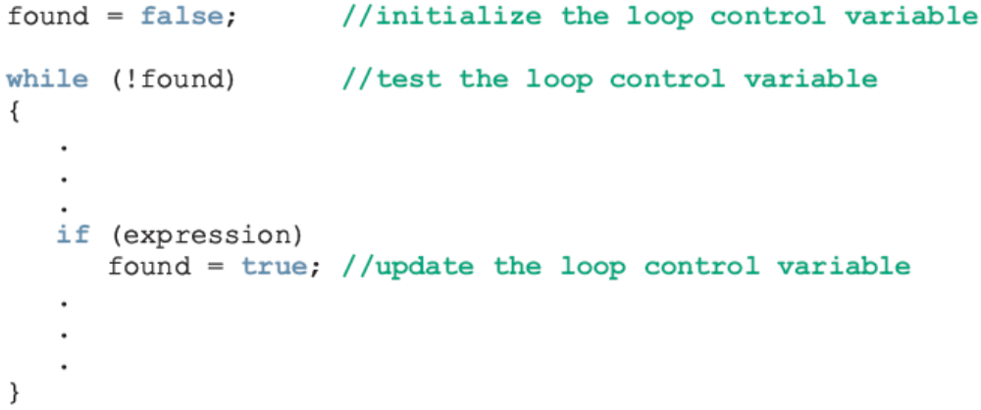
Case 3: Flag-Controlled while Loops
A flag-controlled while loop uses a bool variable to control the loop
The flag-controlled while loop takes the form:
C++ Programming: From Problem Analysis to Program Design

Slide 12
Number Guessing Game
Example 5-6 implements a number guessing game using a flag-controlled while loop
The program uses the function rand of the header file cstdlib to generate a random number
  rand() returns an int value between 0 and 32767
  To convert it to an integer greater than or equal to 0 and less than 100:
    rand() % 100
C++ Programming: From Problem Analysis to Program Design

Slide 13
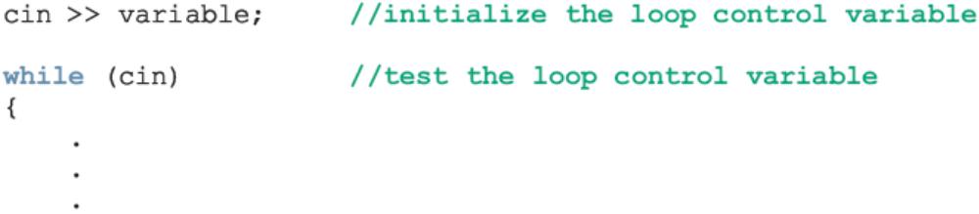
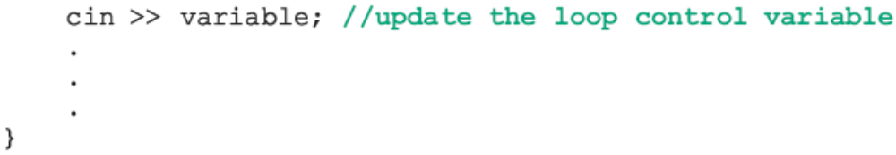
Case 4: EOF-Controlled while Loops
Use an EOF (End Of File)-controlled while loop
The logical value returned by cin can determine if the program has ended input
C++ Programming: From Problem Analysis to Program Design

Slide 14
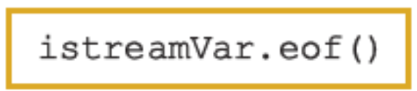
eof Function
The function eof can determine the end of file status
Like other I/O functions (get, ignore, peek), eof is a member of data type istream
The syntax for the function eof is:
where istreamVar is an input stream variable, such as cin
C++ Programming: From Problem Analysis to Program Design

Slide 15
More on Expressions in while Statements
The expression in a while statement can be complex
  For example:
    while ((noOfGuesses < 5) && (!isGuessed))
    {
      …
    }
C++ Programming: From Problem Analysis to Program Design

Slide 16
Programming Example: Checking Account Balance
A local bank in your town needs a program to calculate a customer’s checking account balance at the end of each month
Data are stored in a file in the following form:
467343 23750.40
W 250.00
D 1200
W 75.00
I 120.74
C++ Programming: From Problem Analysis to Program Design

Slide 17
Programming Example: Checking Account Balance (continued)
The first line of data shows the account number followed by the account balance at the beginning of the month
Thereafter each line has two entries:
  Transaction code
  Transaction amount
Transaction codes
  W or w means withdrawal
  D or d means deposit
  I or i means interest paid by the bank
C++ Programming: From Problem Analysis to Program Design

Slide 18
Programming Example: Checking Account Balance (continued)
Program updates balance after each transaction
During the month, if at any time the balance goes below $1000.00, a $25.00 service fee is charged
C++ Programming: From Problem Analysis to Program Design

Slide 19
Programming Example: Checking Account Balance (continued)
Program prints the following information:
  Account number
  Balance at the beginning of the month
  Balance at the end of the month
  Interest paid by the bank
  Total amount of deposit
  Number of deposits
  Total amount of withdrawal
  Number of withdrawals
  Service charge if any
C++ Programming: From Problem Analysis to Program Design

Slide 20
Programming Example: Input and Output
Input: file consisting of data in the previous format
Output is of the following form:
  Account Number: 467343
  Beginning Balance: $23750.40
  Ending Balance: $24611.49
  Interest Paid: $366.24
  Amount Deposited: $2230.50
  Number of Deposits: 3
  Amount Withdrawn: $1735.65
  Number of Withdrawals: 6
C++ Programming: From Problem Analysis to Program Design

Slide 21
Programming Example: Program Analysis
The first entry in the input file is the account number and the beginning balance
Program first reads account number and beginning balance
Thereafter, each entry in the file is of the following form:
  transactionCode transactionAmount
To determine account balance, process each entry that contains transaction code and transaction amount
C++ Programming: From Problem Analysis to Program Design

Slide 22
Programming Example: Program Analysis (continued)
Begin with starting balance and then update account balance after processing each entry
If transaction code is D, d, I, or i, transaction amount is added to the account balance
If the transaction code is W or w, transaction amount is subtracted from the balance
Keep separate counts of withdrawals and deposits
C++ Programming: From Problem Analysis to Program Design

Slide 23
Programming Example: Analysis Algorithm
Algorithm:
  Declare the variables
  Initialize the variables
  Get the account number and beginning balance
  Get transaction code and transaction amount
  Analyze transaction code and update the appropriate variables
  Repeat Steps 4 and 5 for all data
  Print the result
C++ Programming: From Problem Analysis to Program Design

Slide 24
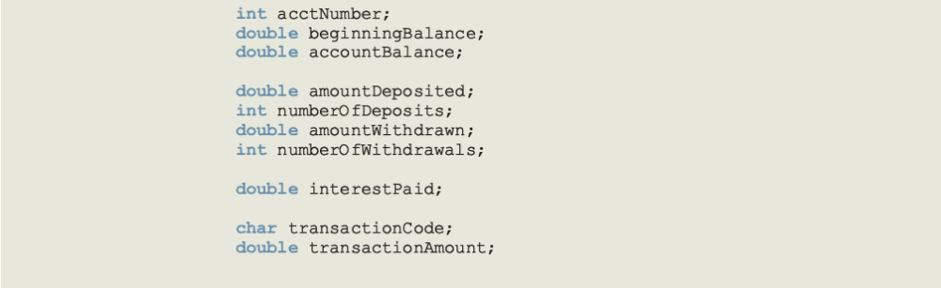
Programming Example: Variables and Constants
C++ Programming: From Problem Analysis to Program Design

Slide 25
Programming Example: Steps
Declare variables as discussed previously
Initialize variables
  isServiceCharged is initialized to false
  Read the beginning balance in the variable beginningBalance from the file and initialize the variable accountBalance to the value of the variable beginningBalance
  Since the data will be read from a file, you need to open input file
C++ Programming: From Problem Analysis to Program Design

Slide 26
Programming Example: Steps (continued)
Get account number and starting balance
infile >> acctNumber >> beginningBalance;
Get transaction code and transaction amount
infile >> transactionCode
>> transactionAmount;
Analyze transaction code and update appropriate variables
C++ Programming: From Problem Analysis to Program Design

Slide 27
Programming Example: Steps (continued)
Repeat Steps 4 and 5 until there is no more data
  Since the number of entries in the input file is not known, use an EOF-controlled while loop
Print the result
C++ Programming: From Problem Analysis to Program Design

Slide 28
Programming Example: Main Algorithm
Declare and initialize variables
Open input file
If input file does not exist, exit
Open output file
Output numbers in appropriate formats
Read accountNumber and beginningBalance
C++ Programming: From Problem Analysis to Program Design

Slide 29
Programming Example: Main Algorithm (continued)
Set accountBalance to beginningBalance
Read transactionCode and transactionAmount
while (not end of input file)
  if transactionCode is 'D' or 'd'
    Add transactionAmount to accountBalance
    Increment numberOfDeposits
  if transactionCode is 'I' or 'i'
    Add transactionAmount to accountBalance
    Add transactionAmount to interestPaid
C++ Programming: From Problem Analysis to Program Design

Slide 30
Programming Example: Main Algorithm (continued)
  if transactionCode is 'W' or 'w'
    Subtract transactionAmount from accountBalance
    Increment numberOfWithdrawals
    if (accountBalance < MINIMUM_BALANCE
    && !isServicedCharged)
      Subtract SERVICE_CHARGE from accountBalance
      Set isServiceCharged to true
  if transactionCode is other than 'D', 'd', 'I', 'i', 'W', or 'w', output an error message
Output the results
C++ Programming: From Problem Analysis to Program Design

Slide 31
for Looping (Repetition) Structure
The general form of the for statement is:
The initial statement, loop condition, and update statement are called for loop control statements
  initial statement usually initializes a variable (called the for loop control, or for indexed, variable)
In C++, for is a reserved word
C++ Programming: From Problem Analysis to Program Design

Slide 32
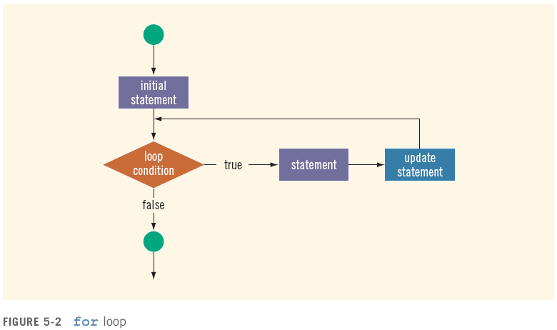
for Looping (Repetition) Structure (continued)
C++ Programming: From Problem Analysis to Program Design

Slide 33
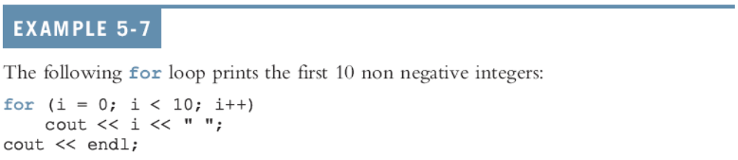
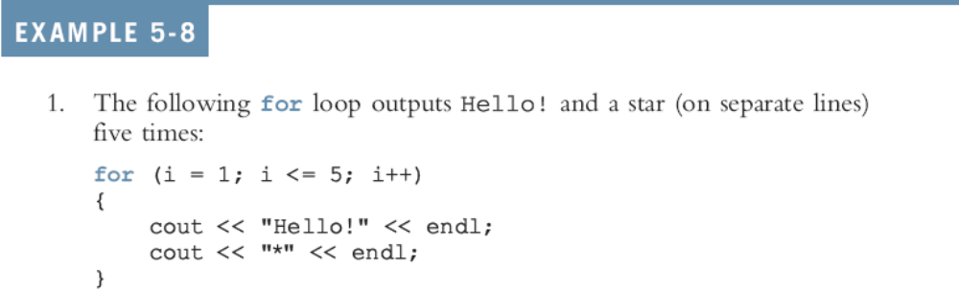
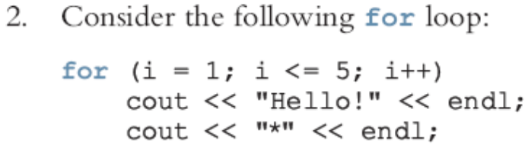
for Looping (Repetition) Structure (continued)
C++ Programming: From Problem Analysis to Program Design

Slide 34
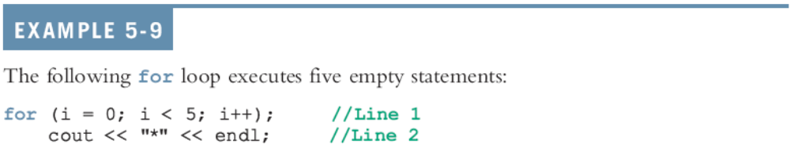
for Looping (Repetition) Structure (continued)
C++ allows you to use fractional values for loop control variables of the double type
  Results may differ
The following is a semantic error:
The following is a legal for loop:
  for (;;)
  cout << "Hello" << endl;
C++ Programming: From Problem Analysis to Program Design

Slide 35
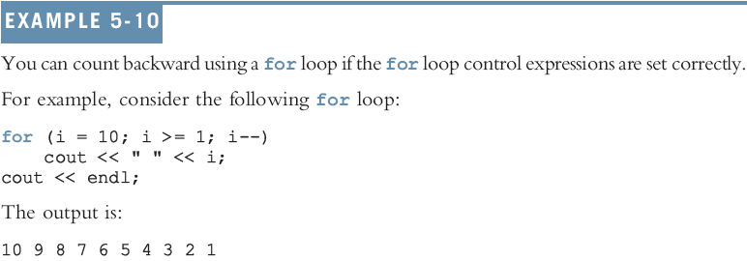
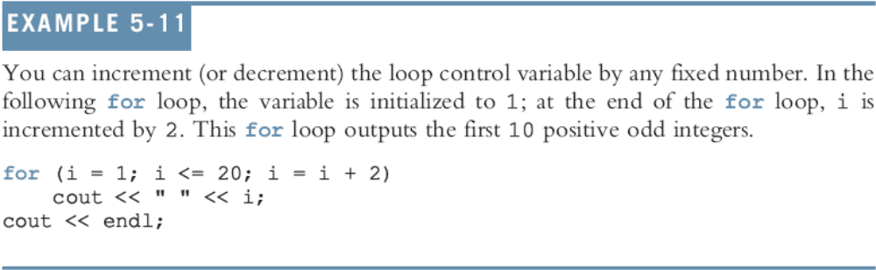
for Looping (Repetition) Structure (continued)
C++ Programming: From Problem Analysis to Program Design

Slide 36

do…while Looping (Repetition) Structure
General form of a do...while:
The statement executes first, and then the expression is evaluated
To avoid an infinite loop, body must contain a statement that makes the expression false
The statement can be simple or compound
Loop always iterates at least once
C++ Programming: From Problem Analysis to Program Design

Slide 37
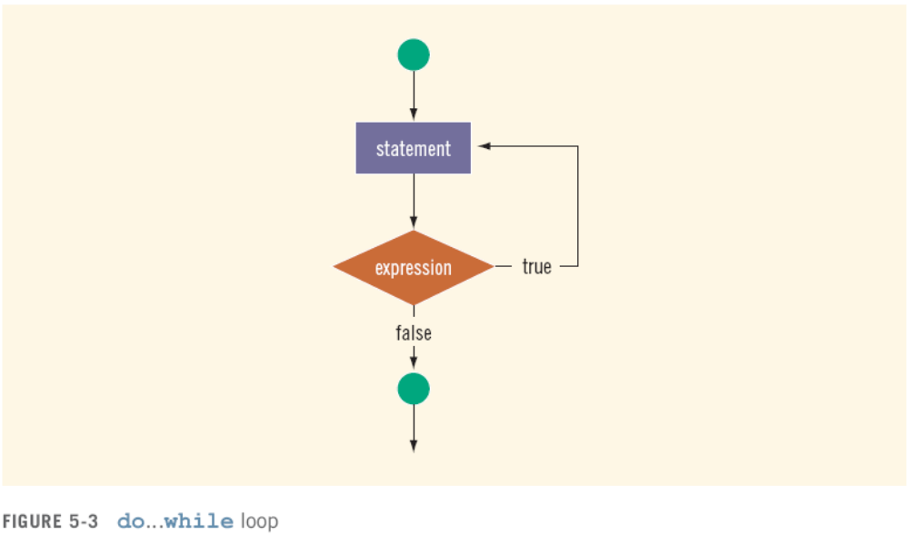
do…while Looping (Repetition) Structure (continued)
C++ Programming: From Problem Analysis to Program Design

Slide 38
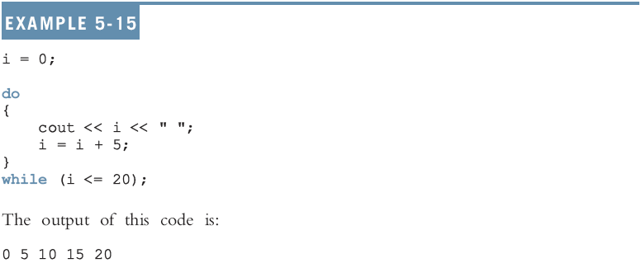
do…while Looping (Repetition) Structure (continued)
C++ Programming: From Problem Analysis to Program Design

Slide 39
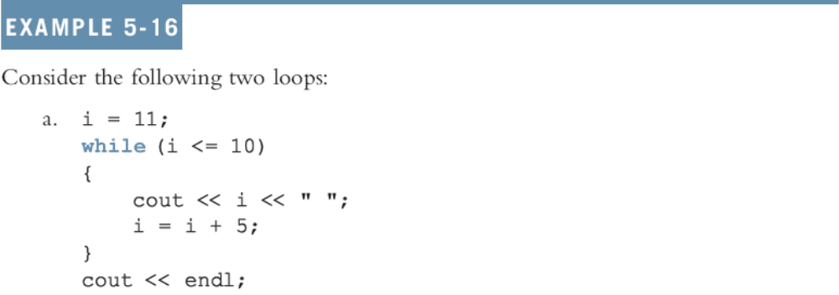
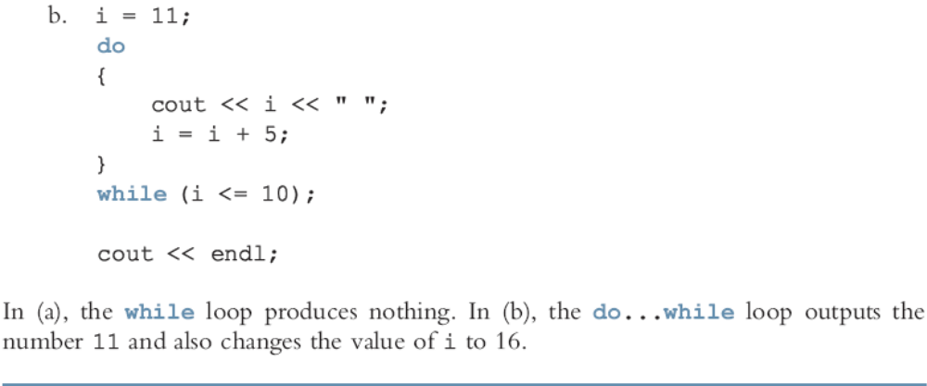

Slide 40
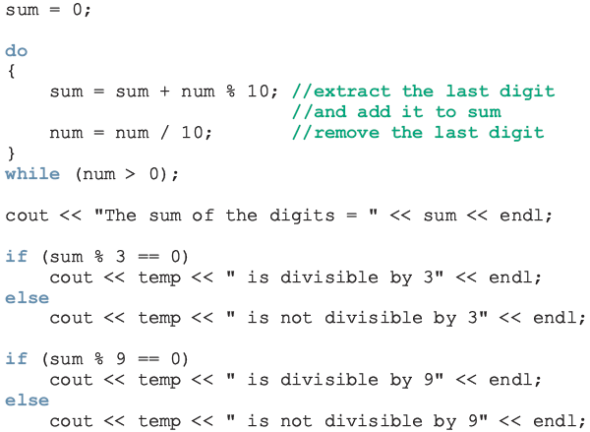
Divisibility Test by 3 and 9
C++ Programming: From Problem Analysis to Program Design

Slide 41
Choosing the Right Looping Structure
All three loops have their place in C++
  If you know or can determine in advance the number of repetitions needed, the for loop is the correct choice
  If you do not know and cannot determine in advance the number of repetitions needed, and it could be zero, use a while loop
  If you do not know and cannot determine in advance the number of repetitions needed, and it is at least one, use a do...while loop
C++ Programming: From Problem Analysis to Program Design

Slide 42
break and continue Statements
break and continue alter the flow of control
break statement is used for two purposes:
  To exit early from a loop
    Can eliminate the use of certain (flag) variables
  To skip the remainder of the switch structure
After the break statement executes, the program continues with the first statement after the structure
C++ Programming: From Problem Analysis to Program Design

Slide 43
break & continue Statements (continued)
continue is used in while, for, and do…while structures
When executed in a loop
  It skips remaining statements and proceeds with the next iteration of the loop
C++ Programming: From Problem Analysis to Program Design

Slide 44
Nested Control Structures
To create the following pattern:
*
**
***
****
*****
We can use the following code:
for (i = 1; i <= 5 ; i++)
{
for (j = 1; j <= i; j++)
cout << "*";
cout << endl;
}
C++ Programming: From Problem Analysis to Program Design

Slide 45
Nested Control Structures (continued)
What is the result if we replace the first for statement with the following?
for (i = 5; i >= 1; i--)
Answer:
*****
****
***
**
*
C++ Programming: From Problem Analysis to Program Design

Slide 46
Summary
C++ has three looping (repetition) structures:
  while, for, and do…while
while, for, and do are reserved words
while and for loops are called pretest loops
do...while loop is called a posttest loop
while and for may not execute at all, but do...while always executes at least once
C++ Programming: From Problem Analysis to Program Design

Slide 47
Summary (continued)
while: expression is the decision maker, and the statement is the body of the loop
A while loop can be:
  Counter-controlled
  Sentinel-controlled
  EOF-controlled
In the Windows console environment, the end-of-file marker is entered using Ctrl+z
C++ Programming: From Problem Analysis to Program Design

Slide 48
Summary (continued)
for loop: simplifies the writing of a counter-controlled while loop
  Putting a semicolon at the end of the for loop is a semantic error
Executing a break statement in the body of a loop immediately terminates the loop
Executing a continue statement in the body of a loop skips to the next iteration
C++ Programming: From Problem Analysis to Program Design

