Slide 1
Personal Portfolio Web Application
Assignment 4 — Final Delivery Moath Mahmoud Haimour | April 2026 King Fahd University of Petroleum & Minerals

Slide 2
Incremental Development Journey
Assignment 1 — Foundation
Assignment 2 — Interactivity
Assignment 3 — Dynamic Data
Assignment 4 — Final Polish
Established basic HTML5 semantic structure and core CSS styling.
Integrated Vanilla JavaScript for theme toggling and mobile navigation.
Implemented Fetch API for live GitHub repositories and Quotable API.
Added advanced filtering, ARIA accessibility, and security hardening.

Slide 3
Defining the Purpose: Why This Project Exists
Professional Identity
Real-World Showcase
Continuous Learning
A centralized, production-ready link to prove full-stack capabilities to recruiters and industry peers.
Replaces generic placeholders with 5 actual projects built using ASP.NET Core, React, and Azure.
A sandbox for mastering API integration, CSS animations, and web security standards.

Slide 4
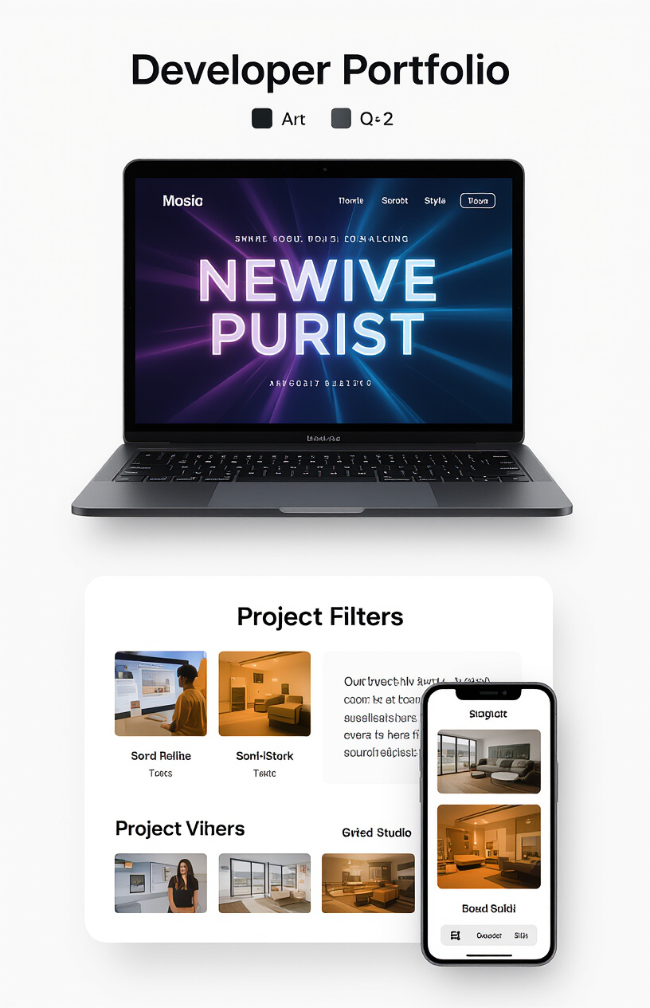
Core Features and Interaction Capabilities
🌙 Theme Management — Dark/Light mode toggle with state persisted in localStorage.
⌨️ Dynamic Hero — Recursive typing animation cycling through professional developer roles.
🔍 Smart Filters — Combined search, category, and difficulty filters for project discovery.
📊 Live Integration — Real-time data fetching from GitHub REST API and Quotable API.
📱 Responsive Design — Mobile-first approach with a custom hamburger navigation system.

Slide 5
The Three-Layer Technical Architecture
Semantic index.html utilizing sections for nav, hero, and projects. Includes ARIA roles and labels to ensure full web accessibility.
Modular styles.css powered by CSS Custom Properties (variables), Flexbox/Grid layouts, and custom keyframe animations.
Core script.js managing the Fetch API calls, compound filter engine, and asynchronous UI state updates.

Slide 6
AI as a Collaborator: Humans vs. Tools
GitHub Copilot
Claude (Anthropic)
Human Oversight
Generated animation skeletons and sort patterns which were then refactored for recursive logic and custom delays.
Provided accessibility audits and explained complex CSS patterns like the pseudo-element timeline implementation.
Critical Review: Rejected unsafe innerHTML suggestions to prevent XSS risks, opting for textContent instead.

Slide 7
Resolving Complex Technical Challenges
Typing Animation Flicker Problem: setInterval caused cursor stuttering. Solution: Switched to recursive setTimeout with variable delays for typing, deleting, and pausing phases.
XSS Security Risks Problem: AI suggested using innerHTML for untrusted API data. Solution: Rewrote rendering logic using createElement and textContent with URL validation.
Compound Filter State Problem: Independent filters resetting each other. Solution: Created a unified filter engine that reads the state of all controls simultaneously.

Slide 8
Future Engineering Roadmap and Scalability
Pending Features
Infrastructure Upgrades
Email Delivery: Integration with EmailJS for functional contact forms.
PWA Support: Adding service workers for offline capabilities.
Skill Bars: Animated progress indicators with percentage labels.
Headless CMS: Integrating Contentful for dynamic project management.
CI/CD Pipeline: Automating deployments via GitHub Actions.
Lighthouse: Targeting a 95+ performance score.

Slide 9
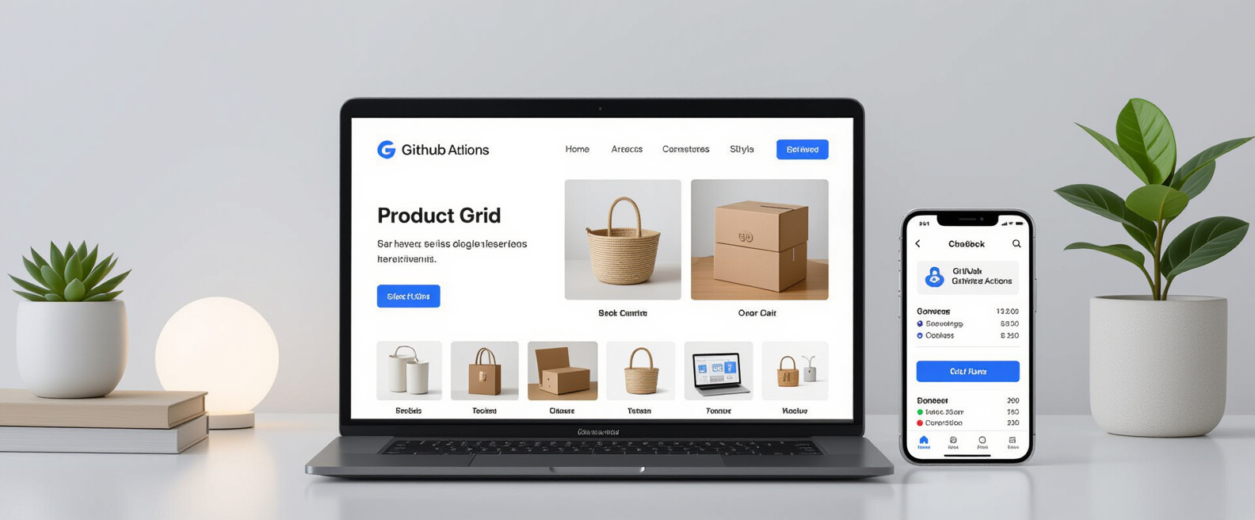
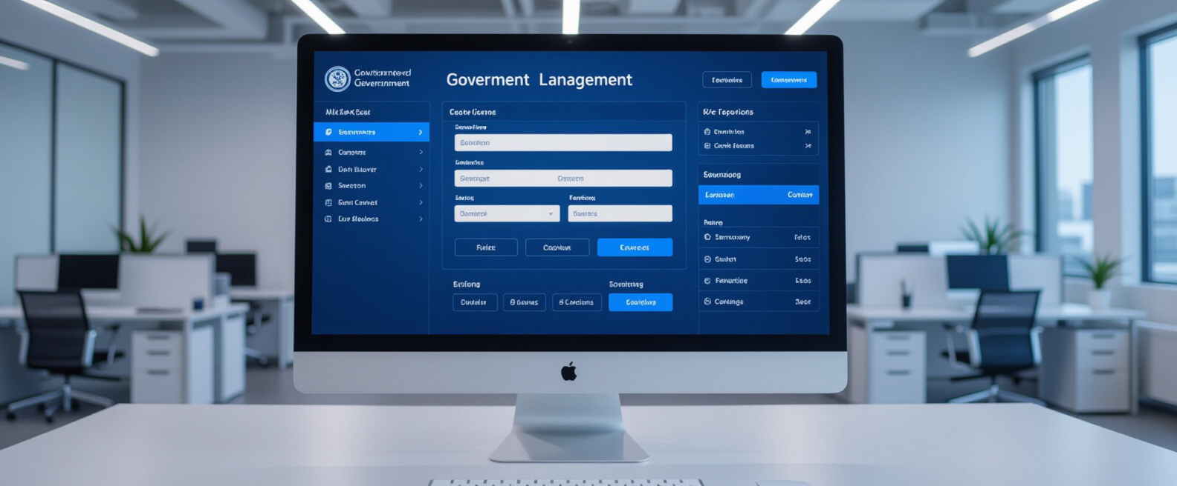
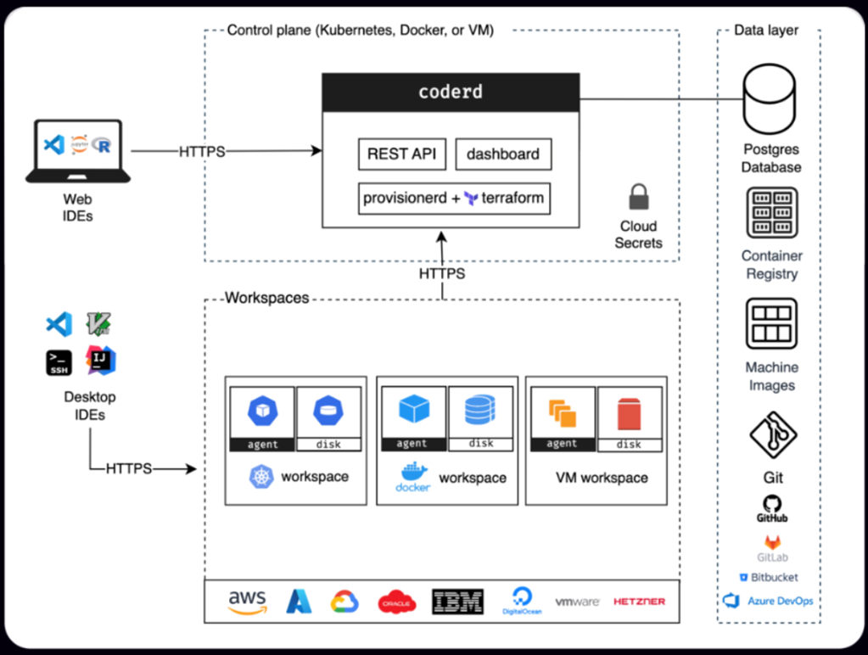
Major Project Portfolio Showcase
Driving License System
E-Commerce Platform
SoccerPro API
Full-stack management app built with ASP.NET Core, React, and SQL Server deployed on Azure.
Modern storefront featuring Stripe integration, React frontend, and GitHub Actions CI/CD.
High-performance tournament API using .NET 9, Docker containers, and Bicep IaC.

Slide 10
Professional Engineering Standards and Security
Security-First
Filter Engine
Full Accessibility
Strict DOM rendering protocols. All external data is sanitized, and URLs are validated before assignment.
A pure function approach to state management, ensuring no race conditions or UI desynchronization.
Adherence to ARIA standards, keyboard-navigable forms, and high-contrast focus rings for all users.

Slide 11
Software Engineering Lessons and Insights
Iterative Development
Building across four distinct assignments proved more effective than attempting a "big bang" release.
AI Literacy
Learned that AI is a starting point, not an endpoint; every line of code must be understood and owned.
Design Systems
Discovered that CSS Variables make features like Dark Mode almost trivial to implement if planned early.

Slide 12
Final Portfolio Delivery and Achievements
Project Achievements
✅ Fully Responsive & Cross-browser
✅ Live API Integration
✅ XSS-Safe Production Logic
✅ ARIA Accessible Design
✅ Complete Documentation
Connect & Explore
Live Demo: [GitHub Pages URL]
Source Code: github.com/MoathEssa
Email: moath.mahmoud.haimour@gmail.com
University: KFUPM
Thank you — Questions?

