Slide 1
Mobile Robotics Hackathon 2026 · TU Dresden
LandMate
A mobile landing pad for drones
"We built a ground robot that watches the sky, predicts where a drone will land,
and drives there before it hits the floor."
Clutch Robotics
1 / 7

Slide 2
Drones fall.
Nobody is ready.
Saturday 11:00 — WHERE WE STARTED
Sunday 17:00 — THE QUESTION WE ASKED
An ANT1 ground robot that drives on command.
A Crazyfile drone that hovers.
Zero connection between them.
When the drone descends → nobody knows where it will land.
Can a ground robot...
SEE the drone from below,
PREDICT its landing point in real time,
INTERCEPT it before it hits the floor?
→
2 / 7

Slide 3
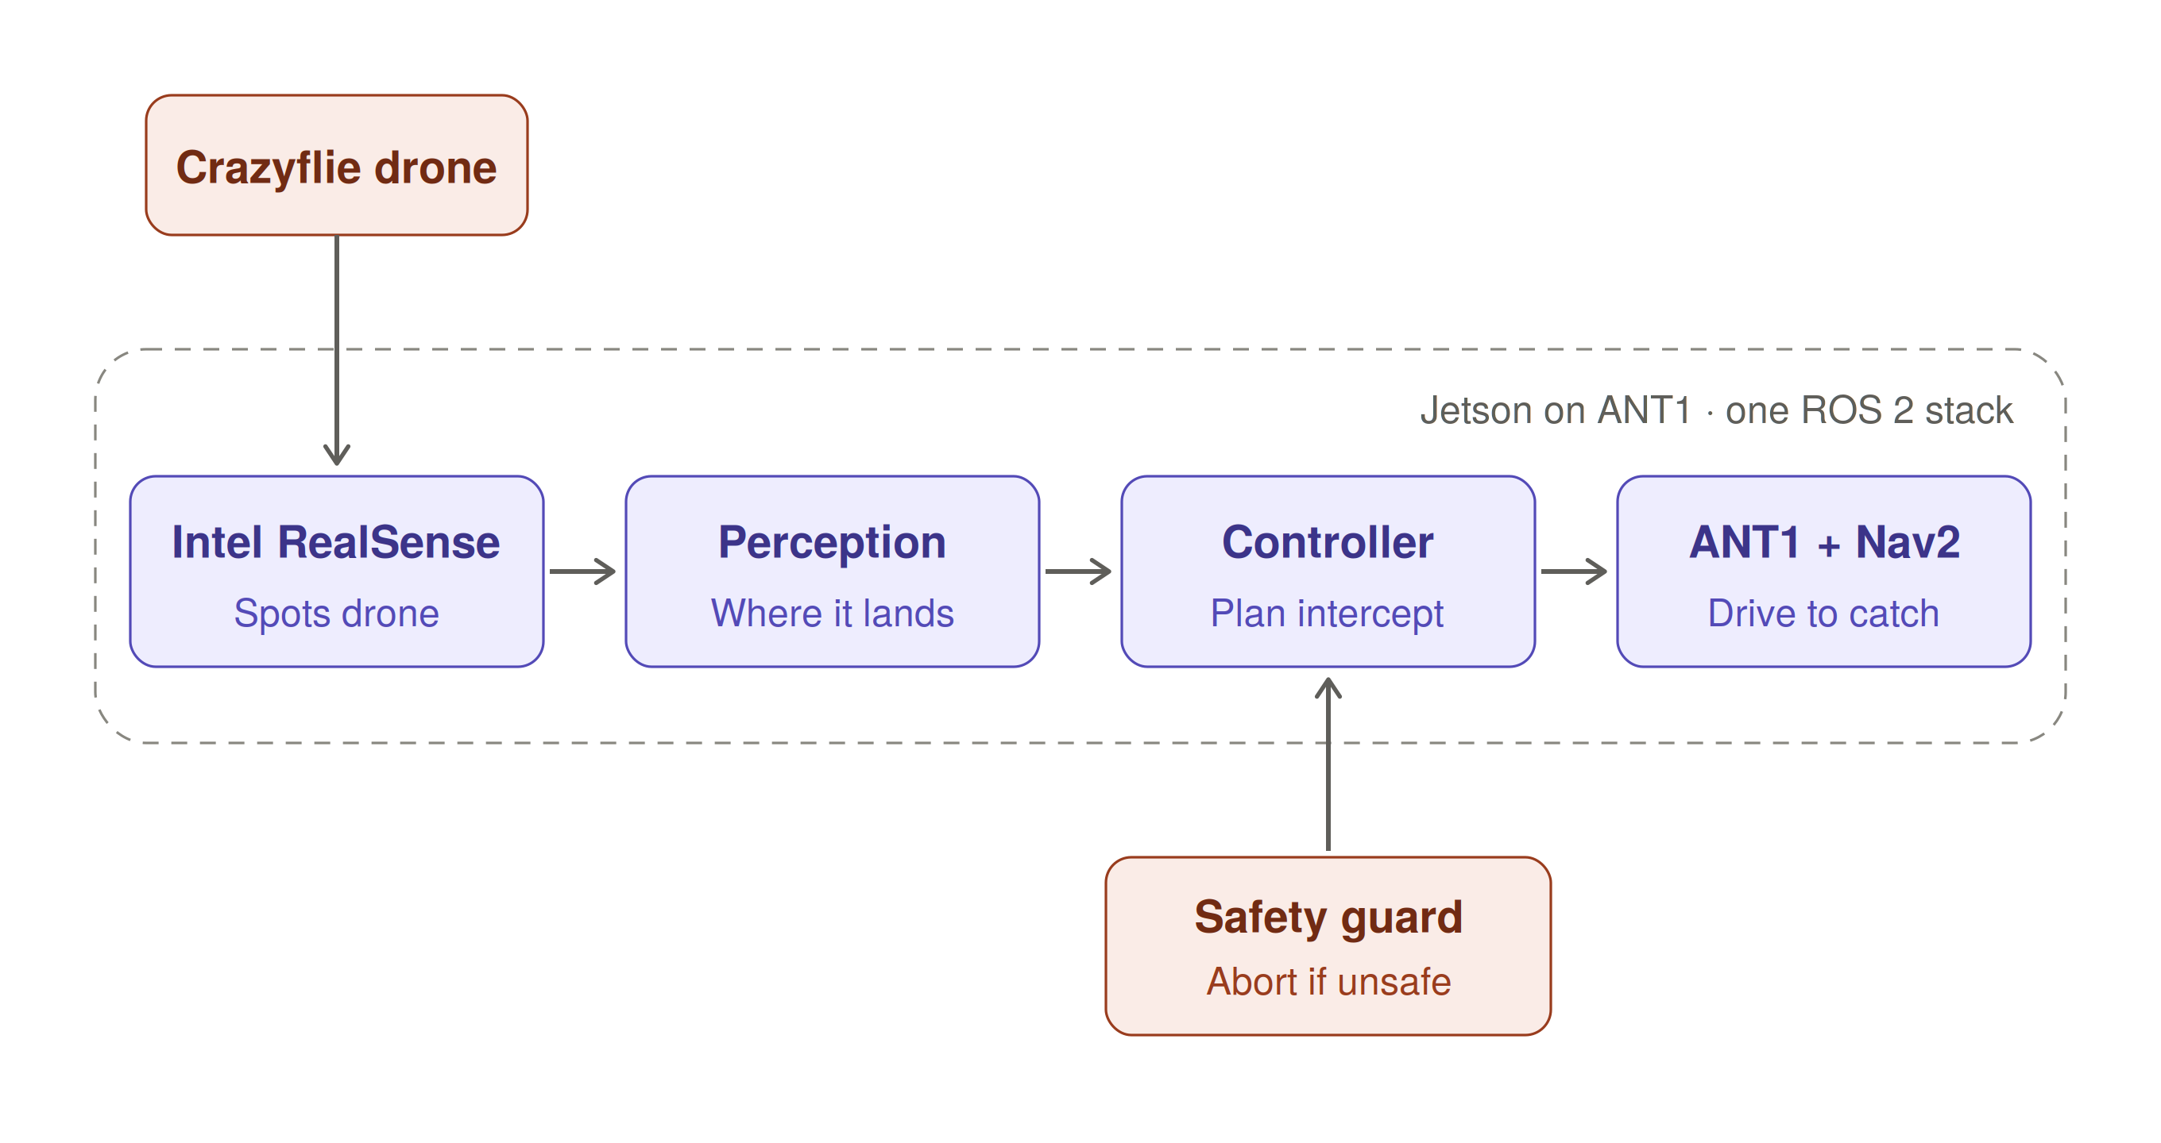
Approach
3 / 7

Slide 4
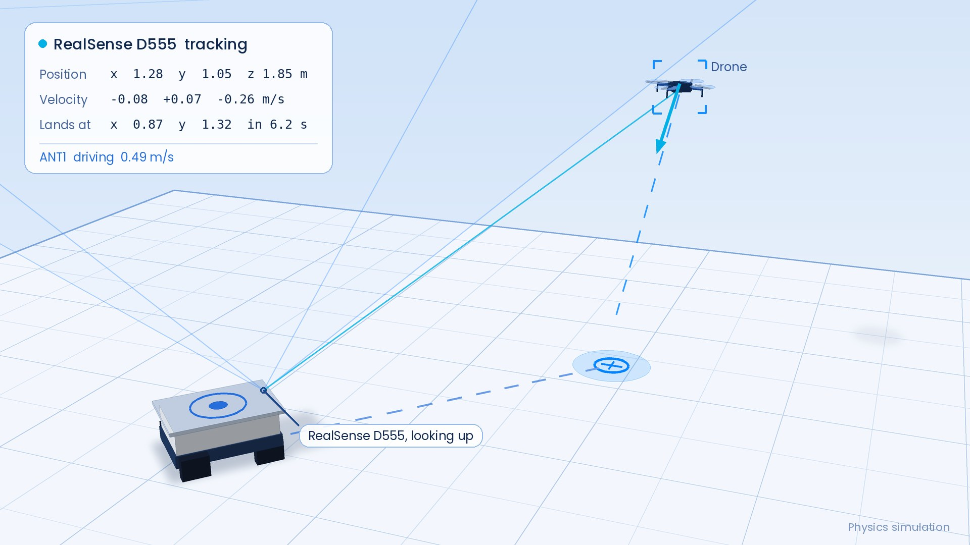
How LandMate catches a drone
4 / 7

Slide 5
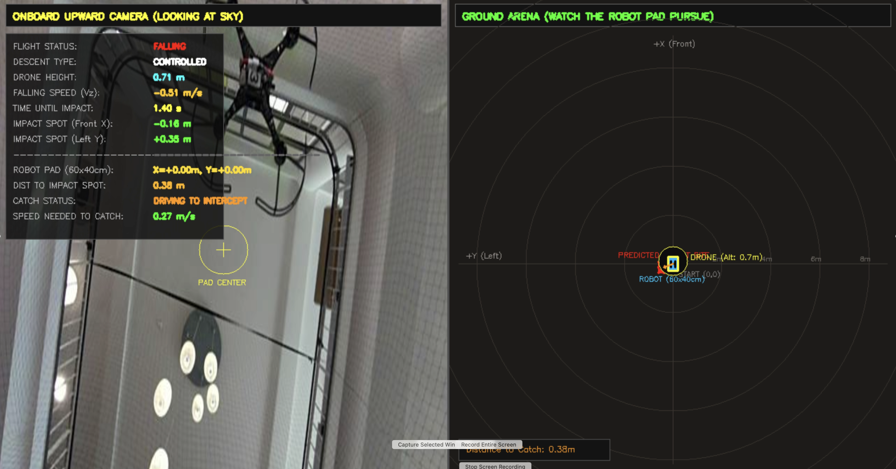
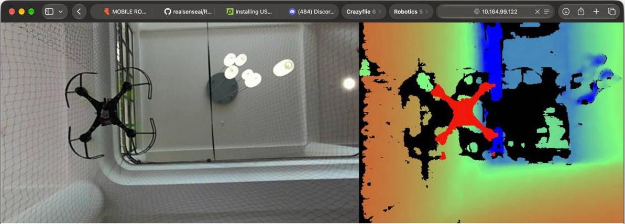
What runs right now
8 / 10
<300ms
interception success — 5 sim scenarios
detect-to-predict
latency per frame
5 / 7
Notes:
→ Detects the drone in a sky-facing camera frame
→ Estimates altitude and velocity from a single camera (no depth sensor needed)
→ Predicts where the drone will land and in how many seconds
→ Drives to the intercept point — stops when the 60×40 cm pad is centred under the drone
→ Aborts if the ANT can't reach the spot in time (reachability gate)

Slide 6
Our biggest challenge and next step
The hard part
Next step
1
The challenge
Scaling to handle multiple drones and coordination between multiple ground robots.
Varying drone positions.
2
First attempt
We removed unreliable detections, but the estimated position still jumped.
3
What improved it
A Kalman filter smoothed the motion estimate, making the predicted landing point more stable.
4
What we learned
Reliable landing predictions need stable tracking first.
6 / 7

Slide 7

Thanks, from ClutchRobotics!!!
7 / 7

Slide 8
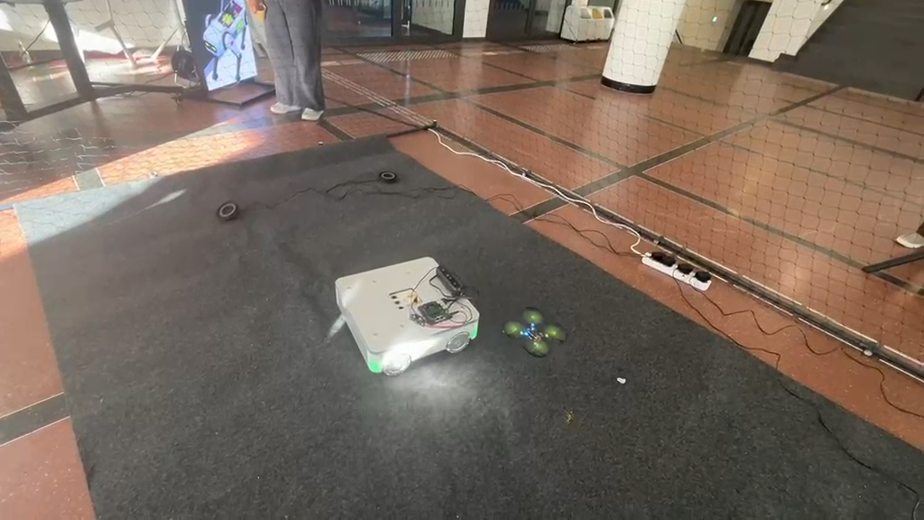
Appendix: Video Demo

Slide 9
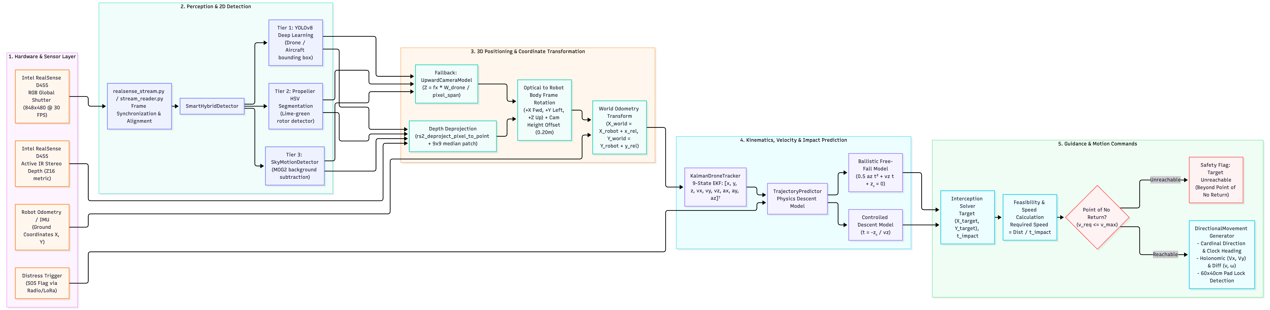
Appendix: Architecture

Slide 10
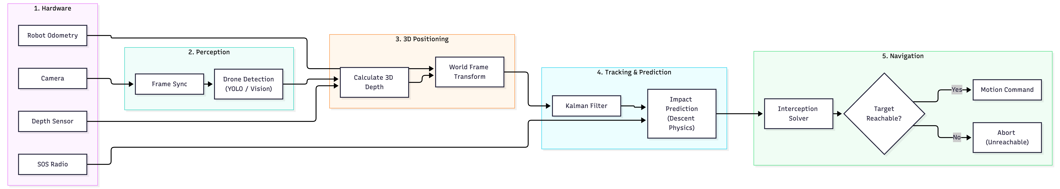
Appendix: Architecture

