Slide 1
School Meal Reimbursement
DOE and MODA
Oct 4, 2017

Slide 2
Existing vs New Schools to CEP
Existing Schools
927 schools (+4 with 0 enrollment)
310 k students
New Schools
1453 schools (+34 with 0 enrollment)
727 k students
Total
2380 schools (+38 with 0 enrollment)
1.037 million students

Slide 3
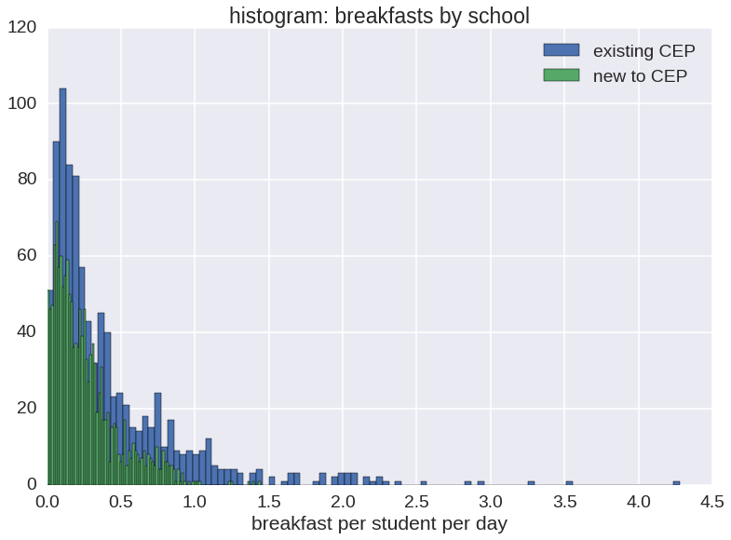
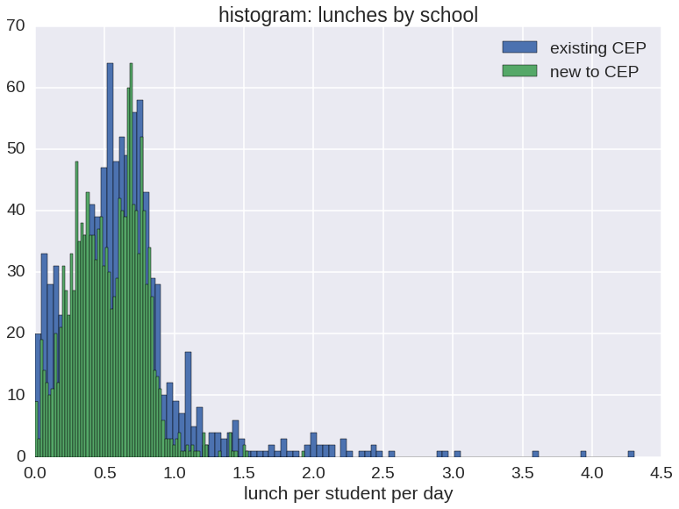
Projected meals per student
Avg meals per student: | Breakfasts | Lunches
Existing schools | .43 | .64
New schools | .26 | .52
 | 60% | 81%

Slide 4
Optimization Method
Tried 2 Monte Carlo approaches: stochastic hill climbing and simulated annealing algorithms
Random start – group schools randomly
Take a step - choose one school randomly and move it to a different group
If the step improves the result keep it
If the step makes things worse
(stochastic hill climbing) discard it
(stimulated annealing) mostly discard, but sometimes keep
Loop back to 2 until convergence

Slide 5
Simulated Annealing
Simulated annealing was a bit better than stochastic hill climbing
Did hundreds of runs at once and chose the best (highest reimbursement)

Slide 6
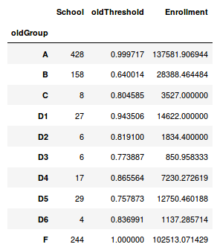
Existing Groups – Schools already in CEP
Which groups to keep? Which to regroup?
10 groups = 10^2 combinations (1024)
Small groups get washed out in the comparison
Groups C, D1-6 have less than 100 schools total (and less than 5% of student population)

Slide 7
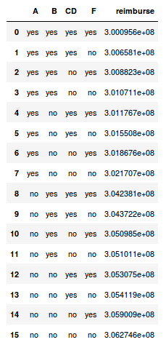
Regroup?
Combining groups C+D’s leaves a total of 4 groups
More manageable: 2^4 = 16 combinations
Tried all combinations (took a day or more to run through all combinations)
Best result – keep all old groupings

Slide 8
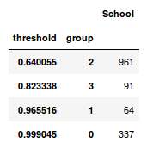
What we sent over
“Test Data for CEP Groupings MODA.xlsx”
Ran simulated annealing algorithm on schools new to CEP, took the best of 5000 runs.
4 groups (labeled 0,1,2,3)
Added in schools with 0 enrollment to highest threshold group (group 0)
Final reimbursement (new schools): $226.5 million
$11.7 million more than grouping everyone together.
number
of
schools

Slide 9
Next Steps?

Slide 10
Presentations
PyData conference in Nov
https://pydata.org/nyc2017/
We were selected to present based on this project!
Opportunity to showcase algorithm to data science community
MODA project library
New repository for data science projects where other departments and other cities can learn

