Slide 1

Medical Diagnosis System
Disease Diagnosis - Deep Learning Project

Slide 2
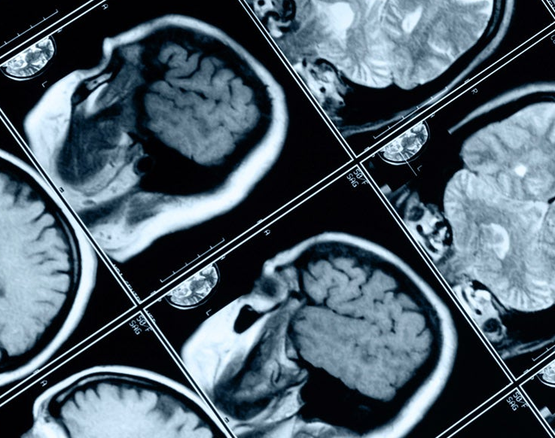
Introduction
Context and Description

Slide 3
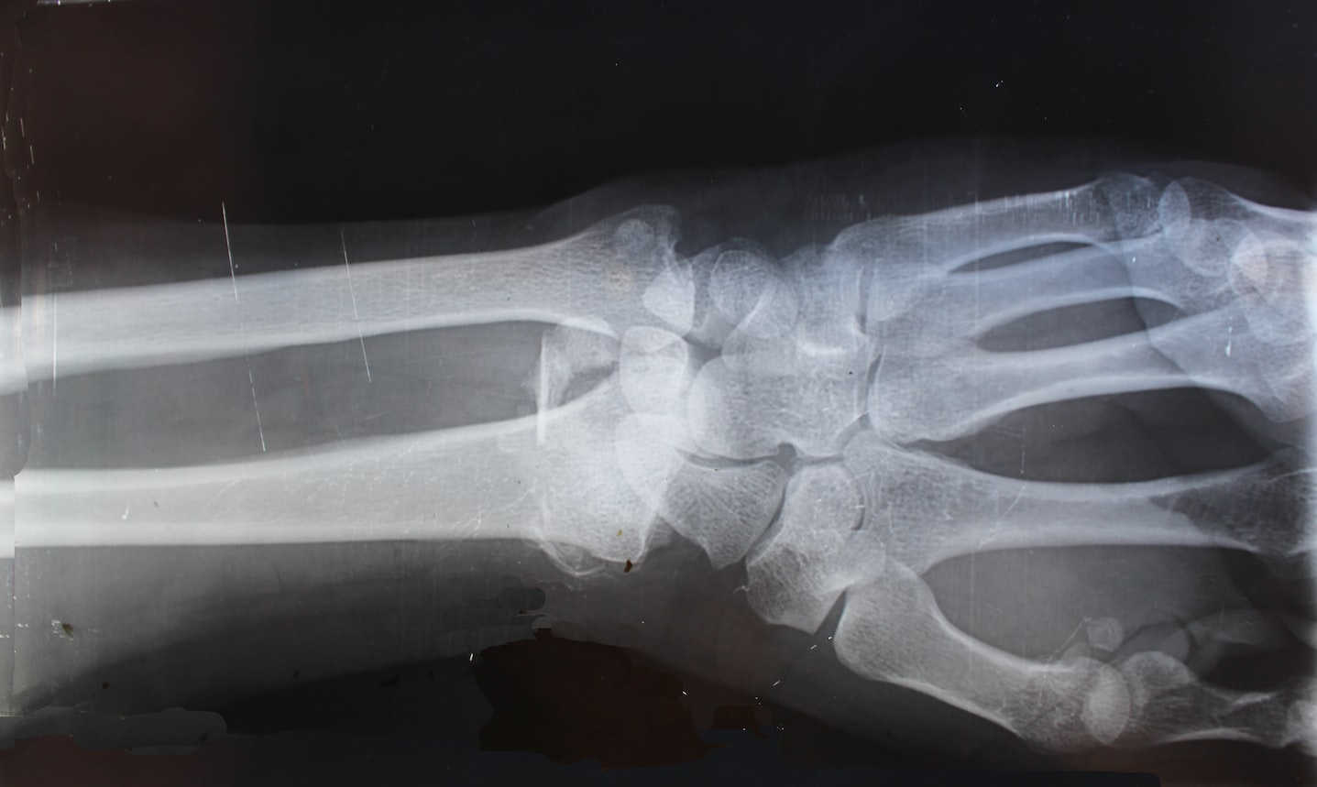
Problem Description
People usually avoid going to the doctor for symptoms they have
Might indicate serious disease
They take simple medicines, but this is only a temporary solution
Medical experts might take some time to diagnose the patient
Even after taking medical examinations
To help provide people with more quick diagnoses of the disease, we built a Deep learning model that can diagnose patients through fed medical images.
Powerful tool, automated process

Slide 4
Problem Type
Image Multi-Classification
Image Recognition
Specifically, the model attempts to diagnose the patient by what disease he has through processing medical images of chest ray images.
We’re going to build a Deep Learning model
With Pytorch Framework
Why PyTorch?
As popular as TensorFlow/karas, but more flexible and computationally efficient.
Same structure as traditional programming, with easier debugging.
Many state-of-the-art models and specialized frameworks are built with PyTorch.

Slide 5
Data
Description, Categories, Data Volume

Slide 6
Dataset
Train Data
1196 Images, each one is labeled
295 covid, 468 normal, 433 virus
Test Data
513 Images, unlabeled
Not much data, so we apply Image augmentation
Up to 8x expansion of data

Slide 7
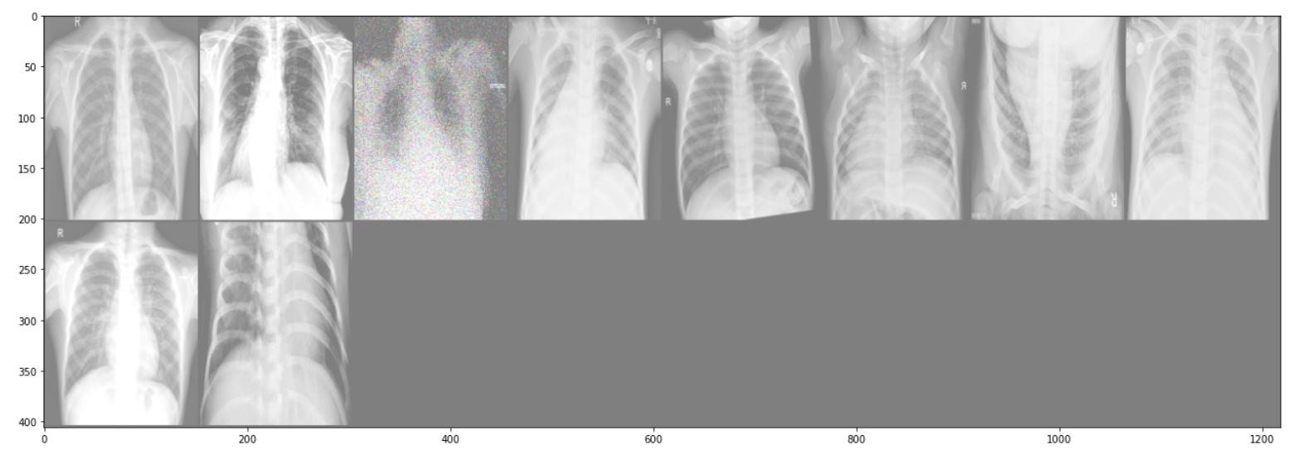
Image Augmentation
Some of the techniques applied are:
Horizontal/Vertical Flip, Rotation
Grayscale, Blur/Noise
Brightness and Contrast

Slide 8
Models
Model Building, Training, and Validation

Slide 9
Models Built
Baseline Model
Simple Model with few number of layers
Using common optimizer and loss (SGD, Cross Entropy)
general test accuracy across different experiments: 89% - 93%
Model v2
Model with bigger, more complex architecture
log_softmax loss, Adam optimizer, with learning rate decay (better results)
General test accuracy across different experiments: 91% - 96%
Vgg16
Transfer Learning with pretrained model
One of the best computer vision models
able to classify 1000 images of 1000 different categories with high accuracy
General test accuracy across different experiments: 96% - 99%

Slide 10
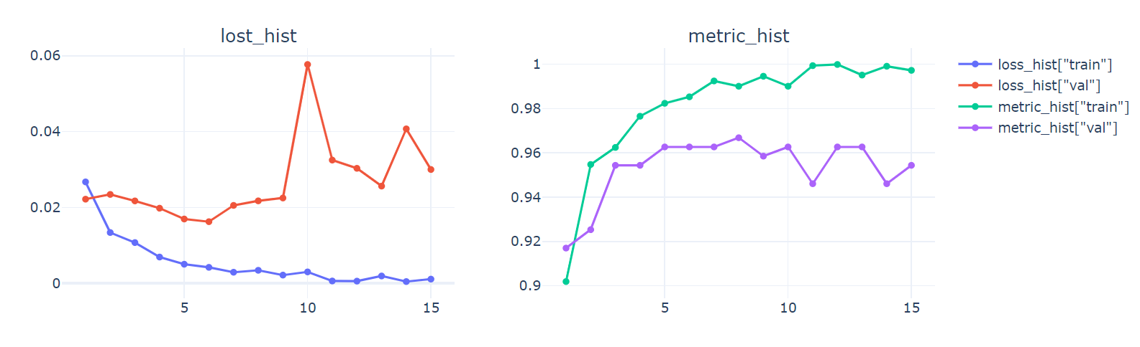
Vgg16 Training

Slide 11
Evaluation
Results and Assessment

Slide 12
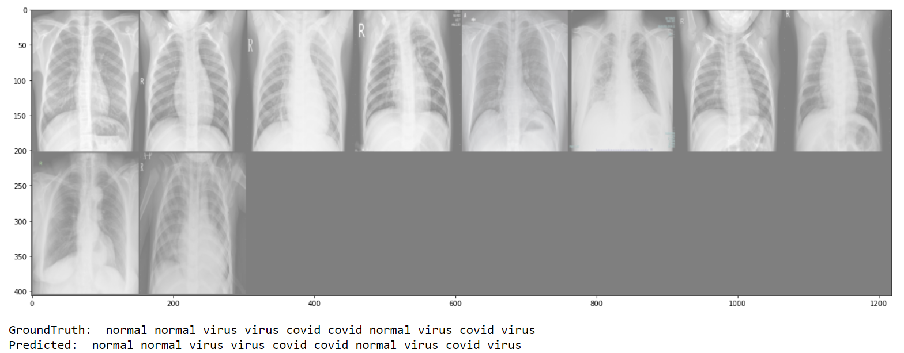
Test on data sample

Slide 13
Experimentation Results
Vgg16 Model Provided the best results
99% Accuracy on test data

Slide 14
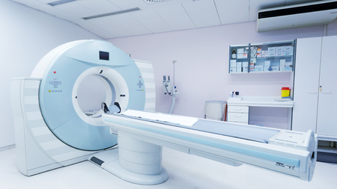
The End
Thank You

