Slide 1
Spoken Dialog System

Slide 2
What is it?
interfaces that enable humans to communicate with machines naturally and efficiently using a conversational paradigm
Microsoft’s Cortana, Apple’s Siri, Amazon Alexa
widely used mainly in telephone-based information and transaction services
divided into two types — Task Oriented and Non-Task Oriented.
The advance of deep learning technologies has recently risen the applications of neural models to dialogue modeling
Notes:
Task oriented systems are built for specialized use cases such as a banking app using which a user can withdraw or deposit money. Non-Task Oriented Dialogue Systems are built for a general use case, and form a majority of Dialogue Systems including Siri, Alexa

Slide 3
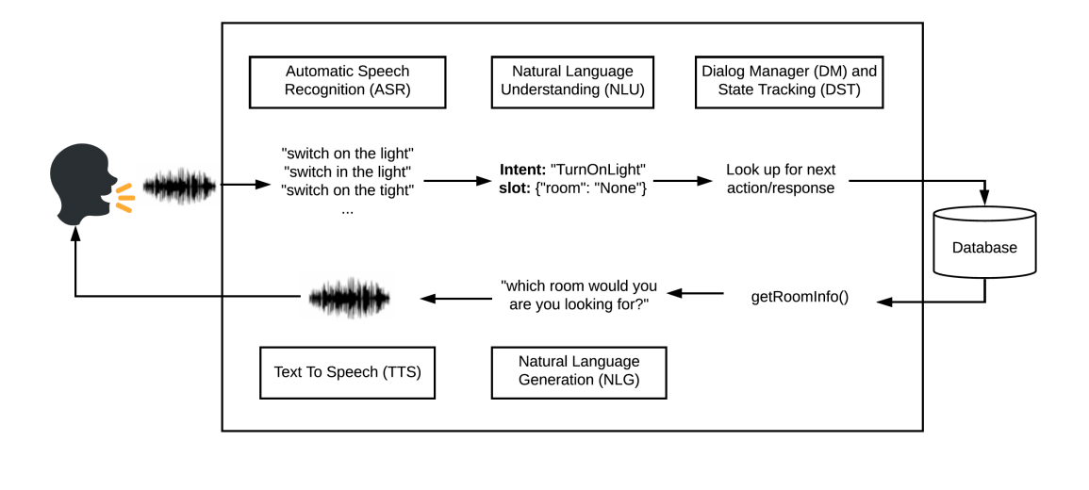
A typical dialog system
Figure 1: Depiction of a typical dialogue system [3]

Slide 4
Speech Recognition
Speech must be converted from physical sound to an electrical signal with a microphone.
then to digital data with an analog-to-digital converter.
Once digitized, several models can be used to transcribe the audio to text.

