Slide 1




Research proposal
Roberto Chiosa
Date
5 April 2021

Slide 2
Matrix Profile (MP): Main Properties
It is exact: For motif discovery, discord discovery, time series joins etc., the Matrix Profile based methods provide no false positives or false dismissals.
It parameter-free: In contrast, the more general algorithms in this space that typically require building and tuning spatial access methods and/or hash functions.
It allows anytime algorithms: While exact MP algorithms are extremely scalable, for extremely large datasets we can compute the Matrix Profile in an anytime fashion, allowing ultra-fast approximate solutions and real-time data interaction.
It is incrementally maintainable: Having computed the Matrix Profile for a dataset, we can incrementally update it very efficiently. In many domains this means we can effectively maintain exact joins/motifs/discords on streaming data forever.
It can handle missing data: Even in the presence of missing data, we can provide answers which are guaranteed to have no false negatives.

Slide 3
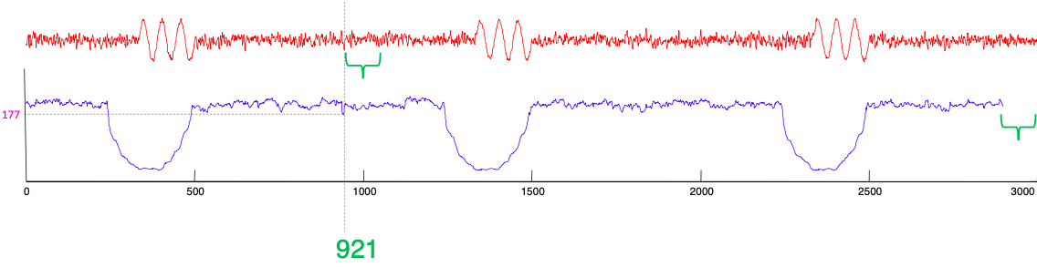
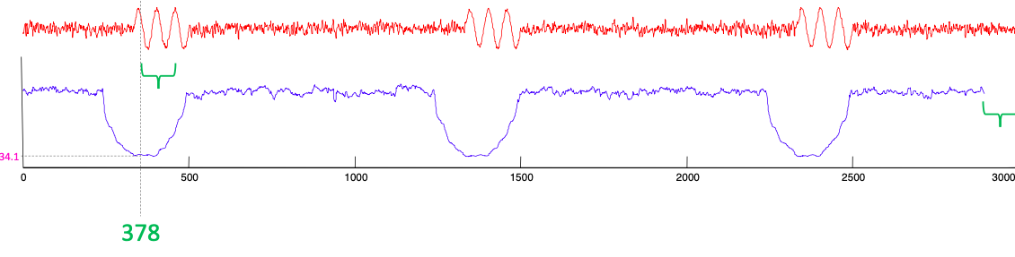
Matrix Profile (MP): What Is It?
Suppose to have a TS with 3000 points/observations (T = n = 3000)
We define a subsequence m of 100 points/observations (m=100)
The matrix profile at the ith location records the distance of the subsequence in T, at the ith location, to its nearest neighbor under z-normalized Euclidean Distance.

Slide 4
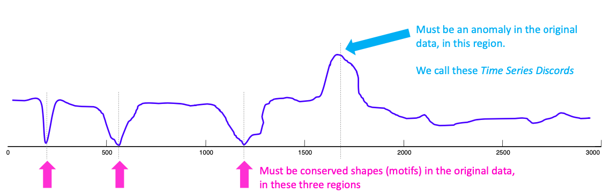
Matrix Profile (MP): How to Read?
Where you see relatively low values, you know that the subsequence in the original time series must have (at least one) relatively similar subsequence elsewhere in the data (such regions are “motifs” or reoccurring patterns)
Where you see relatively high values, you know that the subsequence in the original time series must be unique in its shape (such areas are “discords” or anomalies).

Slide 5
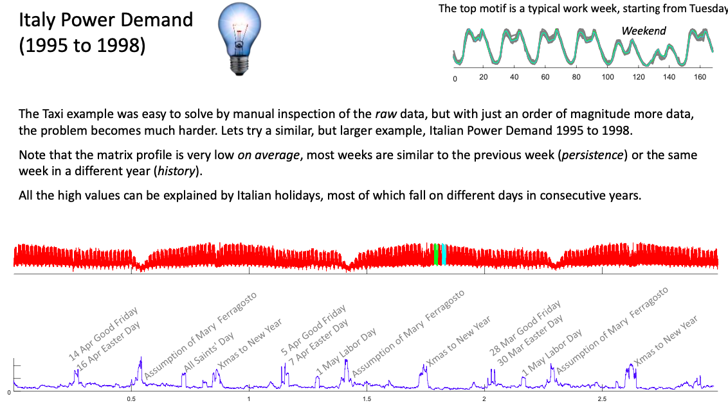
Matrix Profile (MP): Example of Application

Slide 6
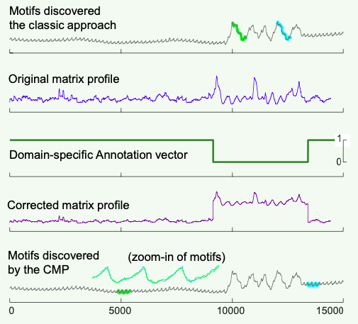
Matrix Profile (MP): From Domain Agnostic to Domain Aware
The great strength of the MP is that is domain agnostic. A single black box algorithm works for taxi demand, seismology, DNA, power demand, heartbeats, music, bird vocalizations....
However, in a handful of cases, there is a need to, or some utility in, incorporating some domain knowledge/constraints.
There is a simple, generic and elegant way to do this, using the Annotation Vector (AV).
The annotation vector (AV) is a time series consisting of real- valued numbers between [0 - 1].
A lower value indicates the subsequence starting at that index is less desirable, and therefore should be biased against
Conversely, higher values mean the corresponding subsequences should be favored for the potential motif pool

Slide 7
Matrix Profile (MP): What we can do?
Search and find motifs by querying in TS
Find the most conserved pattern that happens at least once every two days in this dataset.
Have we ever seen a pattern that looks just like this? )
Find motif or discords in an unsupervised fashion, even of different length
Comparison between 2 TS
Summarize TS with typical patterns (like clustering)
Find change in regime (winter/summer) When does the regime change in this time series?
Predict what is likely to happen next
Fast and sutable for real time deployment online and continuous learning
Data driven and domain knowledge
Anomaly detection with anomaly library with expert based annotation
Anomaly detection on subsequences by TS concatenation

Slide 8
