Slide 1



Process of completed works
Analyzed CPAP Adherence & Therapy Optimization Challenges
Developed a Conceptual AI-Driven Framework for CPAP Therapy Personalization (Still in the research phase, identifying key elements, but not yet implemented)
Explored the role of Digital Biomarkers (HRV, SpO₂, BP, EEG) in real-time physiological monitoring.
Proposed an event-driven intervention model → Aiming to detect therapy failures and suggest corrective actions.
Investigated multi-factor clustering approaches → Combining CPAP data, digital biomarkers, and patient feedback for personalized stratification.
Outlined a real-time patient pathway model → To enhance collaboration between physicians, technicians, and patients.
Reviewed CPAP machine usage data (AHI, leak rate, compliance hours) and patient surveys.
Identified limitations in existing CPAP adherence models:
Lack of physiological validation
No real-time intervention adjustments
Simple clustering models
Conducted a literature review and data-driven analysis to identify gaps in personalized CPAP treatment and intervention strategies.
Dropout Analysis
Cost & Usage Analysis
Identified the need for digital biomarkers and adaptive interventions
Notes:
*No real-time intervention adjustments → Physicians receive data too late to make timely decisions.
*Simple clustering models → Patients are categorized only by CPAP usage, ignoring physiological and behavioral factors.
Identified key patient groups—adherent, attempted, and non-adherent—based on therapy usage patterns.
Dropout Analysis: intervention impact, and patient response variability.
Cost & Usage Analysis: Evaluated intervention costs and therapy adjustments across different patient groups.
Identified the need for digital biomarkers and adaptive interventions → As a way to improve therapy personalization and long-term adherence.

Slide 2


Why ?
1. CPAP Usage Data Alone is Not Sufficient
Analyzed CPAP machine usage data (AHI, leak rate, compliance hours).
Collected patient surveys to monitor therapy experience.
❌
CPAP adherence does not necessarily mean therapy success.
❌
Patients may be using CPAP, but physiological markers (e.g., HRV, SpO₂, BP) may still indicate poor response.
❌
Surveys provide subjective feedback, but there is no objective physiological validation or real situation of patients.
Introduce Digital Biomarkers → Physiological data (HRV, SpO₂, BP, EEG) provides real-time insights into therapy effectiveness.
Move beyond survey-based clustering → Use biomarker-driven clustering to classify therapy response accurately.

Slide 3
Why ?
2. No Real-Time Intervention Adjustments
❌
If a patient started experiencing aggressive symptoms, there was no automatic intervention adjustment.
❌
Doctors & technicians received data too late to make timely interventions
Develop real-time event detection models → If a biomarker signals therapy failure, the system triggers an immediate therapy adjustment.
Adaptive intervention validation → Patient feedback + Biomarker response continuously refine therapy recommendations.

Slide 4
Why ?
3. Lack of Personalized, Multi-Factor Clustering
Patients were categorized based on CPAP compliance (Adherent, Non-Adherent, Attempting).
Clustering was based on CPAP metrics + Patient-reported adherence issues.
❌
Therapy adherence is complex → Simple clustering ignores underlying physiological and behavioral factors.
❌
Clustering should include biomarkers → HRV, SpO₂, BP, EEG provide deeper insights into therapy effectiveness.
Multi-modal clustering → Integrate CPAP data + Digital biomarkers + Patient surveys for dynamic patient categorization.

Slide 5
Why ?
4. Limited Stakeholder (Physician) Collaboration
❌
Doctors and technicians were disconnected from real-time patient data.
❌
No structured system to notify physicians when therapy needed adjustment.
Develop a structured patient pathway model → Doctors, technicians, and patients interact dynamically in a real-time data exchange framework.
Introduce event-triggered reports → When therapy deviation occurs, physicians are notified with structured intervention recommendations.
Improve technician oversight → Ensure that CPAP settings are adjusted based on real-time biomarker feedback.

Slide 6


A different approach to using Digital Biomarkers
CPAP machine data: Basic adherence metrics (AHI, usage compliance, leak rates).
Limited clinical insights: Focuses on device performance rather than individual patient physiology.
Clinical data: Patient history, diagnostic reports, treatment response records.
CPAP data: Usage hours, pressure settings, AHI, and leak rates.
Decision-making tree: Based on periodic check-ups, symptoms, and static CPAP adherence data.
Why we want Digital Biomarkers:
To enhance CPAP monitoring by integrating physiological responses into therapy tracking.
To develop smarter intervention strategies that adapt based on real-time biomarker deviations.
To optimize adherence support mechanisms using AI-driven insights rather than solely relying on static CPAP metrics.
Why they want Digital Biomarkers:
To fill the gap between CPAP adherence and actual treatment effectiveness by integrating DB.
To enable real-time, personalized interventions based on objective biomarker-driven evidence.
To improve decision trees with continuous monitoring.
Goal: More effective CPAP management, reduced dropout rates, and improved patient support through AI-based predictive models.
Goal: More precise patient profiling, data-driven intervention strategies, and dynamic therapy adjustments to improve treatment success.
For Patients: A personalized, adaptive, and proactive treatment model that optimizes CPAP usage based on their unique physiological responses.

Slide 7
Why ?
🔬 Scientific Reasons
Bridging the gap between patient-reported & biomarker-driven adherence monitoring.
Developing a real-time, event-driven intervention system to prevent therapy failure.
Implementing AI-based clustering to refine therapy adjustments dynamically.
Establishing a structured, data-driven communication.
🏥 Clinical & Practical Impact
Helping physicians tailor CPAP therapy based on real-time patient biomarkers.
Empowering patients with transparent feedback and self-monitoring tools.
Reducing CPAP dropout rates by identifying adherence risks early.
Improving the collaboration between physican, technicians, and patients.

Slide 8
Categories of Digital Biomarkers in CPAP Therapy
A. Respiratory Biomarkers (Breathing Function & Sleep Apnea Severity)
Apnea-Hypopnea Events
Respiratory Rate & Variability
Snoring Intensity & Frequency
Upper Airway Resistance
B. Oxygenation Biomarkers (Sleep Hypoxia & Cardiovascular Risks)
SpO₂ Levels (Blood Oxygen Saturation)
Oxygen Desaturation Index (ODI)
Cumulative Hypoxic Burden
C. Cardiovascular & Autonomic Biomarkers (Impact on Heart & Nervous System)
Heart Rate Variability (HRV)
Blood Pressure Variability
ECG Morphology (Heart Electrical Activity)

Slide 9
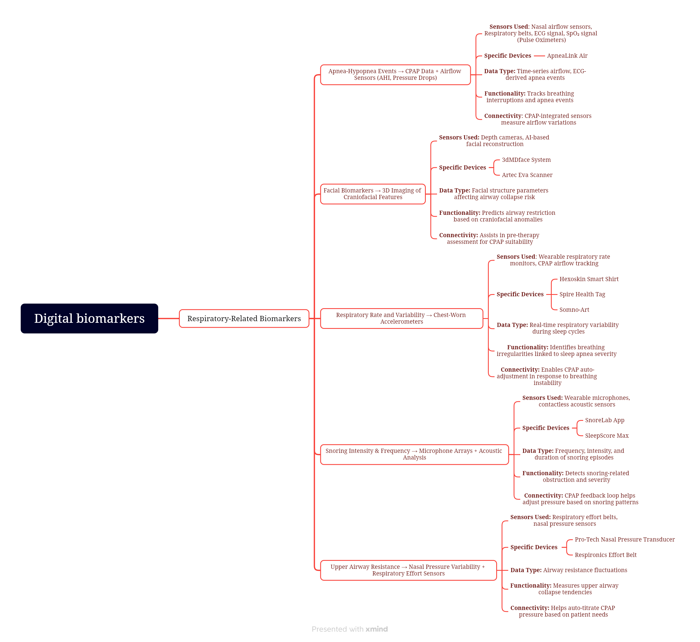
Digital Biomarkers map

Slide 10
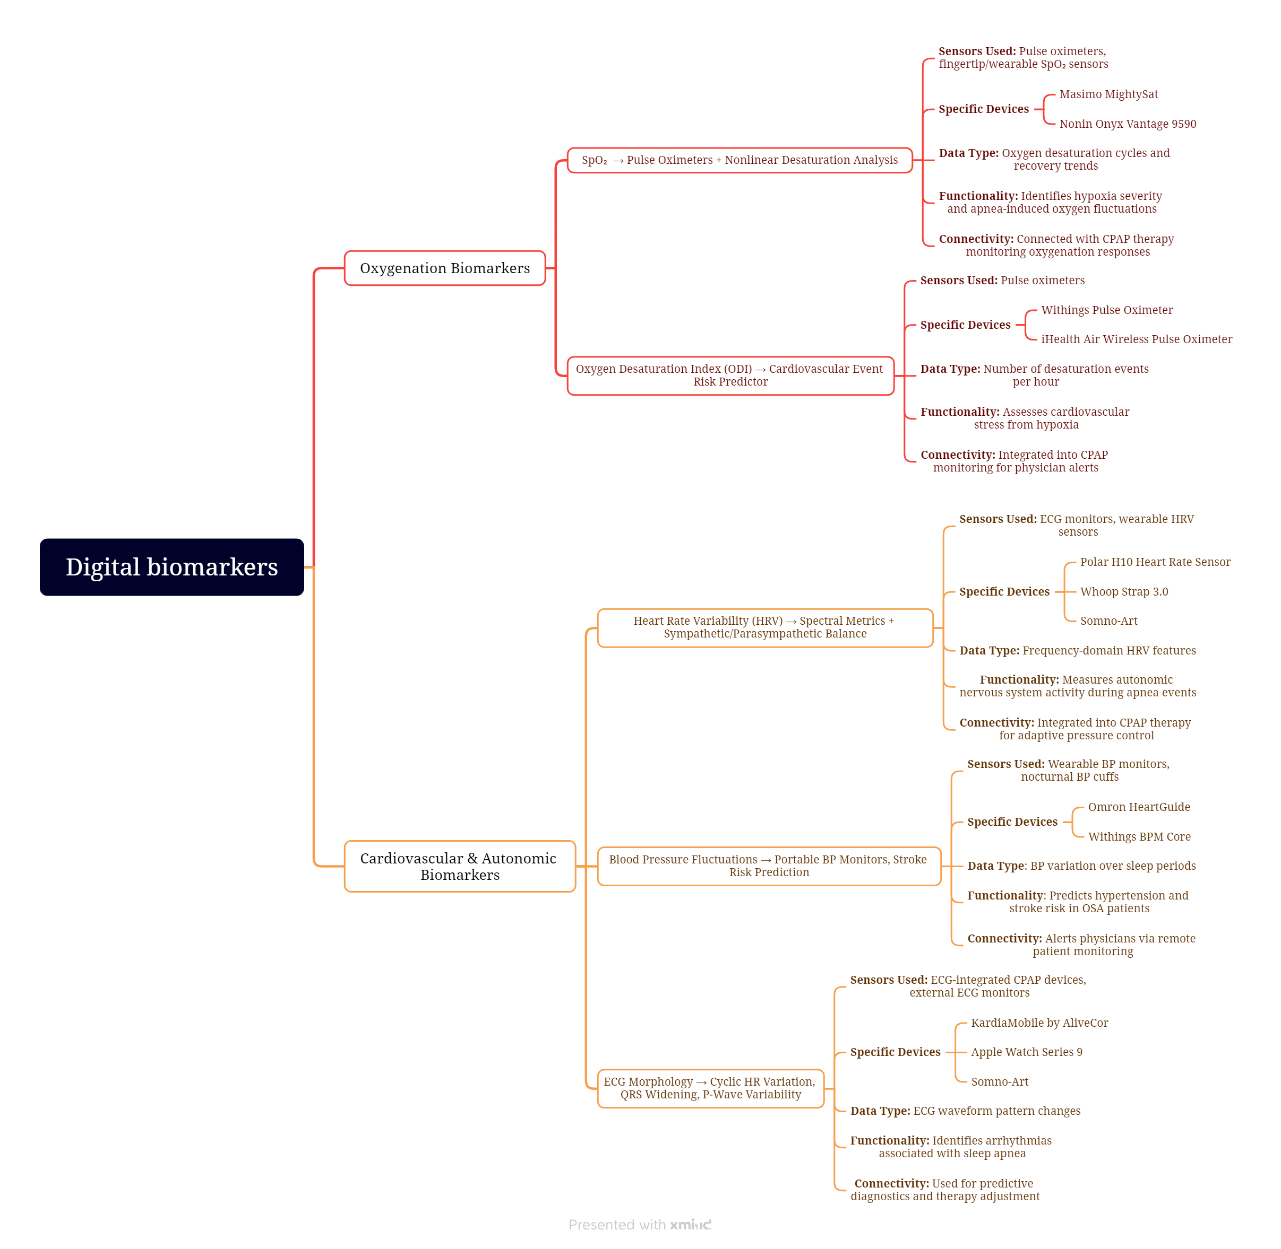
Digital Biomarkers map

Slide 11
Why Are Digital Biomarkers Important?
Enhancing CPAP Adherence Monitoring
Traditional CPAP monitoring only tracks usage and AHI, which does not fully capture patient experience or therapy effectiveness.
Digital biomarkers provide additional insights into why patients may struggle with adherence.
Refining Patient Clustering & Personalization
Moving beyond compliance-based clustering by integrating physiological and behavioral markers.
Enables personalized treatment plans based on real-world patient data.
Supporting Early Intervention & Therapy Optimization
Detects therapy failure risk before it happens through real-time biomarker deviations.
Ensures adaptive CPAP adjustments based on real-time patient needs.
Bridging Physician & Patient Interaction
Provides structured, risk-based reports instead of overwhelming physicians with excessive data.
Improves data-driven decision-making for CPAP therapy adjustments.
Facilitating Long-Term OSA Management
Helps in tracking disease progression beyond CPAP usage.
Supports better cardiovascular risk assessment in OSA patients.

Slide 12
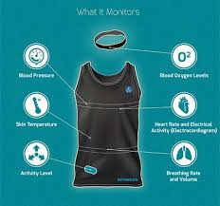
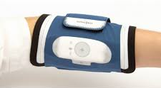
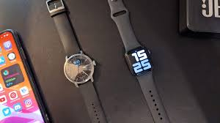
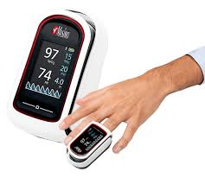
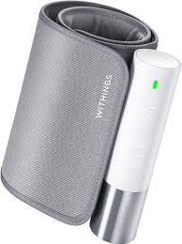
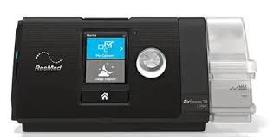
List of Digital Biomarkers
Device | Biomarkers Covered | Sensors Used | Clinical Relevance | Price
Hexoskin Smart Shirt | HRV, Respiratory Rate, Sleep Patterns, ECG | Chest-worn sensors, ECG | Multi-biomarker wearable ideal for continuous monitoring | 800-900 EU
Somno-Art | Sleep Stages, HRV, Sleep Efficiency, Sleep Latency, WASO, Sleep fragmentation | ECG-based sleep stage analysis, HRV-derived sleep metrics | Alternative tp PSG for sleep staging& therapy effectivness tracking | Renting
Apple Watch Series 9/WHITHINGS WATCH | HRV, ECG, Blood Pressure, SpO₂ | PPG, ECG, BP sensor | Best for cardiovascular biomarker tracking | 300-400 EU
Masimo MightySat | SpO₂, HRV, Respiratory Rate | Pulse oximeter, photoplethysmography (PPG) | High-fidelity oxygen & HRV monitoring | 300 EU
Withings BPM Core | Blood Pressure, ECG, HRV | BP cuff, ECG electrodes | Ideal for tracking cardiovascular impact | 250-300 EU
ResMed AirSense 11 | AHI, CPAP Usage, Flow Limitations, SpO₂ | CPAP-integrated airflow & pulse oximeter | Best for CPAP-based respiratory monitoring | -
💡 Best Choice for of digital biomarkers? Hexoskin Smart Shirt → Captures multiple respiratory + cardiovascular biomarkers in real-time
💡 Best Choice for of sleep staging& Cpap therapy? Somno-Art
Notes:
wake after sleep onset:'WASO’
This refers to periods of wakefulness occurring after defined sleep onset. This parameter measures wakefulness
SpO₂:Blood oxygen during sleep
cardiac rate and rhythm
sleep fragmentation: the total number of awakenings and shifts to Stage 1 sleep divided by the total sleep time

Slide 13
New Clinical Indicators from Resmed
Patient Demographics & Environment
Data Field | Why It Matters?
Patient Age & DOB | Helps adjust therapy pressure based on age-related lung function changes
Gender | Women may have different OSA patterns and CPAP adherence levels
Body Mass Index (BMI) | Obesity influences CPAP pressure needs & alternative therapy options
Height (cm) | Used for tidal volume & respiratory calculations
Smoking History | Smoking impacts airway inflammation & therapy effectiveness
Location (Environmental Factors) | Altitude and air quality may affect oxygenation and therapy efficacy
B. Sleep & Respiratory Event Tracking
Data Field | Why It Matters?
Apnea-Hypopnea Index (AHI) | Determines OSA severity and therapy adjustments
Oxygen Desaturation Index (ODI) | Tracks hypoxia burden & cardiovascular risks
Cheyne-Stokes Respiration (CSR) Duration | Identifies cardiovascular risks & heart failure association
Central Apnea Index (CAI) | Differentiates central vs. obstructive apnea for treatment optimization
Obstructive Apnea Index (OAI) | Confirms airway collapse severity for CPAP vs. MAD therapy selection
Notes:
the amount of air that moves in or out of the lungs with each respiratory cycle

Slide 14
New Clinical Indicators from Resmed
C. CPAP Therapy Compliance & Adherence Metrics
Data Field | Why It Matters?
Total Usage Hours per Night | Key CPAP adherence metric
Percentage of Nights ≥ 4 Hours | Determines long-term therapy success
Mask Leak Rate (50th, 95th Percentile, Maximum) | High leak rates reduce therapy efficiency and patient comfort
Session Start & Stop Times | Helps detect sleep disruption patterns
D. Device & Therapy Settings
Data Field | Why It Matters?
Therapy Mode (CPAP, BiPAP, AutoPAP) | Determines respiratory support level
Expiratory Positive Airway Pressure (EPAP) Trends | Critical for BiPAP users & neuromuscular patients
Peak Inspiratory Pressure (IPAP) Trends | Tracks lung function & airway resistance
Tidal Volume & Minute Ventilation | Measures breathing efficiency & therapy impact
Respiratory Rate (Median, Max, 5th/95th Percentiles) | Tracks breathing stability during sleep
Notes:
BiPAP therapy is primarily used to treat central sleep apnea (CSA), as well as heart, lung, and neurological disorders that require structured airway support during sleep

Slide 15
Selection Database Structure for Wearable Devices & Digital Biomarkers
What Details & Criteria Should Be Analyzed?
A. Demographic & Lifestyle Factors
Factor | Why It Matters? | Key Data to Analyze
Age | Older patients have higher CPAP intolerance, cardiovascular risks, and cognitive decline | Patient age group <40, 40-60, 60+- History of hypertension, cardiovascular diseases
Gender | Women experience different OSA symptoms, lower AHI but worse hypoxia burden | Gender-specific CPAP adherence & therapy response
BMI & Obesity | Higher BMI correlates with severe OSA, increased airway collapse, and CPAP resistance | BMI Classification (Normal, Overweight, Obese)
Smoking History | Smoking increases airway inflammation, impacting CPAP therapy effectiveness | Pack-years of smoking history
Height (cm) | Affects tidal volume, lung function estimates | Patient height input required for lung function calculations
Physical Activity Levels | Lower activity levels increase autonomic dysfunction, CPAP intolerance | Daily step count, resting HRV trends
Notes:
Tidal volume describes how much air is supplied to a patient during ventilation

Slide 16
Selection Database Structure for Wearable Devices & Digital Biomarkers
What Details & Criteria Should Be Analyzed?
B. Physiological & Clinical Indicators
Factor | Why It Matters? | Key Data to Analyze
OSA Severity (AHI, ODI, RDI levels) | Determines CPAP requirement alternative therapy (MAD, HNS) | AHI classification: Mild (5-15), Moderate (15-30), Severe (30+)
Oxygen Desaturation (ODI <90%) | Indicates hypoxia burden and cardiovascular stress | Nocturnal SpO₂ drops (frequency, severity)
Heart Rate Variability (HRV) & Autonomic Function | Tracks sympathetic overactivation and CPAP adherence prediction | HRV trends, LF/HF ratio, Nocturnal BP surges
Central vs. Obstructive Apnea Events | Helps differentiate CPAP vs. BiPAP or ASV requirements | Central Apnea Index (CAI), Obstructive Apnea Index (OAI)
Upper Airway Resistance (UAR) | Determines airway collapse risk for therapy adjustments | CPAP pressure requirements, snoring intensity
C. CPAP Therapy Compliance & Adherence Metrics
Factor | Why It Matters? | Key Data to Analyze
Total Usage Hours per Night | Identifies adherence trends and CPAP tolerance | Session durations, frequency of interruptions
Percentage of Nights ≥ 4 Hours | Determines long-term therapy success | Percentage of nights meeting usage threshold
Mask Leak Rate (50th, 95th Percentile, Maximum) | High leak rates reduce therapy efficiency and patient comfort | Leakage trend analysis, mask fit indicators
Session Start & Stop Times | Helps detect sleep disruption patterns | Daily therapy start/stop tracking
Notes:
respiratory disturbance index (RDI)
(MAD) has been a novel method in the management of snoring and OSA
HNS treatment, a surgical team will insert an Inspire device under the skin on your chest.
The LF/HF ratio, its maximal value during REM sleep and a minimal value in synchronous sleep.

Slide 17
Selection Database Structure for Wearable Devices & Digital Biomarkers
What Details & Criteria Should Be Analyzed?
D. Behavioral & Psychological Factors
Factor | Why It Matters? | Key Data to Analyze
CPAP Adherence Patterns | Patients with poor adherence require telemonitoring & interventions | CPAP usage hours, therapy interruptions, mask fit issues
Claustrophobia & Mask Discomfort | Higher dropout rates in patients with mask intolerance | Self-reported discomfort, mask fit issues
Cognitive Impairment (Dementia, ADHD) | Forgetfulness reduces long-term CPAP compliance | Memory screening (MMSE, MoCA), adherence reports
Notes:
Individuals with ADHD had an increased risk for dementia
Mini-Mental State Examination (MMSE) and Montreal Cognitive Assessment (MoCA) are two commonly used cognitive screening and diagnostic tools.

Slide 18
Categorizing Patients Based on CPAP Data
Patient Category | Key Indicators from Data | Wearable/Digital Biomarker Recommendations
Severe OSA with Cardiovascular Risk | AHI >30, frequent SpO₂ desaturations- Cheyne-Stokes Breathing (CSR)- Nocturnal hypertension & HRV abnormalities | HRV Monitors (Whoop Strap, Polar H10) BP Wearables (Omron HeartGuide)
CPAP Non-Adherent with High Mask Leak | Leak rate >95th percentile, frequent mask adjustments- Session interruptions & discomfort reports | AI-Powered Sleep Trackers (Oura Ring, SleepScore Max, Fitbit Sense) Real-time Leak Monitoring (Hexoskin, Withings Sleep Analyzer)
Positional OSA Patients | AHI fluctuates significantly between supine & non-supine sleep- Snoring detected more frequently in back position | Positional Therapy Sensors (NightBalance, SleepScore Max)
Mild-Moderate OSA with CPAP Intolerance | CPAP usage <4 hours/night, patient-reported discomfort- Lower AHI but high daytime sleepiness score | Alternative Therapy Tracking (Mandibular Devices, Myofunctional Therapy Apps)
Neuromuscular Patients on BiPAP | High reliance on machine-triggered breaths- Frequent backup rate adjustments | Ventilation Monitoring Wearables (ResMed Astral, Ventec VOCSN)

Slide 19
Analysis of Patient Dropout

Slide 20
Data sets
File | Unique Patients | Data Duration
Patient | 91472 | All time
StartDate | 96135 | All time
Mask | 42404 | All time
Usage | 48160 | Last 2 Years
Intervention | 47403 | Last 2 Years
Survey | 45074 | Last 2 Years

Slide 21
Analysis Steps to prepare Data sets
Defining Adherent, Attempted, Not Adherent category
Categorize Patients by Usage: Patients are divided into categories based on how much they use their devices daily.
Not Adherent: Low Usage (< 2 hours per day)- 2677 Unique patients
Attempted: Medium Usage (2-4 hours per day)- 3522 Unique patients
High Usage (> 6 hours per day) But usage > 4 are Adherent with 41961 Unique patients
Analysis Steps to prepare Data sets
Including mask and birthdate: combining the patient usage data with their demographic information, such as birthdate and gender.
Including start date of therapy and end date of the therapy
Including survey and Intervention data sets
Separating the three category of patient from our final merged file: categorizing patients into three adherence groups (Adherent, Not Adherent, and Attempted) by merging patient demographic and mask data with adherence metrics.

Slide 22
All Patients
Attempter
Adherent
Gender |  | Mask |  | Age
Male | 2228 | Nasal | 1123 | 61-80 | 1653
Female | 1210 | Facial | 663 | 41-60 | 1024
 |  | Narinaire | 315 | 81-100 | 530
 |  |  |  | 21-40 | 222
 |  |  |  | 0-20 | 5
Gender |  | Age
Male | 29482 | 61-80 | 24686
Female | 12017 | 41-60 | 10216
 |  | 81-100 | 5396
 |  | 21-40 | 1160
 |  | 0-20 | 28
Mask
Nasal | 19717
Facial | 7529
Narinaire | 3709
Buccal | 1
Not_Adherent
Gender |  | Mask |  | Age
Male | 1706 | Nasal | 433 | 61-80 | 1055
Female | 942 | Facial | 302 | 41-60 | 923
 |  | Narinaire | 146 | 81-100 | 430
 |  |  |  | 21-40 | 224
 |  |  |  | 0-20 | 15

Slide 23
AirGenious Patients
Attempter
Adherent
Gender |  | Mask |  | Age
Male | 758 | Nasal | 446 | 61-80 | 589
Female | 422 | Facial | 310 | 41-60 | 370
 |  | Narinaire | 131 | 81-100 | 163
 |  |  |  | 21-40 | 56
 |  |  |  | 0-20 | 2
Gender |  | Age
Male | 6625 | 61-80 | 5511
Female | 2609 | 41-60 | 2096
 |  | 81-100 | 1379
 |  | 21-40 | 241
 |  | 0-20 | 7
Mask
Nasal | 4264
Facial | 2308
Narinaire | 796
Not_Adherent
Gender |  | Mask |  | Age
Male | 319 | Nasal | 154 | 61-80 | 205
Female | 199 | Facial | 123 | 41-60 | 200
 |  | Narinaire | 52 | 81-100 | 64
 |  |  |  | 21-40 | 45
 |  |  |  | 0-20 | 4
Adherent 9234
Attempted 1180
Not Adherent 518

Slide 24
Not AirGenious Patients
Attempter
Adherent
Gender |  | Mask |  | Age
Male | 1410 | Nasal | 648 | 61-80 | 1024
Female | 761 | Facial | 333 | 41-60 | 629
 |  | Narinaire | 177 | 81-100 | 354
 |  |  |  | 21-40 | 159
 |  |  |  | 0-20 | 3
Gender |  | Age
Male | 21473 | 61-80 | 18033
Female | 8957 | 41-60 | 7649
 |  | 81-100 | 3838
 |  | 21-40 | 883
 |  | 0-20 | 20
Mask
Nasal | 15344
Facial | 5167
Narinaire | 2889
Buccal | 1
Not_Adherent
Gender |  | Mask |  | Age
Male | 1336 | Nasal | 272 | 61-80 | 822
Female | 726 | Facial | 176 | 41-60 | 707
 |  | Narinaire | 91 | 81-100 | 345
 |  |  |  | 21-40 | 177
 |  |  |  | 0-20 | 10
Adherent 30430
Attempted 2171
Not Adherent 2062

Slide 25
How left the therapy?
How It Works:
Prepare Therapy Data: Therapy start, and end dates are standardized.
Aggregate Therapy Periods: For each patient, the earliest therapy start date and latest therapy end date are determined to define the overall therapy period.
Determine Therapy Status: Patients are classified as "In Therapy" if their therapy end date is in the future (or ongoing) or "Left Therapy" if the therapy has ended.
Finding their initial AHI those patient respond to this "1c IAH initial"

Slide 26
Not adherent
AtHomePatientId | Mask | Gender | AverageDailyUsage | StartDateTherapy | EndDateTherapy | TherapyStatus
103414 | Nasal | Male | 0.70297619 | 11/4/2014 | 5/13/2024 | Left Therapy
107376 | Nasal | Male | 0.243154574 | 1/29/2015 | 2099 | In Therapy
TherapyStatus | PatientCount
Left Therapy | 1474
In Therapy | 1112
AirGenious
Not AirGenious
TherapyStatus | PatientCount
Left Therapy | 412
In Therapy | 105
TherapyStatus | PatientCount
Left Therapy | 1296
In Therapy | 695

Slide 27
Adherent
AtHomePatientId | Mask | Gender | AverageDaily Usage | StartDate Therapy | EndDate Therapy | TherapyStatus
100161 | Nasal | Male | 6.914011299 | 8/12/2014 | 2099 | In Therapy
101583 | Facial | Male | 7.899394813 | 9/25/2014 | 12/21/2023 | Left Therapy
104842 | Nasal | Female | 6.549783237 | 12/5/2014 | 8/29/2024 | Left Therapy
TherapyStatus | PatientCount
Left Therapy | 4787
In Therapy | 36526
AirGenious
Not AirGenious
TherapyStatus | PatientCount
Left Therapy | 283
In Therapy | 8942
TherapyStatus | PatientCount
Left Therapy | 2471
In Therapy | 27531

Slide 28
Attempter
AtHomePatientId | MaskType | Gender | AverageDailyUsage | StartDate Therapy | EndDate Therapy | TherapyStatus
100767 | Narinaire | Male | 3.121581633 | 9/5/2014 | 2099 | In Therapy
100792 | Facial | Female | 3.971657459 | 9/5/2014 | 2099 | In Therapy
102408 | Facial | Male | 2.937989418 | 12/24/2014 | 7/20/2023 | Left Therapy
TherapyStatus | PatientCount
Left Therapy | 804
In Therapy | 2559
AirGenious
Not AirGenious
TherapyStatus | PatientCount
Left Therapy | 70
In Therapy | 1105
TherapyStatus | PatientCount
Left Therapy | 635
In Therapy | 1441

Slide 29
Summary cancellation reason all patients
CancellationReason | Non-Adherent (Count) | Attempted (Count) | Adherent (Count)
Intolerance / Non-adherence / No improvement | 725 | 256 | 355
Doctor's request | 342 | 175 | 432
Patient's death | 118 | 118 | 917
Clinical improvement | 61 | 39 | 150
Relocation outside LHF zone | 55 | 58 | 999
Transfer CO | 32 | 48 | 998
Hospitalisation | 26 | 26 | 250
Unhappy patient-change of provider | 16 | 16 | 197

Slide 30
Summary cancellation reason AirGenious
CancellationReason | Adherent (Count) | Attempted (Count) | Non-Adherent (Count)
Patient Death | 83 | 11 | 4
Hospitalization | 80 | 5 | 6
Intolerance / Non-Compliance / No Improvement | 29 | 26 | 59
Doctor's Request | 27 | 16 | 16
Treatment Change (Non-Switch) | 21 | 3 | 3
Clinical improvement | 18 | 3 | 7
Relocation outside LHF zone | 11 | 3 | 2
Unhappy patient-change of provider | 10 | 1 | 2

Slide 31
Summary cancellation reason Not AirGenious
CancellationReason | Non-Adherent (Count) | Attempted (Count) | Adherent (Count)
Intolerance / Non-adherence / No improvement | 665 | 230 | 326
Doctor's request | 324 | 156 | 389
Patient's death | 111 | 107 | 830
Clinical improvement | 54 | 36 | 131
Relocation outside LHF zone | 29 | 25 | 128
Unhappy patient-change of provider | 14 | 15 | 185
Hospitalisation | 20 | 21 | 170

Slide 32
Usage of Intervention (Done) for all patients how left therapy
JobTypeCode | Adherent_Count | Adherent_Perc | Non_Adherent_Count | Non_Adherent_Perc | Attempted_Count | Attempted_Perc | Total_JobType
TA | 2351 | 41.22% | 1274 | 22.34% | 630 | 11.04% | 5704
VK | 2040 | 2.89% | 446 | 0.63% | 367 | 0.52% | 70607
EX | 1280 | 3.41% | 155 | 0.41% | 233 | 0.62% | 37491
VH | 1212 | 5.99% | 591 | 2.92% | 394 | 1.95% | 20237
HL | 785 | 4.41% | 170 | 0.95% | 173 | 0.97% | 17807
AP | 711 | 3.44% | 1029 | 4.98% | 416 | 2.02% | 20642
VA | 556 | 6.94% | 772 | 9.64% | 228 | 2.85% | 8011
AW | 400 | 6.12% | 392 | 5.99% | 221 | 3.38% | 6539
WM | 307 | 4.73% | 152 | 2.34% | 96 | 1.48% | 6485
LC | 261 | 8.76% | 92 | 3.09% | 46 | 1.54% | 2978
TT | 236 | 3.01% | 603 | 7.69% | 209 | 2.67% | 7841
IU | 232 | 3.39% | 491 | 7.17% | 174 | 2.54% | 6850
O1 | 216 | 1.70% | 127 | 1.00% | 104 | 0.82% | 12694
FO | 195 | 3.58% | 75 | 1.38% | 52 | 0.96% | 5443
O2 | 186 | 3.32% | 2 | 0.04% | 5 | 0.09% | 5598
V9 | 170 | 2.55% | 308 | 4.62% | 138 | 2.07% | 6664
PW | 93 | 7.82% | 48 | 4.03% | 24 | 2.02% | 1190
RC | 83 | 23.38% | 19 | 5.35% | 12 | 3.38% | 355

Slide 33
Usage of Intervention (Done) for Not-AirGenious patients how left therapy
JobTypeCode | Adherent_Count | Adherent_Perc | Non_Adherent_Count | Non_Adherent_Perc | Attempted_Count | Attempted_Perc | Total_JobType
TA | 2151 | 37.71% | 1183 | 20.74% | 575 | 10.08% | 5704
VK | 1722 | 2.44% | 384 | 0.54% | 303 | 0.43% | 70607
EX | 1080 | 2.88% | 131 | 0.35% | 194 | 0.52% | 37491
VH | 959 | 4.74% | 511 | 2.53% | 318 | 1.57% | 20237
HL | 618 | 3.47% | 144 | 0.81% | 138 | 0.77% | 17807
AP | 584 | 2.83% | 955 | 4.63% | 352 | 1.71% | 20642
VA | 518 | 6.47% | 701 | 8.75% | 207 | 2.58% | 8011
AW | 355 | 5.43% | 318 | 4.86% | 188 | 2.88% | 6539
WM | 266 | 4.10% | 120 | 1.85% | 87 | 1.34% | 6485
LC | 216 | 7.25% | 86 | 2.89% | 38 | 1.28% | 2978
TT | 210 | 2.68% | 575 | 7.33% | 192 | 2.45% | 7841
IU | 208 | 3.04% | 467 | 6.82% | 163 | 2.38% | 6850
FO | 167 | 3.07% | 67 | 1.23% | 48 | 0.88% | 5443
V9 | 147 | 2.21% | 285 | 4.28% | 125 | 1.88% | 6664
RC | 69 | 19.44% | 15 | 4.23% | 8 | 2.25% | 355
EM | 67 | 5.71% | 11 | 0.94% | 18 | 1.53% | 1173
PW | 65 | 5.46% | 36 | 3.03% | 19 | 1.60% | 1190
T1 | 63 | 2.11% | 84 | 2.82% | 49 | 1.64% | 2981

Slide 34
Usage of Intervention (Done) for AirGenious patients how left therapy
JobTypeCode | Adherent_Count | Adherent_Perc | Non_Adherent_Count | Non_Adherent_Perc | Attempted_Count | Attempted_Perc | Total_JobType
VK | 318 | 0.45% | 62 | 0.09% | 64 | 0.09% | 70607
VH | 253 | 1.25% | 80 | 0.40% | 76 | 0.38% | 20237
O1 | 216 | 1.70% | 127 | 1.00% | 104 | 0.82% | 12694
TA | 200 | 3.51% | 91 | 1.60% | 55 | 0.96% | 5704
EX | 200 | 0.53% | 24 | 0.06% | 39 | 0.10% | 37491
O2 | 186 | 3.32% | 2 | 0.04% | 5 | 0.09% | 5598
HL | 167 | 0.94% | 26 | 0.15% | 35 | 0.20% | 17807
AP | 127 | 0.62% | 74 | 0.36% | 64 | 0.31% | 20642
O4 | 61 | 3.84% | 1 | 0.06% | 2 | 0.13% | 1587
O9 | 55 | 0.80% | 2 | 0.03% | 13 | 0.19% | 6873
O7 | 46 | 4.42% | 1 | 0.10% | 2 | 0.19% | 1040
LC | 45 | 1.51% | 6 | 0.20% | 8 | 0.27% | 2978
AW | 45 | 0.69% | 74 | 1.13% | 33 | 0.50% | 6539
O3 | 41 | 2.10% | 39 | 2.00% | 30 | 1.54% | 1952
WM | 41 | 0.63% | 32 | 0.49% | 9 | 0.14% | 6485
O5 | 38 | 3.87% | 0 | 0.00% | 2 | 0.20% | 982
VA | 38 | 0.47% | 71 | 0.89% | 21 | 0.26% | 8011
OA | 37 | 1.42% | 0 | 0.00% | 1 | 0.04% | 2602

Slide 35
Implementation of Methodology

Slide 36
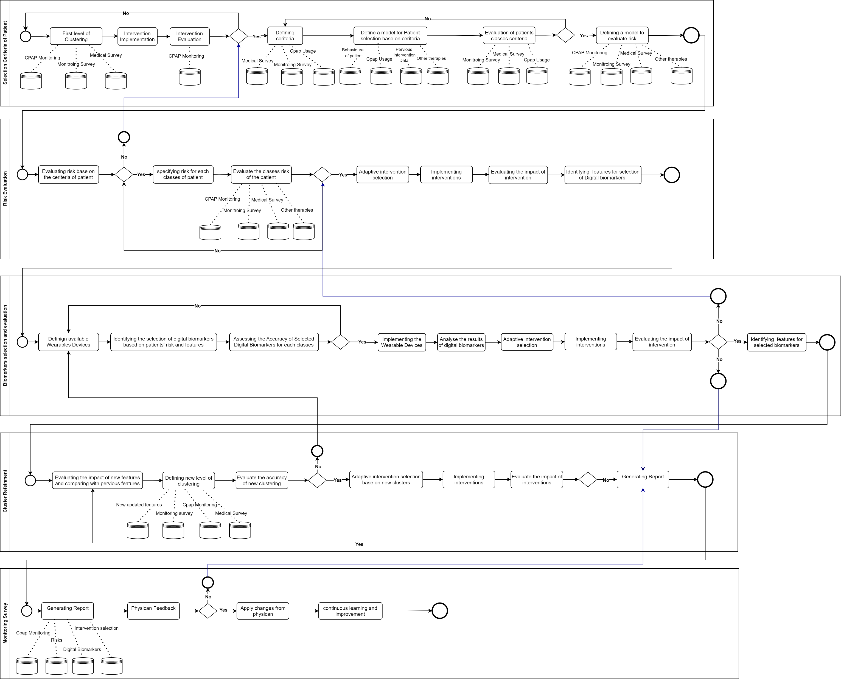
Framework

Slide 37
Framework
C:\Users\A6QU89\OneDrive - univ-lyon2.fr\UML1.pdf

Slide 38
Digital Biomarker Integration for New CPAP Patients (From Day 1)
📌 Goal: Apply digital biomarkers immediately to optimize therapy from the start.
Why Immediate Biomarker Use is Essential?
✔ New CPAP users often struggle with adherence. ✔ Early monitoring detects therapy inefficacy before dropout occurs. ✔ Identifying risk factors early allows for personalized intervention.
Factor | Criteria | Impact on CPAP Therapy
OSA Severity | High AHI (>30) or Oxygen Desaturation Index (ODI) | Requires continuous SpO₂ & HRV tracking
Cardiovascular Comorbidities | Hypertension, Heart Disease, High BP Variability | HRV + BP Monitoring to track cardiovascular response
Obesity & Metabolic Risks | BMI > 30, Diabetes, Insulin Resistance | Respiratory rate & HRV monitoring
Sympathetic Nervous System Activation | High resting heart rate, BP | HRV & BP variability tracking to detect stress responses
Reduces CPAP dropout rates by detecting early inefficacy.
Provides an AI-driven early warning system for therapy failure.
Improves therapy adherence through adaptive real-time adjustments.
Notes:
New patients benefit from a proactive approach. By integrating biomarkers from day one, we ensure that high-risk patients receive intensive monitoring while low-risk patients have a more flexible setup. This approach improves early adherence and reduces CPAP dropout.

Slide 39
Adaptive Digital Biomarker Integration for Mid-Treatment CPAP Patients (3+ Months)
📌 Goal: Introduce biomarkers selectively based on therapy response and risk factors. 📌 Purpose: Refine interventions dynamically and ensure long-term adherence.
Why Adjust Biomarkers for Patients Already in Therapy?
✔ Some patients show therapy response notstable (AHI improvement but persistent symptoms). ✔ Cardiovascular markers may worsen over time, requiring additional tracking. ✔ CPAP usage compliance ≠ therapy success (patients may still experience symptoms).
Factor | Criteria | Adjustment Strategy
Worsening Symptoms | Fatigue, morning headaches, BP | Add HRV & BP monitoring to detect therapy inefficacy
CPAP Effectiveness | AHI improvement but no clinical symptom | Monitor respiratory effort & HRV for optimization
Cardiovascular Risk Progression | Hypertension worsening over time | Introduce continuous BP & HRV tracking
Patient Expresses Discomfort or Non-Adherence | Reports mask issues, discomfort, therapy resistance | Adaptive intervention based on biometric stress markers
Refines CPAP therapy continuously for long-term adherence.
Detects therapy inefficacy and need for adjustments early.
Prevents unnecessary monitoring burden by targeting specific patient needs.
Notes:
Patients already in therapy may not need full-scale biomarker integration from the start. Instead, we introduce sensors based on their evolving needs and therapy responses. This ensures that CPAP therapy is continuously optimized while keeping patient burden minimal.

Slide 40
Implementation Pathway for Real-World Deployment of the CPAP Optimization Framework
🔹 Phase 1: Infrastructure & System Setup (Weeks 1–8)
📌 Objective: Establish IT infrastructure, integrate data pipelines
✅ Tasks:
Develop a cloud-based data repository for CPAP and digital biomarker data.
Ensure Wearable devices integration.
Define patient inclusion/exclusion criteria for the pilot study.
Secure regulatory approval for patient monitoring and data collection.
Collaborate with Linde, IT teams, and physicians for data standardization.
⚠ Challenges:
Interoperability issues between CPAP manufacturers and different biometric devices.
Physicians’ skepticism about AI-driven patient monitoring and clustering models.

Slide 41
Implementation Pathway for Real-World Deployment of the CPAP Optimization Framework
🔹 Phase 2: Wearable Device Deployment & Data Collection (Weeks 6–16)
📌 Objective: Deploy biometric wearables for continuous physiological monitoring and collect real-time patient data.
✅ Tasks:
Select wearable sensors: HRV, SpO₂, BP, EEG, respiratory effort sensors.
Train patients and caregivers on proper device usage.
Ensure real-time data transmission and secure cloud storage.
Validate data accuracy, reliability, and calibration with CPAP usage data.
⚠ Challenges:
Patient compliance issues (some patients may forget or refuse to wear devices).
Connectivity & data transmission reliability (ensuring minimal data loss).
Variability in biomarker readings requires continuous AI model adjustment.

Slide 42
Implementation Pathway for Real-World Deployment of the CPAP Optimization Framework
🔹 Phase 3: AI-Based Patient Clustering & Adaptive Intervention Design (Weeks 10–24)
📌 Objective: Develop patient profiles, detect therapy failures, and design personalized interventions based on real-time data.
✅ Tasks:
Implement AI-driven patient clustering models using:
CPAP adherence data (usage trends, compliance history).
Biomarker patterns (HRV fluctuations, SpO₂ desaturation, AHI trends).
Patient-reported feedback (symptom tracking, perceived therapy benefits).
Develop anomaly detection algorithms to flag therapy failures.
Design an AI-powered decision-support tool for physicians to optimize interventions.
⚠ Challenges:
Ensuring clustering accuracy handling variability in patient responses.
Physician acceptance AI models must be explainable and clinically validated.
Handling large data streams in real time requires computational efficiency.

Slide 43
Implementation Pathway for Real-World Deployment of the CPAP Optimization Framework
🔹 Phase 4: Adaptive Intervention Deployment (Weeks 18–28)
📌 Objective: Implement real-time, personalized interventions based on patient adherence trends and biomarker data.
✅ Tasks:
Deploy automated intervention triggers (alerts, notifications, or physician consultations).
Implement engagement strategies such as:
Personalized coaching messages (based on biomarker fluctuations).
Gamification elements (reward-based engagement).
Real-time adherence feedback via mobile apps.
⚠ Challenges:
Patient responsiveness, some patients may ignore or delay acting on alerts.
Scalability concerns, ensuring interventions work across larger populations.

Slide 44
Implementation Pathway for Real-World Deployment of the CPAP Optimization Framework
🔹 Phase 5: Model Validation & Cost Analysis (Weeks 22–32)
📌 Objective: Validate the effectiveness of interventions, measure patient outcomes, and assess economic feasibility.
✅ Tasks:
Compare intervention groups to assess adherence improvement.
Measure biomarker-driven therapy success (AHI reduction, HRV stability, SpO₂ improvements).
Conduct a cost-benefit analysis:
Cost of wearable devices & software.
Reduction in therapy dropout rates & long-term healthcare savings.
Identify bugs, software failures, and workflow inefficiencies for system refinement.
⚠ Challenges:
Patient retention, ensuring study participants remain engaged for 6 months.

Slide 45
Implementation Pathway for Real-World Deployment of the CPAP Optimization Framework
🔹 Phase 6: Full-Scale Deployment & Continuous Optimization (Post-Pilot, Month 6 Onward)
📌 Objective: Expand to a larger patient population (50+ patients) and continuously improve model performance.
✅ Tasks:
Scale implementation to multiple healthcare settings.
Implement periodic AI model retraining based on new data trends.
Develop a structured feedback loop with stakeholders (physicians, Linde, IT teams).
Optimize real-time monitoring efficiency and system response time.
⚠ Challenges:
Managing large-scale real-time data processing.
Ensuring sustained engagement from physicians and healthcare providers.

Slide 46
Adherent Patients (Sustaining Long-Term Engagement & Therapy Optimization) Interventions
Proactive therapy optimization: Periodic CPAP pressure adjustments based on biometric trends
AI-based treatment feedback: Recommend real-time pressure adjustments based on data patterns
Monthly biomarker analysis: Monitor physiological trends to detect silent therapy
Bi-annual clinical evaluations: Physician integrate sleep quality assessments (ESS, SF-36)
Smart alert system: Detect early signs of declining adherence trends
Automated positive reinforcement: Behavioral reinforcement strategies via personalized digital gamification

Slide 47
Non-Adherent Patients (Addressing Barriers & Preventing Therapy Dropout) Interventions
Real-time intervention triggers
AI-driven algorithms detect early therapy non-adherence and trigger immediate, targeted interventions .
Personalized coaching
Virtual or in-person coaching sessions guided by biometric insights to tailor solutions.
Mask-fitting optimization comfort adjustments
AI-driven facial scanning & pressure adaptation to improve fit and comfort dynamically.
Psychological support integration
For patients with therapy resistance, implement motivational interviewing strategies, cognitive-behavioral interventions, and stress-reduction techniques.
Telemonitoring
& physician alerts
If a patient fails to reach a minimum adherence threshold, direct physician involvement is triggered for a structured intervention session.

Slide 48
Attempting Patients (Transitioning from Partial to Full Adherence) Interventions
AI-driven dynamic adherence scoring
Patients receive real-time, personalized adherence insights and predictive risk scores to help them stay on track.
Real-time CPAP feedback & education
Personalized alerts provide daily adherence summaries, pressure adjustments, and bite-sized CPAP training videos to encourage consistent use.
Nightly adherence reinforcement
AI-driven digital assistant provides personalized encouragement messages, progress comparisons, and recommendations.
Smart nudging strategies and Early-stage intervention triggers
Use predictive analytics to intervention at high risk dropout point.
Notes:
Objective: Ensure successful transition from low-to-moderate adherence to long-term therapy commitment.
Challenges: This group often consists of patients in their first 1-3 months of therapy, where initial struggles with comfort, perceived benefit, and routine-building are most common. Many of these patients drop out before experiencing clinical improvements.

