Slide 1

Summary cancellation reason all patients
CancellationReason | Non-Adherent (Count) | Attempted (Count) | Adherent (Count)
Intolerance / Non-adherence / No improvement | 725 | 256 | 355
Doctor's request | 342 | 175 | 432
Patient's death | 118 | 118 | 917
Clinical improvement | 61 | 39 | 150
Relocation outside LHF zone | 55 | 58 | 999
Transfer CO | 32 | 48 | 998
Hospitalisation | 26 | 26 | 250
Unhappy patient-change of provider | 16 | 16 | 197

Slide 2
Details of Data
Data ranges from 2023-01 to 2025-01
All patients in therapy 38,301 unique patients
Natural Dropout Patients: 2,036 unique patients
Effectful Dropout Patients: 598 unique patients
Gender | Natural Dropout (%) | Effectful Dropout (%)
Male | 75 | 66
Female | 25 | 34
Natural CancellationReason | Count
Transfert CO | 913
Moving outside the LHF zone | 794
Death of the patient | 93
Input error | 51
Expired prescription | 13
Holiday transfer (Temporary cancellation) | 5
IU canceled because patient equipped by another PSAD | 1
Problem of care - patient without mutual insurance | 1
Effectful CancellationReason | Count
Hospitalisation | 210
Intolerance / Non-compliance / No improvement | 124
Doctor's request | 84
Change of treatment (Outside Switch) | 25
Unhappy Patient - Change of Provider | 21
Unhappy doctor - Change of provider | 14
Clinical improvement | 14
Care problem - patient unreachable | 9
Change of doctor - does not work with LHF | 8
Change of treatment (Switch code Therapy) | 7
Patient refuses doctor's appointment for treatment | 3
04
Dropout Analysis

Slide 3
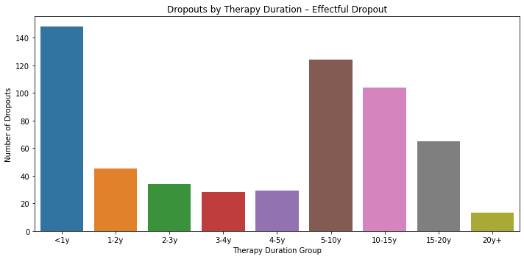
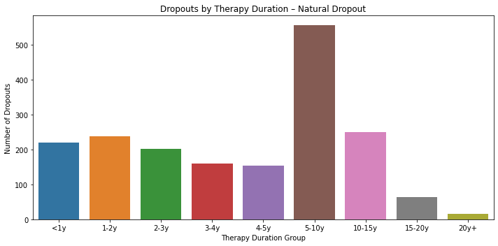
Dropout of Patient
Duration | Natural Dropout (%) | Effectful Dropout (%)
<1y | 11.81 | 25.08
1-2y | 12.83 | 7.63
2-3y | 10.84 | 5.76
3-4y | 8.63 | 4.75
4-5y | 8.25 | 4.92
5-10y | 29.97 | 21.02
10-15y | 13.48 | 17.63
15-20y | 3.4 | 11.02
20y+ | 0.81 | 2.2
04
Dropout Analysis

