Slide 1

AirGenious Interventions
AirGenious_Interventions = ['O1', 'O2', 'O3', 'O4', 'O5', 'O6', 'O7', 'O8', 'O9', 'oa']
1. Low Effort Remote Notification (Effort Level A)
Remote_Notification on LISA app: Push notifications sent via the LISA app.
Remote_Email: Emails sent directly to the patient.
Remote_SMS:
SMS Observance AIRGENIOUS (O1): Remind patients regarding compliance.
SMS Fuite AIRGENIOUS (O2): Notify patients about leakage issues.
2. Personalized Remote Intervention (Effort Level B)
Remote_Phone/Video Call:
APPEL Observance AIRGENIOUS (O3): Call to address compliance issues.
APPEL Fuite AIRGENIOUS (O4): Call to address leakage issues.
3. Physician Collaboration (Special Level)
APPEL IAH AIRGENIOUS (O5): Inform prescriber about AHI flow issues and determine intervention actions.
21
Notes:
1. Low Effort Remote Notification (Effort Level A)
Goal: Notify patients about compliance or other clinical parameters in a non-intrusive manner.
2. Personalized Remote Intervention (Effort Level B)
Goal: Provide a more interactive approach by directly communicating with patients via phone or video to address compliance or leakage issues.
3. Physician Collaboration (Special Level)
Goal: Involve prescribers when a clinical decision is necessary, especially for addressing AHI flow issues.
4. High Effort In-Person Interventions (Effort Level C)
Goal: Conduct in-person visits, either at a healthcare center or at home, for patients who need intensive assistance.

Slide 2
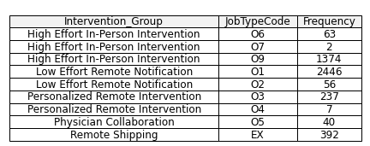
AirGenious Interventions
AirGenious_jobtypes = ['O1', 'O2', 'O3', 'O4', 'O5', 'O6', 'O7', 'O8', 'O9', 'oa']
4. High Effort In-Person Interventions (Effort Level C)
Presential_Linde Center:
VISITE Observance AIRGENIOUS (O6): Observance visit at a Linde center.
VISITE Fuite AIRGENIOUS (O7): Leakage visit at a Linde center.
VISITE IAH AIRGENIOUS (O8): Visit for AHI flow issues at a Linde center.
2. Presential_Home Visit:
VISITE Observance AIRGENIOUS (O6): Technician visits the patient’s home for compliance issues.
VISITE Fuite AIRGENIOUS (O7): Technician visits for leakage problems.
VISITE IAH AIRGENIOUS (O8): Technician visits for AHI flow issues.
5. Remote_Shipping (Supporting Intervention)
Remote_Shipping:
ET, EX: Shipment of equipment remotely as part of treatment.
Number of unique patients in AirGenious: 6272
After Cleaning steps:3621
Number of unique patients in NotAirGenious: 32001
Last 6 months
22
Notes:
5. Remote_Shipping (Supporting Intervention)
Goal: Ship equipment to patients as part of their treatment or as a follow-up to another intervention

Slide 3
AirGenious Data Results
AtHomePatientId | JobTypeCode | Occurrences
46220 | O1 | 2
46220 | O9 | 2
46220 | EX | 1
46220 | VK | 1
46220 | VM | 1
JobTypeCode | Occurrences
VK | 20075
EX | 8805
HL | 6210
AP | 5454
VH | 5196
V9 | 2690
TT | 2459
IU | 1896
VA | 1790
TA | 1470
JobTypeCode | Occurrences
O1 | 5280
O9 | 3744
O2 | 2206
O3 | 845
O4 | 679
O5 | 445
O7 | 409
O6 | 312
24

Slide 4
Analyzing AirGenious Data Results
Patient 46220
ReferenceDate | JobTypeCode | OneSleepId | TherapyStartDate | DaysFromTherapyToJobType | DaysFromPreviousJobType | QuestionnaireIds
02/05/2024 | O1 | 22846 | 22/06/2016 | 2871 | 0
31/05/2024 | O9 | 25053 | 22/06/2016 | 2900 | 29
19/06/2024 | VK |  | 22/06/2016 | 2919 | 18 | 410
19/06/2024 | VM |  | 22/06/2016 | 2919 | 0
24/06/2024 | EX |  | 22/06/2016 | 2924 | 5
29/08/2024 | O1 | 34706 | 22/06/2016 | 2990 | 65
27/09/2024 | O9 | 39085 | 22/06/2016 | 3019 | 29
25

Slide 5
Analyzing AirGenious Data Results
Patient 46220
ReferenceDate | JobTypeCode | Use | Leaks95 | Leaks0 | AHI | Presure90 | Presure0
5/2/2024 | O1 | 5.95 | 16.8 | 3.6 | 0.8 | 9.84 | 8.64
5/31/2024 | O9 | 5.32 | 22.8 | 4.8 | 0.7 | 9.96 | 9.12
6/19/2024 | VK | 5.93 | 18 | 9.6 | 0.8 | 8.88 | 8.4
6/19/2024 | VM | 5.93 | 18 | 9.6 | 0.8 | 8.88 | 8.4
6/24/2024 | EX | 5.23 | 16.8 | 8.4 | 0.3 | 9 | 8.76
8/29/2024 | O1 | 5.82 | 27.6 | 4.8 | 0.5 | 9 | 8.76
9/27/2024 | O9 | 6.73 | 21.6 | 0 | 0.2 | 9 | 8.88
26

Slide 6
Analyzing AirGenious Data Results
Patient 46220
JobTypeCode | ReferenceDate | Mean_AHI | Mean_Usage | Mean_Leakage | Days_Before_JobType | Mean_AHI_After | Mean_Usage_After | Mean_Leakage_After | Days_After_JobType
Before_FirstJobType | 5/2/2024 | 0.3 | 5.13 | 14.4 | 8
O1_to_O9 | 5/31/2024 | 0.56 | 5.11 | 18.32 | 26
O9_to_VK | 6/19/2024 | 0.74 | 5.04 | 17.11 | 19
VK_to_VM | 6/19/2024 |  |  |  | 0
VM_to_EX | 6/24/2024 | 0.4 | 4.14 | 16.32 | 5
EX_to_O1 | 8/29/2024 | 0.59 | 5.06 | 19.12 | 66
O1_to_O9 | 9/27/2024 | 0.62 | 5.80 | 20.31 | 29
LastJobType_to_End | 9/27/2024 |  |  |  |  | 0.428 | 5.77 | 20.352 | 25
27

Slide 7
Analyzing AirGenious Data Results
Rate of change Patient 46220
From_JobTypeCode | To_JobTypeCode | AHI_Rate_Of_Change | Usage_Rate_Of_Change | Leakage_Rate_Of_Change | JobType_Occurrence
Before_FirstJobType | O1_to_O9 | 0.26 | -0.015 | 3.92 | 1
O1_to_O9 | O9_to_VK | 0.17 | -0.071 | -1.20 | 2
O9_to_VK | VK_to_VM |  |  |  | 3
VK_to_VM | VM_to_EX |  |  |  | 4
VM_to_EX | EX_to_O1 | 0.19 | 0.92 | 2.80 | 5
EX_to_O1 | O1_to_O9 | 0.025 | 0.73 | 1.19 | 6
O1_to_O9 | LastJobType_to_End |  |  |  | 7
27

Slide 8
All transaction in AirGenious Data
Transition | TotalOccurrences
O1_to_O1 | 1090
O1_to_O9 | 975
O9_to_O1 | 586
O1_to_VK | 504
O9_to_VK | 418
VK_to_O1 | 385
O1_to_O3 | 190
VK_to_EX | 171
EX_to_O1 | 146
From_JobTypeCode | To_JobTypeCode | Mean_Days_For_Transaction
AM | O1 | 125
AP | AP | 11
AP | AW | 4
AP | EX | 13.
AP | HL | 1
AP | LC | 8
AP | O1 | 39
AP | O3 | 12.6
AP | O5 | 22
From_JobTypeCode | To_JobTypeCode | AHI_Mean_Change | Usage_Mean_Change | Leaks95_Mean_Change
O1 | AP | 0.35 | -0.7 | -2.4
O1 | AW | -1.2 | 0.48 | 7.2
O1 | EX | 0.018 | 0.26 | -4.03
O1 | FO | 1.65 | -0.465 | 1.2
O1 | HL | -0.53 | -0.32 | -2.86
O1 | O1 | 1.11 | -0.09 | 4.3
O1 | O3 | 0.68 | -0.23 | 2.96
O1 | O5 | 5.4 | 1.55 | -4.8
28

Slide 9
All transaction in AirGenious Data
JobTypeCode | Min_AHI | Max_AHI | Min_Usage | Max_Usage | Min_Leakage | Max_Leakage
O1_to_AP | 0.00 | 11.04 | 0.15 | 7.22 | 1.00 | 31.89
O1_to_AW | 0.93 | 2.16 | 3.13 | 4.90 | 10.38 | 23.01
O1_to_CM | 4.02 | 4.02 | 0.11 | 0.11 | 6.01 | 6.01
O1_to_FO | 0.25 | 2.08 | 5.77 | 9.72 | 0.00 | 31.80
O1_to_O1 | 0.01 | 40.01 | 0.36 | 8.14 | 0.00 | 96.51
O1_to_O5 | 6.02 | 23.40 | 0.00 | 7.21 | 7.20 | 34.20
O1_to_O6 | 0.48 | 3.07 | 3.10 | 3.95 | 23.43 | 40.11
O1_to_O9 | 0.03 | 39.72 | 1.69 | 9.56 | 0.00 | 52.02
O1_to_OP | 2.65 | 2.65 | 2.83 | 2.83 | 19.20 | 19.20
O1_to_PG | 0.23 | 1.44 | 3.45 | 7.51 | 0.00 | 23.79
O1_to_PW | 0.85 | 3.04 | 2.49 | 4.28 | 7.20 | 7.20
O1_to_RC | 3.70 | 3.70 | 10.40 | 10.40 | 12.60 | 12.60
O1_to_SA | 0.73 | 0.73 | 0.00 | 1.79 | 6.80 | 6.80
O1_to_SC | 0.30 | 5.87 | 0.00 | 9.33 | 0.00 | 25.80
O1_to_TA | 0.55 | 1.99 | 4.21 | 6.69 | 17.94 | 37.20
O1_to_VA | 0.07 | 17.75 | 0.82 | 7.83 | 0.64 | 72.60
O1_to_VH | 0.35 | 3.62 | 0.00 | 7.38 | 0.00 | 58.60
29

Slide 10
All transaction in AirGenious Data
JobTypeCode | MinOccurrences | MaxOccurrences | MeanOccurrences
AP_to_O1 | 38 | 38 | 38
EX_to_O1 | 146 | 146 | 146
EX_to_O9 | 74 | 74 | 74
EX_to_VK | 53 | 53 | 53
HL_to_EX | 46 | 46 | 46
HL_to_VH | 36 | 36 | 36
HL_to_VK | 48 | 48 | 48
O1_to_EX | 51 | 51 | 51
O1_to_HL | 65 | 65 | 65
O1_to_O1 | 1090 | 1090 | 1090
O1_to_O3 | 190 | 190 | 190
O1_to_O9 | 975 | 975 | 975
O1_to_VK | 504 | 504 | 504
O3_to_O9 | 73 | 73 | 73
O3_to_VK | 41 | 41 | 41
O9_to_EX | 35 | 35 | 35
O9_to_HL | 38 | 38 | 38
O9_to_O1 | 586 | 586 | 586
O9_to_O2 | 46 | 46 | 46
O9_to_VK | 418 | 418 | 418
VA_to_VK | 36 | 36 | 36
VK_to_AP | 54 | 54 | 54
VK_to_EX | 171 | 171 | 171
VK_to_O1 | 385 | 385 | 385
VK_to_O9 | 143 | 143 | 143
30

Slide 11
Criteria for selection of Medical Survey
Patient Profile and Baseline Characteristics
Criteria: Age, gender, BMI, health literacy, sociological factors, psychological history.
Rationale: Tailor surveys to individual characteristics, e.g., Beck Depression Inventory (BDI) for mental health needs impacting adherence.
· Adherence and Usage Patterns
Criteria: CPAP use frequency, duration, consistency, and challenges (e.g., leakage).
Rationale: Low adherence may prompt quick assessments like the Epworth Sleepiness Scale (ESS), while consistent users benefit from comprehensive surveys (SF-36, PSQI) for deeper insights.
· Intervention Type and Intensity
Criteria: Intervention level (remote vs. in-person), clinical needs.
Rationale: Simple surveys like ESS for low-effort interventions; more detailed surveys (SF-36, condition-specific) for intensive or clinical interventions.
· Duration and Follow-Up Needs
Criteria: Short- vs. long-term monitoring and patient engagement.
Rationale: Frequent early-stage follow-ups (PSQI, FSS) for adjustments; long-term tools (SF-36) at 3–6 month intervals for sustained monitoring.
· Targeted Health Outcomes
Criteria: Goals like improved daytime function or mental health stabilization.
Rationale: Mental health goals use BDI or SF-36; daytime function improvements measured by ESS and FSS to monitor alertness and productivity.
31

Slide 12
Medical Survey Regarding the AirGenious Intervention Category
Intervention Level | Metric Trigger Conditions | Suggested Surveys | Suggested Timing
Low Effort Remote Notification (Effort Level A) | Compliance score 1-3; Leakage or AHI score 0-2 | ESS (for sleepiness), PSQI Subsections (for specific sleep issues) | 14 Days, Monthly or quarterly, based on compliance trend
Personalized Remote Intervention (Effort Level B) | Compliance score 4-5; Moderate AHI/Leakage trend increasing | PSQI, Fatigue Severity Scale (FSS) for fatigue and adherence | monthly, ideally after noted compliance declines
Physician Collaboration (Special Level) | Compliance or AHI score 6; trend stable or worsening | SF-36, BDI, AHI-specific survey for respiratory focus | Monthly; typically initiated by physician assessment
High Effort In-Person Interventions (Effort Level C) | Severe non-compliance or high leakage; AHI > 15 | Comprehensive surveys (PSQI, SF-36, ESS) for sleep quality, health, and adherence | Before and after each in-person visit to track changes
Remote Shipping (Supporting Intervention) | Low initial compliance or AHI/Leakage scores | Device Satisfaction Survey | Immediate post-shipping and at 1-month follow-up
32

Slide 13
Selection of Medical Survey Base on Usage patterns
ReferenceDate | JobTypeCode | Use | AHI | Leaks95 | Recommended_Survey
02/05/2024 | O1 | 5.95 | 0.8 | 16.8 | Personalized Remote Intervention: PSQI, FSS
31/05/2024 | O9 | 5.32 | 0.7 | 22.8 | Personalized Remote Intervention: PSQI, FSS
19/06/2024 | VK | 5.93 | 0.8 | 18 | Personalized Remote Intervention: PSQI, FSS
19/06/2024 | VM | 5.93 | 0.8 | 18 | Personalized Remote Intervention: PSQI, FSS
24/06/2024 | EX | 5.23 | 0.3 | 16.8 | Personalized Remote Intervention: PSQI, FSS
29/08/2024 | O1 | 5.82 | 0.5 | 27.6 | Personalized Remote Intervention: PSQI, FSS
27/09/2024 | O9 | 6.73 | 0.2 | 21.6 | Personalized Remote Intervention: PSQI, FSS
Responded QuestionId 410 in 6/19/2024:
Mean Values for All Dates Before the Questionnaire (up to June 18, 2024):
Usage (Use): 5.29 hours
AHI: 0.67
Leaks95: 18.97
Mean Values for All Dates After the Questionnaire (from June 20, 2024, onwards):
Usage (Use): 5.39 hours
AHI: 0.72
Leaks95: 18.51
Analysis
Usage: Slightly increased after the questionnaire (from 5.29 to 5.39 hours).
AHI: A minor increase was observed in the AHI (from 0.67 to 0.72).
Leaks95: Leakage values showed a slight decrease (from 18.97 to 18.51).
33

Slide 14
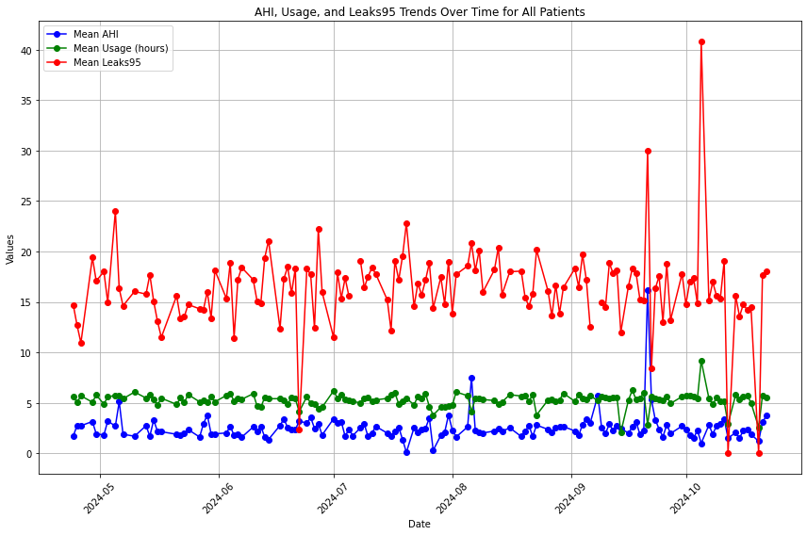
AHI, Usage and Leakage95 Trend During Last 6 Months
34

Slide 15
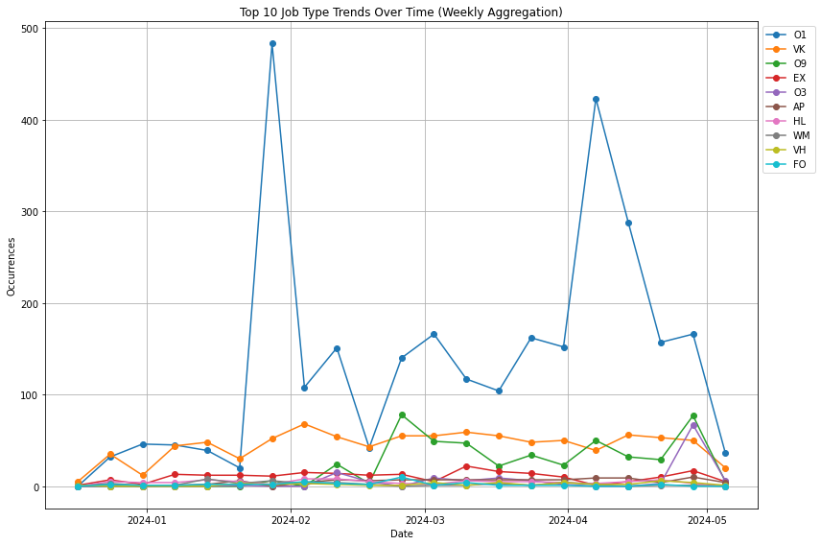
Ten Most Frequently Repeated Interventions in Weekly Aggregation
35

Slide 16
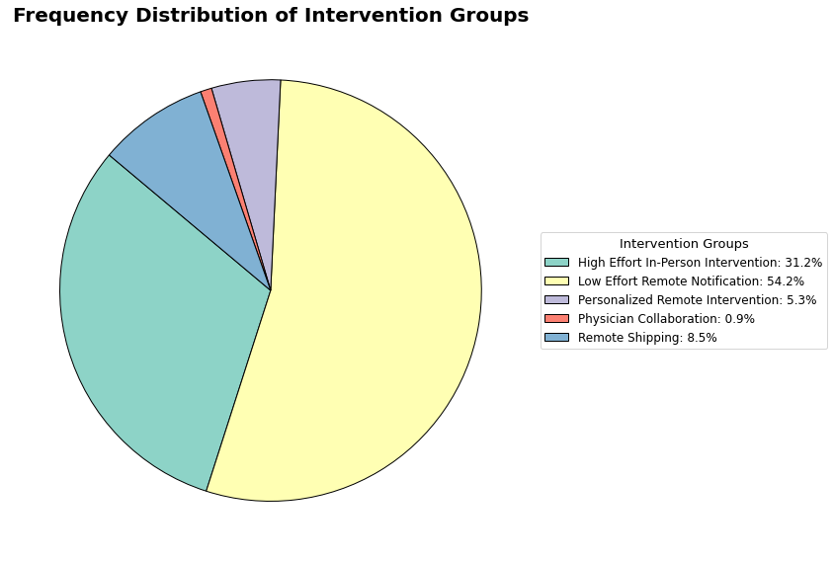
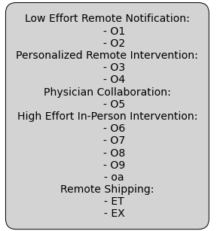
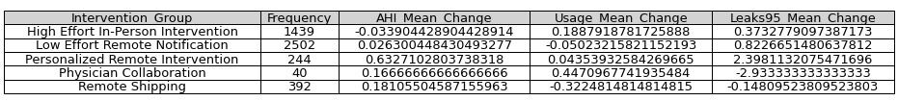
Results of AirGenious Interventions
36

