Slide 1
Health Hub
Back-End(.NET)

Slide 2
Back-ENd
User Verification at Initial Registration:
Users must confirm their account when registering for the first time to ensure authenticity.
Secure Login Process:
During the login process, a token is sent to the user interface (UI) to maintain secure sessions..
Admin Action Logging:
Every action performed by the admin is logged for security and audit purposes.

Slide 3
Back-End
Rate Limiting:
Implementing rate limits to prevent DDoS attacks on the server.
JWT for Secure Tokens:
Using JSON Web Tokens (JWT) to ensure that tokens are not decrypted, maintaining a high level of security.
Automated System Actions:
The system automatically handles certain actions, such as managing appointments for patients who fail to show up.
Patients receive warnings, and after three warnings, they are blocked from the system.

Slide 4
Back-End
Patient Reviews:
Each patient has the right to rate a doctor once and only if they have attended a medical session with the doctor.
Data Cleanup:
Deleting prescriptions, diseases, and medical sessions data for patients who have recovered to keep the system up-to-date and efficient..
Error Logging:
Implementing a comprehensive error logging system to record any errors that occur within the system.
These logs help in identifying, diagnosing, and fixing issues promptly to ensure smooth operation.

Slide 5
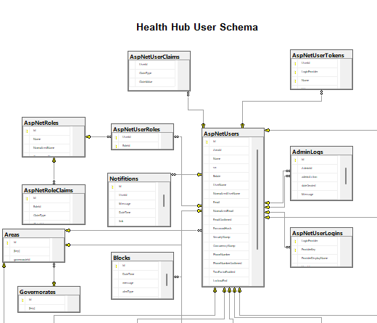
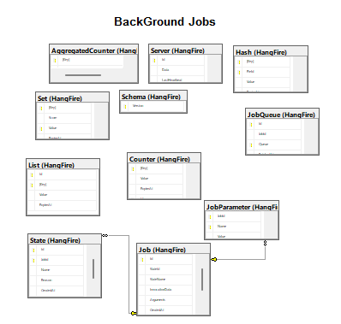
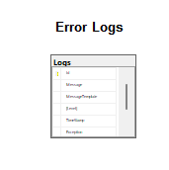
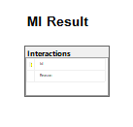
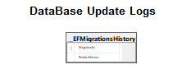
database-Digrams

Slide 6
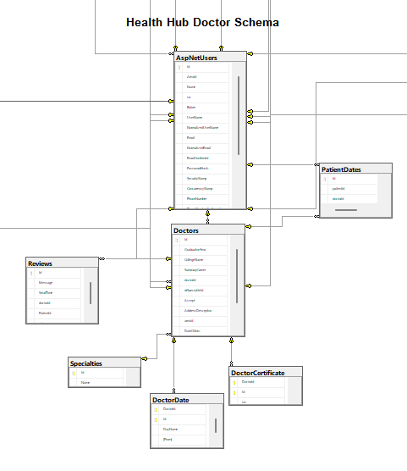
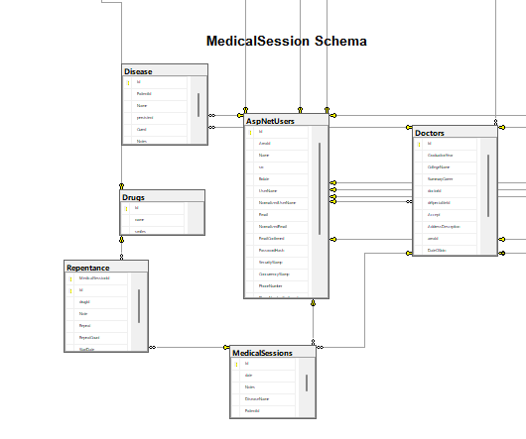

Slide 8
Roles
Patient
Doctor
Customer Service
Admin

Slide 9
Automatic Desisions
Blcok User Or Doctor(IF Not Go To MeddicalSession )
Survey of diseases that have been cured
Delete Old Notification

Slide 10
Notification

Slide 11
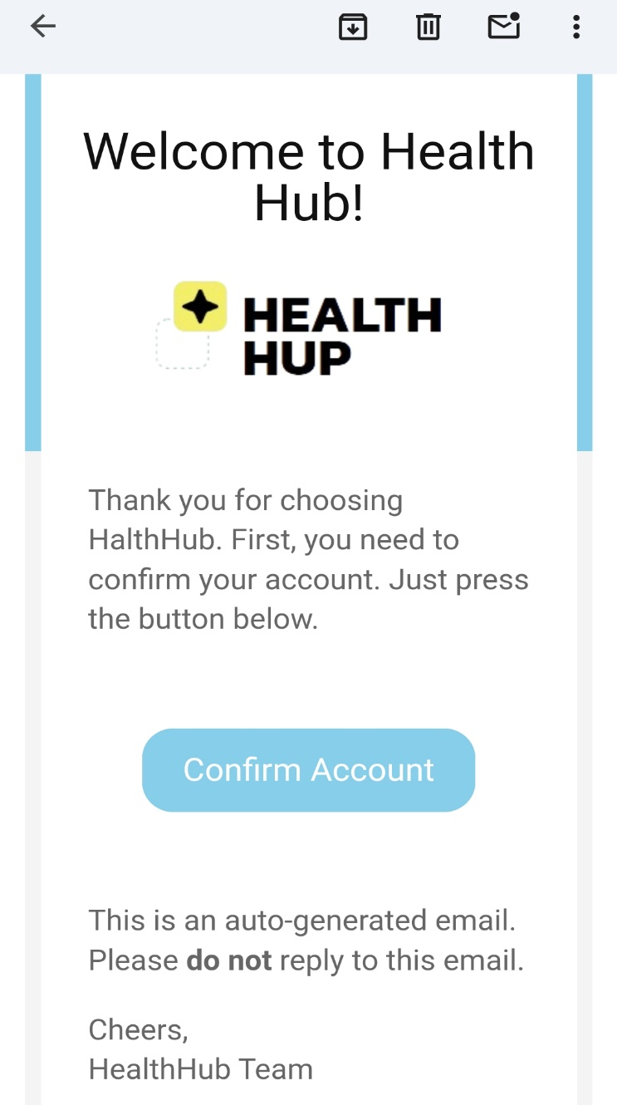

Confirm Account

Slide 12
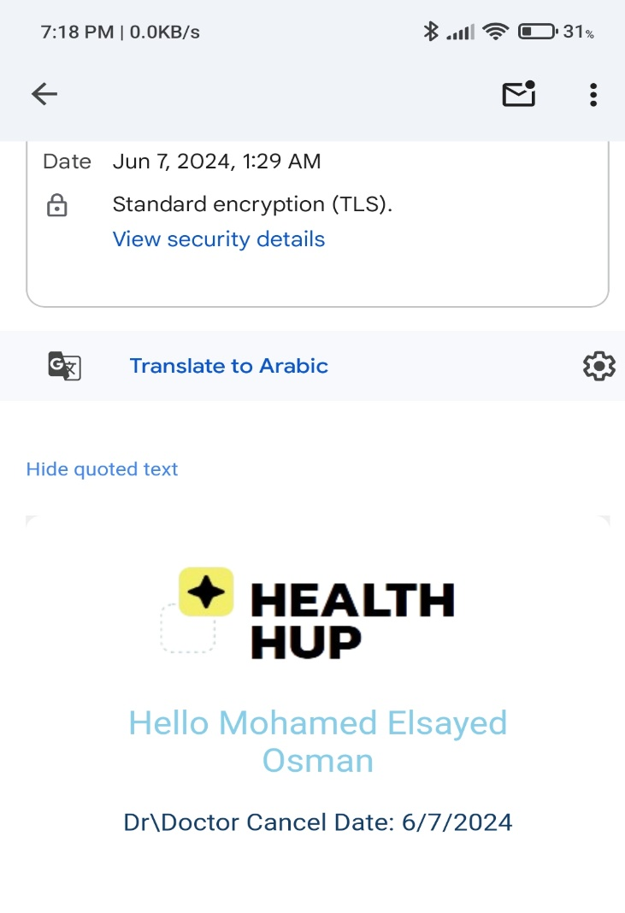
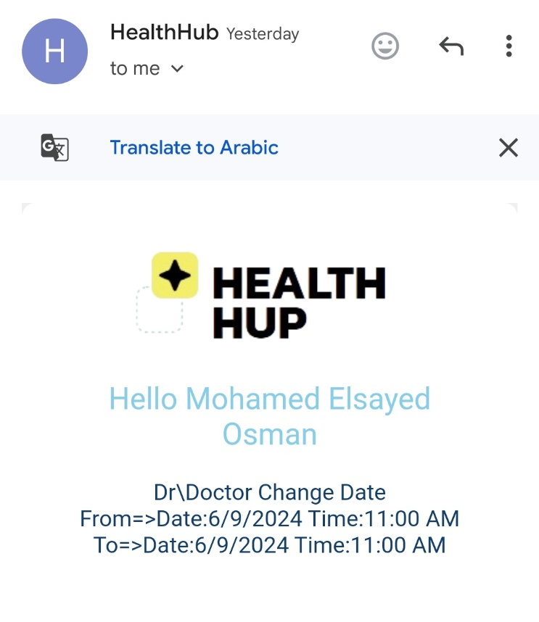
Doctor Change Or cancel Date

Slide 13
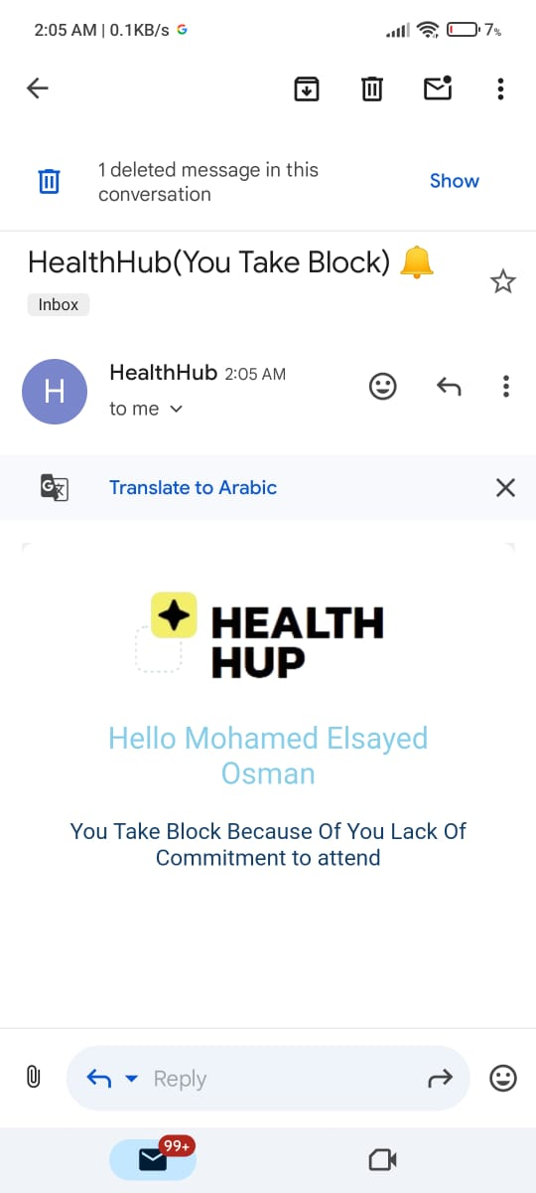
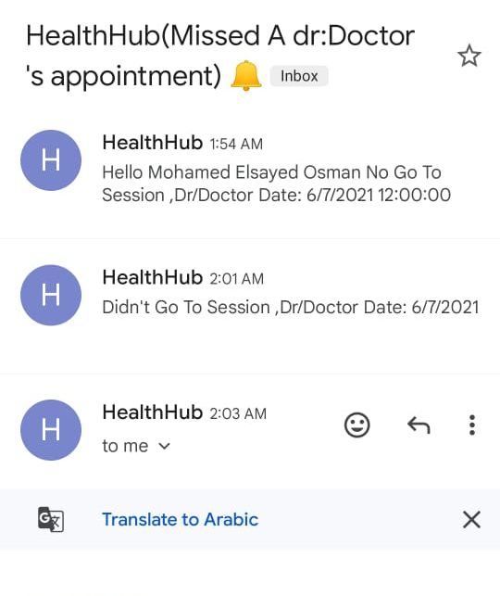
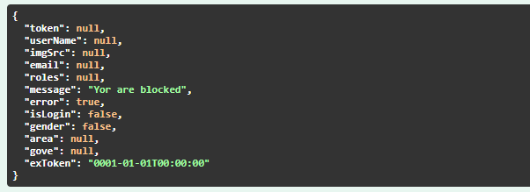
Block

