Slide 1
Auth Controller
Model:
InputLogin:
userName:string//Email(Admin001@gmail.com) Or UserName(Admin001)
password:string //minLen(8),Required,mustHave(CapitalChar(1)),(Num(1)),(_@()!+*(1))
// RegularExpression("^(?=.*[a-z])(?=.*[A-Z])(?=.*\\d)(?=.*[_#$^+=!*()@%&]).{8,}$")]
InputRegister:
name:string//fName,mName
email:string //must (******@*****.com)
password:string //minLen(8),Required,mustHave(CapitalChar(1)),(Num(1)),(_@()!+*(1))
// RegularExpression("^(?=.*[a-z])(?=.*[A-Z])(?=.*\\d)(?=.*[_#$^+=!*()@%&]).{8,}$")]
phone:string //min|maxLen(11),required,(str:01,[0|1|2|5])
// RegularExpression(@"^01[0125][1-9]{8}$")]
birday:date
area:string //Key No tId
gender:bool //True=> male ,false =>female
DTOUserInformation
{
string name
string email
string phone
string gove
string area
string gender
string img
int age
DateOnly birDay
}
OUser:
token:string
username:string //Fname,Mname
imgSrc:string //Image User
email:string
roles:string[]
message:string //Return With Login |Register if error in input or email
error:bool
isLogin:bool
exToken:date
area: string
gove:string

Slide 2
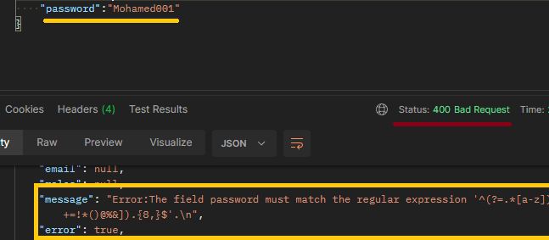
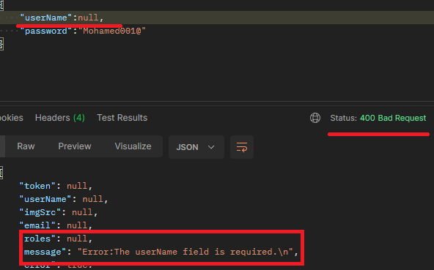
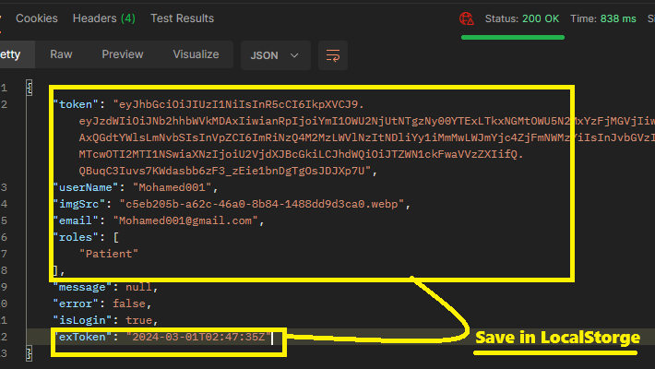
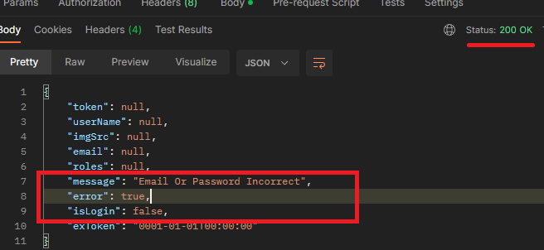
Auth EndPoint:
Login:
'POST' \ 'http://localhost:5225/Auth/Login'
Inputs=> input:InputLogin
output=> Ouser

Slide 3
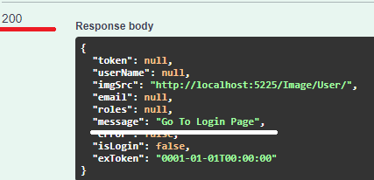
Register EndPoint:
'POST' \ 'http://localhost:5225/Auth/Register'
**Send With FormData
Inputs=>{
Key=“Img”=>value?:file(Type:image)//Can null
Key=“input”=>value: InputRegister
}
output=> Ouser
Add Role:**Must User Login And Have Role:["Admin”|”CustomerService"]
'PUT' \ 'http://localhost:5225/Auth/AddRole?Email=UserEmail&Role=CustomerService'
**User Must not Have Role And Role in Db
Inputs=>{
Email:string,
Role:string
}
output=> string
Add Role:**Must User Login And Have Role:["Admin”|”CustomerService"]
'PUT' \ 'http://localhost:5225/Auth/RemoveRole?Email=UserEmail&Role=CustomerService'
**User Must Have Role And Role in Db
Inputs=>{
Email:string,
Role:string
}
output=> string

Slide 4
Change Password:Must User Login
'PUT' \ 'http://localhost:5225/Auth/ChangePassword?OldPassword=OldPassword&NewPassowrd=NewPassword'
Inputs=>{
OldPassword:string,
NewPassword:string
}
output=> string
Forget Password
'PUT' \ 'http://localhost:5225/Auth/ForgetPassword?NewPassword=NewPassword'
Inputs=>{
NewPassword:string
}
output=> string
Change Imgage
'PUT' \ 'http://localhost:5225/Auth/ChangePhoto
**Send With FormData
Inputs=>{
Key=“Img”=>value?:file(Type:image)
}
output=> bool
GetUser
Inputs=>{
Email?:string
}
---الاميل اختياري لو مبعتوهش هبعت ليك اليوزر الحالي
لو بعتو هبعت ليك اليوزر الي انت عايزو
output=> DTOUserInformation
'GET' \ 'https://localhost:7224/Auth/GetUser?Email=Admin001%40gmail.com'

