Slide 1

Sales Dashboard
Data Analysis Project
Presented by :-
Mohamed Elkhateb
Tools of Analysis: Power BI

Slide 2
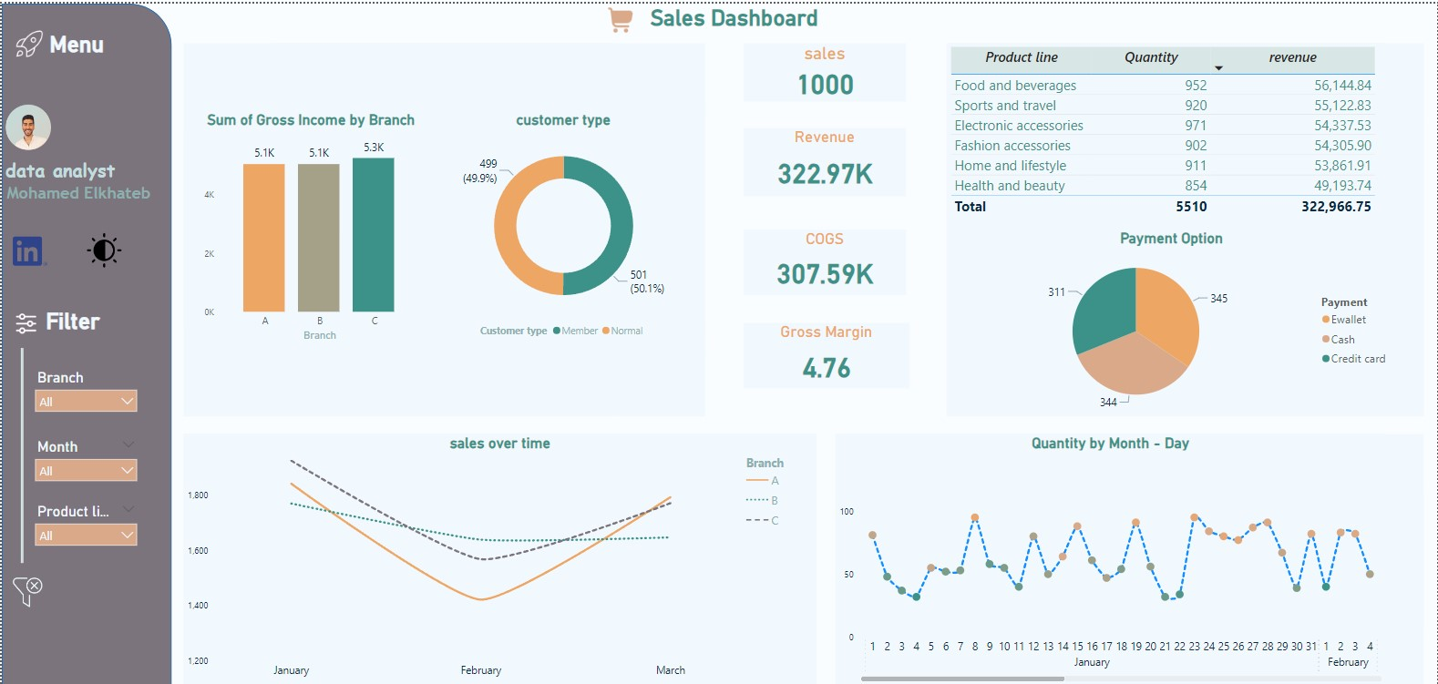
Dashboard Overview

Slide 3
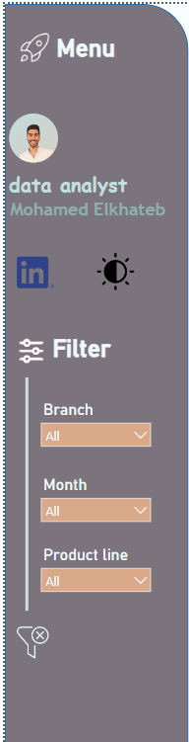


Dealing with the dashboard
Menu bar :
First of all , we can close it from - open it from
Menu bar include :
1- dark / light mode extinction
2- filter bar to filter our data , it include :-
-Branch Filter
-Month Filter
-Product line Filter
3- button to clear filter

Slide 4


Data interpretation and insights
Key Performance Indicators (KPIs) :
Sales = 1000
Cost of Goods Sold(COGS)=307.59K
Revenue =322.97K
Gross Margin = 4.76 %
By comparing revenue with COGS, we find that the company does not earn much because the difference between them is small, and this is clear from the Gross Margin ratio.
Solution :
Optimize Pricing Strategy
Reduce (COGS)
Enhance Product Quality
Increase Gross Margin
Marketing and Promotion

Slide 5
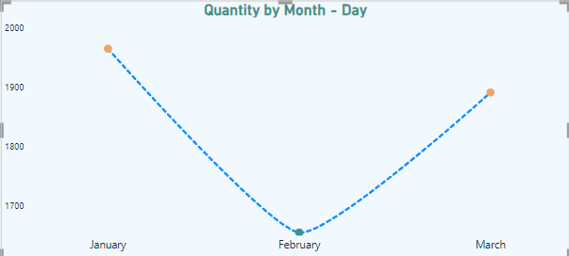
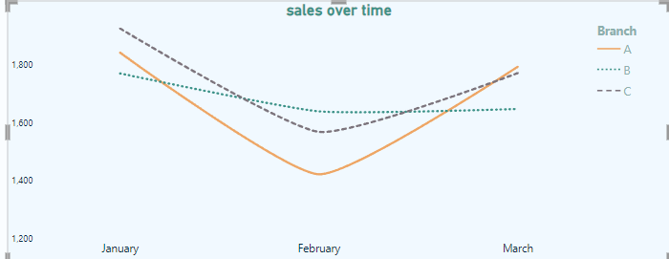
Data interpretation and insights
Quantity vs sales Per month :
By comparing the two charts, we find that in February, sales decrease compared to the period before and after February.
Comparing this with the quantity of goods available each month, we see that in February, the quantity of available goods is low.
These steps can mitigate the sales drop in February
Improve inventory planning and demand forecasting to ensure adequate stock levels.
Implement promotional strategies, such as pre-February discounts, to boost sales.
Utilize real-time inventory management and increase production before February to maintain sufficient stock levels.

Slide 6
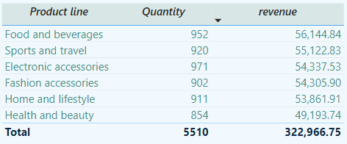
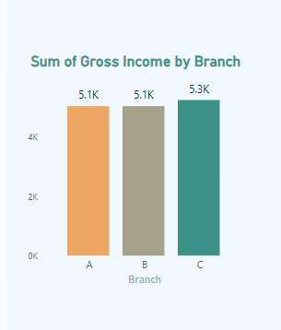
Data interpretation and insights
The top 5 categories with the highest revenue
Sum of Gross Income by branch
All branches have nearly equal gross income, but Branch C shows a slight increase compared to A and B.

Slide 7
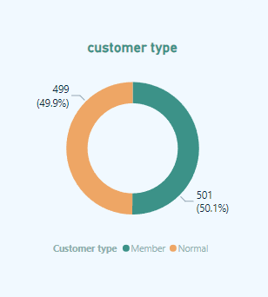
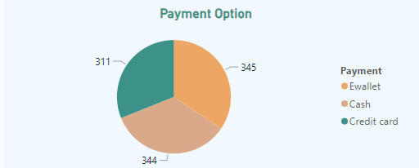
Data interpretation and insights
There are 2 types of customers :
member
normal
There are 3 Payment option :
eWallet (electronic wallet)
Cash
Credit
Customer types are almost equivalent in numbers.

Slide 8



Email : mobebo2007@gmail.com
01064810788

