Slide 1

Projectwork1(19AI701) – Review2
Hybrid Quantum–Classical CryptographicFrameworkfor Secure Data Communication
Submitted by:
MOHAMED FAREED(212222230082)
DevaDarshan A S(212222110007)
Adhithya Perumal D(212222230007)
2022-2026 Batch
TEAM NO: 205
Under the guidance of:
Ms.PANIMALAR S.P
Department of Information Technology
DEPARTMENT OF ARTIFICIAL INTELLIGENCE AND MACHINE LEARNING
SAVEETHA ENGINEERING COLLEGE
(Autonomous Institution – UGC, Govt. of India)
(Affiliated to Anna University, Approved by AICTE - Accredited by NBA & NAAC – ‘A’ Grade - ISO 9001:2015 Certified)
Saveetha Nagar, Thandalam, Chennai-602 105, TamilNadu, INDIA.

Slide 2
Agenda
Introduction
Statement of the Problem
Scope of the project
Methodology
  Architectural Diagram
  Flow
  Algorithm used
  Design - Use Case Diagram, Class Diagram
  Implementation
  Important code segments
Output, Results
Test Cases
Conclusions
Future work
References

Slide 3
Introduction
Digital communication growth demands strong protection for sensitive data.
Classical cryptography faces threats from future quantum attacks.
Quantum cryptography is secure but difficult to deploy at scale.
This project proposes a hybrid quantum–classical cryptographic framework.
It integrates QKD with post-quantum and classical encryption.
The system ensures secure, efficient, and future-ready communication.

Slide 4
Statement of the Problem
Existing cryptographic systems rely on mathematical complexity, which can be broken by quantum computers
Algorithms like RSA and Elliptic Curve Cryptography are vulnerable to Shor’s Algorithm
This threatens data confidentiality and long-term security
Pure quantum cryptographic solutions are secure but costly and hard to deploy
There is a need for a practical, scalable, and quantum-resistant framework
The challenge is to design a system secure against quantum attacks while remaining compatible with existing infrastructure

Slide 5
Scope of the project
Design and implementation of a hybrid cryptographic framework
Integration of Quantum Key Distribution (QKD) with classical and post-quantum encryption
Focus on secure key generation, key management, encryption, and decryption
Secure data transmission demonstrated through software simulation tools
Implementation limited to prototype-level simulation, not real quantum hardware
Evaluation based on security, performance, and adaptability for future quantum-resistant systems

Slide 6
Scope of the project
Limitations
  Implementation is limited to software-based simulation
  No use of real quantum communication hardware
  Network conditions are assumed to be ideal and controlled
  Performance results may differ in real-world deployment
Assumptions
  Secure and authenticated communication channels are available
  Quantum Key Distribution (QKD) is assumed to work without noise
  Classical and post-quantum algorithms are correctly implemented
  System users follow secure key-handling practices

Slide 7
Scope of the project
Key Technologies Used
  Quantum Key Distribution (QKD): Secure key exchange using quantum principles
  Post-Quantum Cryptography: Algorithms resistant to quantum attacks
  Classical Encryption: Used for data encryption and compatibility
  Hybrid Key Management: Combines quantum and classical keys securely
  Simulation Tools: Used to validate feasibility and performance
  Secure Communication Protocols: Ensure confidentiality and integrity

Slide 8
Methodology
Study of classical, post-quantum, and quantum cryptographic techniques
Design of a hybrid cryptographic model
Quantum Key Distribution (QKD) generates a shared secret key
QKD key is combined with a classical/post-quantum key to form a hybrid session key
System implemented using Python and cryptographic libraries
Secure communication simulated between sender and receiver
Functional and security testing using black-box and white-box methods
Performance evaluated based on encryption time and data integrity

Slide 9
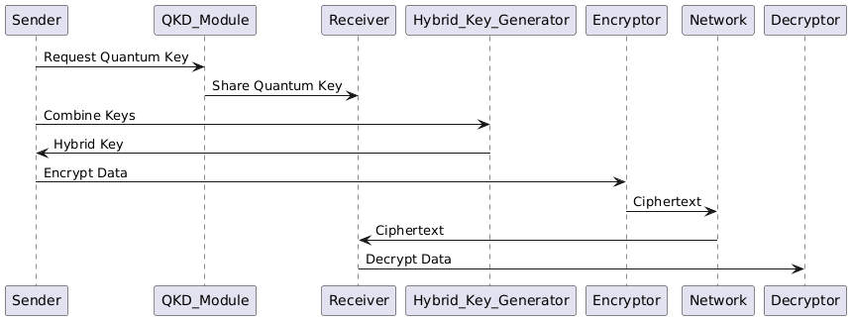
Architecture Diagram/Flow

Slide 10
Design-Use Case Diagram
UML DIAGRAMS
The use case diagram shows the interaction between the sender, receiver, and the hybrid cryptographic system.
The sender initiates secure communication by generating a quantum key using QKD.
A classical or post-quantum key is combined with the quantum key to form a hybrid session key.
The data is encrypted using the hybrid key and transmitted securely to the receiver.
The receiver decrypts the data and verifies its integrity, ensuring quantum-resistant communication.

Slide 11
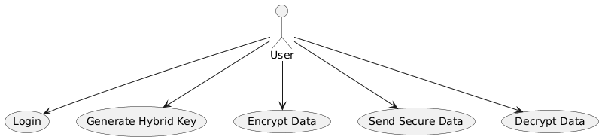
Design-Use Case Diagram

Slide 12
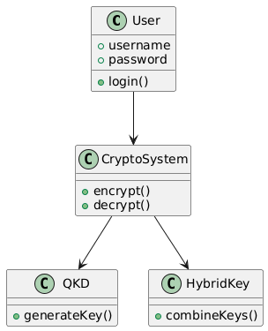
Design-Class Diagram
The class diagram shows the structure of the hybrid cryptographic system.User authentication and encryption are handled by the User and CryptoSystem classes.QKD and HybridKey generate and combine keys for secure communication..

Slide 13
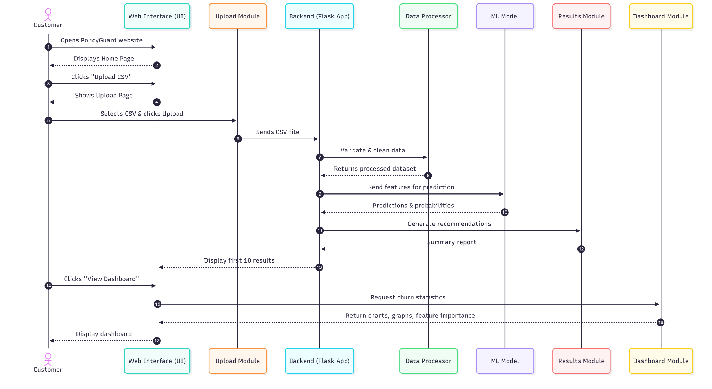
Sequence Diagram

Slide 14
Algorithms used
Quantum Key Distribution (QKD) Algorithm
Used for secure quantum key generation based on quantum principles.
Hybrid Key Generation Algorithm
Combines quantum keys with classical/post-quantum keys to form a hybrid session key.
AES Encryption Algorithm
Used for secure data encryption and decryption
Hashing Algorithm (SHA-256)
Ensures data integrity and message authentication.
Socket Communication Algorithm
Enables secure data transmission between sender and receiver.

Slide 15
Hardware and software selection
Hardware Requirements
  Processor: Standard PC/Laptop with multi-core CPU
  RAM: Minimum 8 GB (for cryptographic computations and simulations)
  Storage: 256 GB SSD or higher
  Network Interface: Ethernet / Wi-Fi for socket-based communication
  Quantum Hardware: Not required (QKD is simulated in software)
  Optional (Future): Access to cloud-based or real quantum communication hardware

Slide 16
Hardware and software selection
Software Requirements
Programming Language: Python 3.x
Cryptographic Libraries: PyCryptodome / Cryptography
Simulation Tools: Python-based QKD simulation modules
Networking: Python Socket Programming
Development Environment: VS Code / PyCharm
Operating System: Windows / Linux
Version Control: Git (optional)

Slide 17
Implementation
The system is implemented in Python using modular components for QKD simulation, hybrid key generation, encryption, and decryption.
The sender initiates a session and generates a quantum key through simulated random bits and basis comparison.
The quantum key is combined with a classical/post-quantum key to form a hybrid key.
AES is used for secure data encryption and decryption.
Socket programming, along with logging and exception handling, is used to simulate secure and reliable communication.

Slide 18
Important Code segments
import os
from cryptography.fernet import Fernet
# Hybrid key generation (simulation)
quantum_key = os.urandom(16)
classical_key = Fernet.generate_key()[:16]
hybrid_key = bytes(a ^ b for a, b in zip(quantum_key, classical_key))
# Encryption
cipher = Fernet(Fernet.generate_key())
encrypted_data = cipher.encrypt(b"Secure Message")
# Decryption
decrypted_data = cipher.decrypt(encrypted_data)
print(decrypted_data.decode())

Slide 19
Important Code segments
Key Modules
QKD Simulation Module:
Handles random bit generation, basis selection, and shared quantum key simulation.
Hybrid Key Generation Module:
Combines quantum keys with classical/post-quantum keys to create a hybrid session key.
Encryption & Decryption Module:
Implements AES-based encryption and decryption using the hybrid key.

Slide 20
Important Code segments
Security & Reliability
Key Validation Logic:
Ensures correct generation and synchronization of quantum and classical keys.
Error Handling Mechanisms:
Exception handling used to manage transmission and encryption errors.
Logging Module:
Logs key events for debugging, traceability, and audit purposes.
Data Integrity Checks:
Verifies encrypted and decrypted data to prevent tampering.

Slide 21
Output
OUTPUT:
The system successfully demonstrates secure data transmission using hybrid keys
Sender encrypts data and receiver correctly decrypts it, ensuring confidentiality and integrity
Test cases validate login, key generation, encryption, and decryption
The system shows resistance to basic attacks such as replay attempts
Performance evaluation indicates acceptable encryption and decryption time
Results confirm that the hybrid approach improves security while maintaining classical compatibility

Slide 22
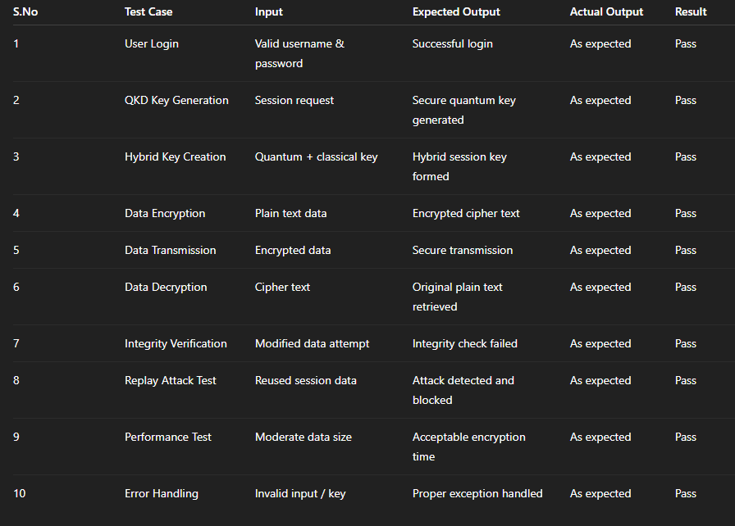
Test Cases
Test Cases

Slide 23
Results
Hybrid Cryptographic System
  Encryption Time: Low latency for moderate data sizes
  Decryption Time: Efficient and consistent performance
  Key Security: Hybrid keys successfully resist quantum-based threats
Inference:
  The system ensures secure and reliable data transmission by combining quantum and classical cryptography.
  It maintains confidentiality and integrity while remaining compatible with existing systems,proving its feasibility for future quantum-resistant communication

Slide 24
Conclusion
Hybrid Cryptographic Framework
  Successfully addresses security threats posed by quantum computing
  Integrates Quantum Key Distribution (QKD) with classical encryption techniques
  Achieves a balance between security, practicality, and scalability
  Ensures strong confidentiality and data integrity without full quantum infrastructure
Inference:
The results confirm that hybrid quantum–classical cryptography is an effective and feasible solution
for secure data communication, making it a promising approach for future-ready and resilient networks.

Slide 25
Future Work
System Enhancements
  Integration of real quantum hardware or cloud-based QKD services
  Adoption of advanced post-quantum algorithms (e.g., lattice-based cryptography)
  Extension to multi-user and large-scale network environments
  Performance improvement through optimization and hardware acceleration
Future Scope:
The framework can be expanded with blockchain-based key management and applied to
domains such as IoT, healthcare, and defense, while future research can focus on
standardization and interoperability with emerging quantum communication protocols.

Slide 26
References
Bennett, C. H., & Brassard, G. (1984). Quantum cryptography: Public key distribution.
Shor, P. (1994). Algorithms for quantum computation: Discrete logarithms and factoring.
Bernstein, D. J. (2009). Introduction to post-quantum cryptography.
Gisin, N. et al. (2002). Quantum cryptography. Rev. Mod. Phys.
Chen, L. et al. (2016). Report on post-quantum cryptography. NIST.
Menezes, A. et al. (1996). Handbook of Applied Cryptography.
Pirandola, S. et al. (2020). Advances in quantum cryptography.
Kahn Academy. Introduction to Cryptography.
NIST PQC Project Documentation.
Stallings, W. (2017). Cryptography and Network Security.

Slide 27


