Slide 1
FPGA-Based Edge-AI
Vision Accelerator
A 3×3 CNN convolution engine at one output pixel per cycle
IEEE SSCS Egypt Chapter · 2026 Student Design Competition
Xilinx Virtex-5 XC5VLX50T · Digilent Genesys · ISE 14.7
Notes:
3x3 convolution accelerator for the SSCS Egypt 2026 competition. Fully verified, timing closed, bitstream generated on Virtex-5.

Slide 2
WHERE WE LANDED
Headline results
317
0
167.0
476
Slice LUTs
Block RAMs
MHz F-max
mW total power
0.8755
78 / 78
70
2.398×10⁻³
out px / cycle
tests bit-exact
cycles to 1st output
Figure of Merit
All figures post-place-and-route, all timing constraints met, timing score 0.
Notes:
Zero BRAM and the FoM are the two numbers that matter most. 74% frequency headroom over the 100 MHz target.

Slide 3
THE BRIEF
What the design had to do
1
Input
32×32 grayscale, 8-bit unsigned fixed point
Scored on
2
Kernel
N×N with programmable coefficients, 8-bit signed
Correctness
Digital design quality
Resource usage
Latency and throughput
Timing closure
Power estimate
3
Stride
1, with a documented border policy
4
Output
16-bit signed minimum, overflow handling explained
5
Verify
Bit-exact against a Python / MATLAB / C golden model
6
Report
Utilisation, timing, power, and a Figure of Merit
Notes:
Note the scoring axes - resource usage and power both feed the Figure of Merit, which drove our key design decision.

Slide 4
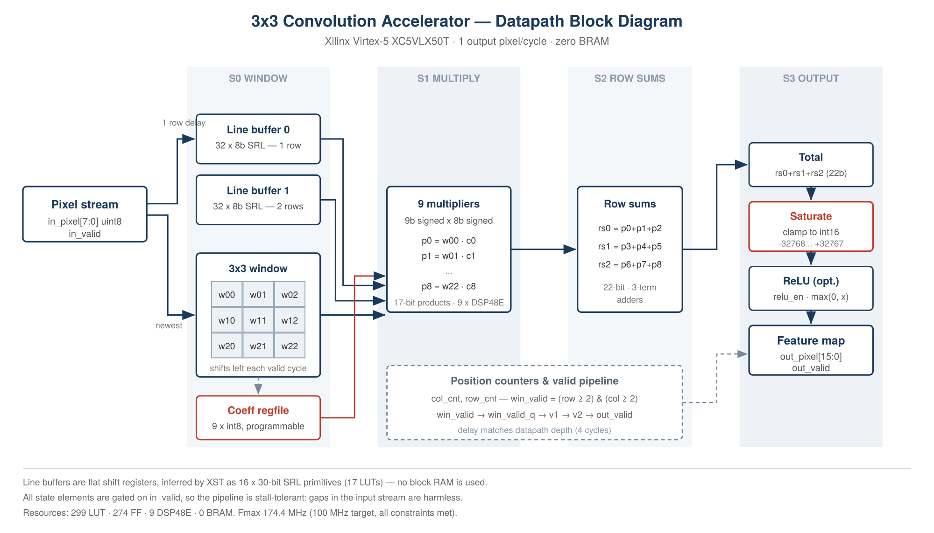
DATAPATH
Architecture
Notes:
Line-buffer sliding window. Two SRL line buffers feed a 3x3 register window; nine multipliers, three row sums, then saturation and optional ReLU.

Slide 5
PIPELINE
One output pixel per cycle
S0
S1
S2
S3
Window
Multiply
Row sums
Output
Two 32-deep SRL line buffers feed a 3×3 register window that shifts left every valid cycle.
→
Nine parallel 9×8 signed multiplies on DSP48E blocks. 17-bit exact products.
→
Three 3-term adders. Short combinational depth is why timing closes with 74% headroom.
→
Final sum, saturation to int16, then optional ReLU as a single-cycle clamp.
Stall-tolerant by construction
Every state element is gated on in_valid, so gaps in the input stream are harmless. The host wrapper therefore advances the stream at UART pace instead of buffering 900 results — one 16-bit register replaces a 14.4 kbit FIFO, which is what keeps BRAM at zero.
Notes:
The stall tolerance is the key architectural property - it eliminates the output FIFO entirely.

Slide 6
NUMERICS
Fixed-point analysis
Worst-case accumulator excursion, computed analytically in the golden model:
Kernel | Max positive | Max negative | Bits needed | Saturation
3×3 | +291,465 | −293,760 | 20 | Required
5×5 | +809,625 | −816,000 | 21 | Required
7×7 | +1,586,865 | −1,599,360 | 22 | Required
Saturation is mandatory
The accumulator range exceeds the 16-bit output range by roughly 9×, so results are clamped to −32,768 .. +32,767 rather than allowed to wrap.
20 of the 72 verification cases drive saturation deliberately, using all-+127 and all-−128 kernels against maximum-intensity images.
Saturation logic that never fires in simulation is untested logic.
22-bit accumulator implemented — headroom to N = 7 with no redesign.
Notes:
Bit-width analysis is derived, not guessed. The saturation test cases were written specifically so the clamp path is exercised.

Slide 7
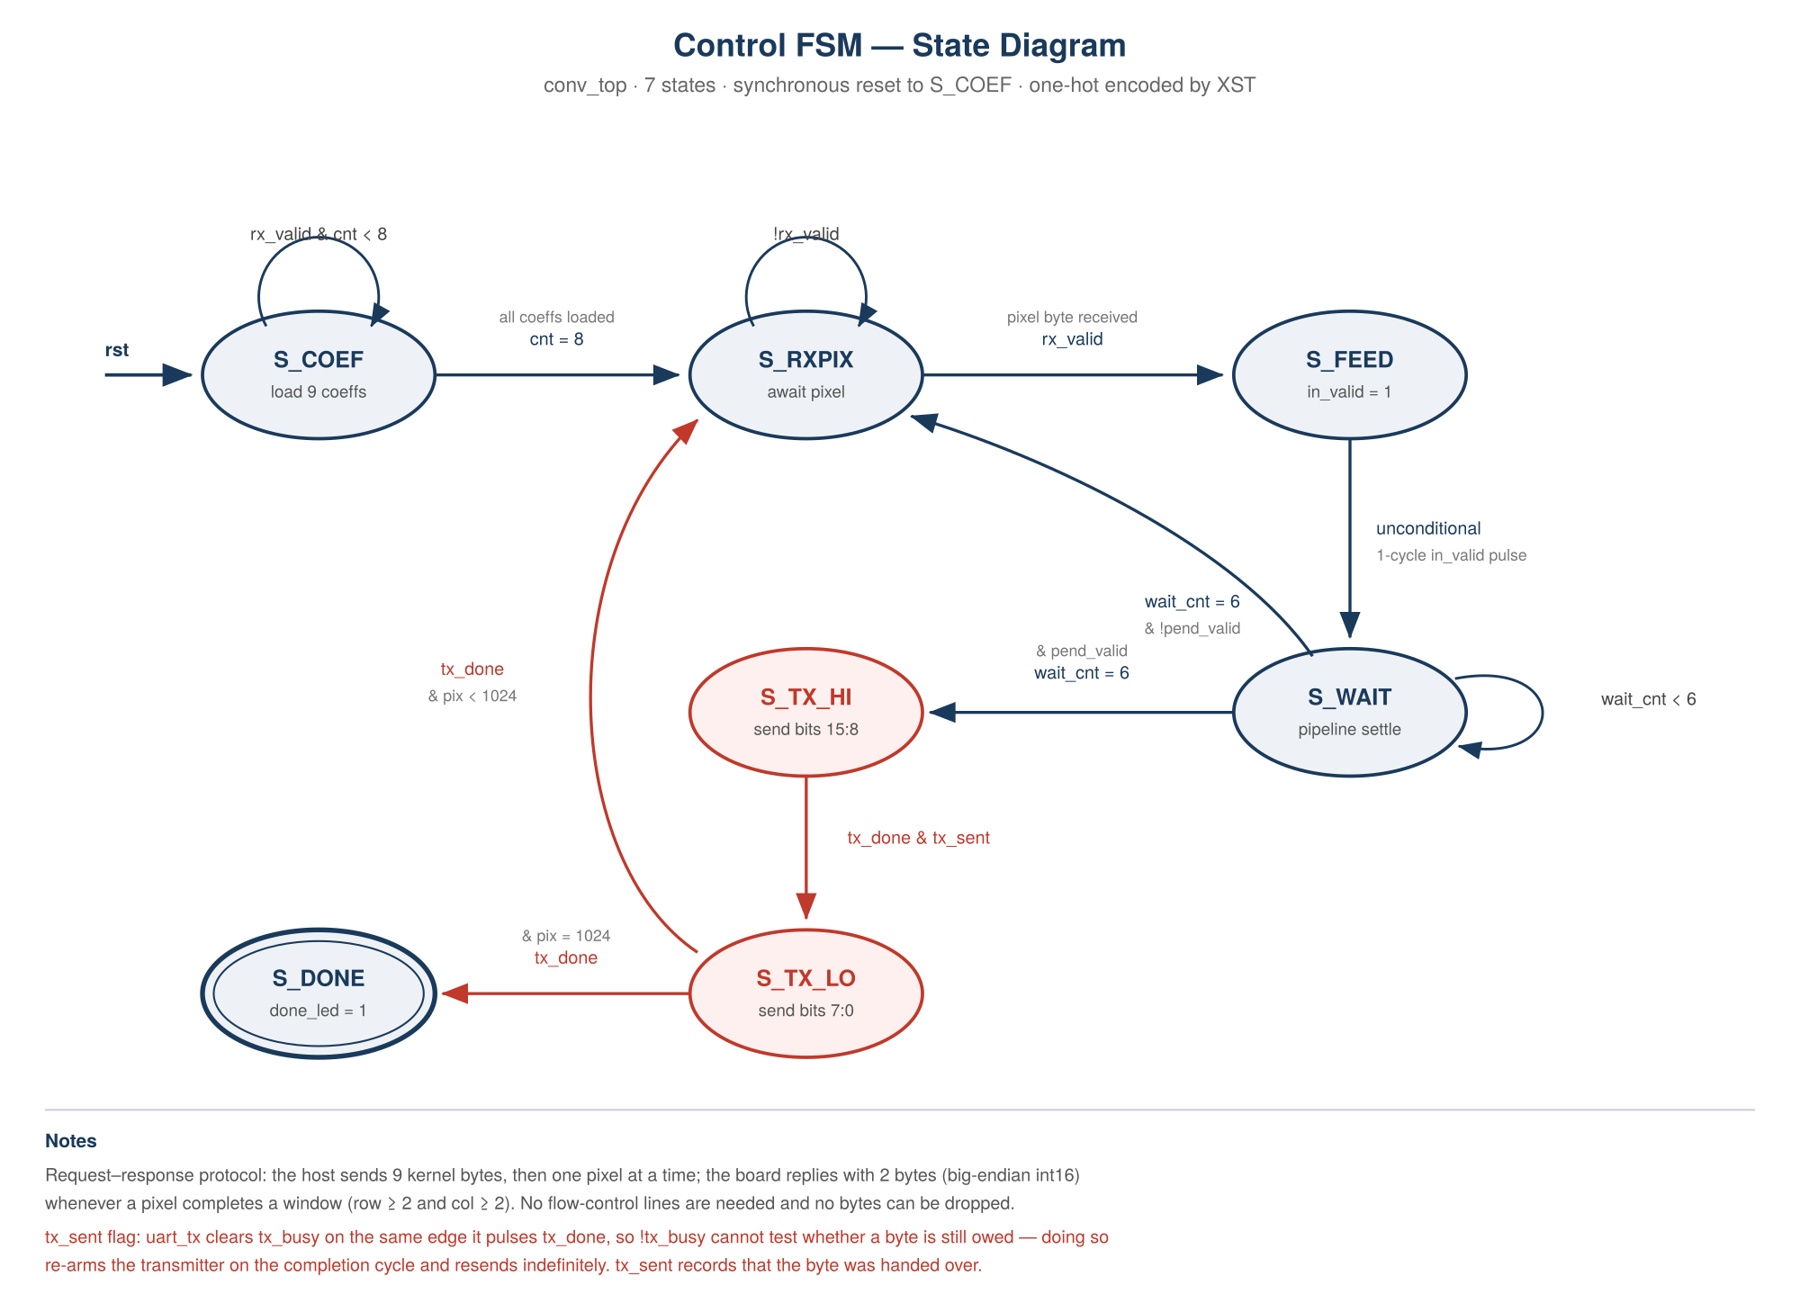
CONTROL
Control and host interface
Notes:
Request-response protocol over UART. Seven states. The tx_sent flag fixes a handshake race described on the verification slide.

Slide 8
VERIFICATION
Verified at three levels
Core
72 cases
System
6 cases
Host
8 cases
6 images × 6 kernels × ReLU on/off,
900 pixels each
Full UART protocol including
coefficient load and readback
Protocol sequencing with no
hardware attached (dry run)
72 / 72 bit-exact
900 / 900 each
All pass
Two defects found — both real synchronous-design hazards
Window-valid misalignment
UART transmit handshake race
Window registers and position counters update on the same edge, so the valid flag led the data by one cycle and every output shifted by one position. Fixed with a registered win_valid_q stage.
uart_tx clears tx_busy on the same edge it pulses tx_done, so testing !tx_busy re-armed the transmitter and it resent the same byte forever. Fixed with an explicit tx_sent flag.
Notes:
Both bugs were found by probing internal state in simulation. On hardware they would have shown only as a hung LED and garbage output.

Slide 9
DESIGN-SPACE EXPLORATION
We measured instead of assuming
FOM = Throughput ÷ [ Power × (LUTs + 50×DSPs + 100×BRAMs) ]
Nine DSP48E blocks contribute 450 units — 60% of the resource denominator. The natural hypothesis: move the multipliers into LUT logic and the FoM improves. So we built both.
 | Build A — DSP48E | Build B — LUT multipliers
Slice LUTs | 317 | 1,318
DSP48E | 9 | 0
Block RAM | 0 | 0
Resource cost | 767 | 1,318
F-max (post-route) | 167.0 MHz | 132.8 MHz
Figure of Merit | 2.398×10⁻³ | 1.395×10⁻³
The hypothesis was wrong
Each 9×8 signed multiplier costs about 113 LUTs in Virtex-5 fabric.
Removing the DSPs saved 450 penalty units but added 1,001 LUTs — a net 551 units worse, plus a 24% loss of maximum frequency.
Build A ships, with a 72% higher Figure of Merit. Reasoning from the formula alone would have selected the worse design.
Notes:
This is the slide to spend time on. Two full builds, placed and routed, to settle a question most teams would answer by guessing.

Slide 10
ZERO-GAP STREAMING
Earning the one-output-per-cycle bonus
The organizer's bar: out_valid must never drop for 2+ cycles during processing — not even at row boundaries.
First attempt: padding pixels
Fix: mask, don't inject
Injected literal zero pixels between rows to zero-pad the math. Correct values — but each injected pixel cost one real cycle: 2-cycle stall at every row boundary, 31 violations measured directly.
Top padding comes free from line-buffer reset timing. Left padding is applied by masking the window's oldest columns to zero — no pixel ever costs a cycle. Every real pixel produces one output.
Proven, not asserted
A dedicated testbench feeds the core 1,024 real pixels continuously — no padding pixels of any kind — and a cycle-by-cycle monitor tracks every gap in out_valid.
Result: 1024 / 1024 bit-exact · max gap = 0 cycles · violations ≥ 2 cycles = 0
Trade-off: +118 LUTs for the masking logic and output FIFO, throughput 0.8755 → 1.0. Net FoM change: −1.0% — reported honestly, not oversold.
Notes:
Emphasize the word 'proven' -- this is a monitored testbench result, not an inference from a smaller violation count.

Slide 11
MEMORY STRATEGY
Zero block RAM, by construction
The line buffers
Why it matters
Two 256-bit flat shift registers, which XST infers as sixteen 30-bit SRL primitives occupying 17 LUTs in total — confirmed in the map report.
One BRAM would have cost at least 100 penalty units — more than a third of the entire LUT budget of the submitted design — to store 512 bits.
Power breakdown
Only 21 mW of the 476 mW total is dynamic. The remaining 455 mW is static leakage inherent to the 65 nm Virtex-5 process and independent of the design — it is the same figure our earlier work measured on this board.
Against dynamic power alone the FoM would be 5.52×10⁻², some 23× higher. We report total power as the official figure, as the conservative reading of the specification.
Notes:
Be upfront about the leakage. A 28nm part would report far lower total power for reasons unrelated to design quality.

Slide 12
POST-PLACE-AND-ROUTE, BOTH BUILDS
Measured results
Parameter | VALID (primary) | SAME (zero-gap bonus) | Units
Input / output precision | 8 / 16, saturating | 8 / 16, saturating | bits
Architecture | Line-buffer sliding window | + column masking, output FIFO | —
Multipliers | 9 (DSP48E) | 9 (DSP48E) | —
Latency, first output | 70 | 70 | cycles
Frame cycles (32×32) | 1,028 | 1,024 | cycles
Throughput, sustained | 0.8755 | 1.0000 | out px/cycle
FPGA utilisation | 317 LUT, 275 FF | 435 LUT, 325 FF | —
Block RAM | 0 | 0 | —
Maximum frequency | 167.0 | 165.7 | MHz
Timing status | All met, score 0 | All met, score 0 | —
Power estimate | 476 (21 dyn / 455 static) | 476 (21 dyn / 455 static) | mW
Verification | 78/78 bit-exact | 1024/1024, 0-cycle max gap | —
FOM | 2.398 × 10⁻³ | 2.374 × 10⁻³ | —
Notes:
This is the required table format from the competition announcement, filled in with measured values.

Slide 13
What we would claim
1
Deterministic and lean
One output pixel per cycle, zero BRAM, 317 LUTs, 67% frequency headroom.
2
Verified, not asserted
78 cases bit-exact against a golden model, including deliberate saturation coverage.
3
Measured, not assumed
Two full builds placed and routed to settle the DSP-versus-LUT question empirically.
4
Honest about limits
Total power reported despite 96% of it being process leakage we cannot influence.
Remaining: board demonstration and an edge-detection demo — both optional bonus items. The bitstream is built.
Notes:
Close by naming what is left: the two bonus items. The bitstream exists, only board access is pending.

