Slide 1

Tax Simulation: A Dynamic Agentic Model
This presentation outlines a comprehensive tax simulation model, leveraging an agentic approach to dynamically link tax policies, economic behavior, and socio-economic outcomes. By structuring agents to mirror real-world actors and incorporating feedback loops, the system can provide actionable insights for equitable, GDP-positive reforms.

Slide 2
Core Variables: Building Blocks of the Model
Tax System Variables
Economic Variables
Direct taxes include income tax rates, corporate tax rates, exemptions, deductions, compliance rates, and evasion rates. Indirect taxes encompass GST rates, customs duties, excise duties, tax buoyancy, and informal sector penetration. Tax administration factors include filing efficiency, enforcement mechanisms, digital infrastructure, and litigation rates.
Economic variables include GDP components like consumption, investment, and net exports. Macro indicators encompass inflation, unemployment rates, interest rates, exchange rates, and fiscal deficit. Sectoral data includes the contribution of agriculture, manufacturing, and services to GDP.

Slide 3
Demographic & Socio-Economic Factors
Population Segmentation
Welfare Metrics
The model considers population segmentation based on income classes (low, middle, high), rural/urban divide, formal/informal sectors, and education levels. It also analyzes consumption patterns, including disposable income, savings rates, and spending on essentials vs. luxuries.
Welfare metrics include access to healthcare, education, subsidies (e.g., food, fuel), and social mobility. These factors are crucial for understanding the distributional impact of tax policies and their influence on overall well-being.

Slide 4
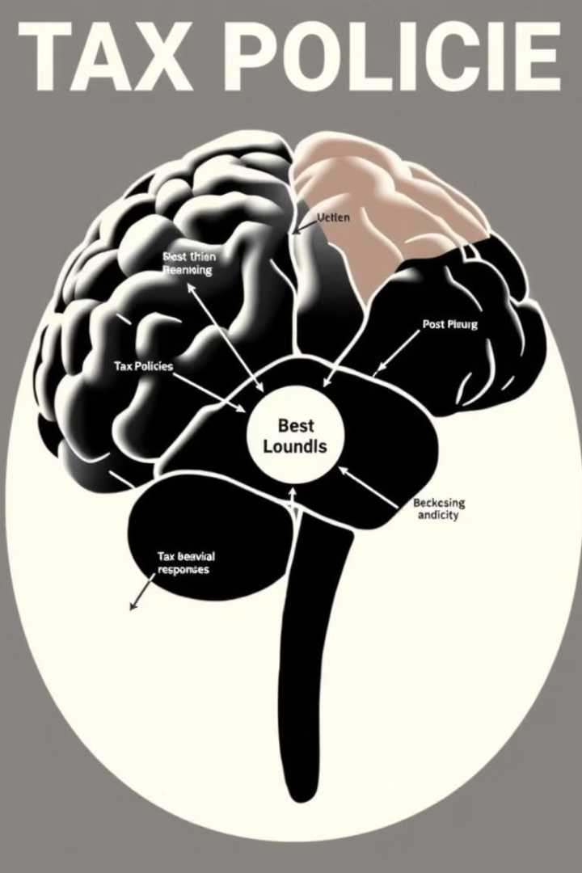
Behavioral Variables: Shaping Economic Responses
1
Taxpayer Behavior
2
Corporate Behavior
The model analyzes taxpayer behavior, including elasticity of taxable income, compliance likelihood, and evasion strategies. It considers how individuals respond to changes in tax rates, deductions, and enforcement mechanisms.
Corporate behavior is modeled to understand reinvestment vs. profit repatriation, R&D spending, and hiring trends. It examines how businesses react to tax incentives, regulations, and economic conditions.
3
Consumer Behavior
Consumer behavior is analyzed to understand the marginal propensity to consume and response to price changes (e.g., GST hikes). It considers how consumers adjust their spending patterns based on tax policies and economic factors.

Slide 5
Government Policy & Spending: Shaping the Economic Landscape
Revenue Allocation
Fiscal Levers
The model simulates government revenue allocation, including budgetary spending on infrastructure, healthcare, education, subsidies, and debt servicing. It analyzes how these spending priorities impact economic growth and social welfare.
Fiscal levers, such as borrowing rates, public debt levels, and deficit financing, are modeled to understand their impact on the economy. The model assesses the sustainability of government finances and the potential consequences of different fiscal policies.

Slide 6
Agentic Model Architecture: Simulating Interactions
Tax Policy Agent
Household Agent
Simulates changes in tax rates, slabs, and compliance mechanisms. Output: Projected revenue, behavioral responses (evasion/compliance).
Models income distribution, consumption, savings, and tax liabilities across classes. Output: Disposable income shifts, demand elasticity.
Corporate Agent
Government Agent
Simulates investment decisions, hiring, and tax optimization strategies. Output: Private sector growth, employment trends.
Allocates revenue to spending priorities and monitors fiscal health. Output: Public investment impact, deficit/GDP ratio.
Macroeconomic Agent
External Sector Agent
Integrates GDP components, inflation, and interest rates. Output: GDP growth forecasts, inflationary pressures.
Models trade dynamics, forex reserves, and global shocks. Output: Export/import volatility, FDI impacts.

