Slide 1
Explore Fundamentals of Artificial Intelligence

Slide 2
Agenda
Introduction to Artificial Intelligence
Artificial Intelligence in Microsoft Azure
Notes:
The topics should take approximately 50 minutes total to deliver. The lab exercise should take an additional 25-30 minutes.

Slide 3
Introduction to Artificial Intelligence
Notes:
The goal of this topic is to introduce some fundamental, high-level concepts; which we'll explore in greater depth later in the course. Don’t spend too much time getting into the details here.

Slide 4

What is Artificial Intelligence?
Software that imitates human capabilities
Predicting outcomes and recognizing patterns based on historic data
Recognizing abnormal events and making decisions
Interpreting visual input
Understanding language, and engaging in conversations
Extracting information from sources to gain knowledge
Notes:
These are all things that most humans do on a day-to-day basis, often subconsciously:
We make predictions or recognize patterns using the information we have available and our past experience to guide us.
We can intuitively know when something isn’t quite right or doesn't fit an expected pattern.
We use sight to experience the world visually.
We communicate by writing and speaking, and engage in dynamic conversations, responding appropriately.
We can extract information from multiple sources to extend our knowledge

Slide 5








Common Artificial Intelligence Workloads
 | Machine Learning | Predictive models based on data and statistics – the foundation for AI
 | Anomaly Detection | Systems that detect unusual patterns or events, enabling pre-emptive action
 | Computer Vision | Applications that interpret visual input from cameras, images, or videos
 | Natural Language Processing | Applications that can interpret written or spoken language, and engage in dialogs with human users
 | Knowledge Mining | Extract information from data sources to create a searchable knowledge store
Notes:
The slide lists common workloads or "areas" of AI, which correspond to the human traits on the previous slide.
We'll explore each of these workloads in detail, but for now just point out that in many solutions, the workloads may overlap.
For example, imagine a conversational AI solution that uses a bot to process an auto insurance claim. The bot relies on some natural language processing capabilities to make sense of input such as "I want to submit a claim". It may allow users to send a photograph of a damaged vehicle, use computer vision to assess the damage, and apply a machine learning model to predict likely repair costs. The bot might also use anomaly detection to identify potentially fraudulent claims. Finally, the claims data, including forms, photographs, and other artefacts might be indexed to extract insights and create a searchable knowledge store to help manage future claims.

Slide 6






Principles of Responsible AI
 | Challenge or Risk | Example
Fairness | Bias can affect results | A loan-approval model discriminates by gender due to bias in the data with which it was trained
Reliability & Safety | Errors may cause harm | An autonomous vehicle experiences a system failure and causes a collision
Privacy & Security | Data could be exposed | A medical diagnostic bot is trained using sensitive patient data, which is stored insecurely
Inclusiveness | Solutions may not work for everyone | A predictive app provides no audio output for visually impaired users
Transparency | Users must trust a complex system | An AI-based financial tool makes investment recommendations - what are they based on?
Accountability | Who's liable for AI-driven decisions? | An innocent person is convicted of a crime based on evidence from facial recognition – who's responsible?
Notes:
At Microsoft, AI software development is guided by a set of six principles for responsible AI.
Use the summaries below to relate these to the challenges and risks on the previous slide.
Fairness AI systems should treat all people fairly. For example, suppose you create a machine learning model to support a loan approval application for a bank. The model should make predictions of whether or not the loan should be approved without incorporating any bias based on gender, ethnicity, or other factors that might result in an unfair advantage or disadvantage to specific groups of applicants.
Azure Machine Learning includes the capability to interpret models and quantify the extent to which each feature of the data influences the model's prediction. This capability helps data scientists and developers identify and mitigate bias in the model.
Reliability and safety AI systems should perform reliably and safely. For example, consider an AI-based software system for an autonomous vehicle; or a machine learning model that diagnoses patient symptoms and recommends prescriptions. Unreliability in these kinds of system can result in substantial risk to human life.
AI-based software application development must be subjected to rigorous testing and deployment management processes to ensure that they work as expected before release.
Privacy and security AI systems should be secure and respect privacy. The machine learning models on which AI systems are based rely on large volumes of data, which may contain personal details that must be kept private. Even after the models are trained and the system is in production, it uses new data to make predictions or take action that may be subject to privacy or security concerns.
Inclusiveness AI systems should empower everyone and engage people. AI should bring benefits to all parts of society, regardless of physical ability, gender, sexual orientation, ethnicity, or other factors.
Transparency AI systems should be understandable. Users should be made fully aware of the purpose of the system, how it works, and what limitations may be expected.
Accountability People should be accountable for AI systems. Designers and developers of AI-based solution should work within a framework of governance and organizational principles that ensure the solution meets ethical and legal standards that are clearly defined.

Slide 7
Artificial Intelligence in Microsoft Azure
Notes:
The goal of this topic is to introduce some fundamental, high-level concepts; which we'll explore in greater depth later in the course. Don’t spend too much time getting into the details here.

Slide 8





Azure Basics
Scalable, reliable cloud platform
Data storage
Compute
Services
Subscription
Resource Group
Resources
Notes:
Ask students about their existing level experience with Azure and cloud services in general, and if appropriate provide a quick demonstration of navigating the Azure portal at https://portal.azure.com.

Slide 9

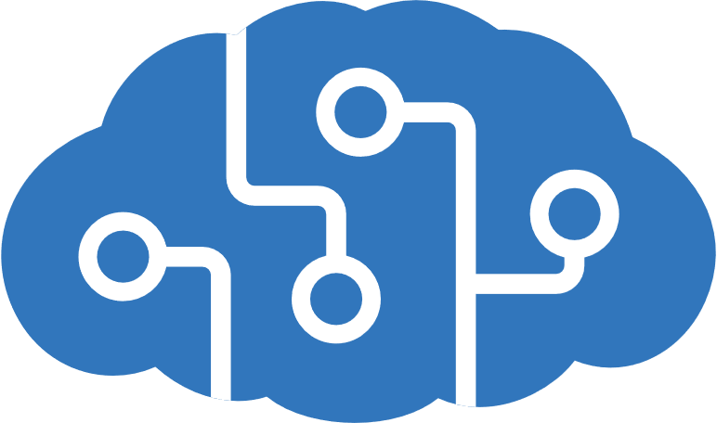


AI Services in Microsoft Azure
 | Azure Machine Learning | A platform for training, deploying, and managing machine learning models
 | Cognitive Services | A suite of services with four main pillars: Vision, Speech, Language, Decision
 | Azure Bot Service | A cloud-based platform for developing and managing conversational bots
 | Azure Cognitive Search | Data extraction, enrichment, and indexing for intelligent search and knowledge mining
Notes:
The Azure AI services that we'll explore in this course are:
Azure Machine Learning
Cognitive Services
Azure Bot Service
Azure Cognitive Search
Highlight: Cognitive Services can be categorized into four main pillars: Vision, Speech, Language, Decision

Slide 10




Cognitive Services
AI application resources in an Azure subscription:
Standalone resources for specific services
General Cognitive Services resource for multiple services
Consumed by applications via:
A REST endpoint (https:// address)
An authentication key or authorization token
https://eastus/...
abc-1234-efg-5678…
Notes:
(If students would like more information on how an API like the Cognitive Services API works, they can review this additional material: https://aka.ms/api-infographic)
It's worth spending a little more time examining cognitive services, as they illustrate a pattern that is common for many AI app scenarios on Azure.
To use cognitive services, you must provision a resource in your Azure subscription. This can be a standalone, service-specific resource (for example, an Computer Vision resource) or a general Cognitive Services resource that encapsulates multiple services. Using a standalone service-specific resource enables you to manage costs and access to that service independently of other services you may be using, while a general Cognitive Services resource enables you to combine all of your AI services in a single Azure resource for centralized management.
Regardless of the type of resource you use, client applications will consume the services it provides by connecting to a REST endpoint (an HTTPS address to which they can submit requests) using a resource-specific key for authentication.

Slide 11
Lab: Explore Cognitive Services
In this lab, you will explore the Anomaly Detector cognitive service, which analyzes data over time to detect any unusual values.
Start the virtual machine for this lab
or go to the exercise page at https://aka.ms/ai900-anomaly-lab
Follow the instructions to complete the exercise
Use the Azure subscription provided for this lab
Notes:
If necessary, demonstrate how to sign into the lab virtual machine and follow the instructions there. If you’re not using a lab VM, students can follow the instructions in the GitHub exercise page for this lab.
Students should generally use the Azure subscription credentials provided to them.
The important aspect of this lab:
- Students get a sense of how to use the portal to create a resource
- Students can differentiate resource creation from service creation
- Students see how to use the resource key and endpoint to run an application
Students do not need to focus on specific capabilities of the Anomaly Detector service

Slide 12

Review
You want to create a model to predict sales of ice cream based on historic data that includes daily ice cream sales totals and weather measurements. Which Azure service should you use?
Azure Machine Learning
Azure Bot Service
Cognitive Services
You are designing an AI application that uses images to detect cracks in car windshields and warn drivers when a windshield should be repaired or replaced. What AI workload is described? ​
Computer Vision
Anomaly Detection
Natural Language Processing
A predictive app provides audio output for visually impaired users. Which principle of Responsible AI is reflected here?
Transparency
Inclusiveness
Fairness
Notes:
Allow students a few minutes to think about the questions, and then use the animated slide to reveal the correct answers.

Slide 13

Summary
Introduction to Artificial Intelligence
What is Artificial Intelligence?
Common Artificial Intelligence Workloads
Principles of Responsible AI
Artificial Intelligence in Microsoft Azure
Azure Basics
AI Services in Microsoft Azure
Cognitive Services

Slide 14
References
Get started with AI on Azure
https://aka.ms/learn-azure-ai
Explore Anomaly Detector in Microsoft Azure
https://aka.ms/anomaly-detector-intro
Introduction to Azure Cognitive Search
https://aka.ms/azure-search-intro
Infographic: How does an Azure API work?
https://aka.ms/api-infographic
Notes:
Encourage students to review the content on Learn for more information.

Slide 15
Closing slide

