Slide 1
Explore Fundamentals of Machine Learning
Notes:
Tip: Before you start the class, complete the following content on Microsoft Learn so that you can use them to demonstrate the services:
https://docs.microsoft.com/learn/modules/use-automated-machine-learning
https://docs.microsoft.com/learn/modules/create-classification-model-azure-machine-learning-designer/

Slide 2
Agenda
Introduction to Machine Learning
Azure Machine Learning
Notes:
The topics should take approximately 45 minutes total to deliver. The lab exercise should take an additional 60 minutes.

Slide 3
Introduction to Machine Learning

Slide 4








What is Machine Learning?
Creating predictive models by finding relationships in data
A botanist collects some samples of flowers
Each sample has a set of features (characteristics) and a label (the species)
An algorithm is used to find the relationship between the features and the label
The result is a model that encapsulates those relationships
The model can predict the label of a new sample based on its features
Bellis Perenis
Rosa Multiflora
Rosa Multiflora
Bellis Perenis
Tulipa
Bellis Perenis
Tulipa
Tulipa
Bellis Perenis
Rosa Multiflora
Notes:
This slide includes an animation – each click corresponds with a step in the machine learning process listed #1-5 above – use the notes below to talk to each animation build (clicks are indicated by numbers)
Machine Learning is a technique we can use to create predictive models based on relationships in data.
So what does that mean? Well, let's look at an example:
Suppose a botanist collects some samples of flowers. {The slide shows images of various flowers}
Each sample has some features, such as measurements of the petals, stem, and other details); and the botanist can provide a label for the flower using its species name. {The Latin name for each flower species appears}
The sample data is then processed using an algorithm that tries to find a relationship between the features and the label. {The flowers are fed into a pair of turning cogs}
The result of this algorithm is a machine learning model. {A human head with cogs for a brain appears}
And since the model has learned the relationship between the features and label, you can use it to predict the species of a flower based on its features. {A new flower appears, and the human head identifies its species}

Slide 5


















Types of Machine Learning
Machine Learning
Supervised Machine Learning
Training data includes known labels
Unsupervised Machine Learning
Training data is unlabeled
Regression
Label is a numeric value
Classification
Label is a categorization (or class)
Clustering
Similar items are grouped together
Predict the number of bike rentals based on day, season, and weather
Predict whether a patient is at-risk for diabetes based on clinical measurements
Vehicles with similar emissions and fuel efficiency characteristics are separated into clusters
Notes:
There are two general approaches to machine learning, supervised and unsupervised machine learning.
Both have a goal of capturing a model, or equation, that will try to predict a result that is as close to the actual result as possible.
Both approaches require an input of data. We call different groups of data, such as height, width, age, features.
Supervised ML relies on us having some data with known label values that we can fit to a model, which can then be applied to new data for which we don’t have the label values. Remember, labels are what we want to predict, such as house price, an item in an image, or if someone has diabetes.
Two types of supervised ML tasks include regression and classification.
- Regression: You use regression when you want to predict a numeric value; like a price, a sales total, or some other measure.
- Classification: determine class test data belongs to, probability between 0 and 1
The unsupervised ML approach trains a model to separate items based purely on their characteristics, or features. There is no previously known cluster value (or label) from which to train the model.
One type of unsupervised ML task is clustering.
- Clustering: determine label based on how similar the item is to the items in the label group

Slide 6




Regression
56 | 115
61 | 126
67 | 137
72 | 140
76 | 152
82 | 156
x y
Training
54 | 114
62 | 129
68 | 130
74 | 152
80 | 154
Validation
Notes:
[NOTE: This slide is optional. Its intention is to reinforce the definition of regression, not the math behind it, and to ask students to think of other scenarios.]
- A regression model captures a relationship between features and the label, in which the label is a continuous number
- Ask students if they can think of other real-world scenarios for a regression model

Slide 7






Classification
[4,2,3.2,10] | 0
[6,3,1.7,12] | 1
[5,2,3.5,11] | 0
[4,1,2.9,10] | 0
[7,4,2.1,11] | 1
x y
Training
[3,1,2.8,10] | 0
[7,3,1.8,11] | 1
[4,8,2.5,10] | 0
[4,1,3,1,11] | 1
Validation
Notes:
[NOTE: This slide is optional. Its intention is to reinforce the definition of classification, not the math behind it, and to ask students to think of other scenarios.]
- A classification model captures a relationship between features and the label, in which the label is a class
- Ask students if they can think of other real-world scenarios for a classification model

Slide 8






Clustering
 | 6 | 3
 | 5 | 3
 | 2 | 3
 | 1 | 3
 | 3 | 8
 | 4 | 8
Notes:
[NOTE: This slide is optional. Its intention is to reinforce the definition of clustering, not the math behind it, and to ask students to think of other scenarios.]
- A clustering model captures a relationship between features without a label, in which the features are grouped by similarity
- Ask students if they can think of other real-world scenarios for a clustering model

Slide 9












Model Training and Validation
Split the data into a training set and a validation set
Apply an algorithm to fit the training data to a model
The trained model encapsulates the relationships in the data
Use the model to generate predictions from the validation data
Use evaluation metrics to compare predicted vs actual labels (supervised) or measure cluster separation (unsupervised)
Repeat…
Notes:
The learning component of machine learning occurs during training. We try to capture the relationships between the features and label in a model. Training is the action of iterating on an algorithm to best fit, or encapsulate those relationships.
After training, we have a model that we can test. We can use some of the data set aside, validation data, to test how closely our model's predicted labels are to actual labels. In the case of unsupervised learning where we don't know the actual labels, we measure how well our model's predicted labels were at separating clusters. There are many types of evaluation metrics. The important thing to remember is that the goal of machine learning is to find a model that gets as close as possible to predicting the actual label. The best model can still have some margin of error.

Slide 10
Azure Machine Learning

Slide 11








What is Azure Machine Learning?
A cloud-based platform for machine learning
Compute
Jobs
Services
Data
Models
Azure ML Workspace
Azure Subscription
Notes:
After talking to the slide for a minute or so, show students your Azure ML workspace in the Azure Portal, and then show them Azure ML Studio
Azure Machine Learning is a cloud-based platform for machine learning.
To use Azure Machine Learning, you need a Microsoft Azure subscription.
In that subscription, you create an Azure Machine Learning workspace. A workspace is a logical container for resources you need to manage machine learning projects.
One of the most important resources is compute. You need this to run machine learning workloads in the cloud instead of on your local computer.
You'll also need to manage the data you need to build machine learning solutions.
You can then use the data to run jobs on the compute resources. These jobs run machine learning tasks, often training models and generating metrics or data that can be retained in the job history to be reviewed later.
Usually, your jobs are used to train models; which you'll register and manage in your workspace.
And when you're ready to use your models in applications, you can publish them as services that can be accessed over HTTP connections.

Slide 12



Automated Machine Learning
Supply the data and desired supervised model type, and let Azure Machine Learning find the best model
Data
Model
Notes:
[Tip: After talking to the slide for a minute or so, show students how to initiate Automated ML in Azure ML Studio – cancelling before actually running the job. Then show them the output from the exercise at https://docs.microsoft.com/en-us/learn/modules/use-automated-machine-learning/ (which you should have previously completed), including the test interface to get a prediction from your deployed service. Spend no more than 5 minutes on this (so it's important to have pre-completed the exercise)]]
Automated Machine Learning in Azure Machine Learning provides the easiest way to train a machine learning model for regression or classification (or forecasting, which is really just regression with a time-series element). There's a visual interface for automated machine learning in the Azure Machine Learning studio web portal. You just need to supply the training data and select the required model type, and Azure ML does the rest.
Later, in the lab, students will get a chance to try this for themselves.

Slide 13
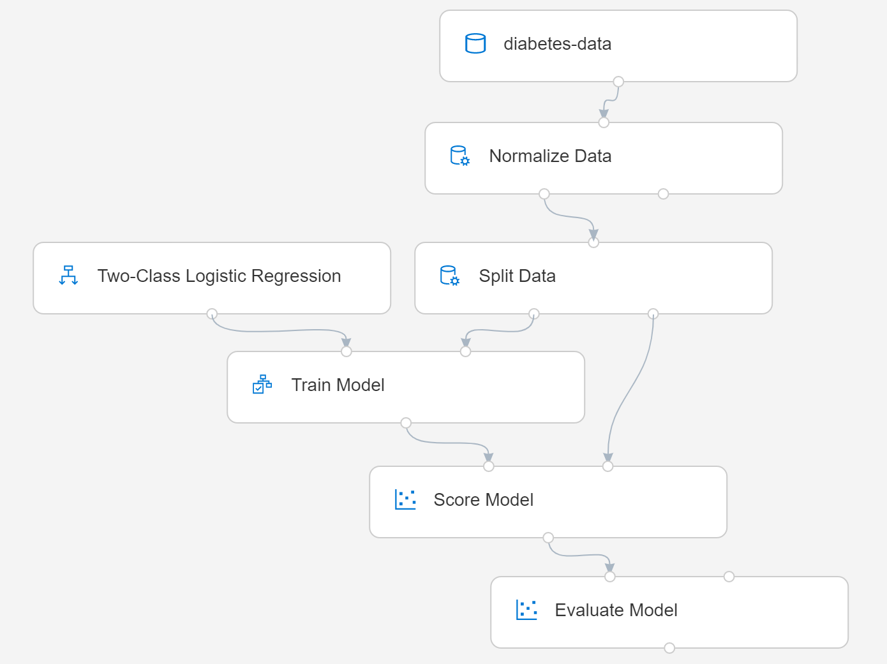
Azure Machine Learning Designer
Visual tool for creating a machine learning pipeline
Use a training pipeline to train and evaluate a model
Create an inference pipeline to predict labels from new data
Deploy the inference pipeline as a service for apps to use
Notes:
[Tip: Instead of talking to the slide, if you prepared ahead of time by completing the exercise at https://docs.microsoft.com/learn/modules/create-classification-model-azure-machine-learning-designer/ , and use that to show students the training and inference pipelines, the endpoint for the published service, and the test interface in Azure ML Studio to generate a prediction. Spend no more than 10 minutes on this (so it's important to have pre-completed the exercise)]
In Azure Machine Learning, multi-step workflows to prepare data, train models, and perform model management tasks are called pipelines. The designer tool in Azure Machine Learning studio enables you to create and run pipelines by using a drag & drop visual interface to connect modules that define the steps and data flow for the pipeline.
On the left side of the slide, you can see the overall workflow for using designer:
Start by creating a pipeline that ingests and preprocesses a dataset before training and evaluating a model.
When you're happy with the model's performance, create an inference pipeline based on your training pipeline. This encapsulates the data preprocessing steps and the trained model so you can use it to predict labels for new data.
When the inference pipeline is ready, deploy it as a service that client applications can use.
On the right side of the slide, you can see an example of a training pipeline. Note the following key points about this:
The pipeline starts with a dataset – in this case containing patient data that includes a diabetes diagnosis (remember the classification example from earlier?)
Before training, data is usually preprocessed to clan it up or otherwise make it more suitable for modeling. In this case, the numeric features in the data (height, weight, diastolic blood pressure, and so on) are normalized – which means to convert them all to be on the same scale. This is a common preprocessing step for numeric features, and designer includes a Normalize Data module to do it.
Next, a Split Data module is used to randomly split the dataset into training and validation subsets. This is a common step in a supervised learning pipeline so that you can evaluate the model using data with which it wasn't trained.
The training subset is connected to a Train Model module, which in this case will fit the data to a function that predicts a diagnosis of diabetic or not-diabetic. This is a classification function with two possible classes, so an appropriate binary classification algorithm must be used to train the model. In this case, a Two-Class Logistic Regression algorithm has been used – but designer includes multiple, algorithm options you can choose from.
After training, a Score Model module is used to score the validation data (in other words, use the trained model to predict labels from the features).
The validation data includes the actual label value, so we can compare this to the predicted label produced by the Score Model module and use an Evaluate Model module to calculate metrics to help us determine if the model is any good or not. For a classification model like this, these metrics include simple accuracy as well as a confusion matrix of true positives, false positives, true negatives, and false negatives from which other, more discerning metrics can be derived.

Slide 14
Lab: Explore Automated Machine Learning in Azure ML
In this lab, you will explore the Azure Machine Learning service's Automated Machine Learning capability to train a machine learning model.
Start the virtual machine for this lab
or go to the exercise page at https://aka.ms/ai900-automl-lab
Follow the instructions to complete the exercise
Use the Azure subscription provided for this lab
Notes:
If necessary, demonstrate how to sign into the lab virtual machine and follow the instructions there. If you’re not using a lab VM, students can follow the instructions in the GitHub page for this lab.
Point out that exercises are also available for all of the other tasks demonstrated and discussed in this powerpoint.
The important takeaways from this lab are:
Identify features and labels in a dataset for machine learning
See the Azure ML environment; see the process at a high level
Describe how the interface of automated machine learning is a low-code solution for machine learning
Identify that automated machine learning does not involve a drag-and-drop interface like Designer
Recall that compute resources were needed to run machine learning model training
Recall that once a model is trained, it can be evaluated, and then deployed to use as an application

Slide 15

Review
You would like to train a model without labels that groups similar features together. What is this an example of?
Classification
Regression
Clustering
An automobile dealership wants to use historic car sales data to train a machine learning model. The model should predict the price of a pre-owned car based on its make, model, engine size, and mileage. What kind of machine learning model should the dealership use automated machine learning to create?
Classification
Regression
Time series forecasting
A bank wants to use historic loan repayment records to categorize loan applications as low-risk or high-risk based on characteristics like the loan amount, the income of the borrower, and the loan period. What kind of machine learning model should the bank use?
Classification
Regression
Clustering
Notes:
Allow students a few minutes to think about the questions, and then use the animated slide to reveal the correct answers.

Slide 16

Summary
Introduction to Machine Learning
What is Machine Learning?
Types of Machine Learning
Model Training and Validation
Azure Machine Learning
What is Azure Machine Learning?
Automated Machine Learning
Azure Machine Learning Designer

Slide 17
References
Explore visual tools for machine learning
https://aka.ms/intro-visual-ml
Notes:
Encourage students to review the content on Learn for more information.

Slide 18
Closing slide

