Slide 1
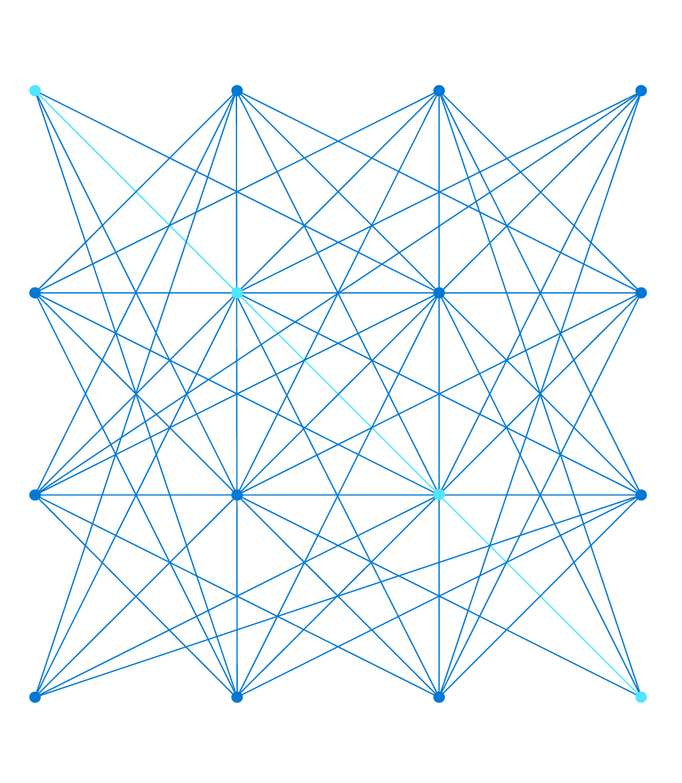
AI-900 Azure AI Fundamentals

Slide 2


About this course
Course format:
One-day instructor-led with hands-on exercises
Supplemented by online training at https://docs.microsoft.com/learn/certifications/azure-ai-fundamentals
Course objectives:
Describe Artificial Intelligence workloads and considerations
Describe fundamental principles of machine learning on Azure
Describe features of computer vision workloads on Azure
Describe features of Natural Language Processing (NLP) workloads on Azure
Notes:
Note that the course is supported by materials on Microsoft Learn, which may contain more information than is covered in the slides and labs.
The slides and labs cover all of the objectives in the associated exam, but encourage students to reinforce and extend their learning by reviewing the associated Learn content.
Note also that this is not an implementation-level course. Students will get some hands-on exposure to the technologies discussed in the course; but the goal is to learn about common data workloads and the Azure services used to support them – not to learn how to use the technologies to implement solutions.

Slide 3
Course agenda
PowerPoint | Topics
Explore Fundamentals of Artificial Intelligence | Introduction to Artificial Intelligence Artificial Intelligence in Microsoft Azure
Explore Fundamentals of Machine Learning | Introduction to Machine Learning Azure Machine Learning
Explore Fundamentals of Computer Vision | Computer Vision Concepts Creating Computer Vision solutions in Azure
Explore Fundamentals of Natural Language Processing | Introduction to Natural Language Processing Building Natural Language Solutions in Azure
Notes:
In most cases, the course schedule will allow for PowerPoints 1 and 2 in the morning, and 3 and 4 in the afternoon.
Use the following schedule as an approximate guide for the day:
9:00-9:10: Introduction
9:10 -10:00: 1-Introduction to AI
10:00-10:30: 1-Introduction to AI (Lab)
10:30-11:15: 2-Machine Learning
11:15-11:30: Break
11:30-12:30: 2-Machine Learning (Lab)
12:30-1:30: Lunch
1:30-2:30: 3-Computer Vision
2:30-3:00: 3-Computer Vision (Lab)
3:00-3:15: Break
3:15-4:15: 4-Natural Language Processing
4:15-4:45: 4-Natural Language Processing (Lab)
4:45-5:00: Summary and Next Steps
Avoid "over-teaching" and the temptation to expand on what's in the slides – remember that this is a fundamentals level course, and your own knowledge most likely exceeds the scope of what needs to be covered!

Slide 4


Lab environment
Labs in this course are based on content in Microsoft Learn
You will be provided with an Azure subscription for use in this class
Your instructor will provide details
Notes:
Now is a good time to explain / demonstrate the lab environment for this course.
The lab instructions are in the GitHub repo associated with this course. If you are using a solution from an authorized lab hoster, there should be a hosted Virtual Machine and an Azure subscription for each student; and the instructions from GitHub may be displayed in the hosted VM environment.
Most labs can be completed using only a browser, and students may find this offers better networking performance than using the hosted VM.
Given that this is a fundamentals-level class, avoid overwhelming students with too much detail. Demonstrate now how to log into the virtual machine environment (if used) or access the instructions in GitHub, how to determine the Azure credentials to use, and how to follow the link to the instructions in Learn. You may also consider demonstrating how you want students to complete each lab as you get to them.

Slide 5
Template slide

