Slide 1
Microsoft EXCEL
Presented by :
M.Ali Farhan
M.AOUN KHAN

Slide 2
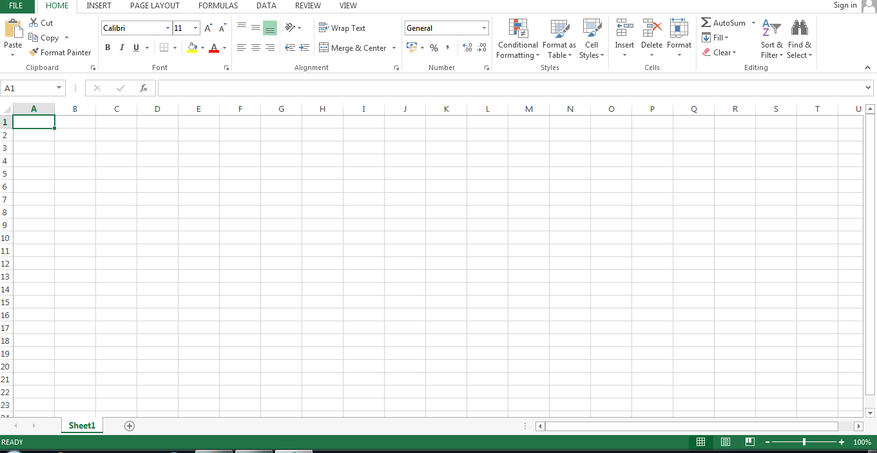
What is MS Excel?
A spreadsheet program developed by Microsoft.
Part of the Microsoft Office suite.
Used for data organization, analysis, and visualization.
Features include formulas, functions, charts, and pivot tables.

Slide 3
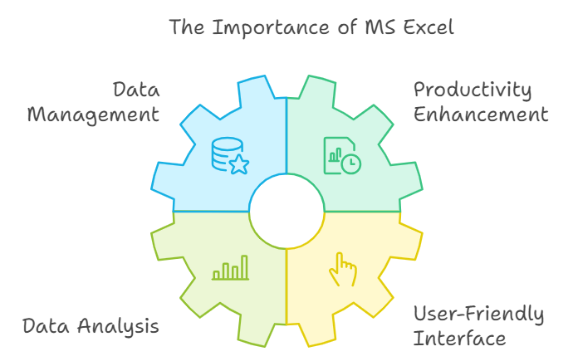
Why is MS Excel Important?
Widely used in various industries for data management.
Enhances productivity through automation of calculations.
Facilitates data analysis and decision-making.
User-friendly interface with extensive support and resources.

Slide 4
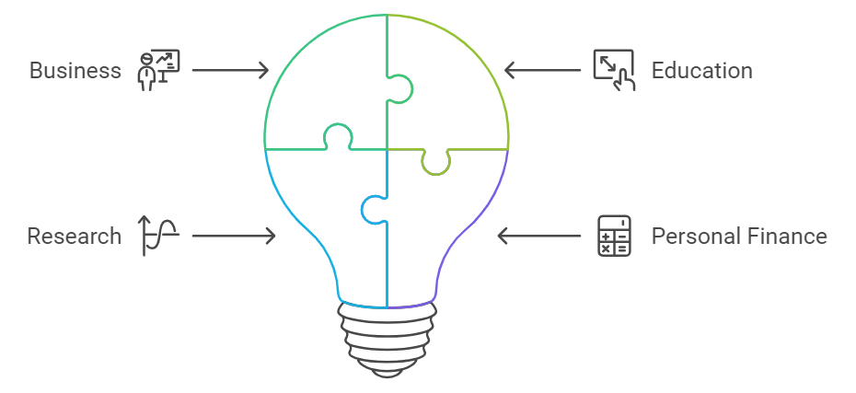
When is MS Excel Used?
In business for financial analysis and budgeting.
In education for grading and data tracking.
In research for data collection and analysis.
In personal finance for expense tracking and planning.

Slide 5
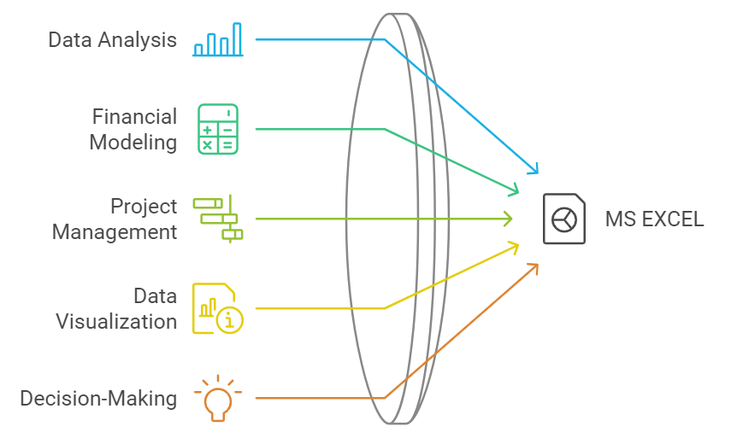
Where Can MS Excel be Applied?
Corporate environments for reporting and forecasting.
Academic institutions for research projects and assignments.
Non-profit organizations for budgeting and resource allocation.
Personal use for household budgeting and planning events.

Slide 6
Thank you !

