Slide 1
Computer Networks
Lecture-1

Slide 2
Networks
A network is a group of connected, communicating devices such as computers and printers.

Slide 3
Line configuration

Slide 4
Line configuration
Refers to the way two or more communication devices attach to a link.
Or, defines the attachment of communication devices to a link.
A link is the physical communication pathway that transfers data from one device to another.
For communication to occur, two devices must be connected in some way to the same link at the same time.

Slide 5
Line Configuration Types
Two possible line configurations
- point-to-point
- multipoint

Slide 6
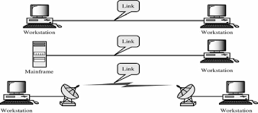
Point-to-point line configuration
Provides a dedicated link between two devices.
The entire capacity of the channel is reserved for transmission between those two devices.

Slide 7
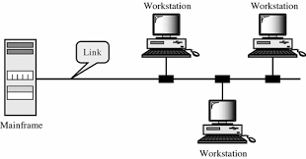
Multipoint line configuration
Also called multidrop line configuration
Here, more than two specific devices share a single link.
The capacity of the channel is shared either simultaneously or in turn (time is shared).

Slide 8
Topology
Refers to the way a network is laid out (established)
Or,
defines the physical or logical arrangement of links in a network.
Two or more devices connect to a link, two or more links form a topology.

Slide 9
Basic Topologies
Five basic topologies possible:
- mesh
- star
- tree
- bus
- ring

Slide 10
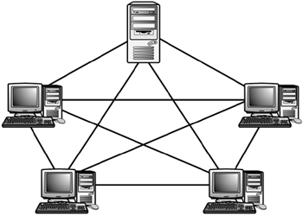
Mesh topology
Every device has a dedicated point-to-point link to every other device.
A fully connected mesh network therefore has n(n-1)/2 physical channels to link n devices.
Every device on the network must have n-1 I/O ports.

Slide 11
Mesh topology Adv. & Disadv.
Advantage:
- no traffic
- robust
- privacy or security
- easy to detect and repair fault.
Disadvantage:
- installation and reconfiguration are difficult
- huge cabling than the available space
- expensive, hardware required to connect each link (I/O ports and cable).

Slide 12
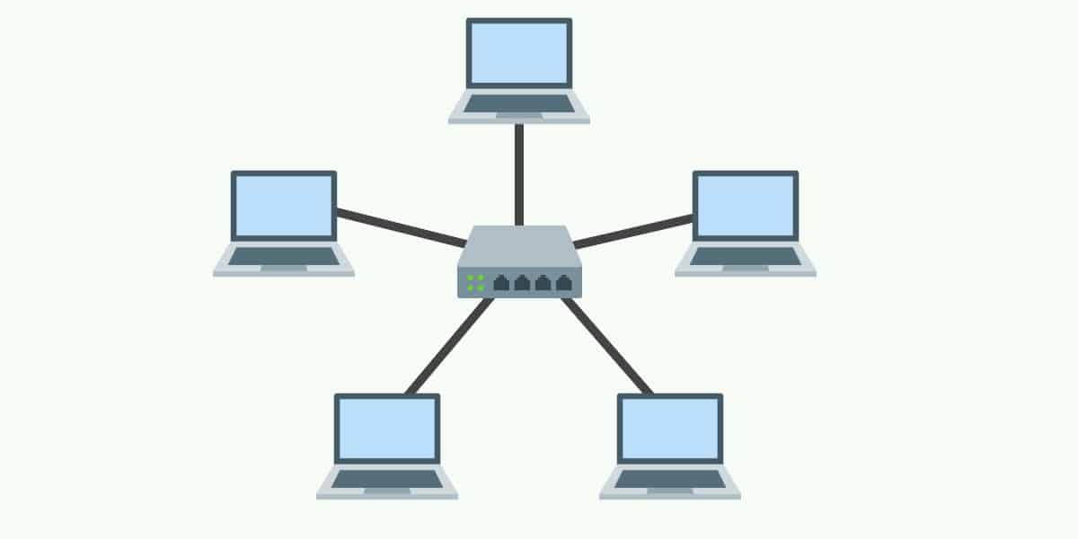
Star topology
Each device has a dedicated point-to-point link only to a central controller, usually called a hub.
The devices are not directly linked to each other.

Slide 13
Star topology Adv. & Disadv.
Advantage:
- less expensive than mesh
- easy to install and reconfigure
- robust
- easy fault identification and fault isolation
Disadvantage:
- extra hardware required (HUB)
- more cable required than tree, bus or ring.

Slide 14
Tree topology
A variation of star topology.
As in a star, nodes in a tree are linked to a central hub that controls the traffic to the network.
However, not every device plugs directly into the central hub.
The majority of devices connect to a secondary hub that in turn is connected to the central hub.
The central hub is an active hub which contains a repeater.
The secondary hubs may be active or passive.
A passive hub provides a simple physical connection between the attached devices.

Slide 15
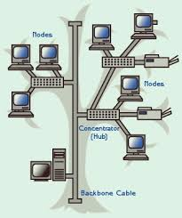
Tree topology adv. & Disadv.
Advantages & disadvantages same as star.
Addition of secondary hubs provide two advantages-
- allows more devices to attach to central hub.
- allows network isolation & prioritize communications.

Slide 16
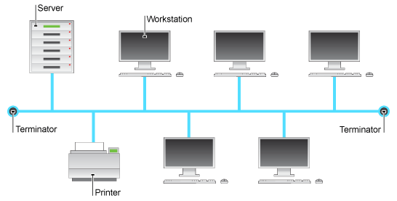
Bus topology
Multipoint configurations.
One long cable acts as a backbone to link all the devices in the network.

Slide 17
Bus topology
Nodes are connected to the bus cable by drop lines and taps.
Advantages:
- ease of installation
- less cabling
Disadvantages:
- difficult to reconfigure and fault isolation
- signal reflection at the taps can cause degradation in quality.
- a fault or break in the bus cable stops all transmission.

Slide 18
Ring topology
Each device has a dedicated point-to-point line configuration only with the two devices on either side of it.
A signal is passed along the ring in one direction, from device to device, until it reaches its destination.
Each device in the ring incorporates a repeater.
When a device receives a signal intended for another device , its repeater regenerates the bits and passes them along.

Slide 19
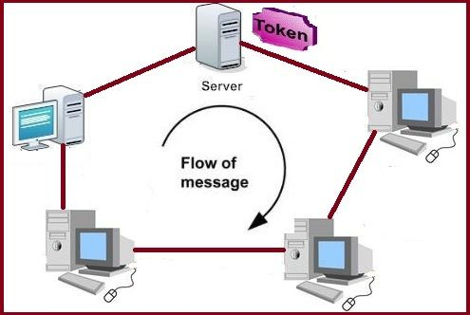
Ring topology adv. & Disadv.
Advantage:
- easy to install and reconfigure
- fault isolation is simple
Disadvantage:
- unidirectional traffic, a break in a simple ring can disable the entire network.

Slide 20
History of Internet

Slide 21
ARPANET
In the mid-1960s, mainframe computers in research organizations were stand-alone devices. Computers from different manufacturers were unable to communicate with one another.
The Advanced Research Projects Agency (ARPA) in the Department of Defense (DOD) was interested in finding a way to connect computers together so that the researchers they funded could share their findings, thereby reducing costs and eliminating duplication of effort.

Slide 22
In 1967, at an Association for Computing Machinery (ACM) meeting, ARPA presented its ideas for ARPANET, a small network of connected computers.
The idea was that each host computer (not necessarily from the same manufacturer) would be attached to a specialized computer, called an interface message processor (IMP).
The IMPs, in turn, would be connected to each other. Each IMP had to be able to communicate with other IMPs as well as with its own attached host.

Slide 23
By 1969, ARPANET was a reality. Four nodes, at the University of California at Los Angeles (UCLA), the University of California at Santa Barbara (UCSB), Stanford Research Institute (SRI), and the University of Utah, were connected via the IMPs to form a network. Software called the Network Control Protocol (NCP) provided communication between the hosts.

Slide 24
internet & Internet
An internet (note the lowercase i) is two or more networks that can communicate with each other.
The most notable internet is called the Internet (uppercase I ), composed of hundreds of thousands of interconnected networks.
Private individuals as well as various organizations such as government agencies, schools, research facilities, corporations, and libraries in more than 100 countries use the Internet.

