Slide 1

Chapter 1
Introduction
Copyright © The McGraw-Hill Companies, Inc. Permission required for reproduction or display.

Slide 2
1-1 A BRIEF HISTORY
A network is a group of connected, communicating devices such as computers and printers. An internet is two or more networks that can communicate with each other. The most notable internet is called the internet, composed of hundreds of thousands of interconnected networks. Private individuals as well as various organizations such as government agencies, schools, research facilities, corporations, and libraries in more than 100 countries use the Internet.

Slide 3
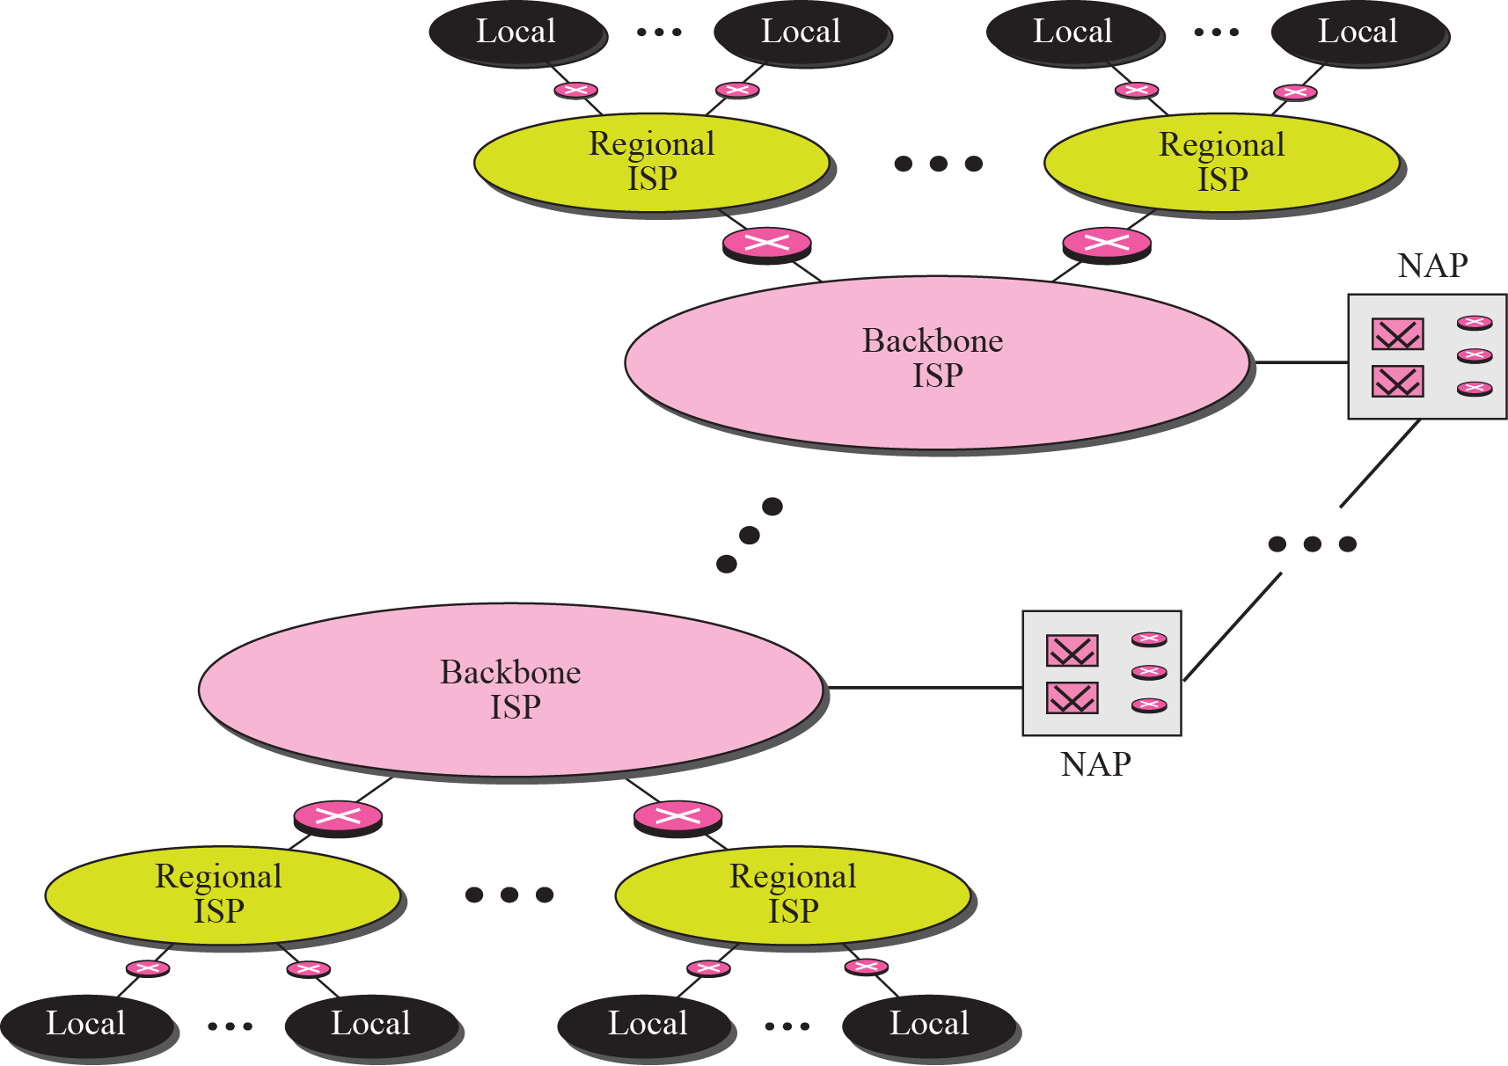
Figure 1.1 Internet today

Slide 4
1-2 PROTOCOLS AND STANDARDS
In this section, we define two widely used terms: protocols and standards. First, we define protocol, which is synonymous with “rule.” Then we discuss standards, which are agreed-upon rules.

Slide 5
Topics Discussed in the Section
Protocols
Standards

Slide 6
1-3 STANDARDS ORGANIZATION
Standards are developed through the cooperation of standards creation committees, forums, and government regulatory agencies.

Slide 7
Topics Discussed in the Section
Standards Creation Committees
Forums
Regulatory Agencies

Slide 8
1-4 INTERNET STANDARDS
An Internet standard is a thoroughly tested specification that is useful to and adhered to by those who work with the Internet. It is a formalized regulation that must be followed. There is a strict procedure by which a specification attains Internet standard status. A specification begins as an Internet draft. An Internet draft is a working document with no official status and a six-month lifetime.

Slide 9
Topics Discussed in the Section
Maturity Levels
Requirement Levels

Slide 10
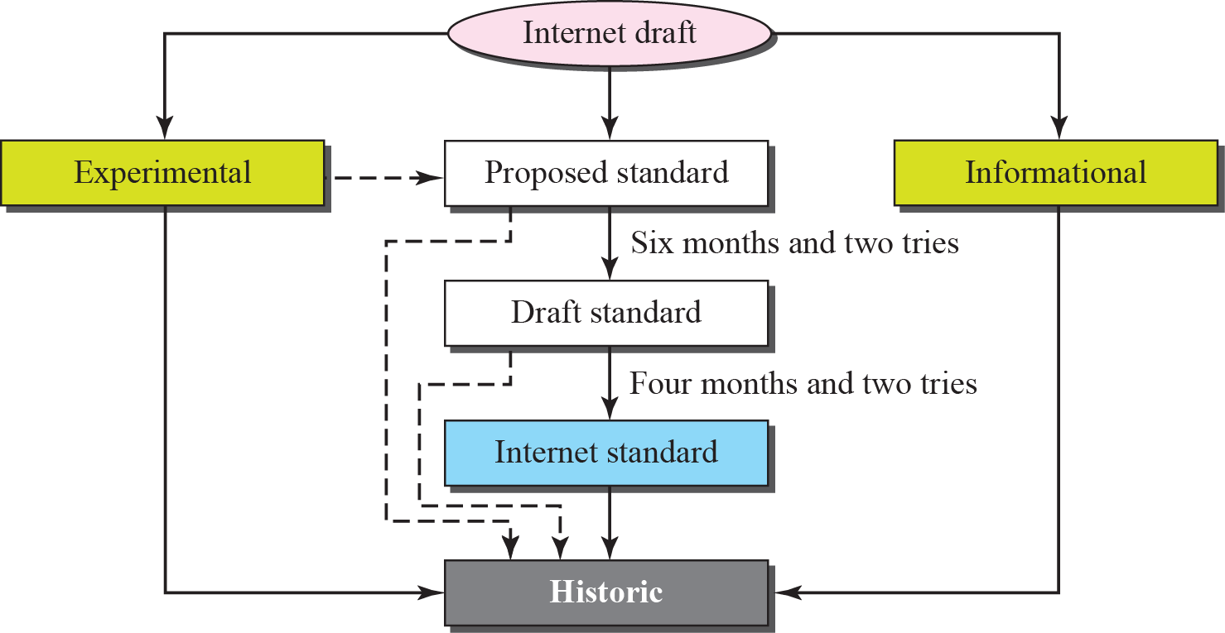
Figure 1.2 Maturity levels of an RFC

Slide 11
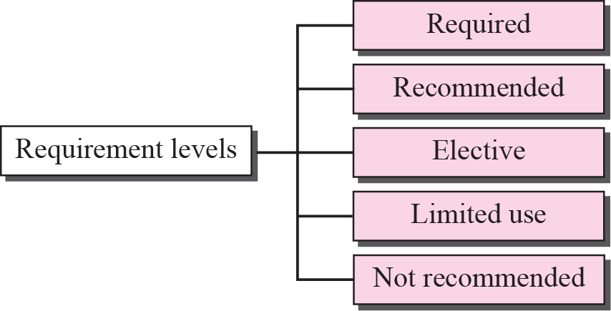
Figure 1.3 Requirement levels of an RFC

Slide 12

Note
RFCs can be found at http://www.rfc-editor.org.

Slide 13
1-5 INTERNET ADMINISTRATION
The Internet, with its roots primarily in the research domain, has evolved and gained a broader user base with significant commercial activity. Various groups that coordinate Internet issues have guided this growth and development. Appendix G gives the addresses, e-mail addresses, and telephone numbers for some of these groups. Figure 1.4 shows the general organization of Internet administration.

Slide 14
Topics Discussed in the Section
Internet Society (ISOC)
Internet Architecture Board (IAB)
Internet Research Task Force (IRTF)
Internet Assigned Number Authority (IANA)
Internet Corporation for Names and Numbers (ICANN)
Network Information Center (NIC)

Slide 15


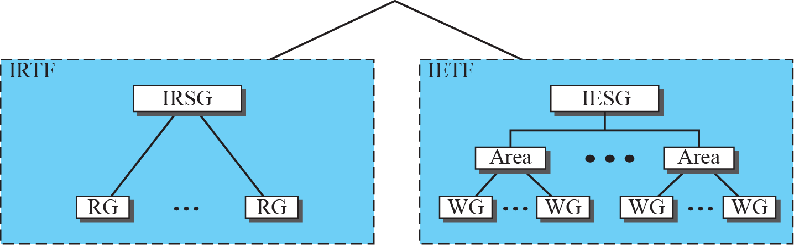
Figure 1.4 Internet administration

Slide 16
Note
The addresses and websites for Internet organizations can be found in Appendix G.

