Slide 1

Chapter 2
The OSI Model and the TCP/IP Protocol Suite
Copyright © The McGraw-Hill Companies, Inc. Permission required for reproduction or display.

Slide 2
Chapter Outline
2.1 Protocol Layers
2.2 The OSI Model
2.3 TCP/IP Protocol Suite
2.4 Addressing

Slide 3
2-1 Protocol Layers
In Chapter 1, we discussed that a protocol is required when two entities need to communicate. When communication is not simple, we may divide the complex task of communication into several layers. In this case, we may need several protocols, one for each layer.
Let us use a scenario in communication in which the role of protocol layering may be better understood. We use two examples. In the first example, communication is so simple that it can occur in only one layer.

Slide 4
Topics Discussed in the Section
Hierarchy
Services

Slide 5
Example 2.1
Assume Maria and Ann are neighbors with a lot of common ideas. However, Maria speaks only Spanish, and Ann speaks only English. Since both have learned the sign language in their childhood, they enjoy meeting in a cafe a couple of days per week and exchange their ideas using signs. Occasionally, they also use a bilingual dictionary. Communication is face to face and Happens in one layer as shown in Figure 2.1.

Slide 6
Figure 2.1 Example 2.1

Slide 7
Example 2.2
Now assume that Ann has to move to another town because of her job. Before she moves, the two meet for the last time in the same cafe. Although both are sad, Maria surprises Ann when she opens a packet that contains two small machines. The first machine can scan and transform a letter in English to a secret code or vice versa. The other machine can scan and translate a letter in Spanish to the same secret code or vice versa. Ann takes the first machine; Maria keeps the second one. The two friends can still communicate using the secret code, as shown in Figure 2.2.

Slide 8
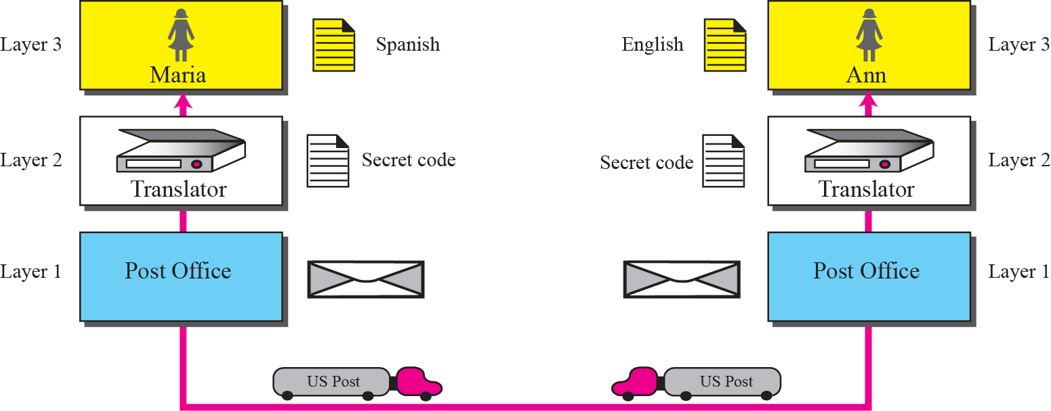
Figure 2.2 Example 2.2

Slide 9
2-2 THE OSI MODEL
Established in 1947, the International Standards Organization (ISO) is a multinational body dedicated to worldwide agreement on international standards. Almost three-fourths of countries in the world are represented in the ISO. An ISO standard that covers all aspects of network communications is the Open Systems Interconnection (OSI) model. It was first introduced in the late 1970s.

Slide 10
Topics Discussed in the Section
Layered Architecture
Layer-to-layer Communication
Encapsulation
Layers in the OSI Model
Summary of OSI Layers

Slide 11

Note
ISO is the organization;
OSI is the model.

Slide 12
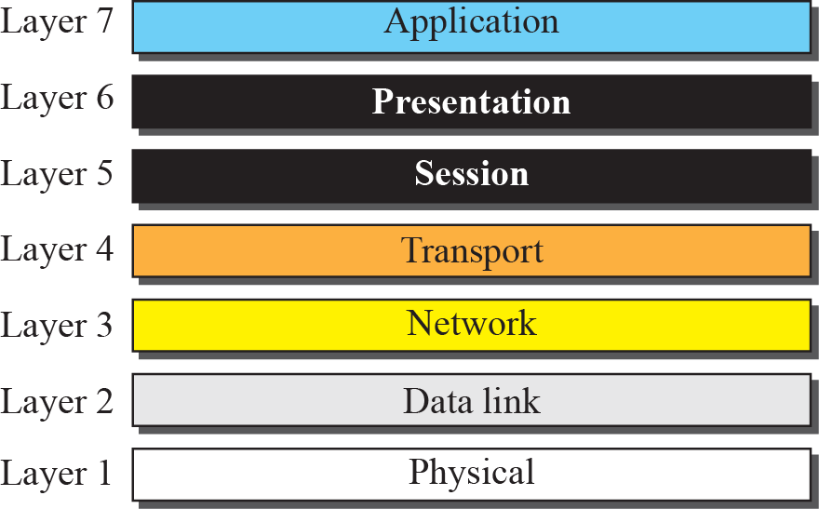
Figure 2.3 The OSI model

Slide 13

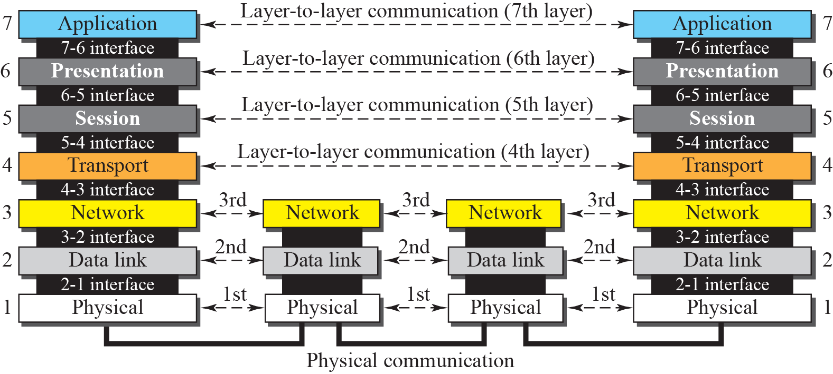
Figure 2.4 OSI layers

Slide 14
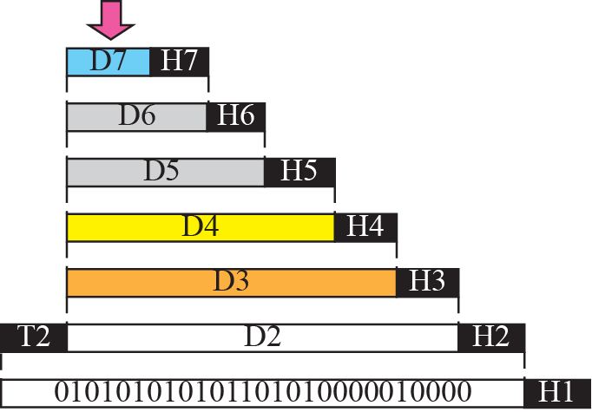


Figure 2.5 An exchange using the OSI model

Slide 15
Note
The physical layer is responsible for moving individual bits from one
(node) to the next.

Slide 16
Physical Layer
Physical characteristics of interface and media
Representation of bits
Data rate
Synchronization of bits
Line configuration
Physical topology
Transmission mode
Notes:
The physical layer is also concerned with the following:
❑ Physical characteristics of interfaces and media. The physical layer defines the characteristics of the interface between the devices and the transmission media. It also defines the type of transmission media (see Chapter 3).
❑ Representation of bits. The physical layer data consists of a stream of bits (sequence of 0s or 1s) with no interpretation. To be transmitted, bits must be encoded into signals—electrical or optical. The physical layer defines the type of encoding (how 0s and 1s are changed to signals).
❑ Data rate. The transmission rate—the number of bits sent each second—is also defined by the physical layer. In other words, the physical layer defines the duration of a bit, which is how long it lasts.
❑ Synchronization of bits. The sender and receiver must not only use the same bit rate but must also be synchronized at the bit level. In other words, the sender and the receiver clocks must be synchronized.
❑ Line configuration. The physical layer is concerned with the connection of devices to the media. In a point-to-point configuration, two devices are connected together through a dedicated link. In a multipoint configuration, a link is shared between several devices.
❑ Physical topology. The physical topology defines how devices are connected to make a network. Devices can be connected using a mesh topology (every device connected to every other device), a star topology (devices are connected through a central device), a ring topology (each device is connected to the next, forming a ring), or a bus topology (every device on a common link).
❑ Transmission mode. The physical layer also defines the direction of transmission between two devices: simplex, half-duplex, or full-duplex. In the simplex mode, only one device can send; the other can only receive. The simplex mode is a oneway communication. In the half-duplex mode, two devices can send and receive, but not at the same time. In a full-duplex (or simply duplex) mode, two devices can send and receive at the same time.

Slide 17
Data Link Layer
Framing
Physical Addressing
Flow Control
Error Control
Access Control
Notes:
The data link layer transforms the physical layer, a raw transmission facility, to a reliable link. It makes the physical layer appear error-free to the upper layer (network
layer). Other responsibilities of the data link layer include the following:
❑ Framing. The data link layer divides the stream of bits received from the network layer into manageable data units called frames.
❑ Physical addressing. If frames are to be distributed to different systems on the network, the data link layer adds a header to the frame to define the sender and/or
receiver of the frame. If the frame is intended for a system outside the sender’s network, the receiver address is the address of the connecting device that connects the network to the next one.
❑ Flow control. If the rate at which the data is absorbed by the receiver is less than the rate produced at the sender, the data link layer imposes a flow control mechanism to prevent overwhelming the receiver.
❑ Error control. The data link layer adds reliability to the physical layer by adding mechanisms to detect and retransmit damaged or lost frames. It also uses a mechanism
to recognize duplicate frames. Error control is normally achieved through a trailer added to the end of the frame.
❑ Access control. When two or more devices are connected to the same link, data link layer protocols are necessary to determine which device has control over the link at any given time.

Slide 18
Network Layer
Logical Addressing
Routing
Notes:
The network layer is responsible for the source-to-destination delivery of a packet, possibly across multiple networks (links). Whereas the data link layer oversees the delivery of the packet between two systems on the same network (link), the network layer ensures that each packet gets from its point of origin to its final destination.
If two systems are connected to the same link, there is usually no need for a network layer. However, if the two systems are attached to different networks (links) with connecting devices between the networks (links), there is often a need for the network layer to accomplish source-to-destination delivery. Other responsibilities of the network layer include the following:
❑ Logical addressing. The physical addressing implemented by the data link layer handles the addressing problem locally. If a packet passes the network boundary, we need another addressing system to help distinguish the source and destination systems. The network layer adds a header to the packet coming from the upper layer that, among other things, includes the logical addresses of the sender and receiver.
❑ Routing. When independent networks or links are connected together to create internetworks (network of networks) or a large network, the connecting devices (called routers or switches) route or switch the packets to their final destination. One of the functions of the network layer is to provide this mechanism.

Slide 19
Transport Layer
Service-point Addressing
Segmentation and reassembly
Connection Control
Flow control
Error control
Notes:
The transport layer is responsible for process-to-process delivery of the entire message. A process is an application program running on the host. Whereas the network
layer oversees source-to-destination delivery of individual packets, it does not recognize any relationship between those packets. It treats each one independently, as though each piece belonged to a separate message, whether or not it does. The transport layer, on the other hand, ensures that the whole message arrives intact and in order, overseeing both error control and flow control at the source-to-destination level. Other responsibilities of the transport layer include the following:
❑ Service-point addressing. Computers often run several programs at the same time. For this reason, source-to-destination delivery means delivery not only from one computer to the next but also from a specific process (running program) on one computer to a specific process (running program) on the other. The transport layer header must therefore include a type of address called a service-point address (or port address). The network layer gets each packet to the correct computer; the transport layer gets the entire message to the correct process on that computer.
❑ Segmentation and reassembly. A message is divided into transmittable segments, with each segment containing a sequence number. These numbers enable the transport layer to reassemble the message correctly upon arriving at the destination and to identify and replace packets that were lost in transmission.
❑ Connection control. The transport layer can be either connectionless or connection oriented. A connectionless transport layer treats each segment as an independent
packet and delivers it to the transport layer at the destination machine. A connection oriented transport layer makes a connection with the transport layer at the destination
machine first before delivering the packets. After all the data are transferred, the connection is terminated.
❑ Flow control. Like the data link layer, the transport layer is responsible for flow control. However, flow control at this layer is performed end to end rather than across a single link.
❑ Error control. Like the data link layer, the transport layer is responsible for error control. However, error control at this layer is performed process-to-process rather
than across a single link. The sending transport layer makes sure that the entire message arrives at the receiving transport layer without error (damage, loss, or duplication). Error correction is usually achieved through retransmission.

Slide 20
Session Layer
Dialog control
Synchronization
Notes:
The services provided by the first four layers (physical, data link, network and transport) are not sufficient for some processes. The session layer is the network dialog controller. It establishes, maintains, and synchronizes the interaction between communicating systems. Specific responsibilities of the session layer include the following:
❑ Dialog control. The session layer allows two systems to enter into a dialog. It allows the communication between two processes to take place in either half duplex (one way at a time) or full-duplex (two ways at a time) mode.
❑ Synchronization. The session layer allows a process to add checkpoints (synchronization points) into a stream of data. For example, if a system is sending a file of 2,000 pages, it is advisable to insert checkpoints after every 100 pages to ensure that each 100-page unit is received and acknowledged independently. In this case, if a crash happens during the transmission of page 523, the only pages that need to be resent after system recovery are pages 501 to 523. Pages previous to 501 need not be resent.

Slide 21
Presentation Layer
Translation
Encryption
Compression
Notes:
The presentation layer is concerned with the syntax and semantics of the information exchanged between two systems. Specific responsibilities of the presentation layer
include the following:
❑ Translation. The processes (running programs) in two systems are usually exchanging information in the form of character strings, numbers, and so on. The information
should be changed to bit streams before being transmitted. Because different computers use different encoding systems, the presentation layer is responsible for interoperability between these different encoding methods. The presentation layer at the sender changes the information from its sender-dependent format into a common format. The presentation layer at the receiving machine changes the common format into its receiver-dependent format.
❑ Encryption. To carry sensitive information a system must be able to assure privacy. Encryption means that the sender transforms the original information to another form and sends the resulting message out over the network. Decryption reverses the original process to transform the message back to its original form.
❑ Compression. Data compression reduces the number of bits contained in the information. Data compression becomes particularly important in the transmission of multimedia such as text, audio, and video.

Slide 22
Application Layer
Network virtual terminal
File transfer, access, and management (FTAM)
E-mail services
Directory services
Notes:
The application layer enables the user, whether human or software, to access the network. It provides user interfaces and support for services such as electronic mail, remote file access and transfer, shared database management, and other types of distributed information services. Specific services provided by the application layer include the following:
❑ Network virtual terminal. A network virtual terminal is a software version of a physical terminal and allows a user to log on to a remote host. To do so, the application creates a software emulation of a terminal at the remote host. The user’s computer talks to the software terminal, which, in turn, talks to the host, and vice versa. The remote host believes it is communicating with one of its own terminals and allows you to log on.
❑ File transfer, access, and management (FTAM). This application allows a user to access files in a remote host (to make changes or read data), to retrieve files from a remote computer for use in the local computer, and to manage or control files in a remote computer locally.
❑ E-mail services. This application provides the basis for e-mail forwarding and storage.
❑ Directory services. This application provides distributed database sources and access for global information about various objects and services.

Slide 23
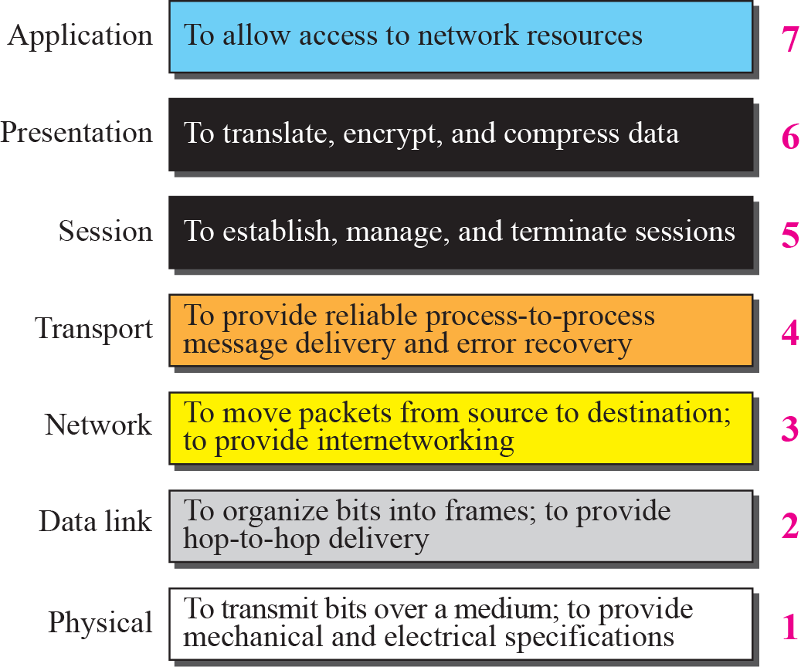
Figure 2.6 Summary of OSI Layers

Slide 24
2-3 TCP/IP PROTOCOL SUITE
The TCP/IP protocol suite was developed prior to the OSI model. Therefore, the layers in the TCP/IP protocol suite do not match exactly with those in the OSI model. The original TCP/IP protocol suite was defined as four software layers built upon the hardware. Today, however, TCP/IP is thought of as a five-layer model with the layers named similarly to the ones in the OSI model. Figure 2.7 shows both configurations.

Slide 25
Topics Discussed in the Section
Comparison between OSI and TCP/IP
Layers in the TCP/IP Suite

Slide 26
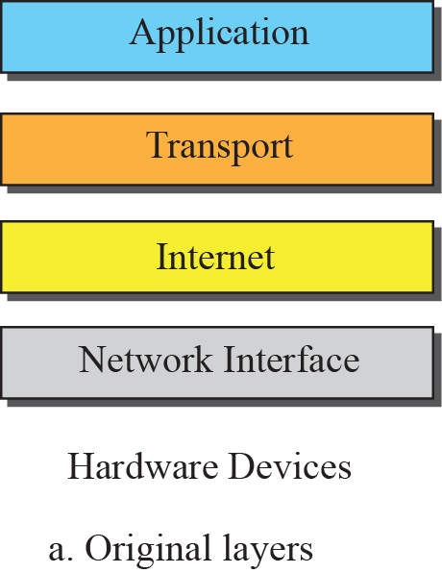
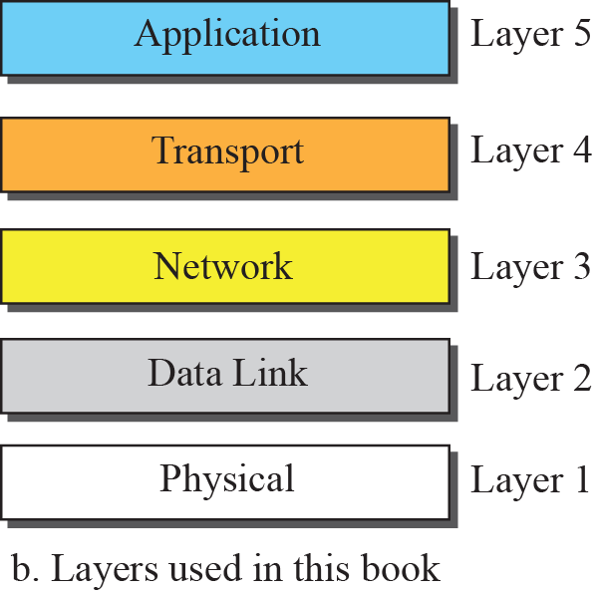

Figure 2.7 Layers in the TCP/IP Protocol Suite

Slide 27
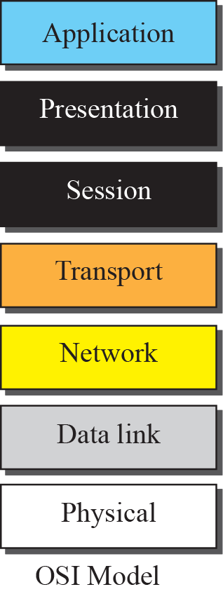
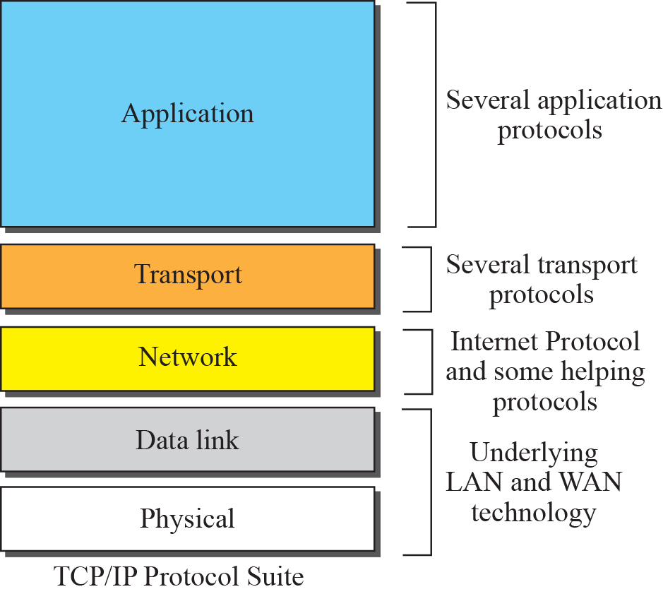
Figure 2.8 TCP/IP and OSI model

Slide 28
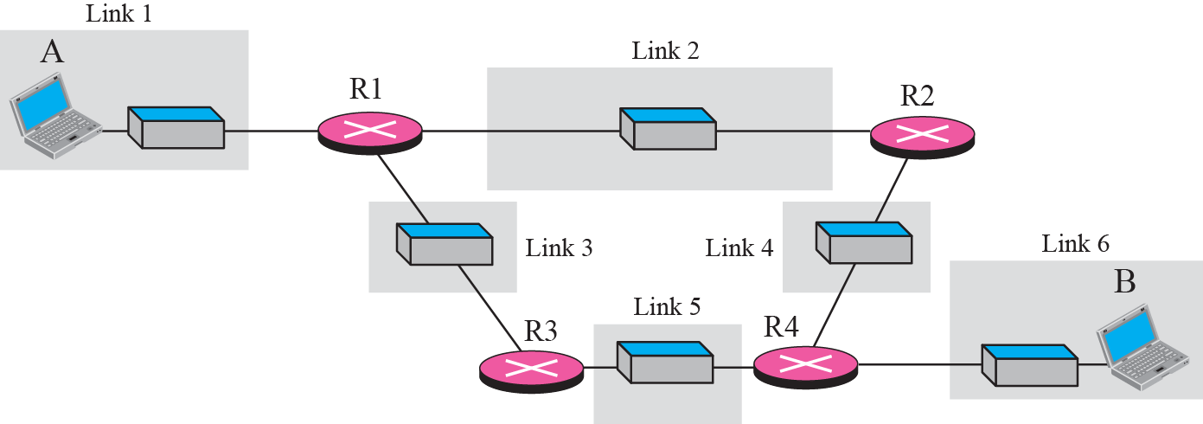
Figure 2.9 A private internet

Slide 29
Figure 2.10 Communication at the physical layer

Slide 30
Note
The unit of communication at the physical layer is a bit.

Slide 31
Figure 2.11 Communication at the data link layer

Slide 32
Note
The unit of communication at the data link layer is a frame.

Slide 33
Figure 2.12 Communication at the network layer

Slide 34
Note
The unit of communication at the network layer is a datagram.

Slide 35
Figure 2.13 Communication at transport layer

Slide 36
Note
The unit of communication at the transport layer is a segment, user datagram, or a packet, depending on the specific protocol used in this layer.

Slide 37
Figure 2.14 Communication at application layer

Slide 38
Note
The unit of communication at the application layer is a message.

Slide 39
2-4 ADDRESSING
Four levels of addresses are used in an internet employing the TCP/IP protocols: physical address, logical address, port address, and application-specific address. Each address is related to a one layer in the TCP/IP architecture, as shown in Figure 2.15.

Slide 40
Topics Discussed in the Section
Physical Addresses
Logical Addresses
Port Addresses
Application-Specific Addresses

Slide 41
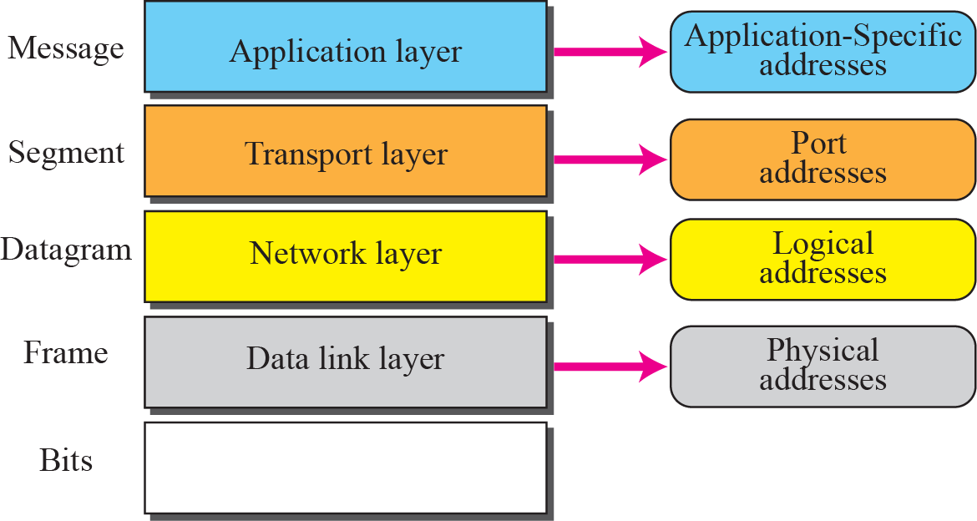
Figure 2.15 Addresses in the TCP/IP protocol suite

Slide 42
Example 2.3
In Figure 2.16 a node with physical address 10 sends a frame to a node with physical address 87. The two nodes are connected by a link (a LAN). At the data link layer, this frame contains physical (link) addresses in the header. These are the only addresses needed. The rest of the header contains other information needed at this level. As the figure shows, the computer with physical address 10 is the sender, and the computer with physical address 87 is the receiver. The data link layer at the sender receives data from an upper layer. It encapsulates the data in a frame. The frame is propagated through the LAN. Each station with a physical address other than 87 drops the frame because the destination address in the frame does not match its own physical address. The intended destination computer, however, finds a match between the destination address in the frame and its own physical address.

Slide 43
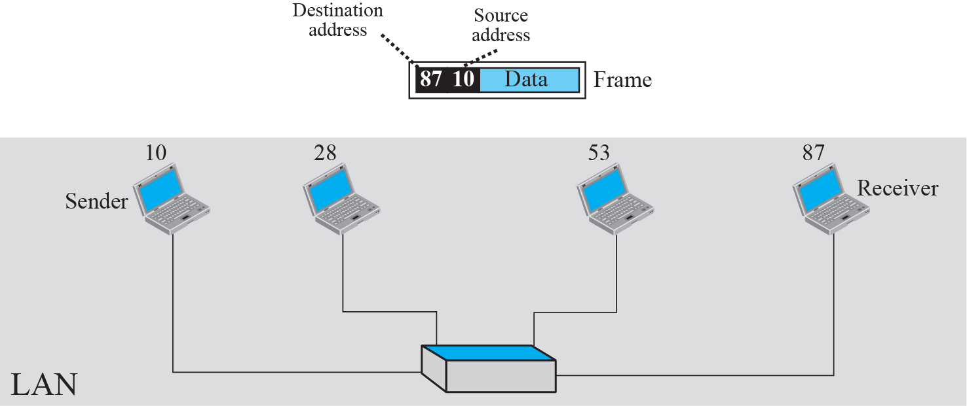
Figure 2.16 Example 2.3: physical addresses

Slide 44
Example 2.4
As we will see in Chapter 3, most local area networks use a 48-bit (6-byte) physical address written as 12 hexadecimal digits; every byte (2 hexadecimal digits) is separated by a colon, as shown below:
07:01:02:01:2C:4B
A 6-byte (12 hexadecimal digits) physical address

Slide 45
Example 2.5
Figure 2.17 shows a part of an internet with two routers connecting three LANs. Each device (computer or router) has a pair of addresses (logical and physical) for each connection. In this case, each computer is connected to only one link and therefore has only one pair of addresses. Each router, however, is connected to three networks. So each router has three pairs of addresses, one for each connection. Although it may be obvious that each router must have a separate physical address for each connection, it may not be obvious why it needs a logical address for each connection. We discuss these issues in Chapters 11 and 12 when we discuss routing. The computer with logical address A and physical address 10 needs to send a packet to the computer with logical address P and physical address 95. We use letters to show the logical addresses and numbers for physical addresses, but note that both are actually numbers, as we will see in later chapters.

Slide 46
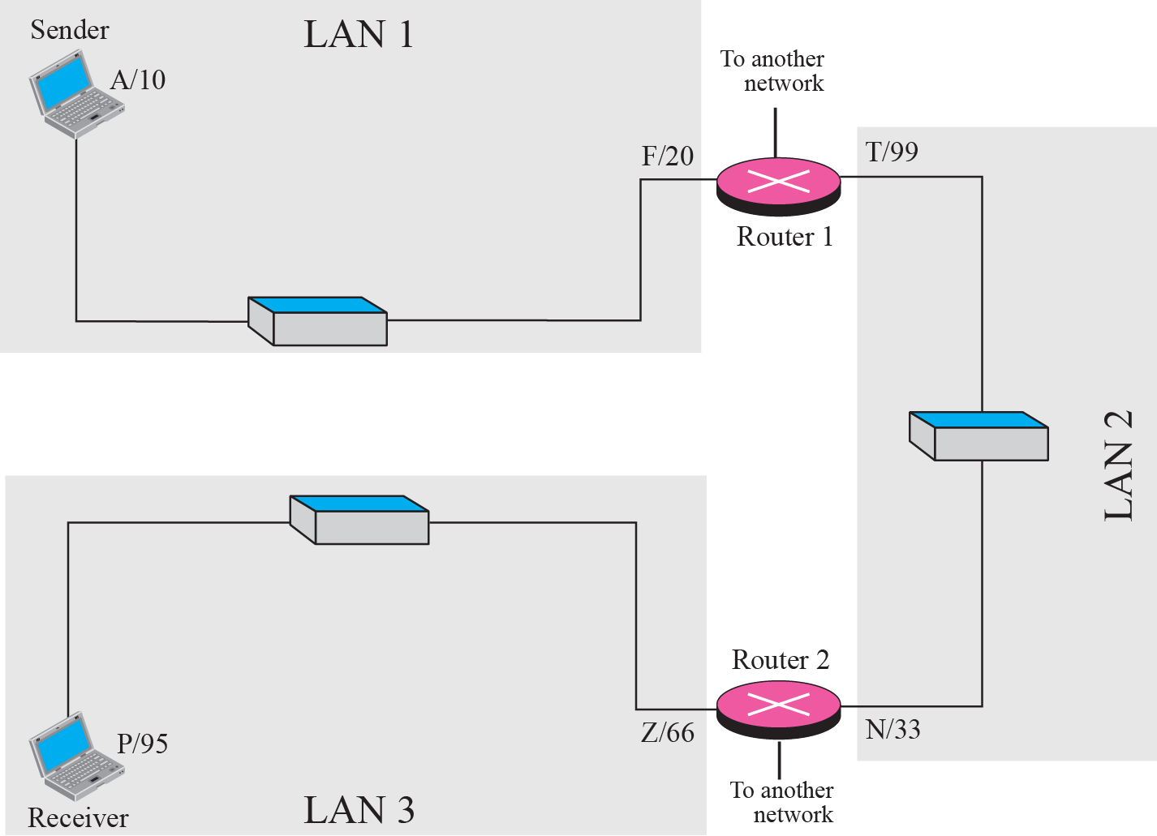
Figure 2.17 Example 2.5: logical addresses

Slide 47
Note
The physical addresses will change from hop to hop, but the logical addresses remain the same.

Slide 48
Example 2.6
Figure 2.18 shows two computers communicating via the Internet. The sending computer is running three processes at this time with port addresses a, b, and c. The receiving computer is running two processes at this time with port addresses j and k. Process a in the sending computer needs to communicate with process j in the receiving computer. Note that although both computers are using the same application, FTP, for example, the port addresses are different because one is a client program and the other is a server program, as we will see in Chapter 17.

Slide 49
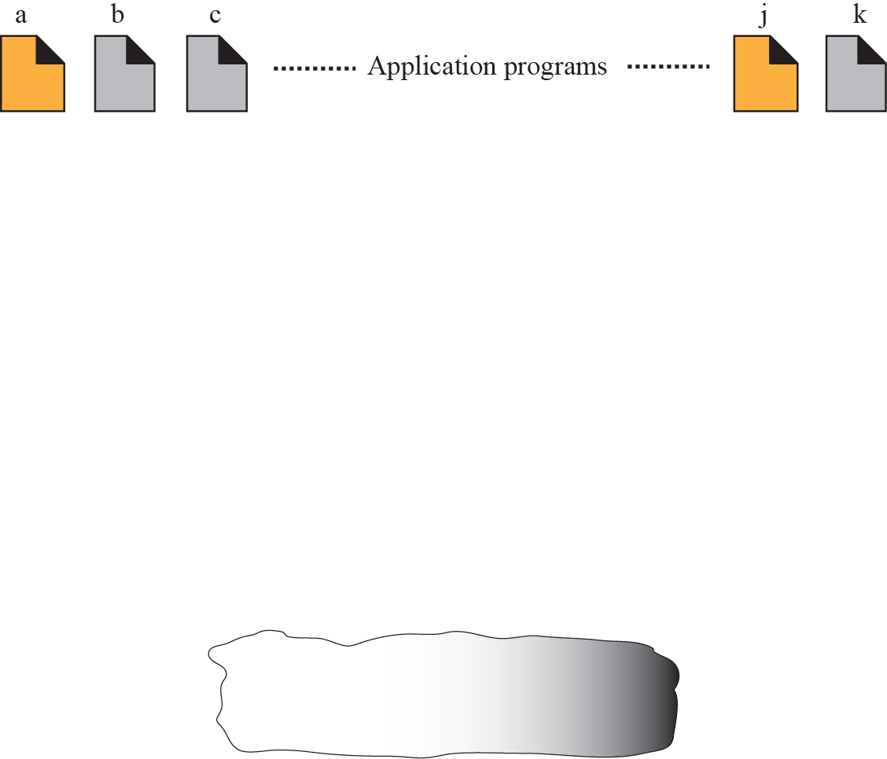
Figure 2.18 Example 2.6: port numbers

Slide 50
Note
The physical addresses change from hop to hop, but the logical and port addresses usually remain the same.

Slide 51
Example 2.7
As we will see in future chapters, a port address is a 16-bit address represented by one decimal number as shown.
753
A 16-bit port address represented as one single number

