Slide 1

Chapter 4
Introduction to
Network Layer
Copyright © The McGraw-Hill Companies, Inc. Permission required for reproduction or display.

Slide 2
OBJECTIVES:
To introduce switching and in particular packet switching as the mechanism of data delivery in the network layer.
To discuss two distinct types of services a packet-switch network can provide: connectionless service and connection-oriented service.
To discuss how routers forward packets in a connectionless packet-switch network using the destination address of the packet and a routing table.
To discuss how routers forward packets in a connection-oriented packet-switch network using the label on the packet and a routing table.
To discuss services already provided in the network layer such as logical addressing and delivery at the source, at each router, and at the destination.
To discuss issues or services that are not directly provided in the network layer protocol, but are sometimes provided by some auxiliary protocols or some protocols added later to the Internet.

Slide 3
Chapter Outline
4.1 Introduction
4.2 Switching
4.3 Packet Switching
4.4 Network Layer Services
4.5 Other Network Layer Issues

Slide 4
4-1 INTRODUCTION
At the conceptual level, we can think of the global Internet as a black box network that connects millions (if not billions) of computers in the world together. At this level, we are only concerned that a message from the application layer in one computer reaches the application layer in another computer.

Slide 5
Figure 4.1 Internet as a block box

Slide 6
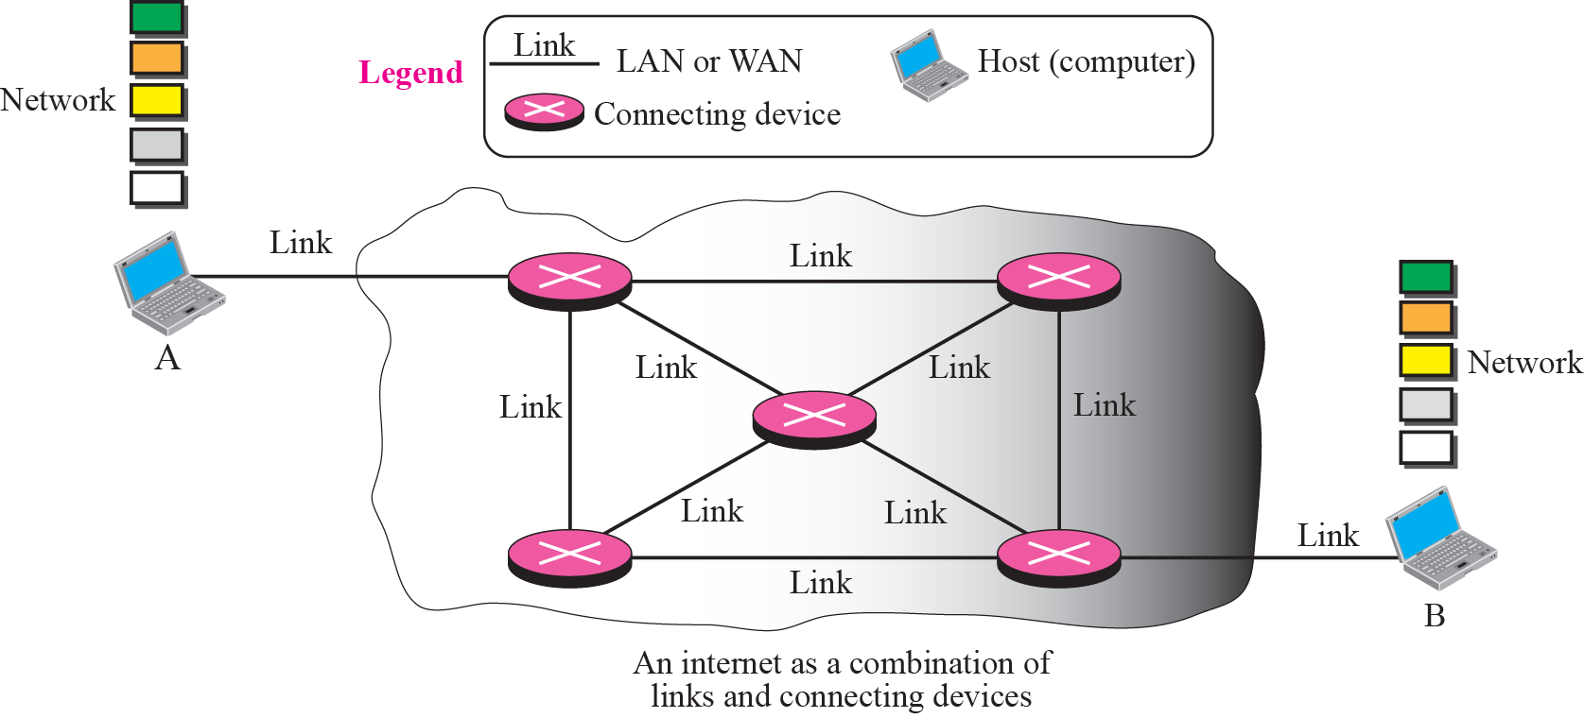
Figure 4.2 Internet as a combination of LANs and WANs connected together

Slide 7
4-2 SWITCHING
From the previous discussion, it is clear that the passage of a message from a source to a destination involves many decisions. When a message reaches a connecting device, a decision needs to be made to select one of the output ports through which the packet needs to be send out. In other words, the connecting device acts as a switch that connects one port to another port.

Slide 8
Topics Discussed in the Section
Circuit Switching
Packet Switching

Slide 9

Note
In circuit switching, the whole message is sent from the source to the destination without being
divided into packets.

Slide 10
Example 4.1
A good example of a circuit-switched network is the early telephone systems in which the path was established between a caller and a callee when the telephone number of the callee was dialed by the caller. When the callee responded to the call, the circuit was established. The voice message could now flow between the two parties, in both directions, while all of the connecting devices maintained the circuit. When the caller or callee hung up, the circuit was disconnected. The telephone network is not totally a circuit-switched network today.

Slide 11
Note
In packet switching, the message is first divided into manageable packets at the source before being transmitted. The packets are assembled at the destination.

Slide 12
4-3 PACKET SWITHING
The network layer is designed as a packet-switched network. This means that the packet at the source is divided into manageable packets, normally called datagrams. Individual datagrams are then transferred from the source to the destination. The received datagrams are assembled at the destination before recreating the original message. The packet-switched network layer of the Internet was originally designed as a connectionless service, but recently there is a tendency to change this to a connection-oriented service.

Slide 13
Topics Discussed in the Section
Connectionless Service
Connection-Oriented Service

Slide 14
Figure 4.3 A connectionless packet-switched network

Slide 15
Figure 4.4 Forwarding process in a connectionless network

Slide 16
Note
In a connectionless packet-switched network, the forwarding decision
is based on the destination address of the packet.

Slide 17


Figure 4.5 Delay in a connectionless network
Notes:
Waiting
time

Slide 18
Figure 4.6 A connection-oriented packet switched network

Slide 19
Note
In a connection-oriented packet switched network, the forwarding decision is based on the label of the packet.

Slide 20
Figure 4.7 Forwarding process in a connection-oriented network

Slide 21
Figure 4.8 Sending request packet in a virtual-circuit network

Slide 22
Figure 4.9 Setup acknowledgement in a virtual-circuit network

Slide 23
Figure 4.10 Flow of one packet in an established virtual circuit
Notes:
14ABData

Slide 24
Figure 4.11 Delay in a connection-oriented network

Slide 25
4-4 NETWORK LAYER SERVICES
In this section, we briefly discuss services provided by the network layer. Our discussion is mostly based on the connectionless service, the dominant service in today’s Internet.

Slide 26
Topics Discussed in the Section
Logical Addressing
Services Provided at the Source Computer
Services Provides at the Each Router
Services Provided at the Destination Computer

Slide 27
Figure 4.12 An imaginary part of the Internet

Slide 28
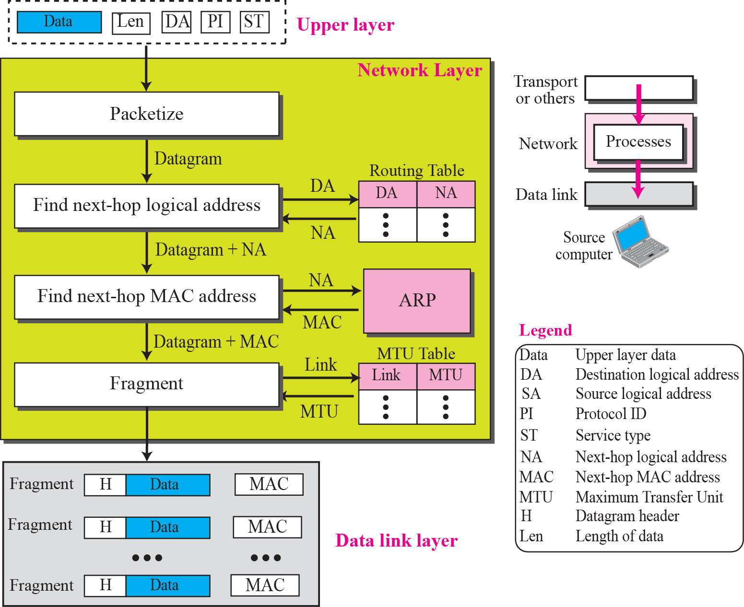
Figure 4.13 Services provided at the source computer

Slide 29
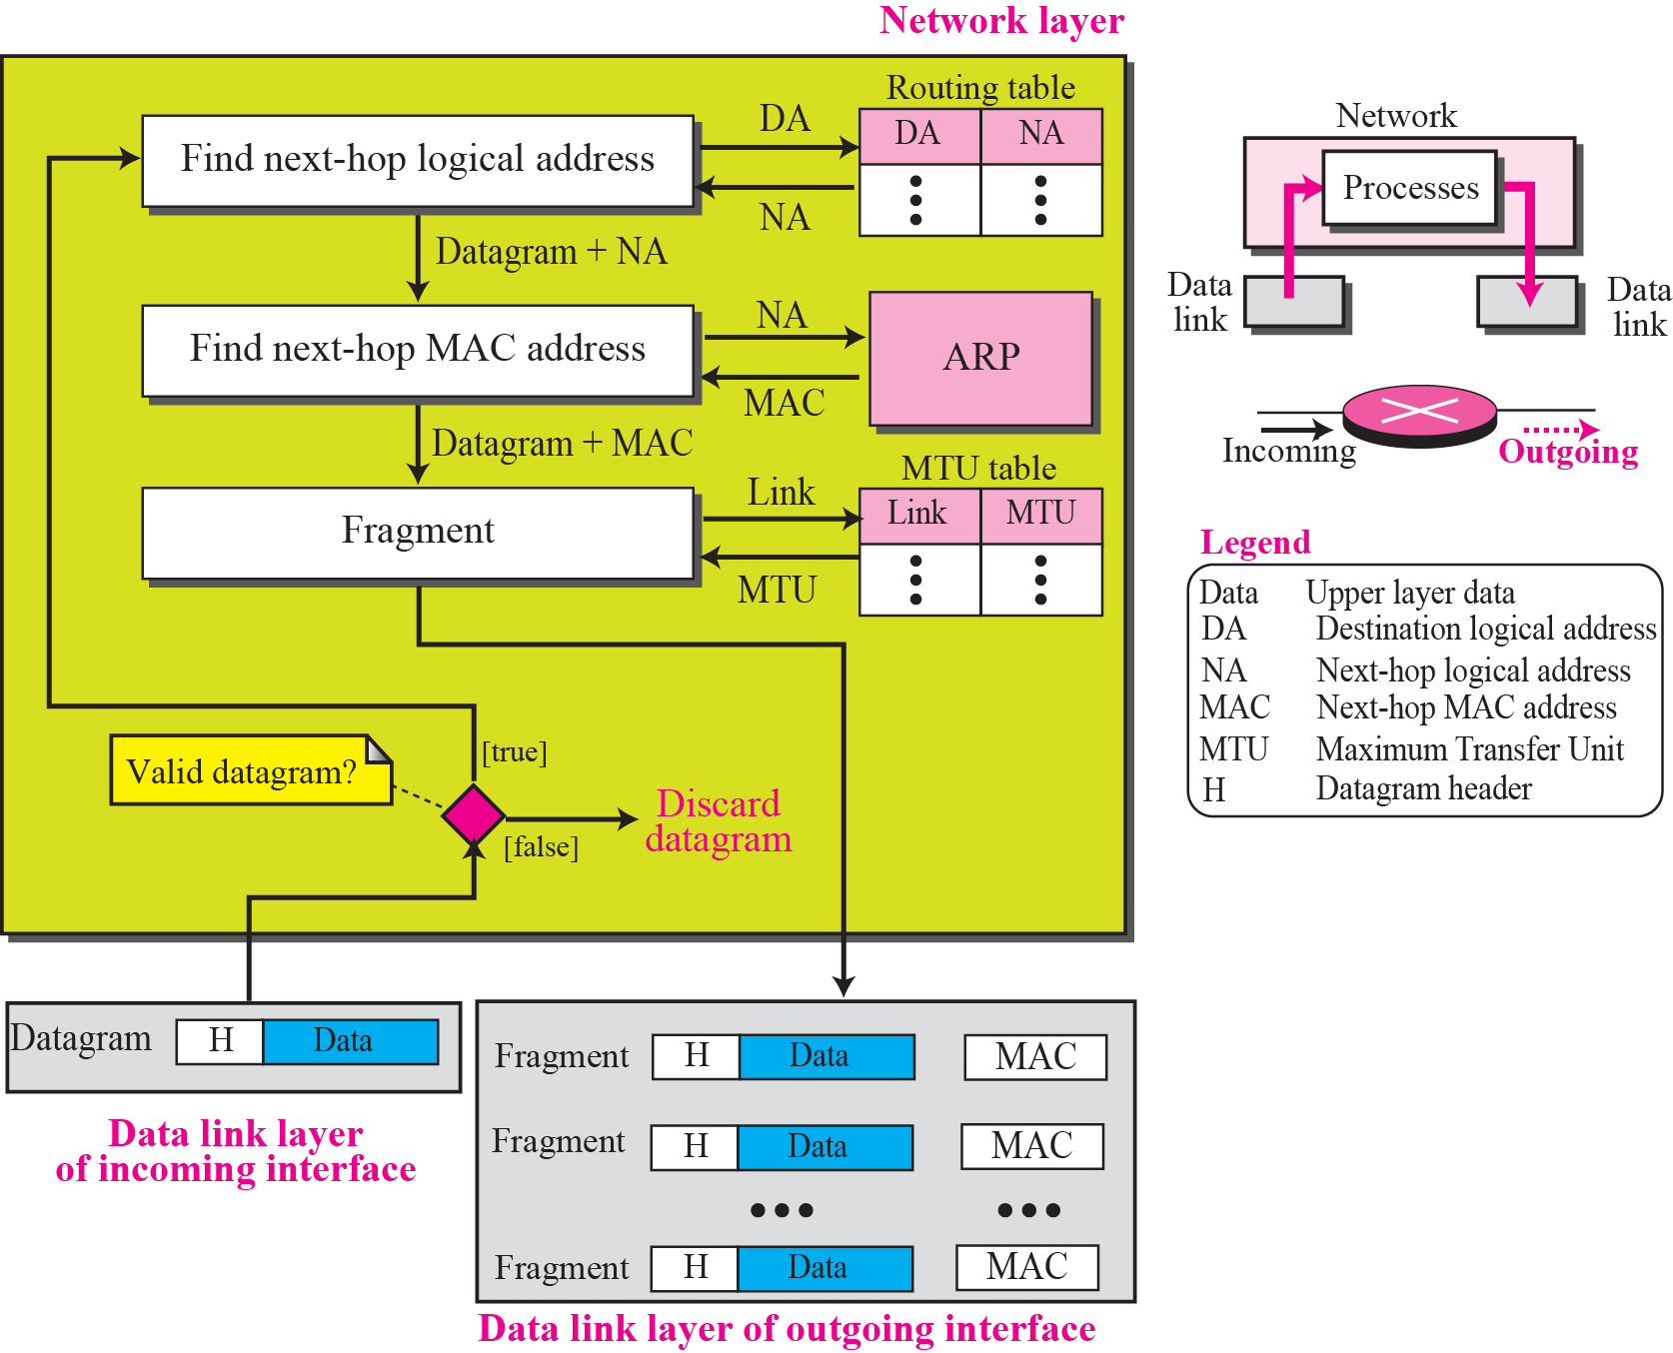
Figure 4.14 Processing at each router

Slide 30
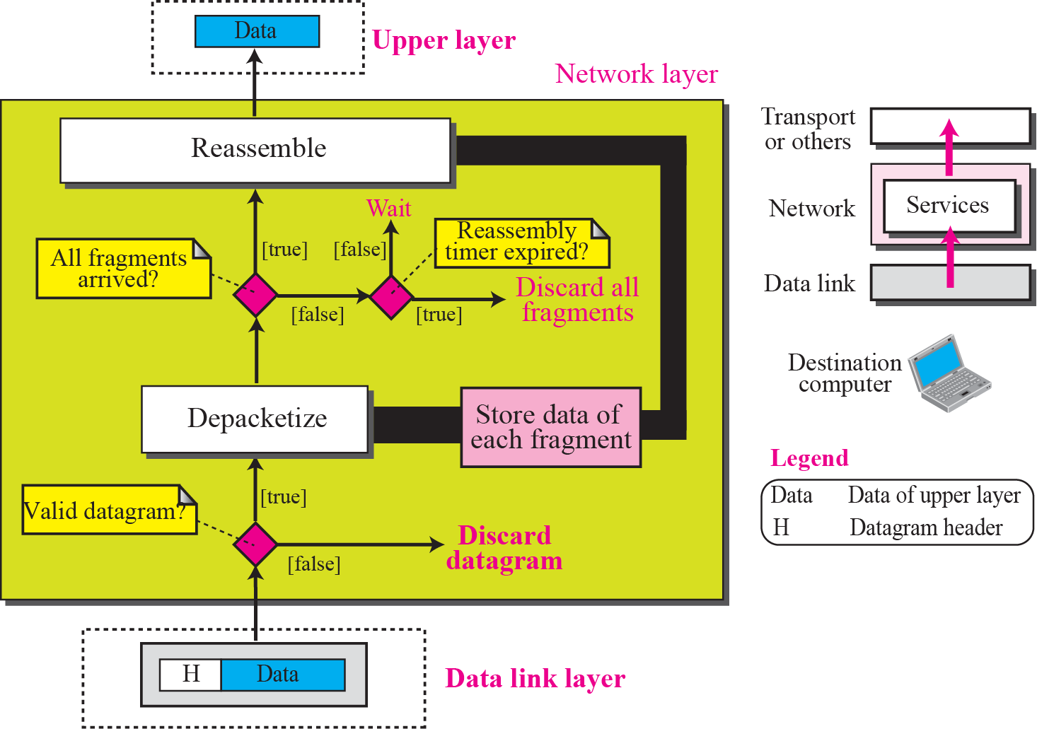
Figure 4.15 Processing at the destination computer

Slide 31
4-5 OTHER SERVICES
In this section we introduce some issues related to the network layer. These issues actually represent services that are normally discussed for the network layer, but they are either partially implemented at the network layer or not implemented at all. Some services are provided by some auxiliary protocols or by protocols added to the Internet later. Most of these issues resurface in future chapters.

Slide 32
Topics Discussed in the Section
Error Control
Flow Control
Congestion Control
Routing
Security

Slide 33
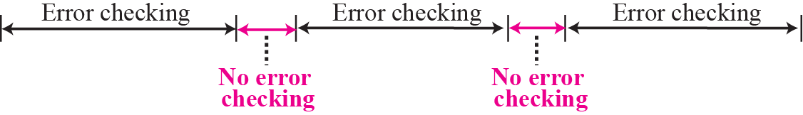
Figure 4.16 Error checking at the data link layer

Slide 34
Note
No flow control is provided for the current version of Internet network layer.

