Slide 1

Chapter 18
Host Configuration: DHCP
Copyright © The McGraw-Hill Companies, Inc. Permission required for reproduction or display.

Slide 2
OBJECTIVES:
To give the reasons why we need host configuration.
To give a historical background of two protocols used for host configuration in the past.
To define DHCP as the current Dynamic Host Configuration Protocol.
To discuss DHCP operation when the client and server are on the same network or on different networks.
To show how DHCP uses two well-known ports of UDP to achieve configuration.
To discuss the states the clients go through to lease an IP address from a DHCP server.

Slide 3
Chapter Outline
18.1 Introduction
18.2 DHCP Operation

Slide 4
18-1 INTRODUCTION
Each computer that uses the TCP/IP protocol suite needs to know its IP address. If the computer uses classless addressing or is a member of a subnet, it also needs to know its subnet mask. Most computers today need two other pieces of information: the address of a default router to be able to communicate with other networks and the address of a name server to be able to use names instead of addresses as we will see in the next chapter. In other words, four pieces of information are normally needed.

Slide 5
Three Methods of Allocating IP Addresses
1.Dynamic allocation—IP address is assigned to a client for a limited period of time (or until the client explicitly relinquishes the address).
2.Automatic allocation—A permanent IP address is assigned to a client.
3.Static allocation—IP address is assigned based on a preconfigured mapping to each client's MAC address.

Slide 6
18-2 DHCP OPERATION
The DHCP client and server can either be on the same network or on different networks. Let us discuss each situation separately.

Slide 7
Steps for Getting an IP Address
When a machine connected in the network is turned on with a DHCP client:
1.The client sends a broadcast request (called a DISCOVER or DHCPDISCOVER), looking for a DHCP server to answer.
2.The DHCP server temporarily reserves an IP address for the client and sends back to the client an OFFER (or DHCPOFFER) packet, with that address information.
3.The client sends a REQUEST (or DHCPREQUEST) packet, letting the server know that it intends to use the address.
4.The server sends an ACK (or DHCPACK) packet, confirming that the client has a been given a lease on the address for a server-specified period of time.

Slide 8
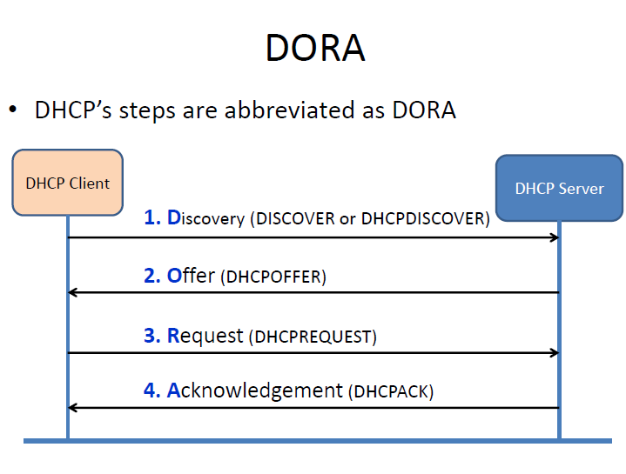

Slide 9
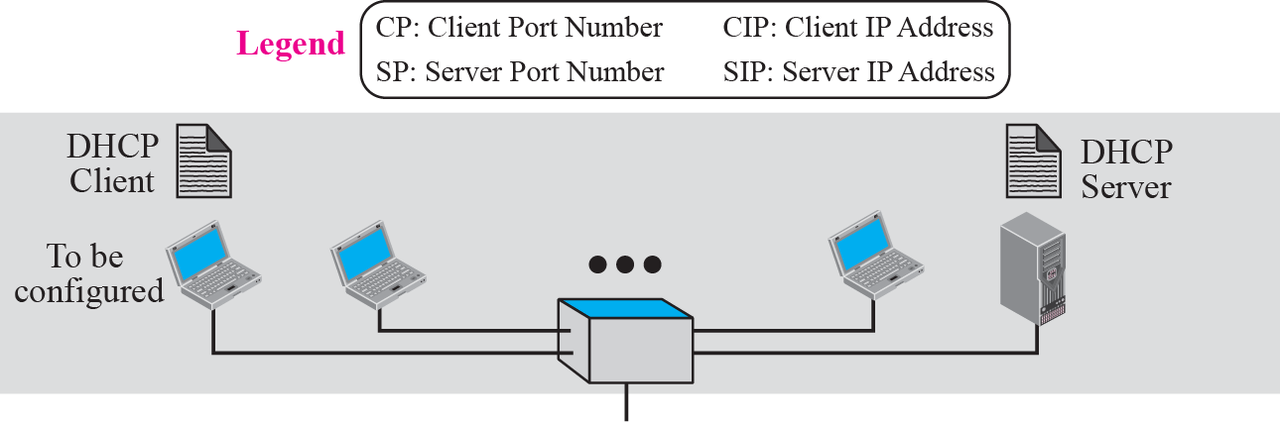
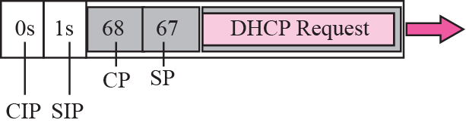
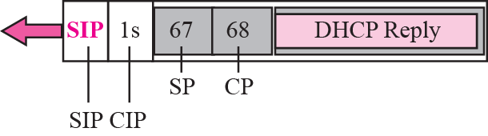
Figure 18.1 Client and server on the same network

Slide 10
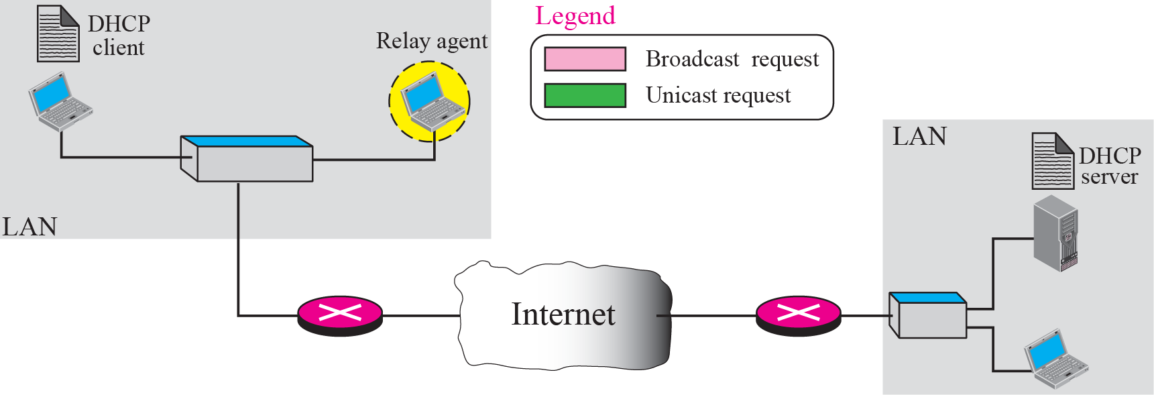
Figure 18.2 Client and server on two different networks

