Slide 1
Unit 1- DATA WAREHOUSING
Data Mining And Data Warehousing-IT633P
Dr. J.Thomas
Dept of CSE

Slide 2

A producer wants to know….
Which are our
lowest/highest margin
customers ?
Who are my customers
and what products
are they buying?
What is the most
effective distribution
channel?
What product prom-
-otions have the biggest
impact on revenue?
Which customers
are most likely to go
to the competition ?
What impact will
new products/services
have on revenue
and margins?

Slide 3
Data, Data everywhere yet ...
I can’t find the data I need
  data is scattered over the network
  many versions, subtle differences
I can’t get the data I need
  need an expert to get the data
I can’t understand the data I found
  available data poorly documented
I can’t use the data I found
  results are unexpected
  data needs to be transformed from one form to other

Slide 4

What is a Data Warehouse?
A single, complete and consistent store of data obtained from a variety of different sources made available to end users in a what they can understand and use in a business context.
[Barry Devlin]

Slide 5
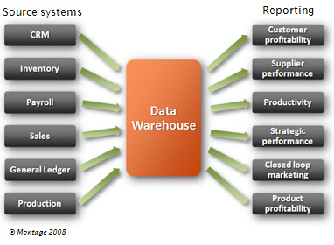
What is Data warehouse?
Data warehousing provides architectures and tools for business executives to systematically organize, understand, and use their data to make strategic decisions.

Slide 6

What is Data Warehousing?
A process of transforming data into information and making it available to users in a timely enough manner to make a difference
[Forrester Research, April 1996]
Information
Data

Slide 7
Very Large Data Bases
Terabytes -- 10^12 bytes:
Petabytes -- 10^15 bytes:
Exabytes -- 10^18 bytes:
Zettabytes -- 10^21 bytes:
Zottabytes -- 10^24 bytes:
Walmart -- 24 Terabytes
Geographic Information Systems
National Medical Records
Weather images
Intelligence Agency Videos

Slide 8
Data Warehouse
A data warehouse is a
  subject-oriented
  integrated
  time-varying
  non-volatile
collection of data that is used primarily in organizational decision making.
  -- Bill Inmon, Building the Data Warehouse 1996

Slide 9
  subject-oriented
  * Organized around major subjects. Customer , products , sales
  * Focus on modelling and analysis of data
  Integrated
  * heterogeneous data
  * data cleaning and integration techniques
  time-varying
  * provide historical data
  * key structure contains element of time
  non-volatile
  * two operations : initial loading & access of data

Slide 10
Unit 1- DATA WAREHOUSING
Data Mining And Data Warehousing-IT6343
Dr. J.Thomas
Dept of CSE

Slide 11

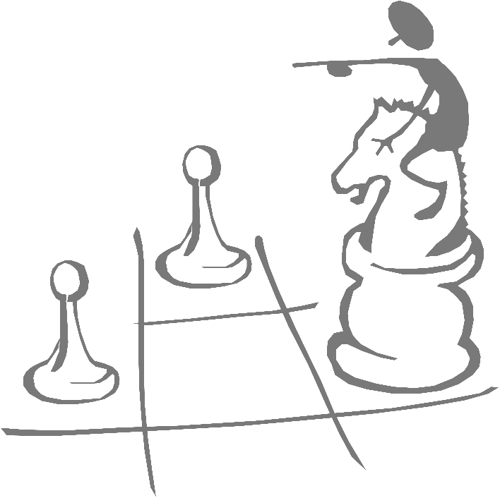
Data Mining works with Warehouse Data
Data Warehousing provides the Enterprise with a memory
Data Mining provides the Enterprise with intelligence

Slide 12
We want to know ...
Given a database of 100,000 names, which persons are the least likely to default on their credit cards?
Which types of transactions are likely to be fraudulent given the demographics and transactional history of a particular customer?
If I raise the price of my product by Rs. 2, what is the effect on my ROI?
If I offer only 2,500 airline miles as an incentive to purchase rather than 5,000, how many lost responses will result?
If I emphasize ease-of-use of the product as opposed to its technical capabilities, what will be the net effect on my revenues?
Which of my customers are likely to be the most loyal?
Data Mining helps extract such information

Slide 13
Application Areas
Industry
Application
Finance
Credit Card Analysis
Insurance
Claims, Fraud Analysis
Telecommunication
Call record analysis
Transport
Logistics management
Consumer goods
promotion analysis
Data Service providers
Value added data
Utilities
Power usage analysis

Slide 14
What makes data mining possible?
Advances in the following areas are making data mining deployable:
  data warehousing
  better and more data (i.e., operational, behavioral, and demographic)
  the emergence of easily deployed data mining tools and
  the advent of new data mining techniques.

Slide 15
A Multidimensional Data Model

Slide 16
From tables to data cubes
Data warehouses and OLAP tools are based on a multidimensional data model.
Views data in the form of a data cube.
A data cube allows data to be modelled and viewed in multiple dimensions.
Defined by
  Dimensions
  perspectives or entities with respect to which an organization wants to keep records.
  Facts
  numerical measures

Slide 17
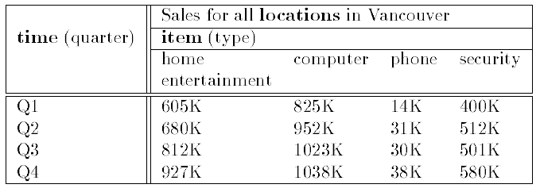
2D view

Slide 18
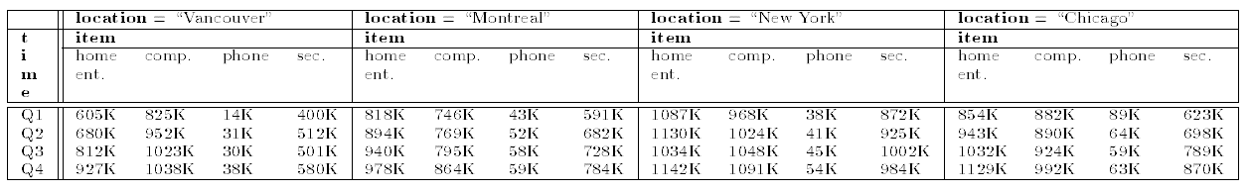
3D view

Slide 19
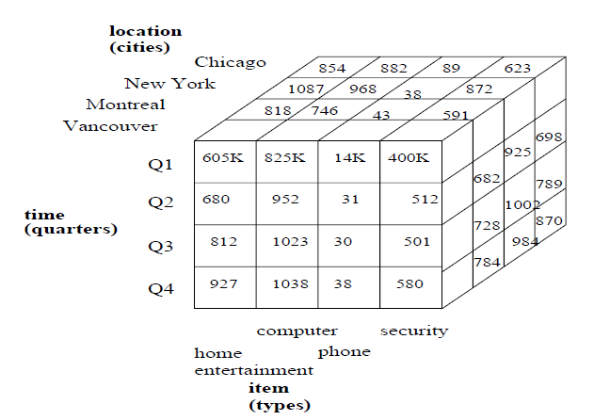
3D data cube representation

Slide 20
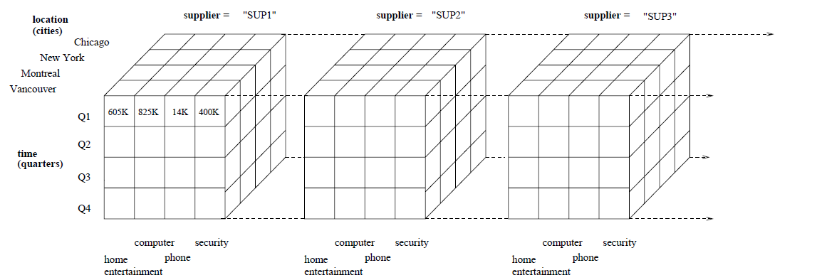
4D data cube representation

Slide 21
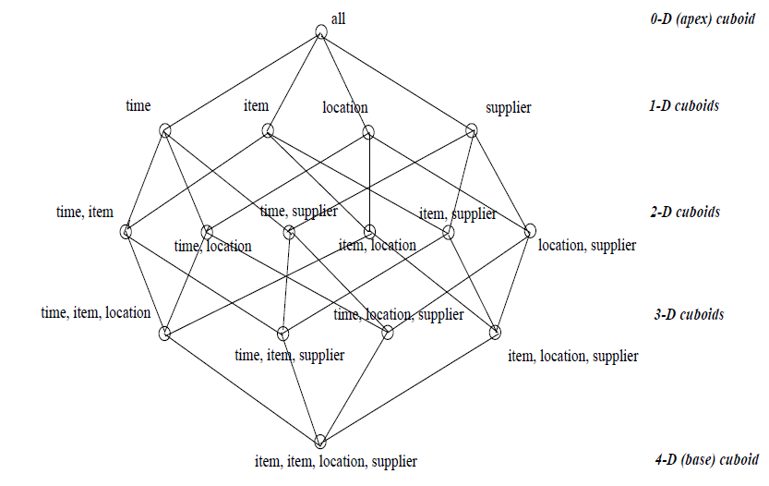
Lattice of cuboids

Slide 22
Conceptual modeling of DW
Multidimensional model exist in the form of:
  Star schema
  consists of a large central table (fact table)
  a set of smaller attendant tables (dimension tables), one for each dimension.
  Snowflake schema
  variant of the star schema model
  some dimension tables are normalized, thereby further splitting the data into additional tables.
  - Fact constellation

Slide 23
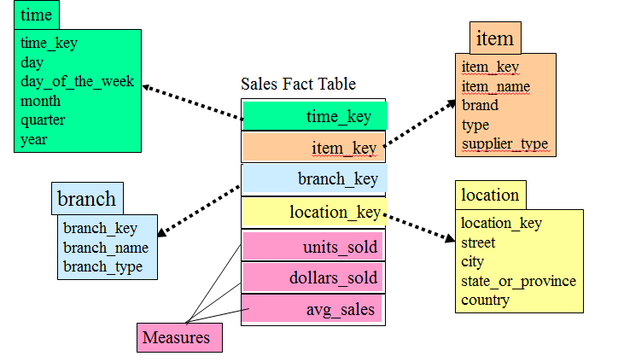
Star schema

Slide 24
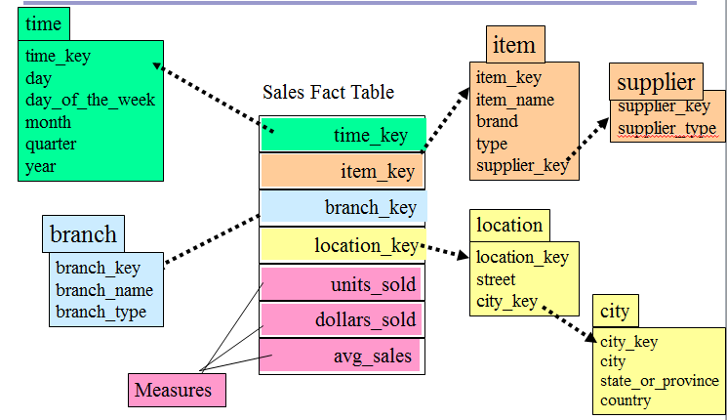
Snowflake schema

Slide 25
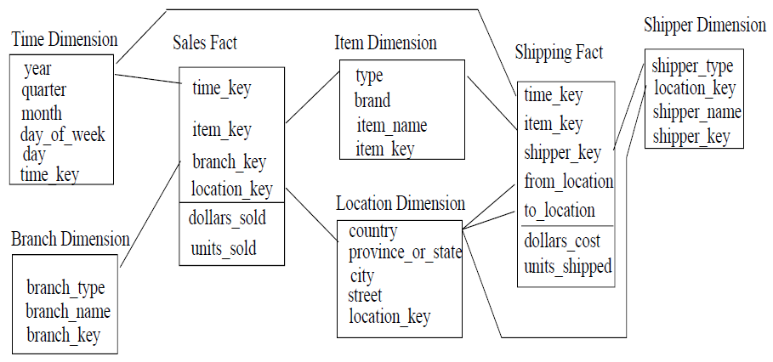
Cont.…
  Fact constellation schema
  multiple fact tables to share dimension tables.
  This kind of schema can be viewed as a collection of stars, and hence is called a galaxy schema or a fact constellation.

Slide 26
Cube definition
Cube Definition (Fact Table)
  define cube <cube_name> [<dimension_list>]: <measure_list>
Dimension Definition (Dimension Table)
  define dimension <dimension_name> as (<attribute_or_subdimension_list>)
Special Case (Shared Dimension Tables)
  First time as “cube definition”
  define dimension <dimension_name> as <dimension_name_first_time> in cube <cube_name_first_time>

Slide 27
Measures
A multidimensional point in the data cube space can be defined by dimension-value pairs.
A data cube measure is a numerical function that can be evaluated at each point in the data cube space.
A measure value is computed for a given point by aggregating the data corresponding to the respective dimension-value pairs defining the given point.

Slide 28
Measures: categorization
Distributive: if the result derived by applying the function to n aggregate values is the same as that derived by applying the function on all the data without partitioning
    E.g., count(), sum(), min(), max()
Algebraic: if it can be computed by an algebraic function with M arguments (where M is a bounded integer), each of which is obtained by applying a distributive aggregate function
    E.g., avg(), min_N(), standard_deviation()
Holistic: if there is no constant bound on the storage size needed to describe a subaggregate.
    E.g., median(), mode(), rank()

Slide 29
Defining Star Schema
define cube sales_star [time, item, branch, location]:
    dollars_sold = sum(sales_in_dollars), avg_sales = avg(sales_in_dollars), units_sold = count(*)
define dimension time as (time_key, day, day_of_week, month, quarter, year)
define dimension item as (item_key, item_name, brand, type, supplier_type)
define dimension branch as (branch_key, branch_name, branch_type)
define dimension location as (location_key, street, city, province_or_state, country)

Slide 30
Defining Snowflake Schema
define cube sales_snowflake [time, item, branch, location]:
    dollars_sold = sum(sales_in_dollars), avg_sales = avg(sales_in_dollars), units_sold = count(*)
define dimension time as (time_key, day, day_of_week, month, quarter, year)
define dimension item as (item_key, item_name, brand, type, supplier(supplier_key, supplier_type))
define dimension branch as (branch_key, branch_name, branch_type)
define dimension location as (location_key, street, city(city_key, province_or_state, country))

Slide 31
Defining Fact Constellation
define cube sales [time, item, branch, location]:
    dollars_sold = sum(sales_in_dollars), units_sold = count(*)
define dimension time as (time_key, day, day_of_week, month, quarter, year)
define dimension item as (item_key, item_name, brand, type)
define dimension branch as (branch_key, branch_name, branch_type)
define dimension location as (location_key, street, city, province_or_state, country)
define cube shipping [time, item, shipper, from_location, to_location]:
    dollar_cost = sum(cost_in_dollars), unit_shipped = count(*)
define dimension time as time in cube sales
define dimension item as item in cube sales
define dimension shipper as (shipper_key, shipper_name, location as location in cube sales, shipper_type)
define dimension from_location as location in cube sales
define dimension to_location as location in cube sales

Slide 32
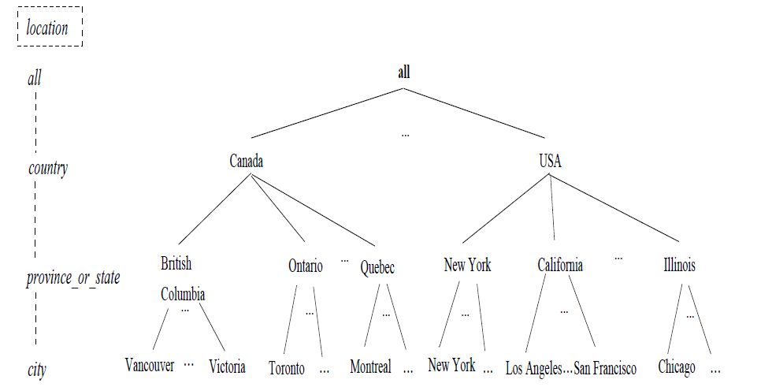
Concept Hierarchy
A concept hierarchy defines a sequence of mappings from a set of low level concepts to higher level, more general concepts.

Slide 33
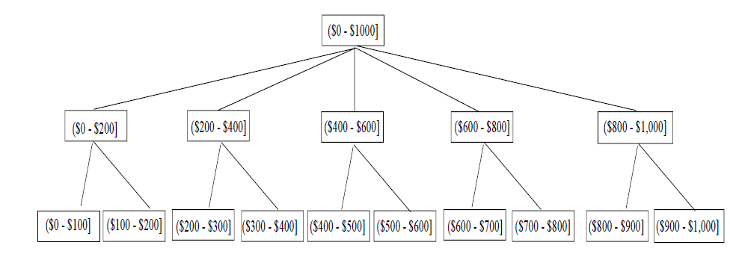
Set grouping hierarchy

Slide 34
OLAP Operations
Roll up (drill-up): summarize data
  by climbing up hierarchy or by dimension reduction
Drill down (roll down): reverse of roll-up
  from higher level summary to lower level summary or detailed data, or introducing new dimensions
Slice and dice: project and select
Pivot (rotate):
  reorient the cube, visualization, 3D to series of 2D planes
Other operations
  drill across: involving (across) more than one fact table
  drill through: through the bottom level of the cube to its back-end relational tables (using SQL)

Slide 35


Slide 36
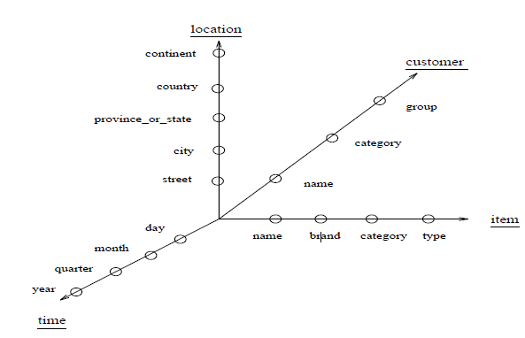
Star-Net Query Model
A starnet model consists of radial lines emanating from a central point, where each line represents a concept hierarchy for a dimension.
Each abstraction level in the hierarchy is called a footprint.

Slide 37
Multi-Tiered Architecture
Monitor
&
Integrator
OLAP Server
other
sources
Metadata
Analysis
Query
Reports
Data mining
Operational
DBs
Extract
Transform
Load
Refresh
Data
Warehouse
Serve
Data Marts
Data Sources
Data Storage
OLAP Engine
Front-End Tools

Slide 38
Three Data Warehouse Models
Enterprise warehouse
  collects all of the information about subjects spanning the entire organization
Data Mart
  a subset of corporate-wide data that is of value to a specific groups of users. Its scope is confined to specific, selected groups, such as marketing data mart
    Independent vs. dependent (directly from warehouse) data mart
Virtual warehouse
  A set of views over operational databases
  Only some of the possible summary views may be materialized

Slide 39
Data Warehouse Development: A Recommended Approach
Multi-Tier Data Warehouse
Distributed Data Marts
Enterprise Data Warehouse
Data Mart
Data Mart
Model refinement
Model refinement
Define a high-level corporate data model

Slide 40
THANKYOU

