Slide 1

INFRATRACK

Slide 2
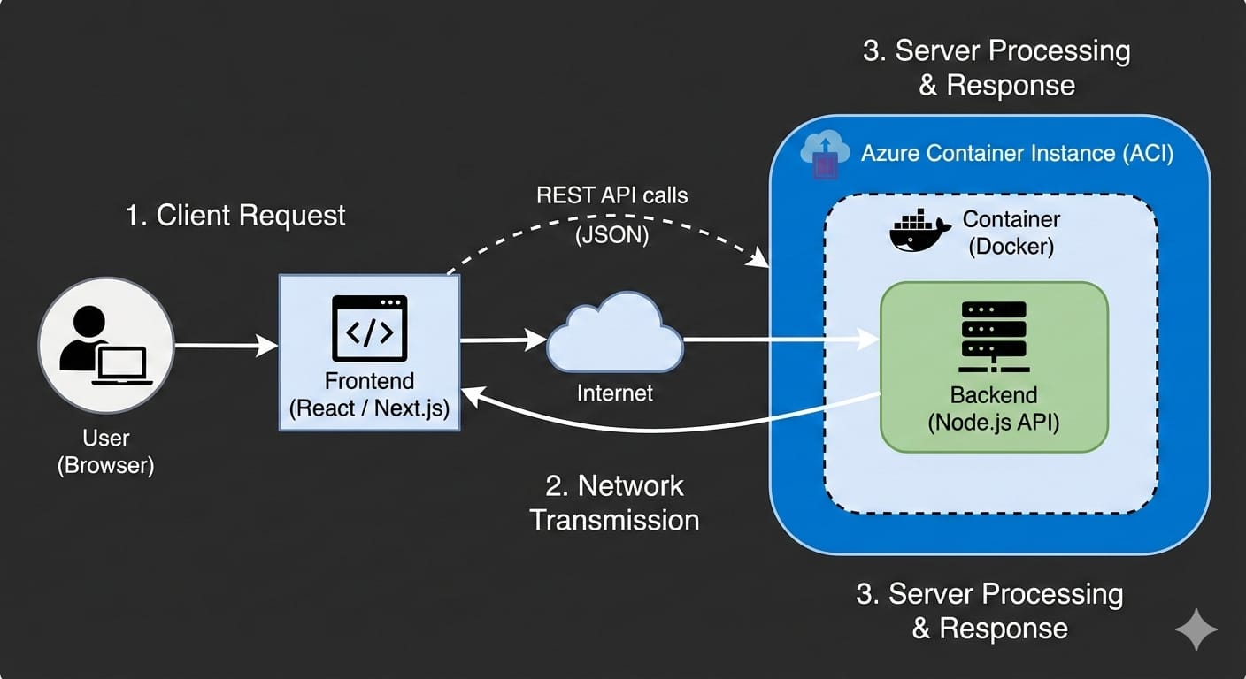
RUN TIME FLOW

Slide 3
Why InfraTrack Was Made
For Industry & Organizations
In real-world industrial and enterprise environments:
Cloud resources are spread across multiple services
Cost tracking is complex and often delayed
Was made individually

Slide 4
Students & Learners
InfraTrack is also designed as a learning and experimentation platform for students entering cloud, DevOps, and software engineering fields.
Students can use InfraTrack to:
Learn how real industrial cloud platforms are structured
Understand Azure services, cloud costs, and monitoring concepts
Visualize CI/CD pipelines and container-based deployments
Practice DevOps workflows in a safe, controlled environment

Slide 5
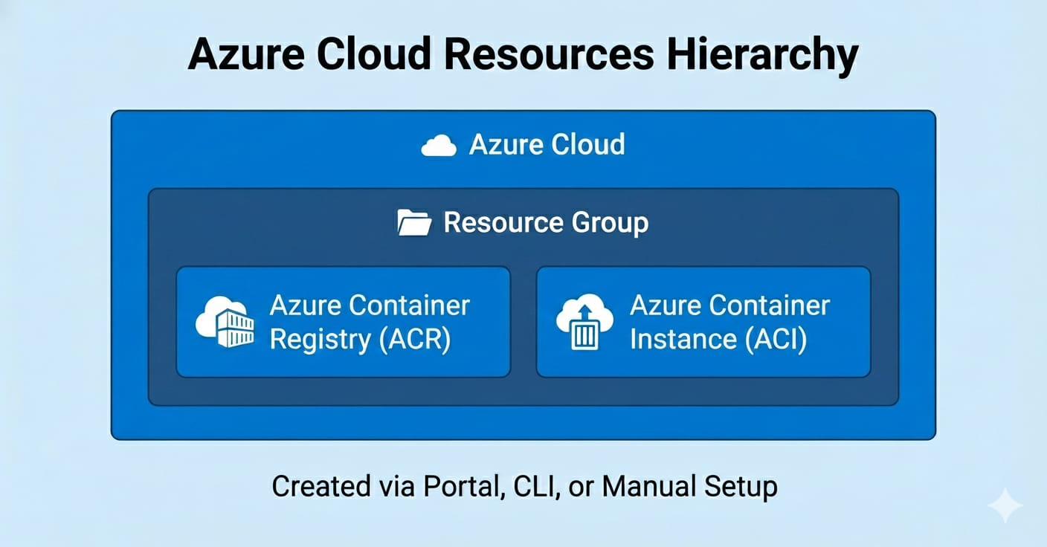

Slide 6
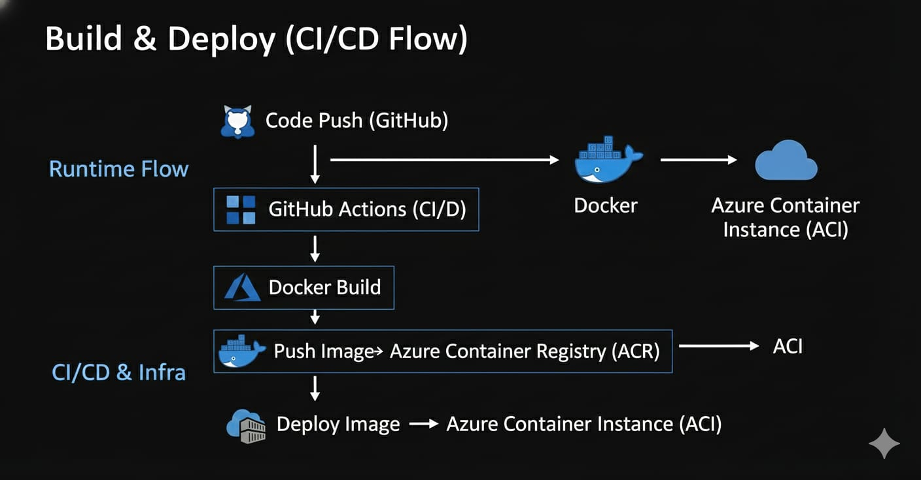

Slide 7
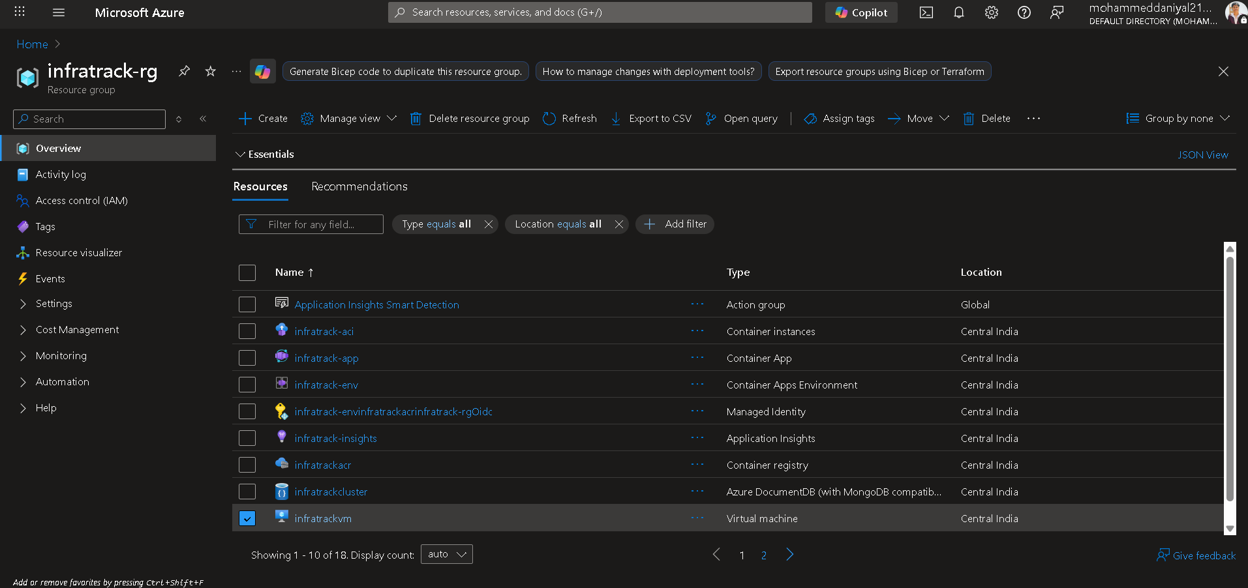

Slide 8
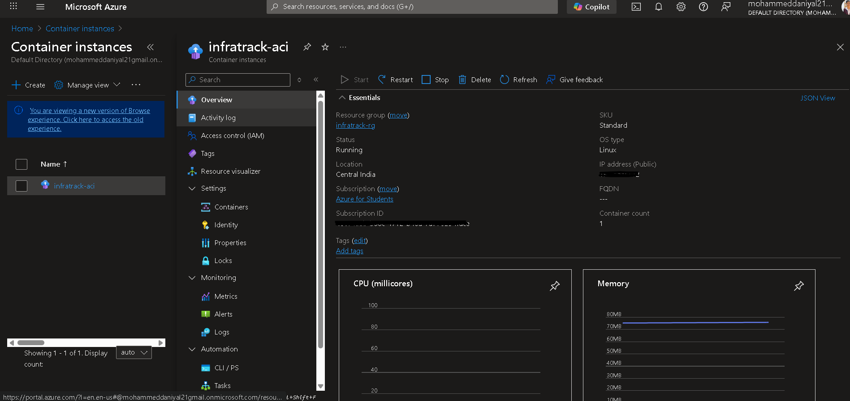

Slide 9
