Slide 1



ASTROSAGE ANALYSIS PPT
MOHAMMED SADIQ
DATE : 19-02-2025

Slide 2
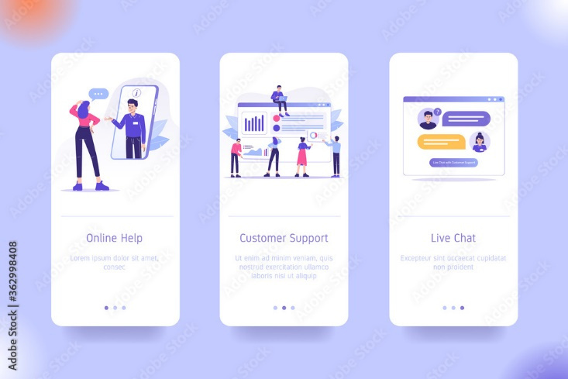
Introduction to AstroSage
AstroSage is a website and app that provides astrology services, including calls, chat consultation data using Excel based on chart, dashboard, tables to evaluate the performance and behavior.
AstroSage is used by many business stakeholder such as management, operation teams and customer experience teams.
AstroSage is used to track revenue, identifying issues and decision to improvement the satisfactions of customers

Slide 3
Problem statement
You are tasked with optimizing the call center operations for AstroSage, which has received a 1 crore investment. The goal is to determine how to allocate this investment to maximize operational efficiency, customer satisfaction, and profitability. This project will involve analyzing historical call data, performance metrics, and market trends to make informed decisions.

Slide 4

ABOUT ASTROSAGE
🌟 Overview
A dedicated astrology-based call center providing expert guidance
Connects customers with professional astrologers for personalized predictions
📞 Services Offered
Horoscope analysis and future predictions
Kundli matching and relationship guidance Career, finance, and health-related consultations
💡 Why It Stands Out
24/7 accessibility for astrology queries
Experienced astrologers with diverse expertise
ASTROSAGE

Slide 5

How Astrosage Call Centre Works
🔗 Customer Interaction Process
Customer calls for an astrology consultation
Assigned to an expert astrologer
Personalized analysis & predictions given
Feedback and follow-up services available
🚀 Technology & Support
AI-powered astrology insights
Secure and efficient customer management system
Multiple language support for diverse audiences

Slide 6
AIMS OF ANALYSIS
ALLOCATION OF INVESTMENT TO OPTIMIZE THE FOLLOWING KEY METRICS:
1.Performance Evaluation
2. Customer Experience Enhancement
3. Agent Productivity & Training
4. Technology & Automation Integration
5. Cost & Resource Optimization

Slide 7

DATA OVERVIEW
Average calls per day approximately 250 indicating that lot of user want suggestion from ASTROSAGE through calling
There are various option by which customer with astrologers or astrologers interact with customers through chatting , calls , public live calling from astrologer etc.
Net revenue by the call center is 213987.3 rupees.
4. Average no of agent working per day is 4
5. Total Consultant is 28027
6. Average rating is 2.93

Slide 8
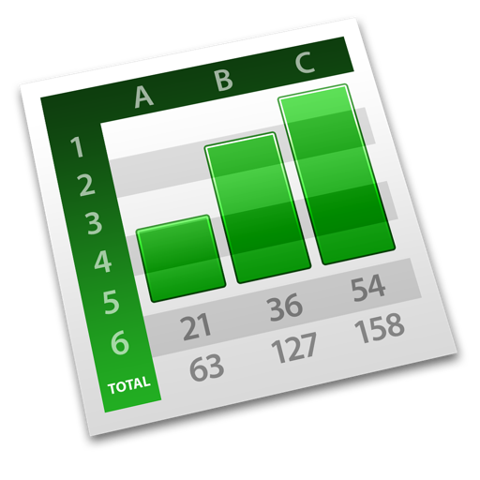
METHODOLOGY
Data cleaning: Utilized functions like remove duplicates to ensure data accuracy
Data enrichment: Enhanced the dataset with additional variables like date , month , day using TEXT function to cross reference external data sources.
Used search function like VLookup, XLookup etc.
Descriptive Analysis : Employed Pivot tables for summarizing key metrics and identifying the patterns and chart.
Trend Analysis: Conducted time series analysis using trend chart
Visualization: created dynamic charts and dashboards for data Representation ,enabling interactive data Exploration
Slice: using slicer we can see the monthly , daily trends of call

Slide 9
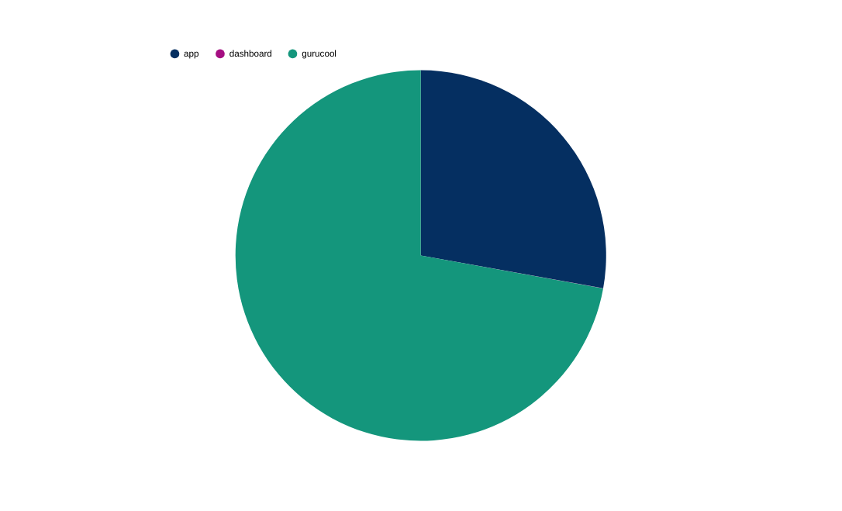
Majority of Consultations Originate from Gurucool Platform
Gurucool generates the highest share of consultations
App-based consultations form a secondary but significant channel
Dashboard-based consultations contribute comparatively less
Consultations by platform

Slide 10

Top 10 Astrologers Based on Customer Ratings
A small group of astrologers consistently receives higher customer ratings
Rating distribution shows clear performance differences among top gurus
High-rated gurus contribute strongly to customer trust and satisfaction

Slide 11
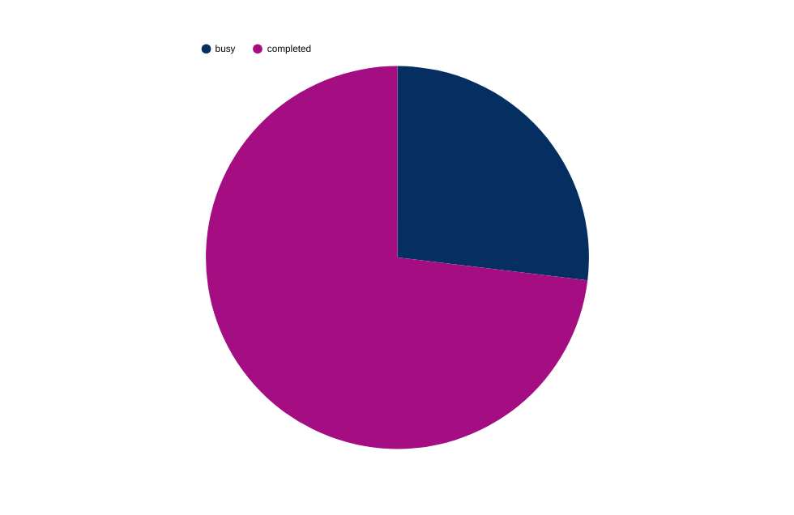
Most Calls Are Successfully Completed
Call Completion status
A large majority of calls reach successful completion
A smaller portion of calls remain busy or incomplete
Call handling efficiency is relatively strong

Slide 12
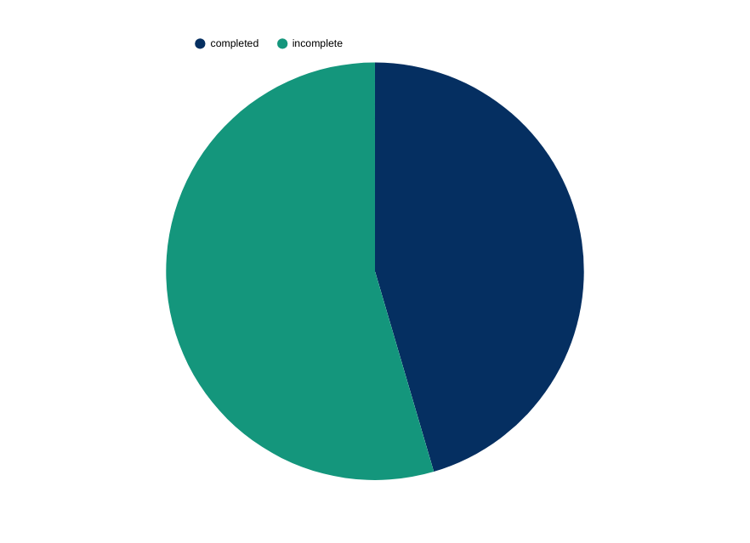
Higher Incompletion Rate Observed in Chat Consultations
Incomplete chats form a significant portion of total chat volume
Chat consultations face more drop-offs compared to calls
Indicates need for improved chat handling mechanisms
Chat Consultation Completion Status

Slide 13
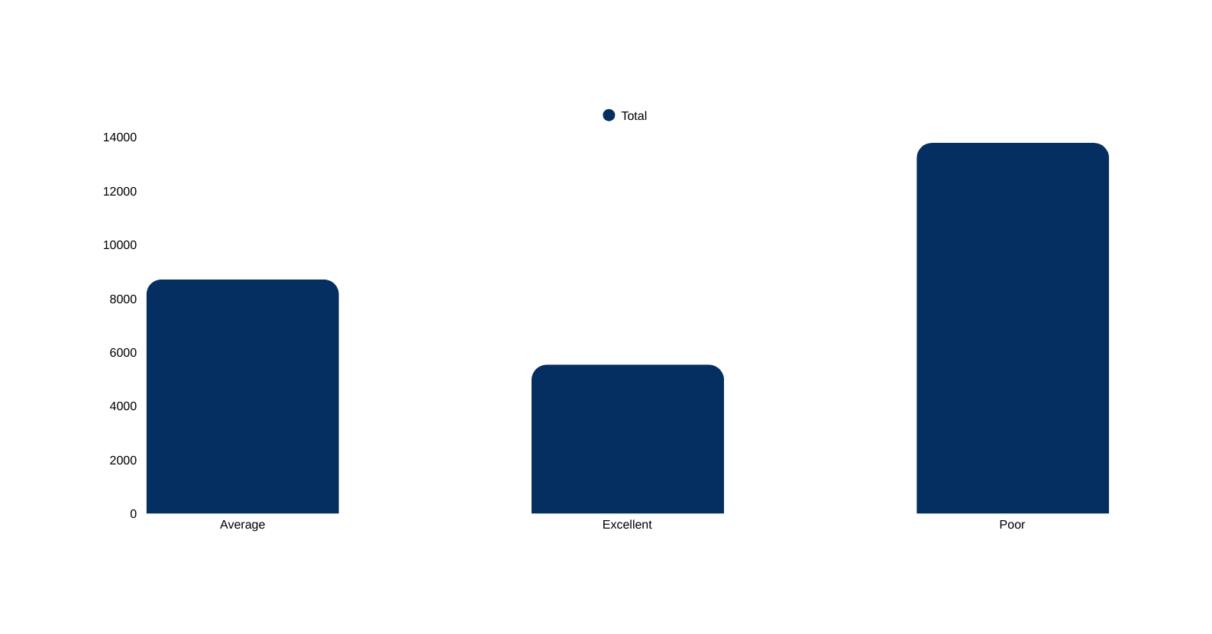
Rating Distribution Overview
Customer Rating Distribution
Majority of users provide average or poor ratings
Fewer users report excellent experiences
Overall customer satisfaction has room for improvement

Slide 14
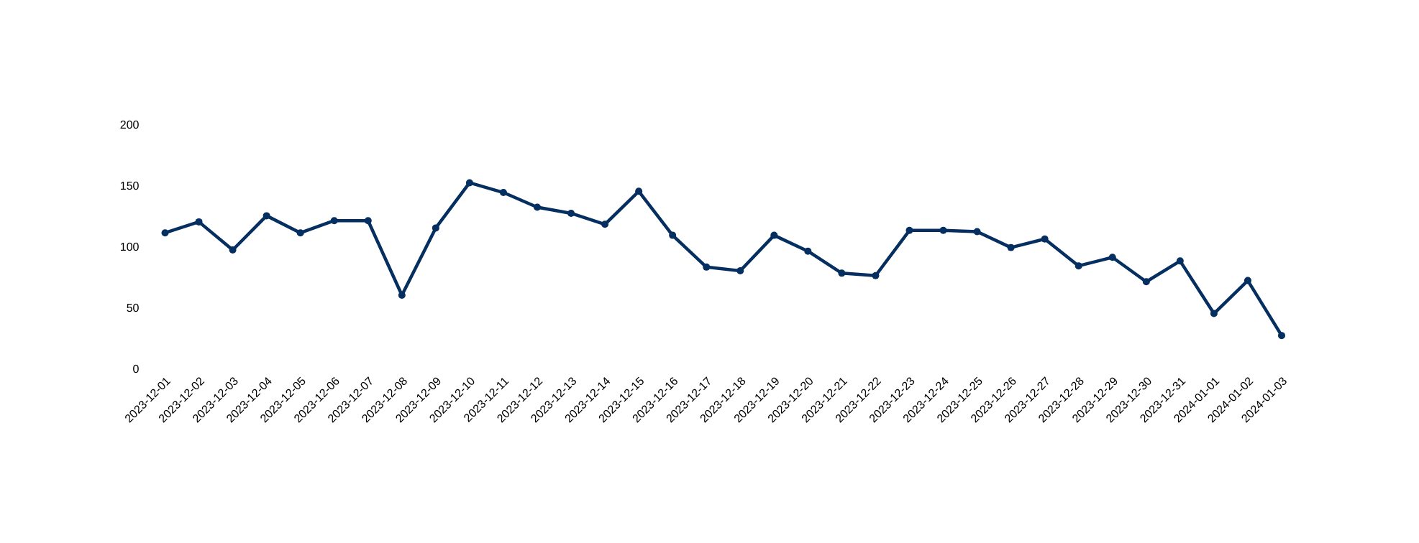
Daily Call Volume Shows Fluctuating Demand Pattern
Daily Call Volume Trend
Call volume varies day-to-day with noticeable fluctuations
Some days experience sharp drops indicating lower engagement
Overall trend suggests demand instability across days

Slide 15
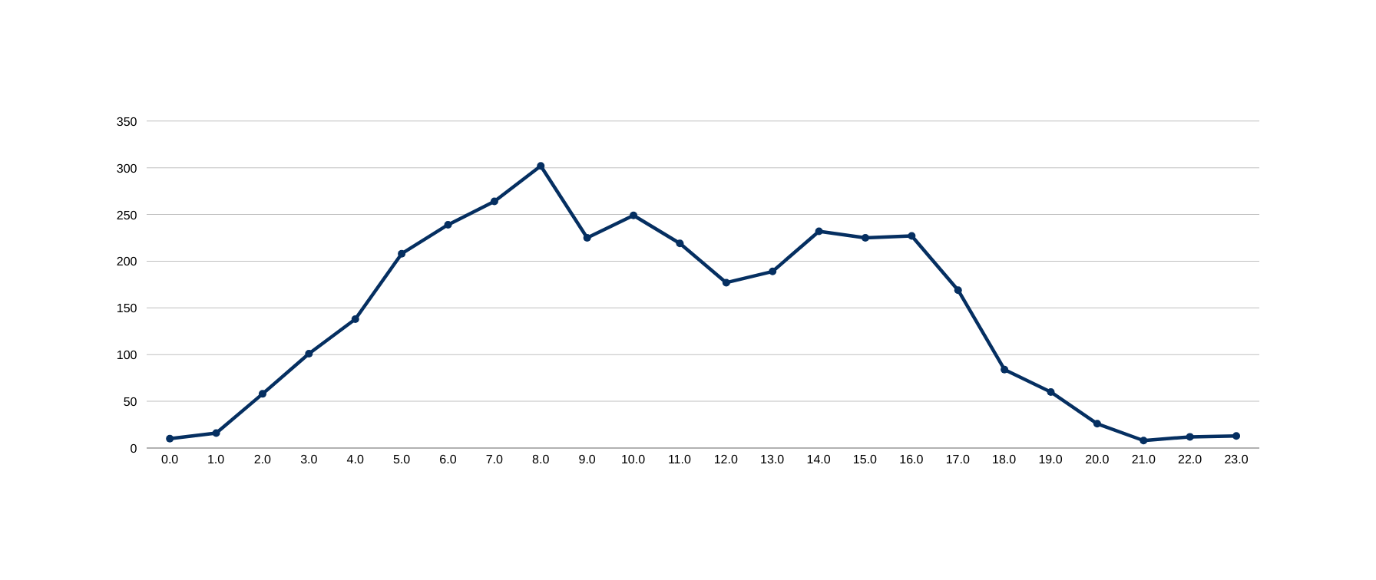
Peak Call Volumes Observation
Peak Hour Analysis
Call volume increases sharply after early morning hours
Highest call traffic occurs during daytime working hours
Call volume drops significantly during late night hours

Slide 16
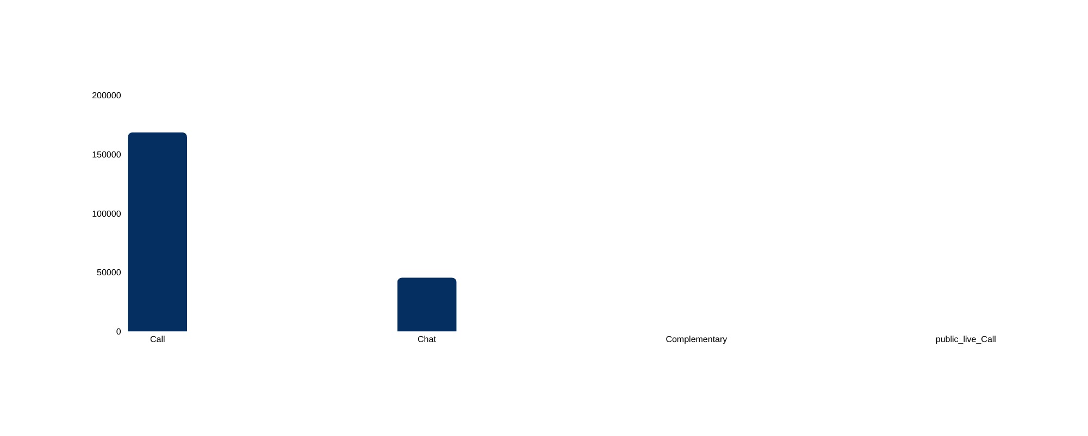
Call Consultations Drive Maximum Revenue Contribution
Call consultations generate significantly higher revenue than chat
Chat consultations contribute moderately to total revenue
Complimentary and public live calls add minimal revenue impact

Slide 17
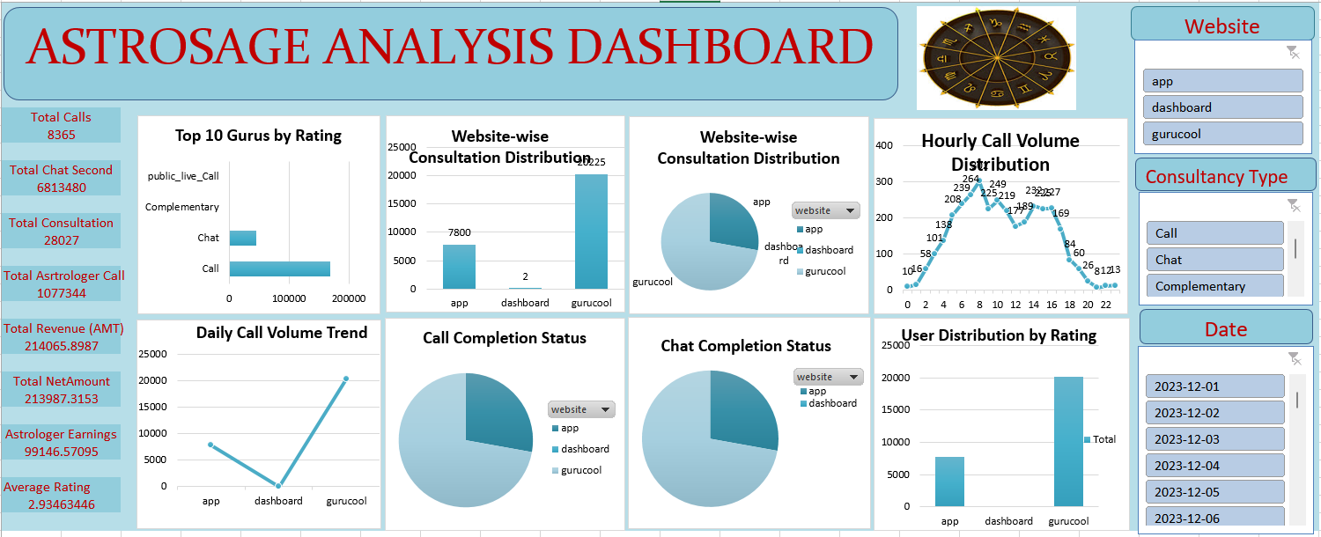
DASHBOARD LINK :https://docs.google.com/spreadsheets/d/1S_zEywWjNK7INfri9rksq0s3Z92yHy1O/edit?usp=sharing&ouid=101248622739799174127&rtpof=true&sd=true

Slide 18
STRATEGIC RECOMMENDATION
Strategic Recommendations
Implement Advanced Analytics
Use AI-driven tools to analyze call data for trends, customer behavior, and agent performance.
Expected Impact: Better insights into customer needs, enabling tailored service, which enhances
satisfaction and loyalty.
Enhance Agent Training
Focus on skills like emotional intelligence, product knowledge, and conflict resolution.
Expected Impact: Improved agent efficiency and a better overall customer experience.
Optimize Call Routing
Deploy intelligent systems to route calls to the most appropriate agent or department.
Expected Impact: Reduced wait times and higher first-call resolution rates, boosting satisfaction.

Slide 19

CONCLUSION
In conclusion, a detailed analysis of our call center operations reveals opportunities to enhance customer satisfaction, streamline processes, and improve efficiency.
By leveraging these insights and adopting the recommended strategies, we can position our call center as a model of excellence.
Thank you for your attention, and I look forward to any questions or further discussions.

Slide 20


