Slide 1
MUTUAL FUND ANALYTICS
Capstone Project I | Final Presentation
From raw investment data to actionable insights
ETL • EDA • Performance • Risk • Investor Analytics • Power BI

Slide 2
Project Objective
Build an end-to-end mutual fund analytics workflow.
Compare fund returns, risk-adjusted performance and downside risk.
Understand investor transactions and SIP behavior.
Create explainable advanced analytics and a risk-based recommender.
Deliver an interactive four-page Power BI dashboard.

Slide 3
Data Coverage
40 mutual fund schemes in the scheme master and performance dataset.
64,320 historical NAV observations.
32,778 investor transaction records.
322 portfolio holding records.
Additional datasets cover AUM, SIP inflows, category inflows, folios and benchmark indices.

Slide 4
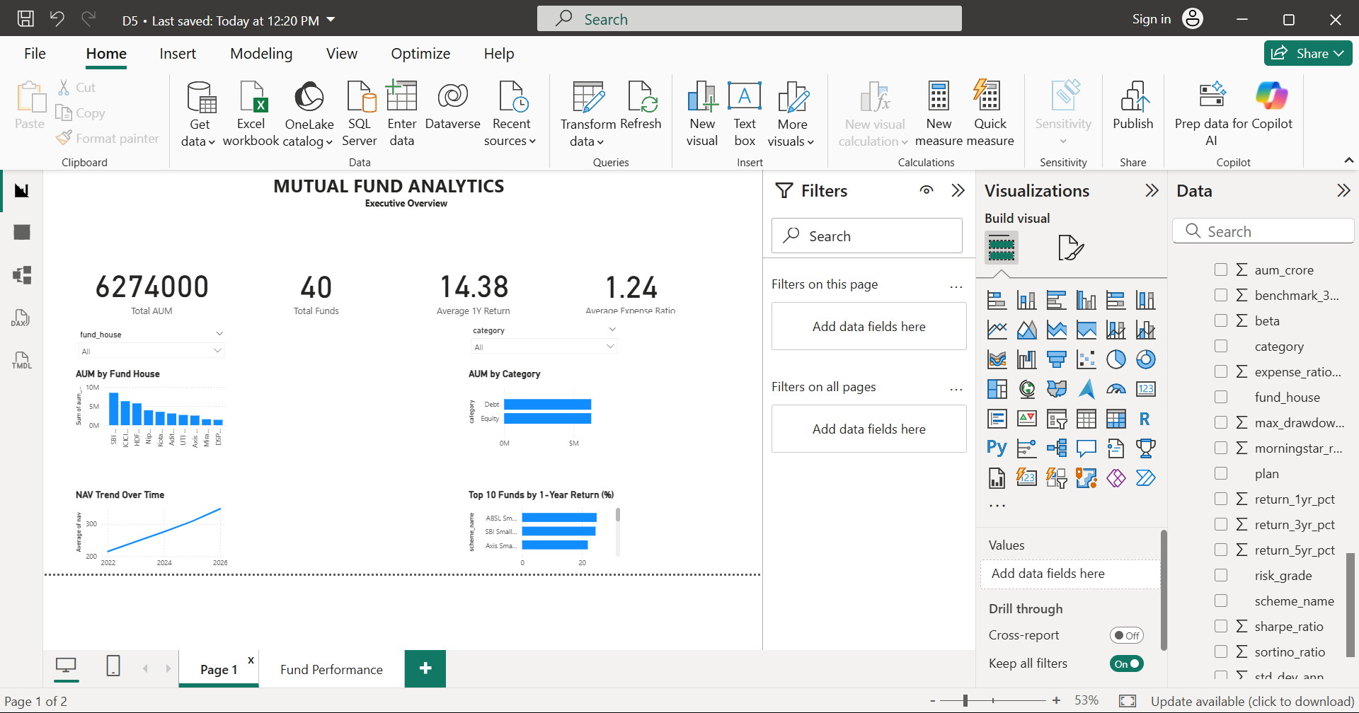
Executive Dashboard
Executive Overview: AUM, fund count, return, expense ratio and trend views

Slide 5
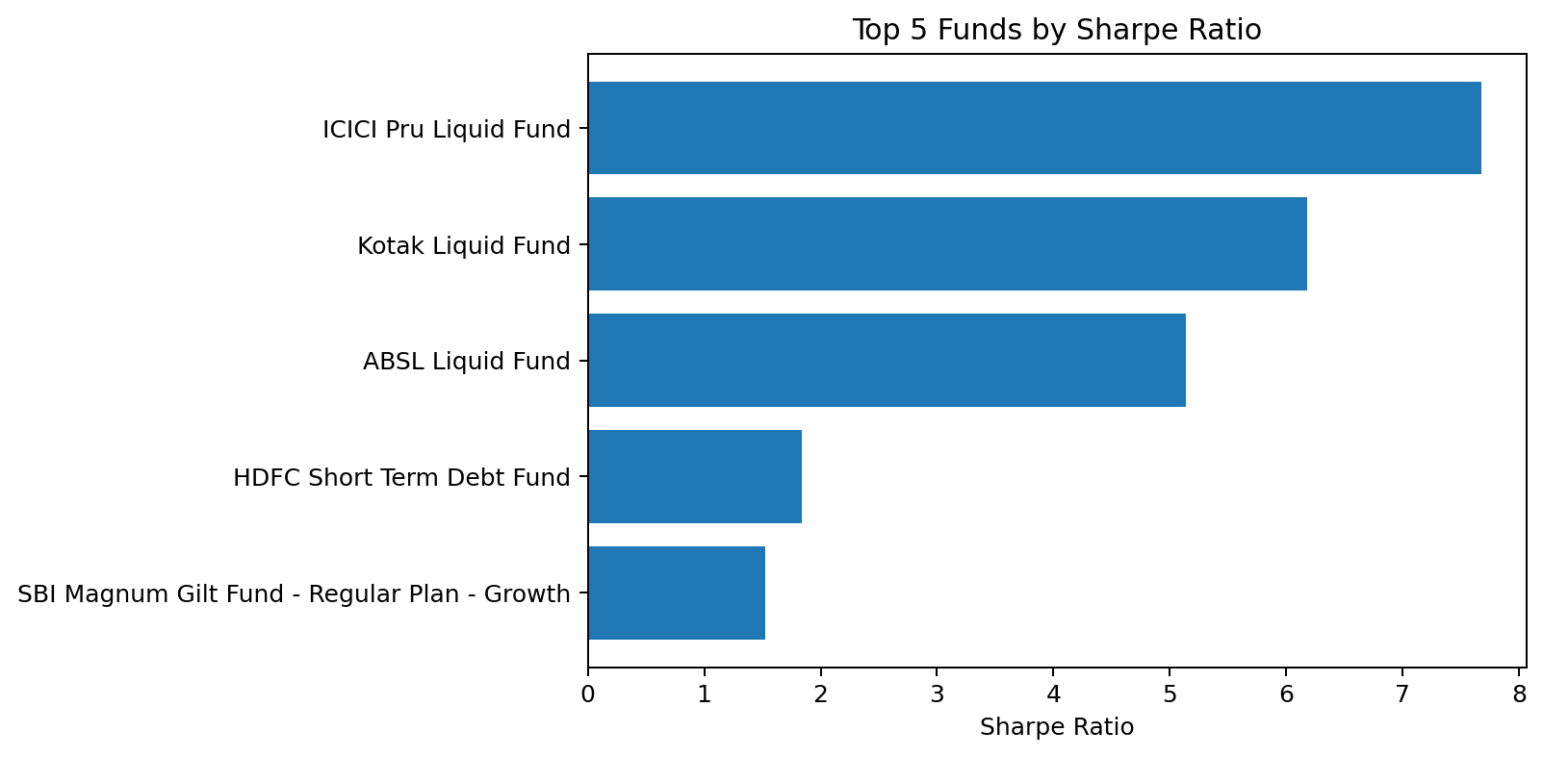
Fund Performance
Average 1-year return: 14.38%.
Average expense ratio: 1.24%.
Highest Sharpe: ICICI Pru Liquid Fund - Regular - Growth at 7.68.
Fund House, Category, Plan and Risk Grade filters support interactive comparison.

Slide 6
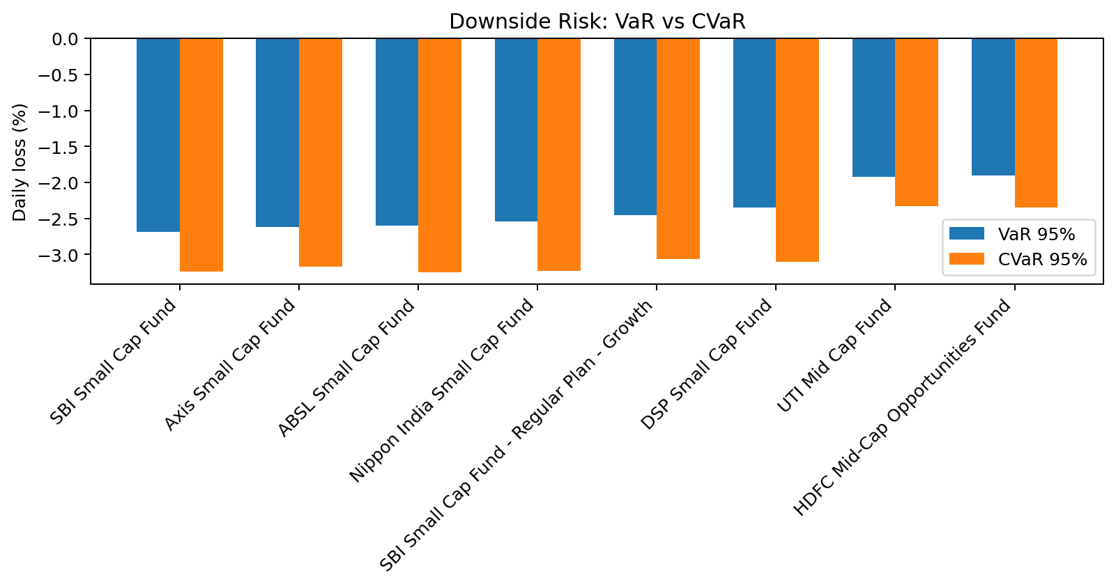
Downside Risk: VaR & CVaR
95% historical VaR uses the 5th percentile of daily returns.
CVaR averages returns in the tail beyond the VaR threshold.
Highest downside risk: SBI Small Cap Fund - Direct Plan - Growth.
VaR: -2.69% | CVaR: -3.24%.

Slide 7
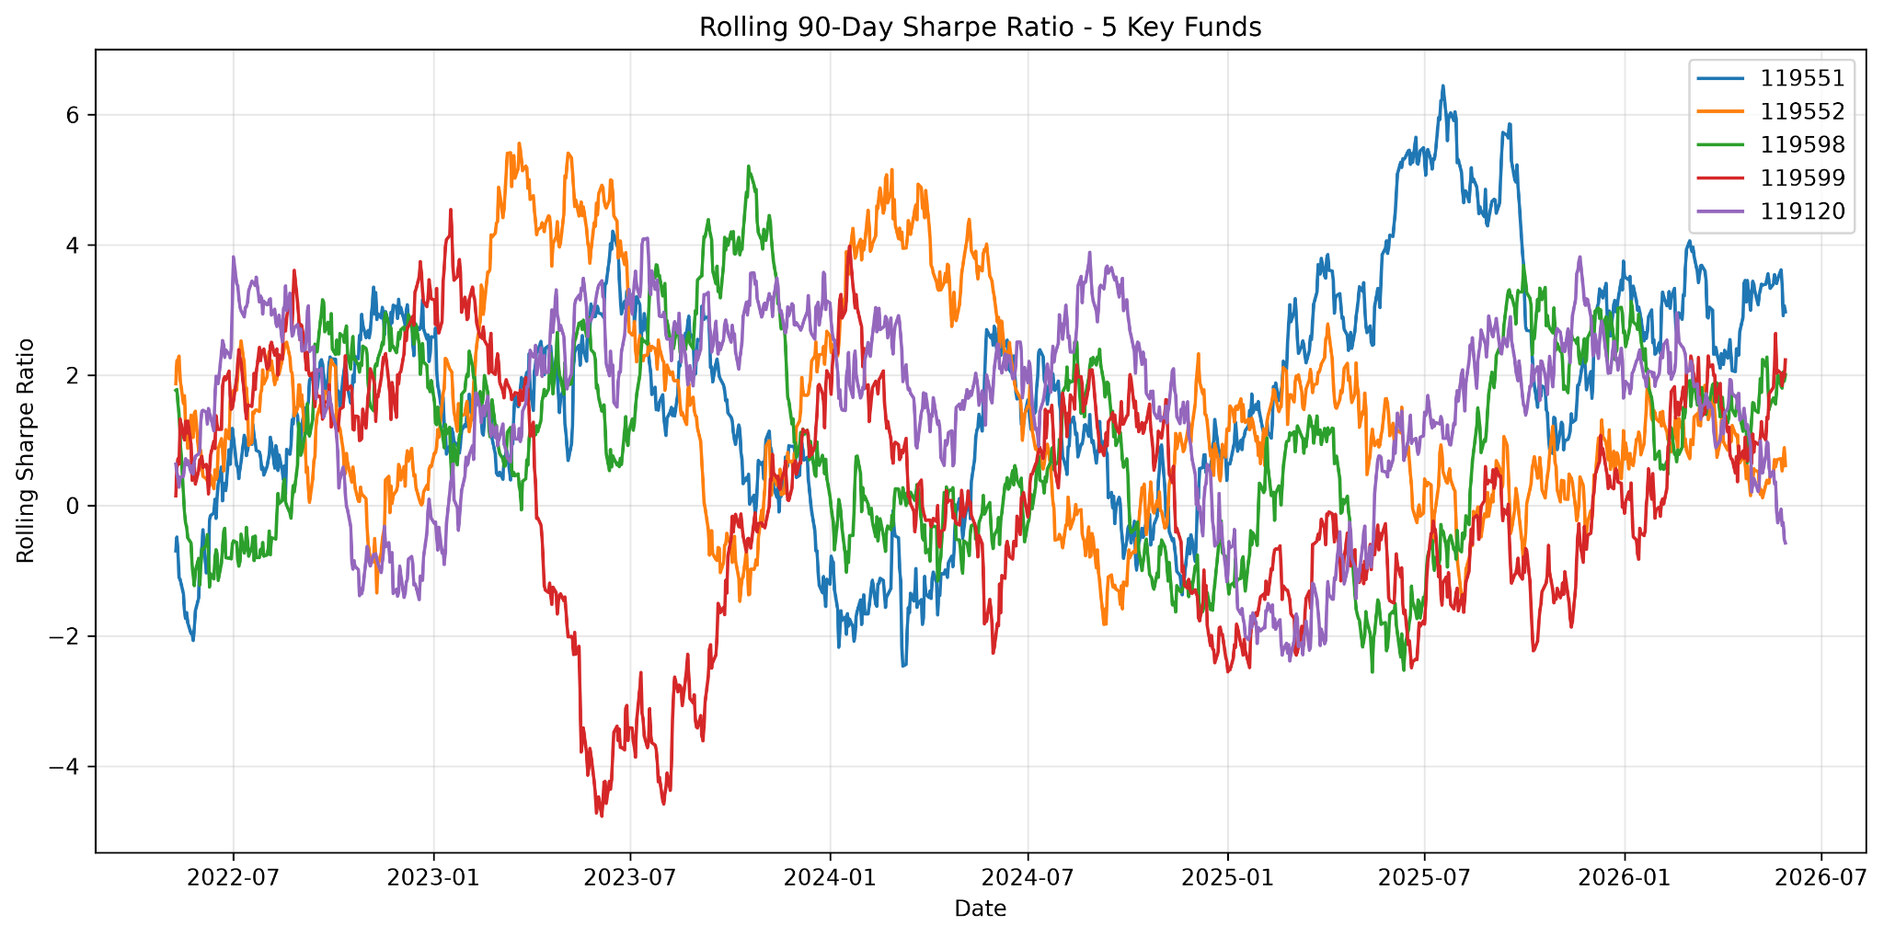
Advanced Analytics
Rolling 90-day Sharpe for five key funds.
Investor cohort analysis.
SIP continuity and at-risk identification.
Sector HHI concentration.
Risk-appetite fund recommender.

Slide 8
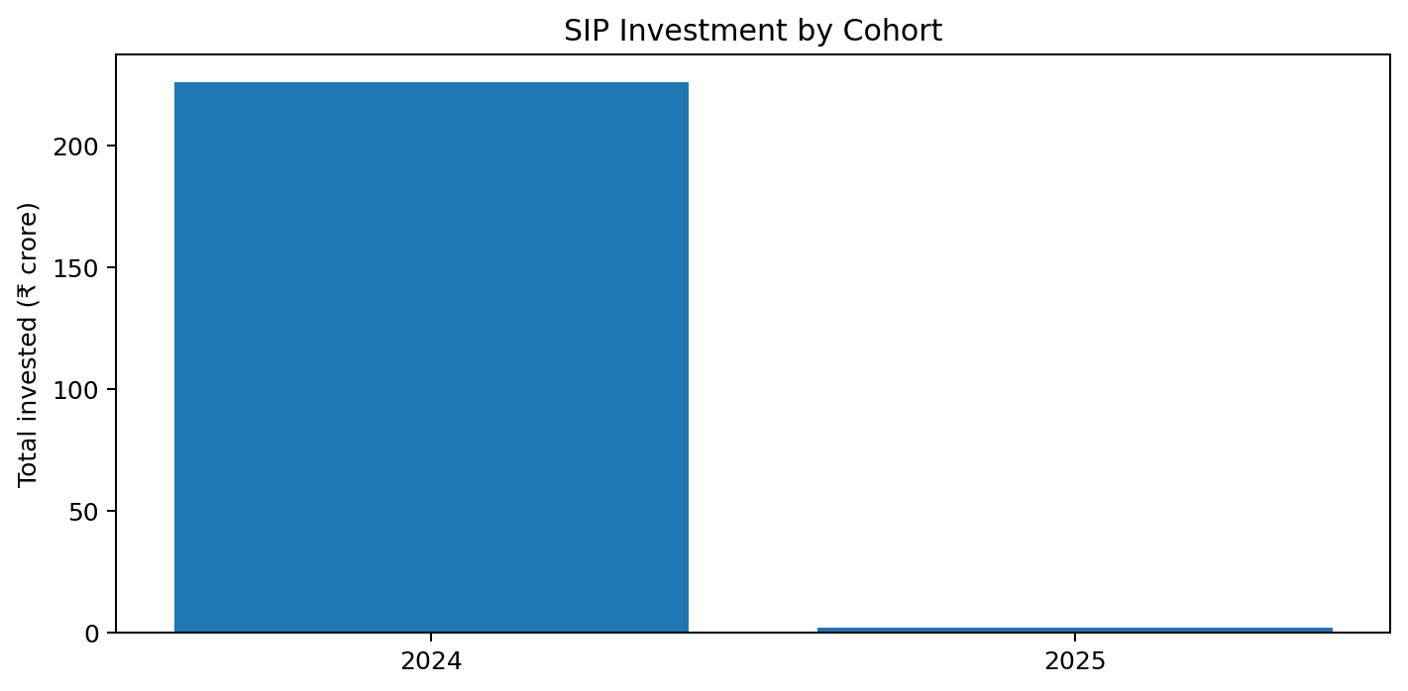
Investor & SIP Insights
Largest SIP cohort: 2024.
Total invested: ₹225.81 crore.
Average SIP amount: ₹10,997.
At-risk rate under the >35-day gap rule: 99.9%.

Slide 9
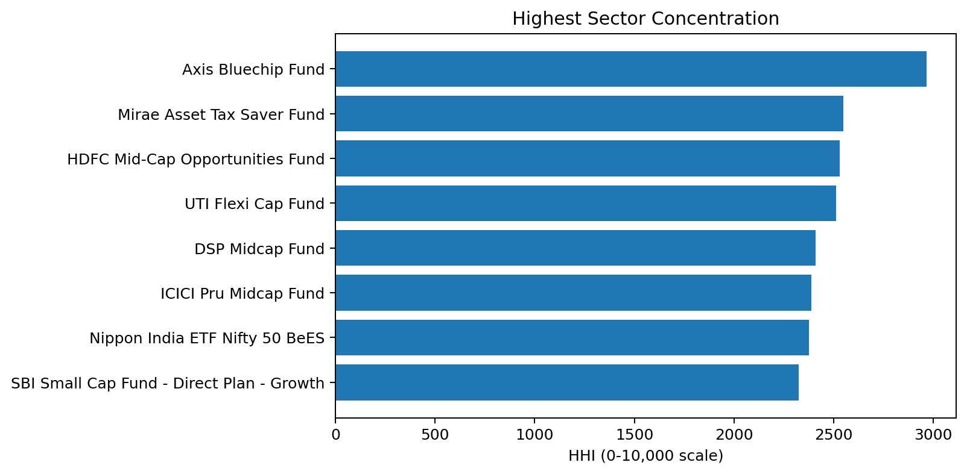
Concentration & Recommendation
Highest sector HHI: Axis Bluechip Fund - Regular - Growth.
HHI: 2968 on the 0–10,000 scale.
Recommender accepts Low, Moderate or High risk appetite.
Matching funds are ranked by Sharpe ratio.
Top 3 funds are returned for the selected risk grade.

Slide 10
Key Findings
ICICI Pru Liquid Fund - Regular - Growth leads the performance scorecard by Sharpe ratio (7.68).
SBI Small Cap Fund - Direct Plan - Growth shows the highest historical downside risk (VaR -2.69%).
The 2024 cohort has the largest reported SIP investment.
99.9% of eligible investors are flagged at-risk under the project's continuity rule.
Axis Bluechip Fund - Regular - Growth has the highest sector concentration HHI.

Slide 11
Conclusion & Next Steps
The project connects data engineering, analytics and business reporting in one workflow.
Risk-adjusted measures add context beyond raw return comparisons.
The dashboard makes fund, investor and SIP insights easier to explore.
Future extensions: live NAV refresh, Monte Carlo simulation, portfolio optimization and automated reporting.

