Slide 1


Product Personalization
Machine Learning Team 6
Saloni Jain
Prashant Jain
Anmol Agarwal
Aachal Kala
Mohan Gayan
Shivam Kushwah
Mentor:
Dr.Geeta Chhabra Gandhi.

Slide 2

Objective
Predict which offers will be most attractive to each individual customer, resulting in more targeted marketing campaigns and higher brand value.

Slide 3

What’s new??
The thing which separate this project from other project which are already available is we have also taken the response from the last conducted campaigns apart from the customer details this help us to find out the factors which are highly related to the campaign.
Keeping this in mind, we have designed our model in such a way that it gives the accuracy of the response to the maximum number of customers.
“Good businesses generate missions to drive their profits. Great businesses generate profits to drive their missions.”

Slide 4
Target Audience
Customer Response
Accept the campaign offer
Reject the campaign offer

Slide 5
Technology
Machine Learning
Power BI

Slide 6
Project Demonstration
Importing Essential Libraries
Data Visualization or EDA
Dealing with missing values
Load the Dataset
Distinguish Attributes
Outlier Detection & Handling
Segregating the Dependent and Independent variables
Encoding
Splitting data in train and test set
PCA
Fitting the model
Cross validation
Model
Comparison
Load the model
Deployment

Slide 7
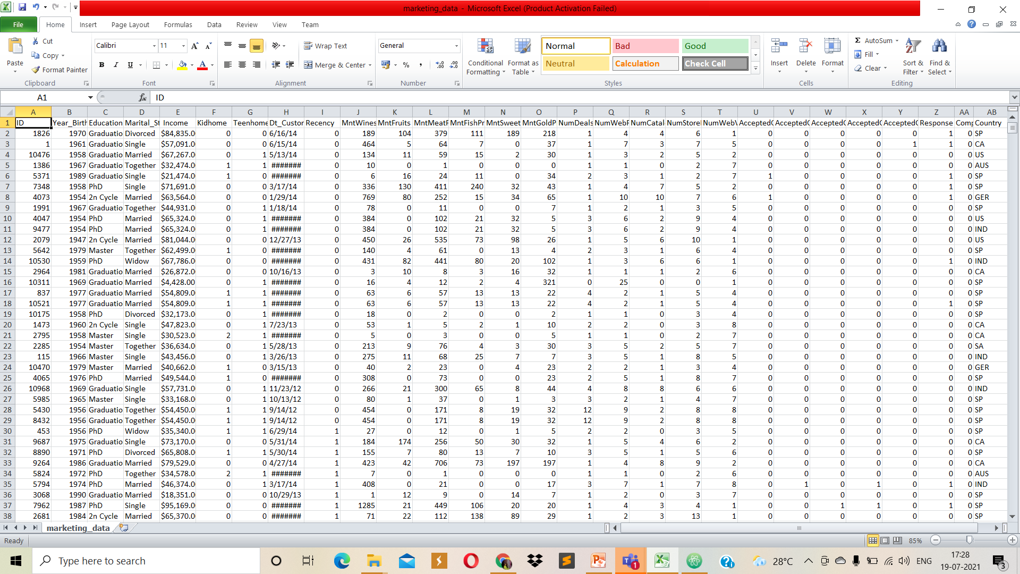
Dataset

Slide 8
Features in training model
Education
Marital status
Kidhome
MntWines
MntFruits
MntMeatProducts
MntFishProducts
MntSweetProducts
MntGoldProds
NumDealsPurch
NumWebPurchases
NumCatalogPurchases
NumStorePurchase
NumWebVisitsMonth
AcceptedCmp3
AcceptedCmp4
AcceptedCmp5
AcceptedCmp1
AcceptedCmp2
Country

Slide 9
Labels
Response
Labels
No
Yes

Slide 10
Model Selection
KNN
Logistic Regression
SVM
Best Model
KNN

Slide 11
Future Score
After completing all the process of machine learning procedures and getting a model with a correct outcome we can conclude that our model will reasonably predict the future outcome up to the 86 percentile.

Slide 12
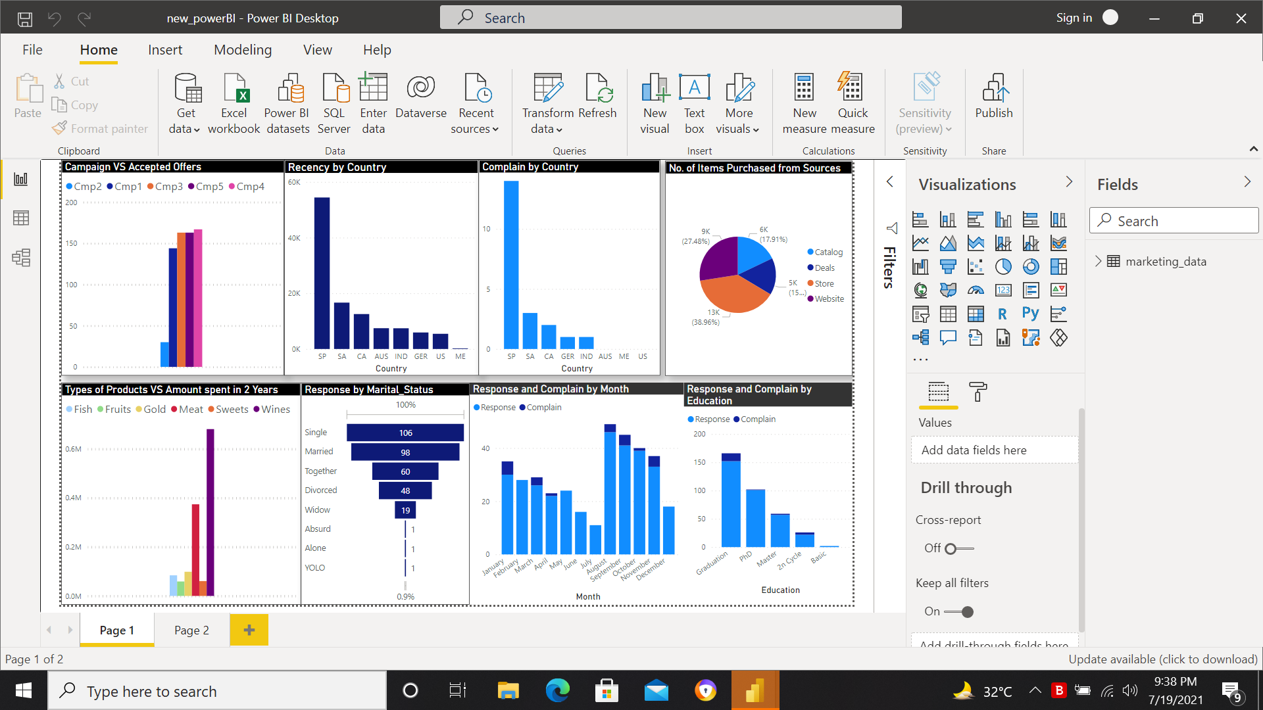
Power BI

Slide 13
Conclusion
The most successful advertising campaign was the most recent campaign (column name: Response), and was particularly successful in Mexico (>60% acceptance rate!)
Advertising campaign acceptance is positively correlated with income and negatively correlated with having kids/teens
The most successful products are wines and meats (i.e. the average customer spent the most on these items)
The underperforming channels are deals and catalog purchases (i.e. the average customer made the fewest purchases via these channels)
The best performing channels are web and store purchases (i.e. the average customer made the most purchases via these channels)

Slide 14
THANKS!

