Slide 1


BUILD WITH INDIA 2025
Idea / Track Title: Personalized Learning Assistant
Theme: Smart Education
PS Category: Software
Team Name: Code_crackers
Team Members: P Mohan Sai, V Venkateswararao, Tata Ganesh, P Tarun Chandra

Slide 2

IDEA TITLE
→Problem: One-size-fits-all education leads to learning gaps.
→Solution: The AI-Powered Personalized Learning Assistant is an intelligent chatbot that customizes learning experiences for students of all levels. The assistant uses AI and NLP to assess individual strengths and weaknesses, recommend personalized study materials, and track progress in real time.
→Innovation & Uniqueness
AI-Driven Personalization
Real-Time AI Learning Coach
Multimodal Learning Support
Scalability & Accessibility
Challenge | Solution
One-size-fits-all learning leads to knowledge gaps. | AI-powered chatbot personalizes learning for each student.
No instant doubt resolution in traditional methods. | Real-time Q&A & AI feedback for instant support.
Lack of engagement & motivation in students. | Gamified quizzes, progress tracking, and AI recommendations keep students engaged.
Limited accessibility to quality education. | Works across subjects & levels, making learning accessible for all.

Slide 3


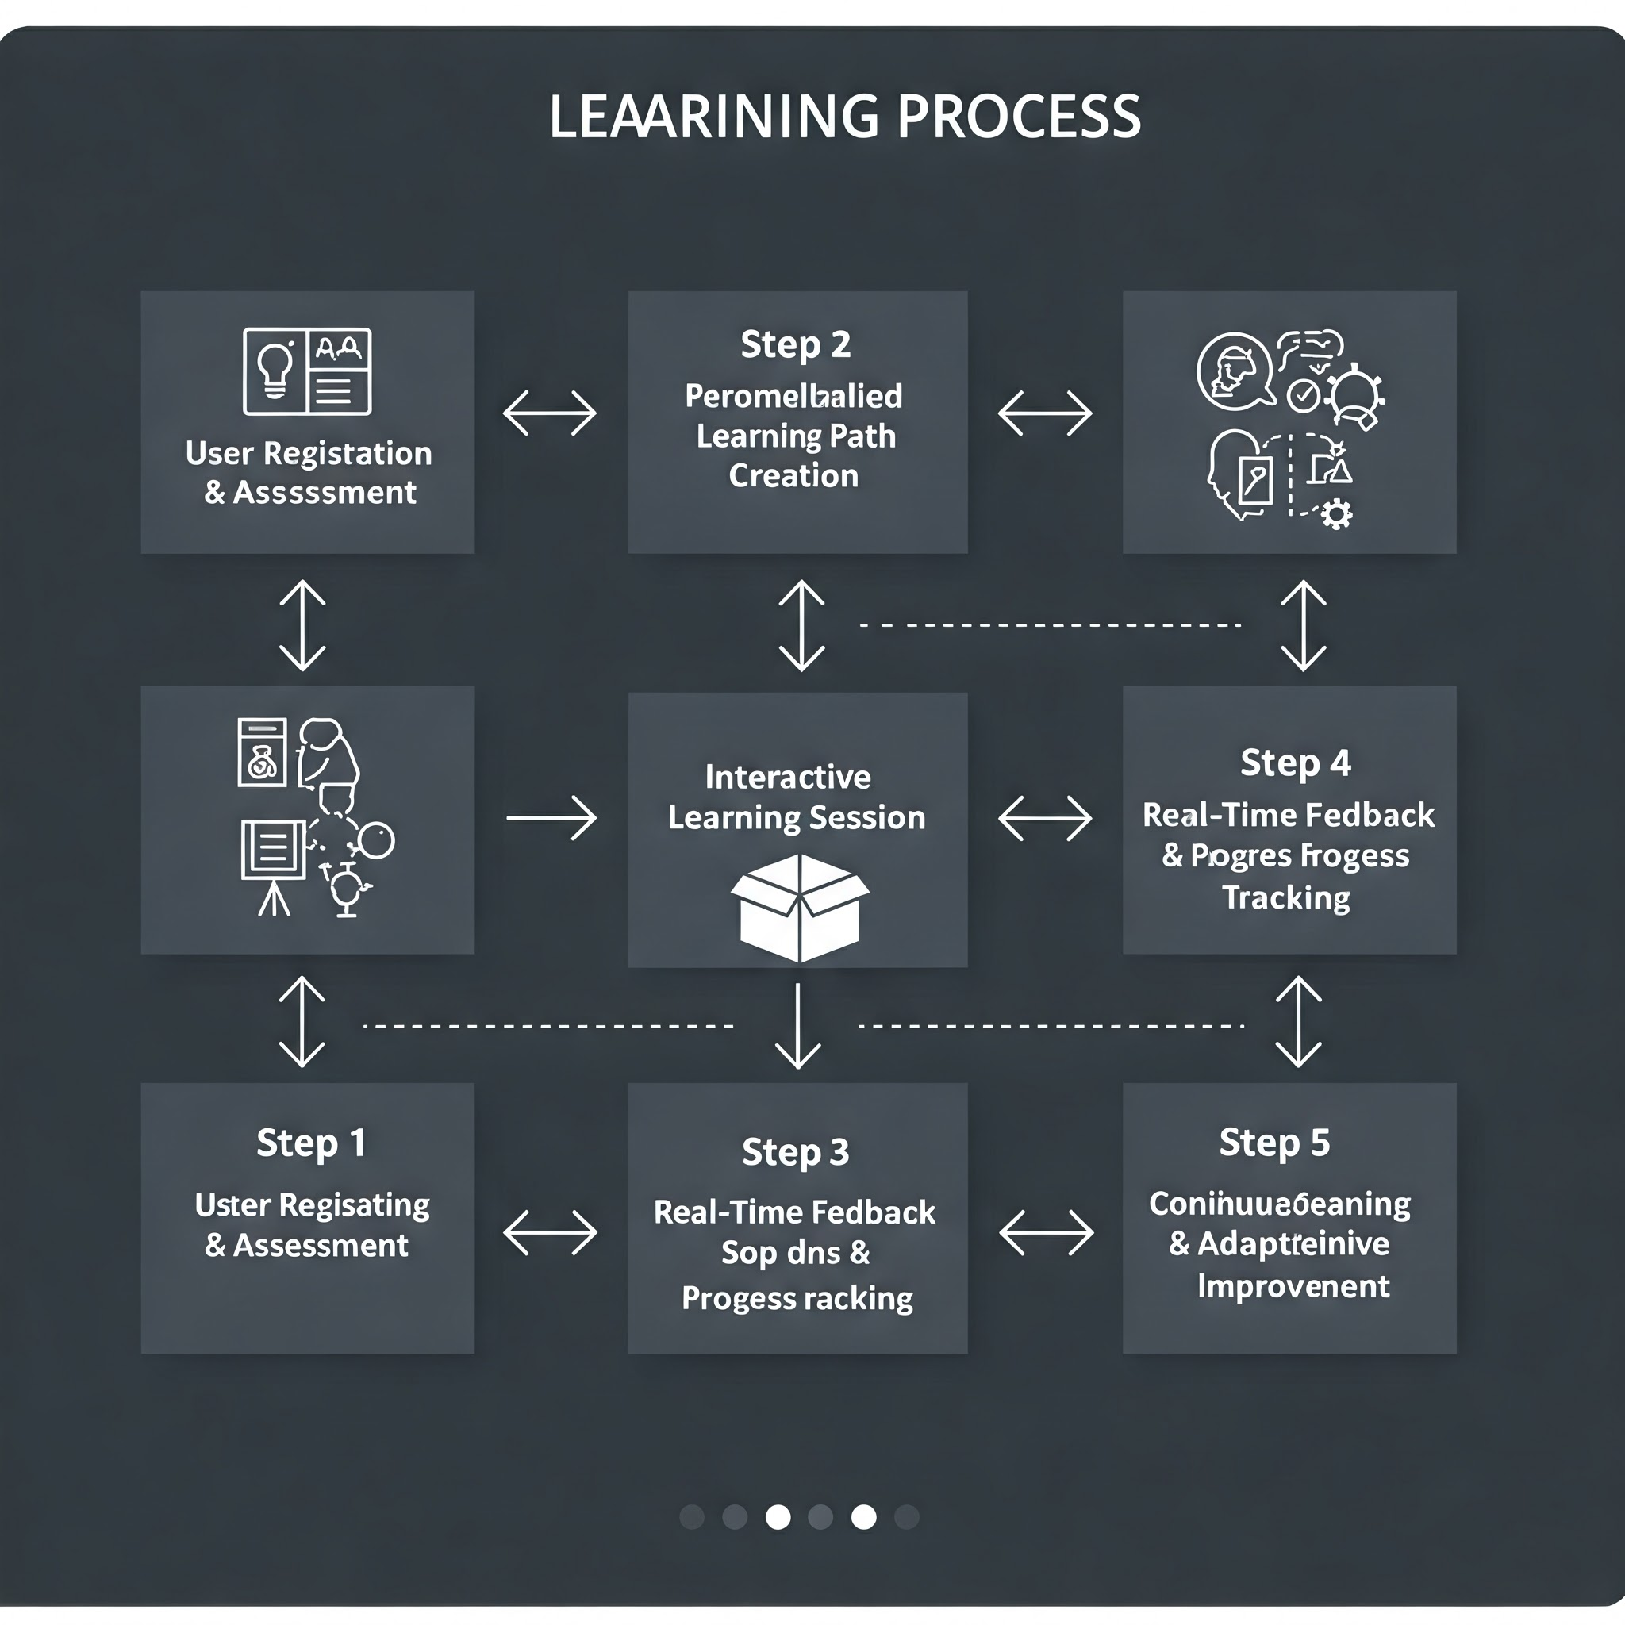



TECHNICAL APPROACH
→Technology Stack:
Frontend: React.js
Backend: Python (Flask)
Database: MySQL
AI/ML Models: NLP models (Gemini API)
Speech Recognition: Whisper API
Deployment: AWS, Firebase
→Methodology & Process for Implementation
Step 1: User Registration & Assessment
Step 2: Personalized Learning Path Creation
Step 3: Interactive Learning Session
Step 4: Real-Time Feedback & Progress Tracking
Step 5: Continuous Learning & Adaptive Improvement

Slide 4
FEASIBILITY AND VIABILITY
Feasibility of the Idea
Technical Feasibility: The project utilizes proven AI and web technologies such as React.js, Flask, MySQL, and AI models (Gemini API, Whisper API) to provide personalized learning experiences. These technologies ensure scalability and efficiency.
Economic Feasibility: Development costs are manageable as cloud-based AI services and open-source tools can be leveraged. Deployment on platforms like AWS or Firebase ensures cost-effective hosting.
Operational Feasibility: The solution is easy to integrate into existing education systems. Students and teachers can access it via a web or mobile app, making it highly user-friendly.
Challenges & Risks | Strategies for Overcoming Challenges
AI Accuracy & Bias – AI may provide incorrect or biased recommendations. | Regularly update training data and implement feedback loops to fine-tune AI responses.
User Adoption & Engagement – Students might find AI-driven learning difficult to adapt to. | Use gamification techniques like badges, leaderboards, and rewards to boost motivation.
Data Privacy & Security – Handling sensitive student data requires strict compliance | Implement end-to-end encryption and follow data protection laws like GDPR.
Scalability Issues – More users can lead to performance bottlenecks. | Use cloud-based infrastructure with load balancing for seamless scaling.
Internet Accessibility – Rural students may struggle with poor connectivity. | Offer offline learning mode with downloadable resources for continuous learning.

Slide 5
IMPACTS AND BENEFITS
→Potential Impact on the Target Audience
Students will receive tailored learning experiences based on their pace and understanding, improving engagement and comprehension.
Teachers can leverage AI-generated insights to track student progress and adjust their teaching strategies accordingly.
Parents will gain real-time insights into their child's learning journey, allowing them to provide better support.
Educational Institutions can utilize AI-driven analytics to enhance curricula and improve overall student performance.
→Benefits of the Solution
Social Benefits : Ensures inclusive and personalized education by adapting to diverse learning needs while fostering curiosity and independent thinking.
Economic Benefits : Makes education more accessible and affordable by reducing reliance on private coaching, bridging skill gaps, and driving AI innovation in EdTech.
Environmental Benefits : Promotes sustainable learning through paperless education and remote accessibility, reducing carbon footprints.

