Slide 1
ANCS Presentation
عرض تقديمي يشرح نظام ANCS لتهيئة وإدارة الشبكات مع نقاط القوة، التكامل مع GNS3، وشاشات المشروع المهمة.

Slide 2
What is ANCS?
ANCS is an Autonomous Network Configuration & Orchestration System that helps engineers automate router and switch configuration, manage multi-vendor devices, and use AI guidance for network operations.
The platform is designed for modern network labs, educational projects, and real-world multi-vendor environments.

Slide 3
The problem ANCS solves
Traditional network configuration is slow, error-prone, and difficult to maintain across many devices.
ANCS reduces manual mistakes by automating configuration generation, validation, and deployment.
It also makes device management easier in GNS3 labs and multi-vendor networks.

Slide 4
Core features
Guided Configuration Wizards for VLANs, OSPF, EIGRP, DHCP, ACLs, and more.
Deep GNS3 integration for topology discovery and device control.
AI Copilot for network discovery, troubleshooting, and auditing.
Support for SSH, Telnet, multi-vendor devices, and bulk deployment.

Slide 5
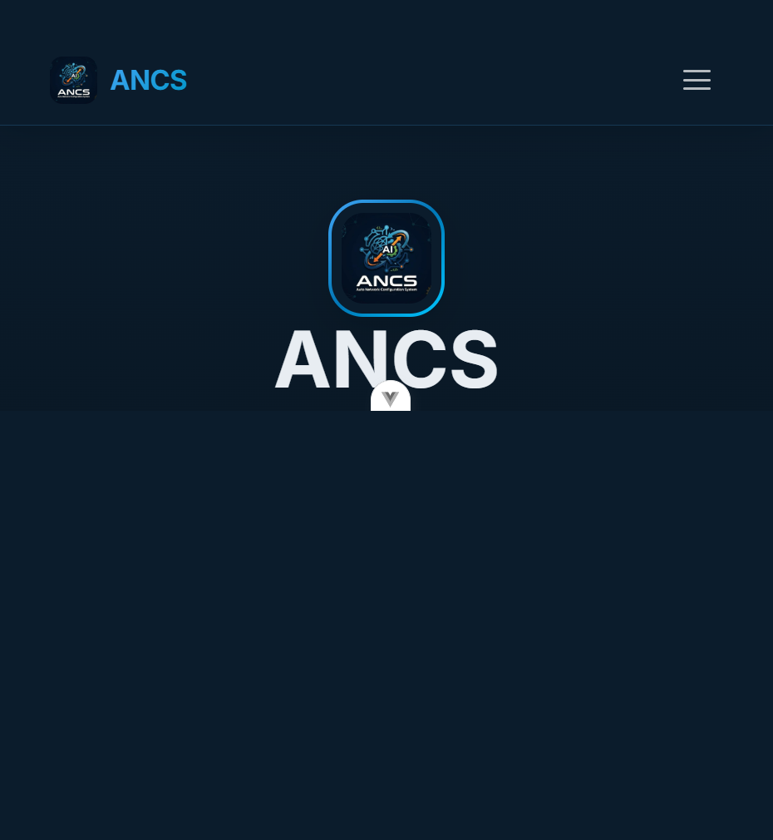
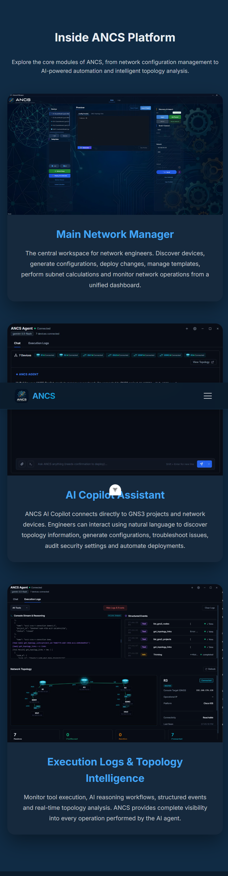
Site Screenshots

Slide 6
Final takeaways
ANCS makes network automation easier, faster, and more reliable.
The platform is ideal for graduation project presentations and practical network lab demonstrations.
Use this file as a complete overview of the website, the project goals, and the delivered features.

