Slide 1
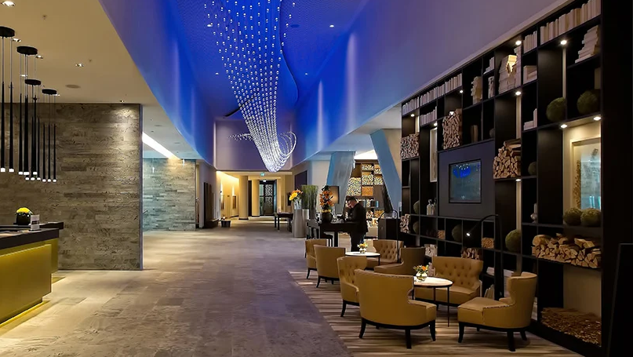
Hospitality Domain Analysis
Presented by Mohd Waqas

Slide 2

AGENDA
Welcome and Introduction
Identifying the Problem Statement
Defining Our Objectives
Key Performance Metrics
Dashboard Overview
Insights and Recommendations

Slide 3
Introduction:
Welcome to our prestigious portfolio of five-star hotels across India, where luxury meets exceptional hospitality. With over 15 years of excellence in the industry, we offer an exquisite collection designed to provide unforgettable experiences.
Objective:
Our goal is to redefine luxury by offering discerning travelers opulent hotels in key cities such as Delhi, Mumbai, Hyderabad, and Bangalore. Each property exemplifies sophistication, featuring world-class amenities and personalized service. Discover your perfect luxurious getaway in our distinguished collection.

Slide 4
Problem Statement:
Market Challenges: Company is facing a decline in market share and revenue in the luxury and business hotel sector, primarily due to aggressive competition and sub optimal management decisions.
Strategic Initiative: In response, management aims to implement a "Business and Data Intelligence" strategy to reclaim lost market share and enhance revenue.

Slide 5
Objective:
The primary aim is to comprehend business challenges and harness data intelligence effectively. We will create an interactive dashboard that allows the company to track key metrics across its hotels in various metro cities. This dashboard will also highlight revenue growth trends, room optimization, and booking analysis, offering valuable insights and recommendations for sustainable growth.

Slide 6
Key Metrices:
Revenue: Total income generated from all hotel operations, including room sales and services.
RevPAR (Revenue per Available Room): Revenue generated per available room, indicating overall hotel performance.
ADR (Average Daily Rate): Average revenue earned per occupied room, reflecting pricing strategy effectiveness.
DBRN (Daily Booked Room Nights): Average number of rooms booked per day over a specified period.
DSRN (Daily Sellable Room Nights): Average number of rooms available for sale per day.
DURN (Daily Utilized Room Nights): Average number of rooms successfully utilized by guests per day.
Realisation %: Percentage of successful check-outs relative to total bookings, indicating booking efficiency.
Occupancy: Percentage of available rooms that are occupied over a specific timeframe.
Cancellation %: Percentage of total bookings that were canceled by guests.

Slide 7
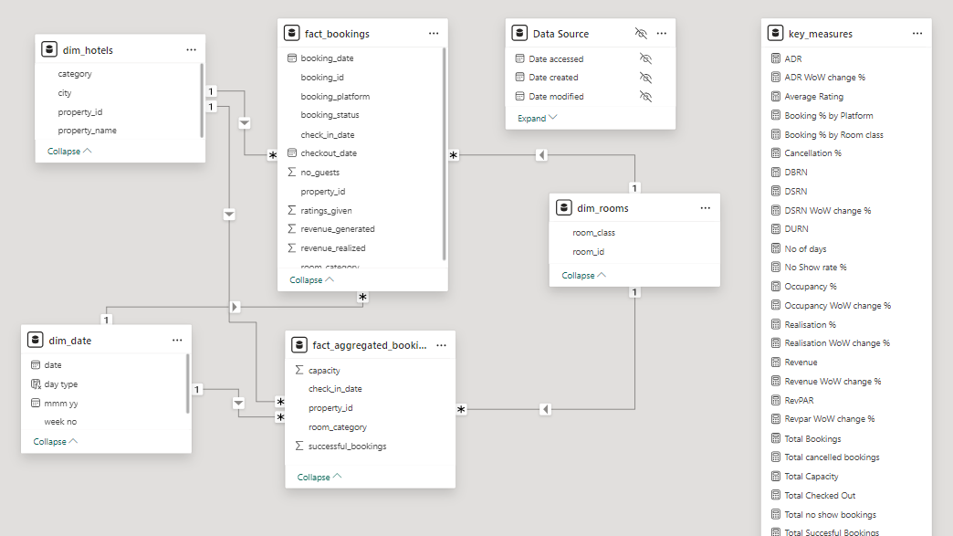

Slide 8
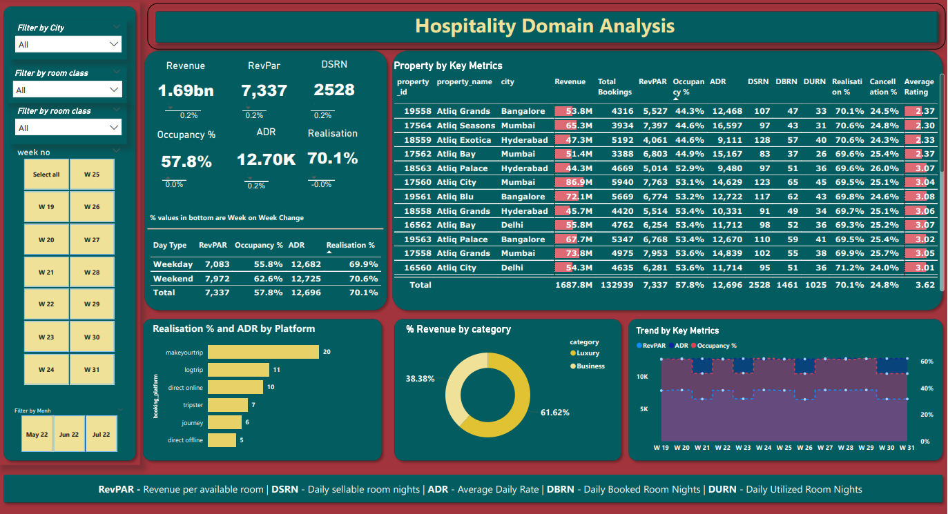

Slide 9
Recommendation & Insights:
Revenue Performance: Mumbai generated the highest revenue at 661 million, while Delhi had the lowest at 291 million. May was the peak month, bringing in 552 million, indicating that seasonal trends significantly impact earnings. Overall, the total revenue was 1.69 billion, with an occupancy rate of 57.8% and a cancellation rate of 24.8%. The average rating of 3.62 suggests there’s room for improvement in customer satisfaction.
Room Class Performance: The elite room class outperformed the standard class, generating 554 million compared to 306 million. This difference highlights the need to investigate why standard rooms are underperforming. Analyzing factors like pricing and amenities could help address these issues and enhance overall performance.
Pricing Strategy: Implementing demand-based pricing for peak and off-peak seasons could maximize revenue. Maintaining consistent pricing online will build customer trust, while offering discounts or complementary services can attract more bookings. Additionally, considering occupancy-based pricing adjustments during high demand could further boost profitability.

Slide 10
Recommendation & Insights:
Enhancing Customer Loyalty: To foster customer loyalty, consider offering exclusive discounts for frequent business travelers and implementing Length of Stay (LOS) discounts. These strategies can encourage guests to prolong their visits, boosting retention and overall revenue.
Linking Service Quality to Performance: There is a notable connection between service quality and financial success, as hotels with higher ratings also experience greater occupancy rates and revenue. By prioritizing service improvements, you can attract more bookings and increase earnings.
Optimizing Booking Channel Performance: The platform "Make Your Trip" has proven to be the top revenue generator among online channels. This highlights the need to enhance performance across various booking platforms to improve visibility and maximize revenue potential.

Slide 11
Thank You

