Slide 1
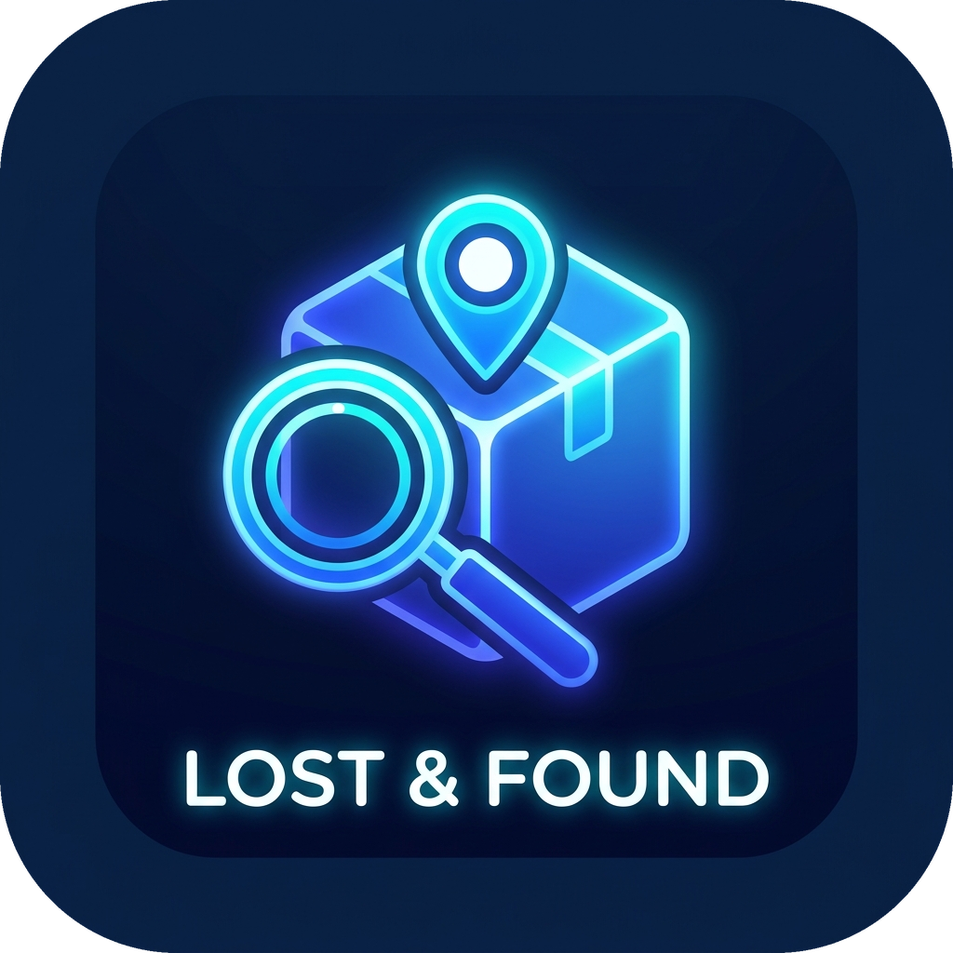
Smart Lost & Found System
B.TECH. AI & DATA SCIENCE | SEMESTER V | 2026-27
Campus Property Recovery & Management System
Arya College of Engineering & Information Technology, Jaipur
Department of AI & Data Science | RTU Kota
Guide: Er. Ram Babu Buri | HOD: Dr. Ashok Kajla
Notes:
Welcome everyone. We present Smart Lost & Found, a desktop application that digitizes lost-and-found handling on our campus. Built with Core Java 17, Swing and MySQL.

Slide 2

Project Team & Mentors
PROJECT GUIDE & MENTOR
Er. Ram Babu Buri
Assistant Professor
HEAD OF DEPARTMENT
Dr. Ashok Kajla
Professor, AI & Data Science
MN
MS
NP
PS
PC
Mitesh Nehra
Mohit Kumar Sharma
Naitik Pathak
Paramveer Singh
Prabhash Kumar Chaudhary
24EARAD102
24EARAD103
24EARAD106
24EARAD119
24EARAD121
Student Panel
Database & DAO Layer
Admin Panel
Testing & Packaging
Authentication & Security
Lost/found forms, notifications, claim workflow
JDBC manager, schema bootstrap, database.sql
Verification queue, desk entry, claimed-items audit
35-case test suite, build pipeline, portable .exe
Login, registration, validation, role-based sessions
Notes:
Five-member team under the guidance of Er. Ram Babu Buri. Each member owned one module: database, authentication, student panel, admin panel, and testing/packaging.

Slide 3


Problem Statement & Objectives
The Problem
Our Objectives
Informal pinboards and security counters with limited hours
Scattered social-media groups: high noise, low reach
No remote search, and a high risk of fraudulent claims
No audit trail showing items reached the real owner
One central platform to report, track and claim items
Role-based access: student self-service vs admin verification
Automated rule-based matching of lost and found reports
Resilient data: 3NF schema, parameterized SQL, auto bootstrap
Portable, zero-install Windows executable
Notes:
Today, finding a lost ID card or calculator depends on notice boards and WhatsApp groups. There is no searchability and no record of whether the item reached its owner. Our objectives address each of these gaps.

Slide 4




Key Features
Student Self-Service Portal
Admin Governance Console
Report lost or found items with contact details
Track status: Pending, Approved, Rejected, Claimed
In-app approval alerts and claim history
Verification queue with one-click approve or reject
Direct desk entry for items handed to staff
Student directory and claimed-items audit
Smart Matching Engine
Cloud Connection Lifecycle
Category check plus title keyword overlap
Flags possible lost-and-found pairs
Transparent rules in MatchingService.java
Releases the DB connection on window close
JVM shutdown hook as a safety net
Liveness check and timeouts for network drops
Notes:
Four pillars: a student portal, an admin console, a transparent matching engine, and cloud connection management so shared database slots are always released.

Slide 5
Technology Stack
LANGUAGE
USER INTERFACE
DATABASE
Java 17
Java Swing & AWT
MySQL 8.0 / Clever Cloud
Core logic, event handling, multithreading
Custom dark theme via UITheme.java
InnoDB engine, utf8mb4, ACID persistence
CONNECTIVITY
ARCHITECTURE
BUILD & PACKAGING
JDBC Type-4
Layered + DAO pattern
build.bat + jpackage
MySQL Connector/J 8.x driver
Presentation, model, service, persistence decoupled
Portable .exe with embedded Java runtime
15 Java source files
4,500+ lines of Java code
5 architecture layers
Notes:
Everything is plain Java 17 with Swing for the UI and JDBC to MySQL, so no heavy framework is needed. jpackage bundles a private runtime, so users just double-click the .exe.

Slide 6
Five-Layer System Architecture
1
Presentation Layer (Swing GUI)
LoginFrame | RegisterDialog | DashboardFrame | UITheme
2
Domain Model Layer
User | LostItem | FoundItem | Claim
3
Algorithmic Service Layer
MatchingService (rule-based lexical matching)
4
Data Access Object (DAO) Layer
UserDAO | LostItemDAO | FoundItemDAO | ClaimDAO
5
Persistence & Database Layer
DatabaseConnection (singleton) > MySQL 8.0 / Cloud DB
Each layer talks only to the layer below it; every SQL call goes through a DAO class.
Notes:
Strict layering keeps the code maintainable. The UI never touches SQL; all database access is inside DAOs using PreparedStatements. The matching service sits between model and DAO results.

Slide 7
Item Lifecycle & Role-Based Workflow
APPROVED student notified
PENDING
Student submits a lost or found report
CLAIMED
Student accepts item; audit trail saved
REJECTED report closed
Student Portal
Admin Console
Report lost items
Report found items
My Reports with colour-coded status
In-app notifications and approvals
Claim history and handover details
Registered students directory
Review pending found items
Direct desk found-item entry
Review pending lost items
Claimed items audit and resolution
Notes:
Every report starts as PENDING. An admin approves or rejects it; approval triggers an in-app notification. Once the student accepts the handover, the item becomes CLAIMED and stays in the audit registry.

Slide 8
Database Design (3NF Schema)
users
lost_items
found_items
claims
id (PK)
full_name
email (UK)
role: STUDENT / ADMIN
phone
college_id
id (PK)
user_id (FK)
item_name
category
location, lost_date
status
id (PK)
user_id (FK)
item_name, category
found_location
storage_location
status
id (PK)
lost_item_id (FK)
found_item_id (FK)
claimant_id (FK)
proof_details
claim_status
users 1 : N lost_items, found_items, claims | found_items 1 : N claims | lost_items 1 : N claims (optional link)
Third Normal Form (3NF)
Foreign keys with ON DELETE CASCADE
100% PreparedStatement queries
Auto schema bootstrap + seed data
Notes:
Four normalized tables. Cascade deletes prevent orphan rows. Every query uses PreparedStatement, which is why the SQL-injection test case passes. The schema is created and seeded automatically on first connection.

Slide 9
Smart Matching Engine
Category must match
Compared case-insensitively, e.g. Electronics = electronics
WORKED EXAMPLES (ILLUSTRATIVE)
1
Lost: Black Wallet (Accessories)
Found: Wallet (Accessories)
Title contains "wallet"
MATCH
Title overlap
One title contains the other, or any word of 3+ letters is shared
2
Lost: Blue Calculator (Electronics)
Found: Calculator Casio (Electronics)
Shared keyword "calculator"
MATCH
Result label
"Possible Match Found" or "No Match Found" shown in the dashboard
=
Lost: ID Card (Documents)
Found: Black Wallet (Accessories)
Categories differ
NO MATCH
Notes:
The matching rules are deliberately simple and transparent: same category, then name containment or a shared keyword of at least three letters. Examples shown are illustrative of how the rule behaves.

Slide 10
Testing & Project Deliverables
REPRESENTATIVE TEST CASES
35/35
TC-03
Admin login opens admin dashboard
PASS
TC-06
Duplicate email registration rejected
PASS
TC-11
Smart match finds candidate pairs
PASS
formal test cases passed
TC-15
SQL injection input stored as plain data
PASS
0 defects reported
TC-17
DB connection closed on window close
PASS
Coverage: login and roles, validation, reporting, matching, claims, SQL injection, DB cleanup, network recovery
TC-19
Auto-reconnect after network drop
PASS
DELIVERABLES
Project Report
SRS (16 FRs)
IEEE Research Paper
Demo Video (~10 min)
12-Week Dev Log
Portable .exe
Notes:
All 35 formal test cases passed. We highlight cases for authentication, duplicate email, matching, SQL injection and the cloud connection lifecycle. Full documentation, demo video and the portable executable are part of the submission.

Slide 11
Conclusion & Future Scope
CONCLUSION
FUTURE SCOPE
Replaces notice boards and chat groups with one structured, role-based workflow
Verified approvals, claim tracking and a permanent audit trail
Secure (parameterized SQL), tested (35/35) and portable (zero-install .exe)
Photo upload and image-based matching
Email / SMS alerts besides in-app notifications
Web and mobile front end on the same database
Thank You
Mitesh Nehra | Mohit Kumar Sharma | Naitik Pathak
Paramveer Singh | Prabhash Kumar Chaudhary
Guide: Er. Ram Babu Buri | HOD: Dr. Ashok Kajla
Questions & Discussion
Notes:
To conclude: the system gives campuses a single, auditable way to recover lost property. Future scope includes image matching, email/SMS alerts and a web or mobile front end. Thank you; we are happy to take questions.

