Slide 1

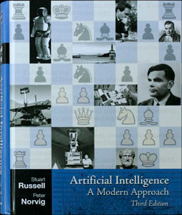
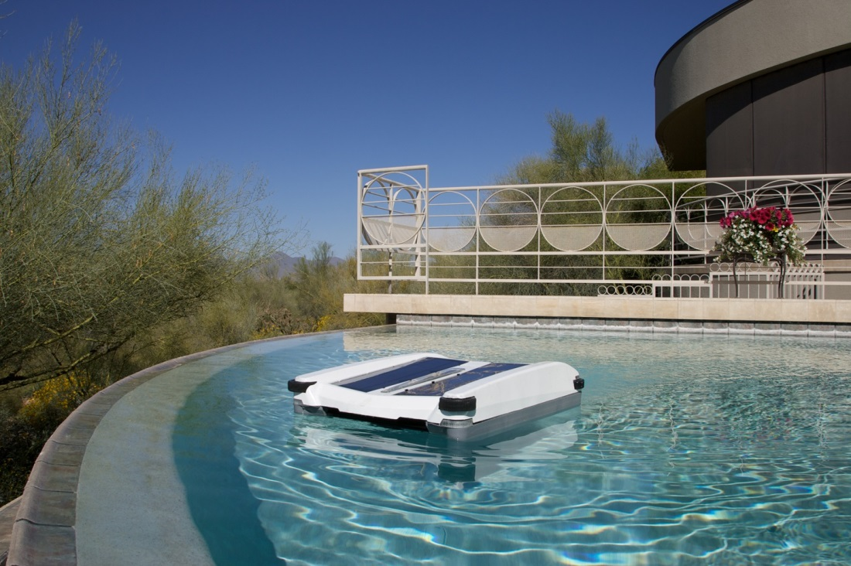
Principles of AI
Chapter 2: Intelligent Agents

Slide 2

What is AI ??
.. Rational Agents ..
Take a closer..
Agents and Rationality
Agent Environments

Slide 3
Acting Rationally!
* Solar Powered Robotic Pool Skimmer

Slide 4
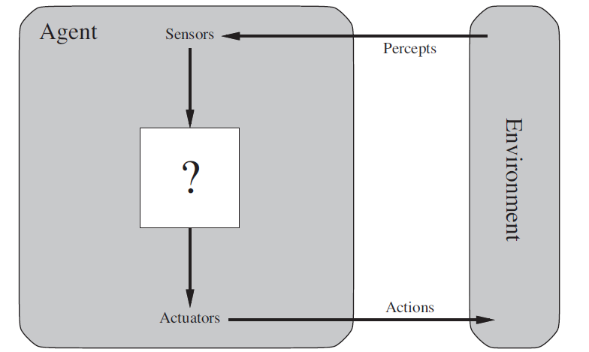
What’s an Agent
Perceives environment through Sensors
Acts out into environment through Actuators

Slide 5
What’s an Agent
Percept refers to the agents sensor data
Percept Sequence is complete percept history

Slide 6
Pool Skimmer
Sensors: When Stuck, Battery Low, etc…
Actuators: Skim debris, Change Direction, Shutdown system, Restart System.

Slide 7

Android
Sensors: Eyes, Ears, Nose, Etc….
Actuators: Arms, Legs, etc…

Slide 8
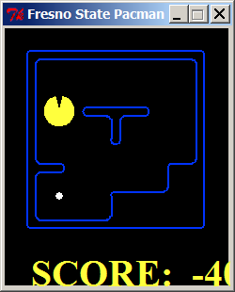
Pacman Agent
Sensors: Current Location, Capsule Locations, Ghost Locations, etc…
Actuators: Direction

Slide 9
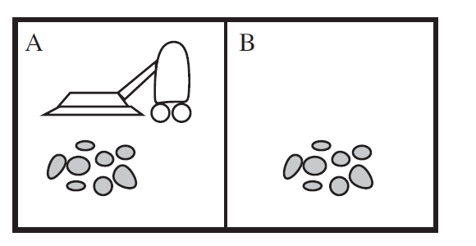
Vacuum Cleaner World
Sensors: Current Location, Dirt
Actuators: Right, Left, Suck

Slide 10
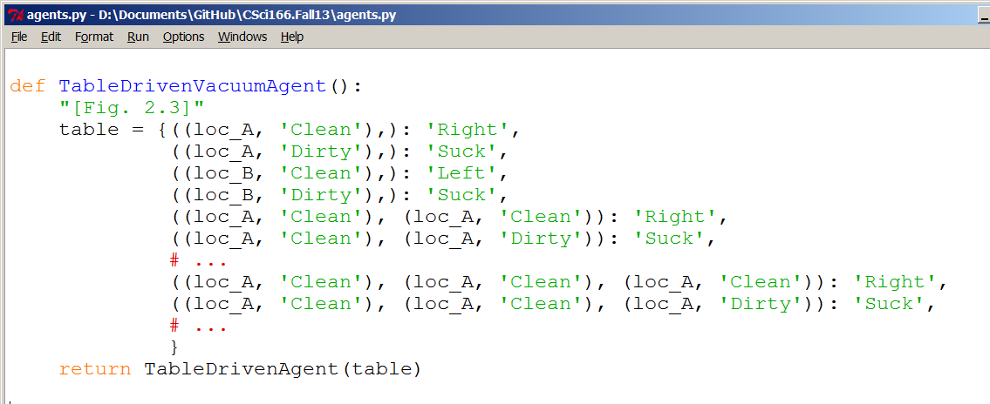
Vacuum Cleaner World
Sensors: Current Location, Dirt
Actuators: Right, Left, Suck

Slide 11
Rational Agent
Just do the right thing!
How do we recognize the right thing??
Performance Metric

Slide 12
Performance Metric
Vary from Environment to Environment
Need care in construction!

Slide 13
Rationality via Performance Measure
Rationality depends on:
Performance Measure
Agent’s prior knowledge
Agent’s available actions
Agent’s percepts

Slide 14
Rational Agent is
Rational Agents act to maximize performance measure given:
Agent’s Percepts
Agent’s prior knowledge

Slide 15
Environment’s Nature
PEAS:
Performance measure
Environment
Actuators
Sensors

Slide 16
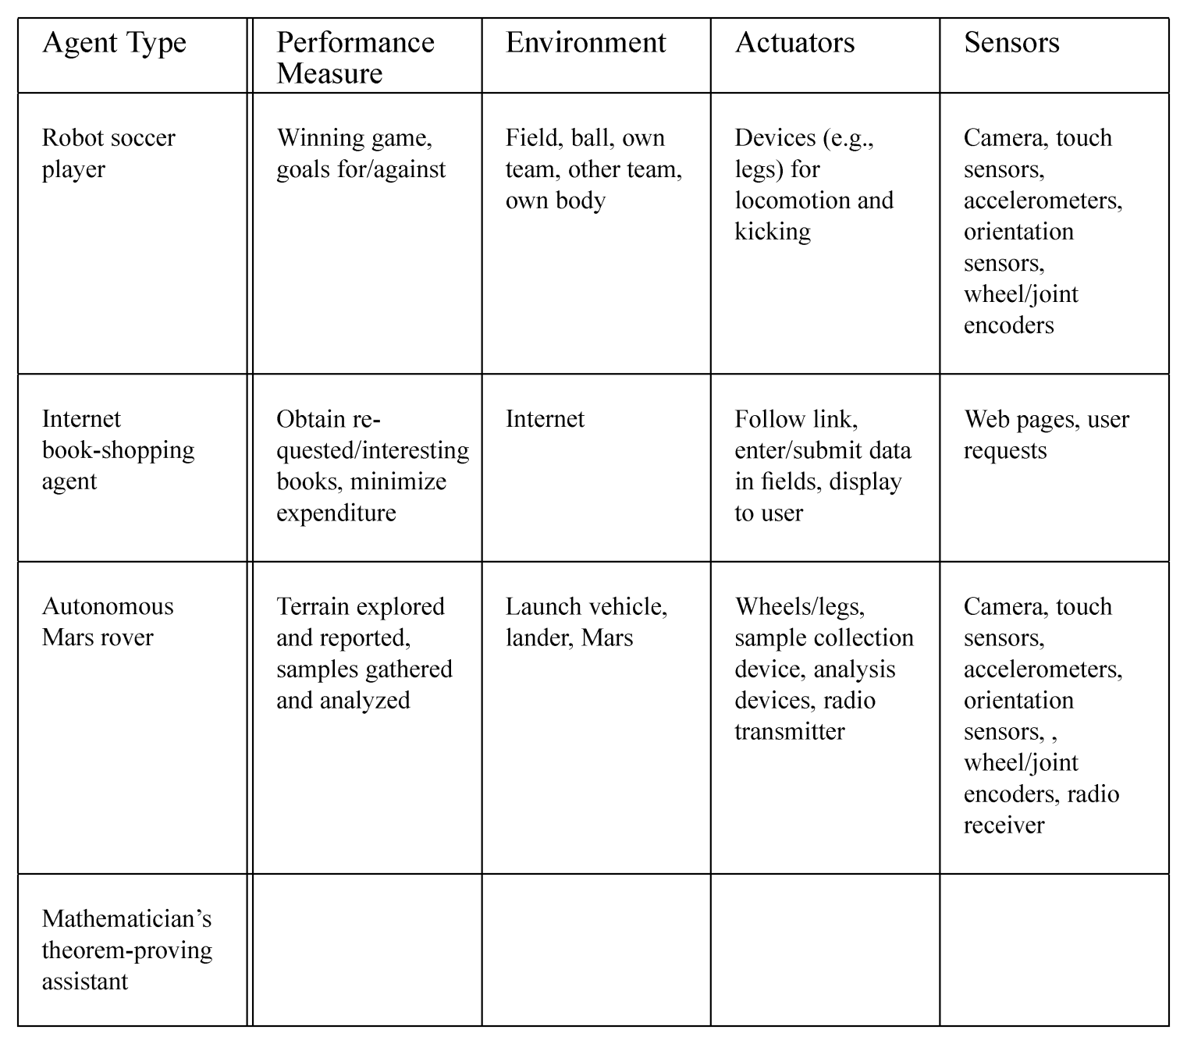
Environment’s Nature

Slide 17
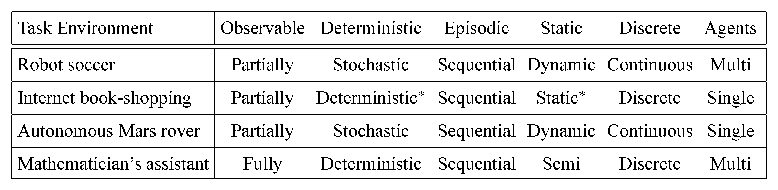
Environment’s Nature
Fully Observable versus Partially Observable
Deterministic versus Stochastic
Episodic versus Continuous
Static versus Dynamic
Discrete versus Continuous
Single Agent versus Multi-Agent

Slide 18
Environment’s Nature
Fully Observable versus Partially Observable
Deterministic versus Stochastic
Episodic versus Continuous
Static versus Dynamic
Discrete versus Continuous
Single Agent versus Multi-Agent
Connect Four????
Tic-Tac-Toe????

