Slide 2
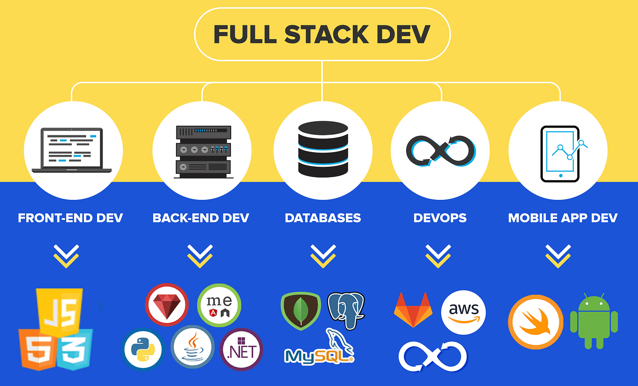
Introduction to Full Stack Development
Full stack development refers to the complete process of building web applications. It includes both frontend (client-side) and backend (server-side) development. Essential for creating modern, interactive web applications. Key roles involve developers skilled in various technologies.

Slide 3
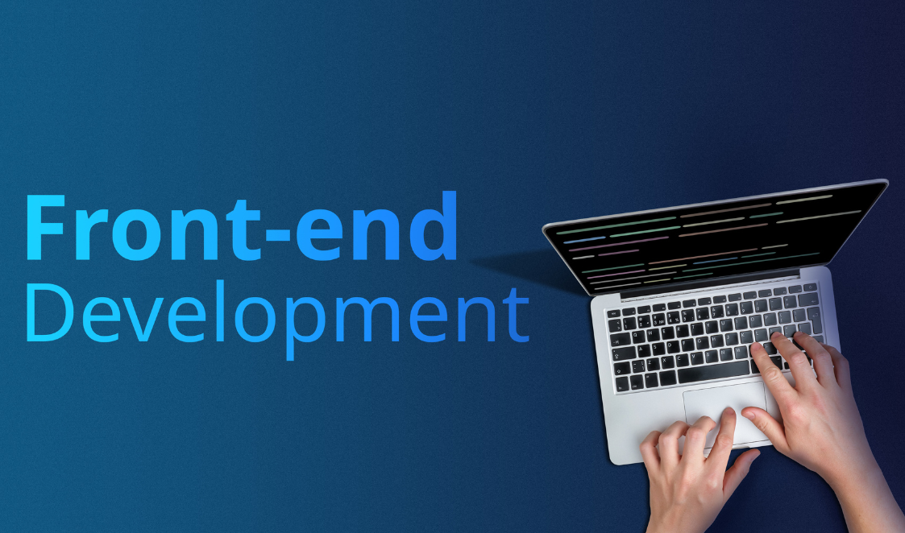
Frontend Technologies
Frontend development focuses on what users see and interact with.
HTML: The structure of web pages.
CSS: Styles and layouts for visual appeal.
JavaScript: Adds interactivity and dynamic content.
These technologies work together to create user-friendly interfaces.

Slide 4
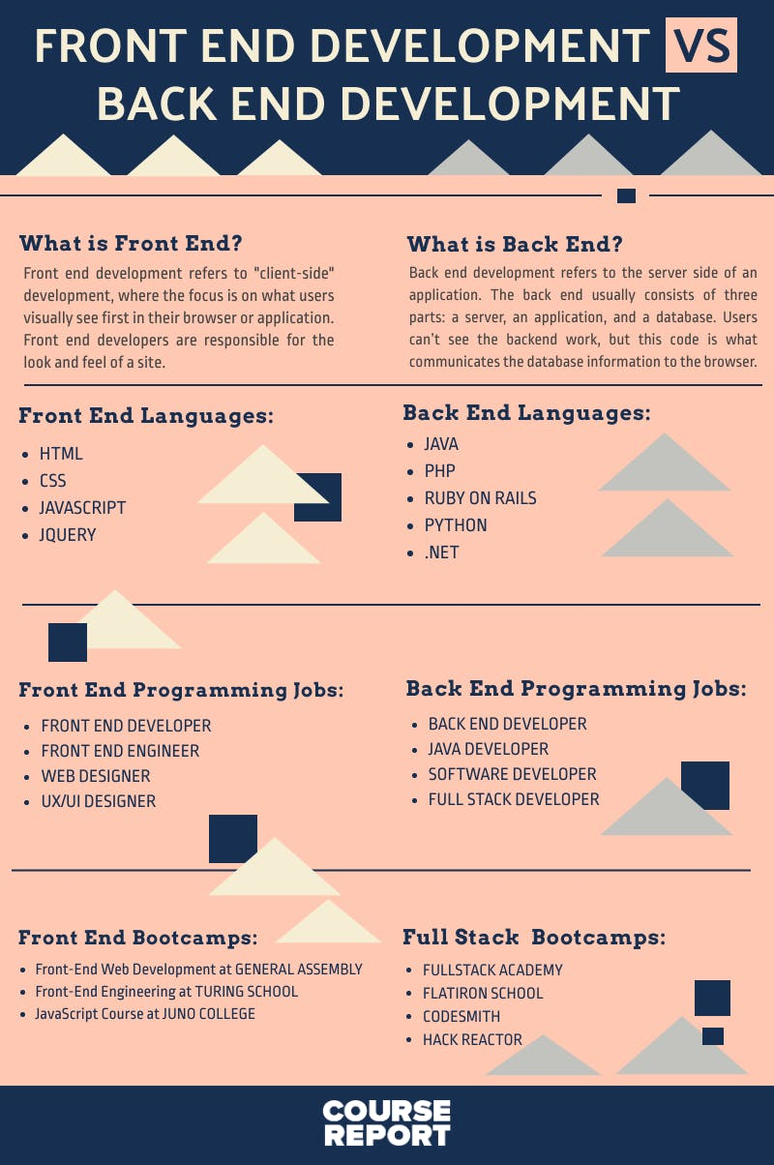
Backend Technologies
Backend development handles server-side logic and database interactions.
Node.js: JavaScript runtime for building scalable applications.
Python: Versatile language known for its simplicity and readability.
Ruby on Rails: Framework that emphasizes convention over configuration.
These technologies manage data and server responses.

Slide 5
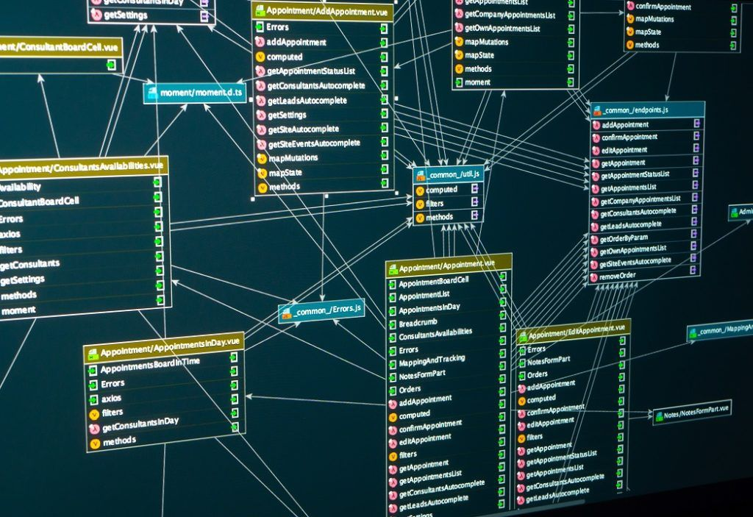
Database Management
Databases are crucial for storing and retrieving data in applications.
SQL Databases: Structured data, examples include MySQL and PostgreSQL.
NoSQL Databases: Flexible data models, examples include MongoDB and CouchDB.
Choosing the right database is vital for application performance.

Slide 6
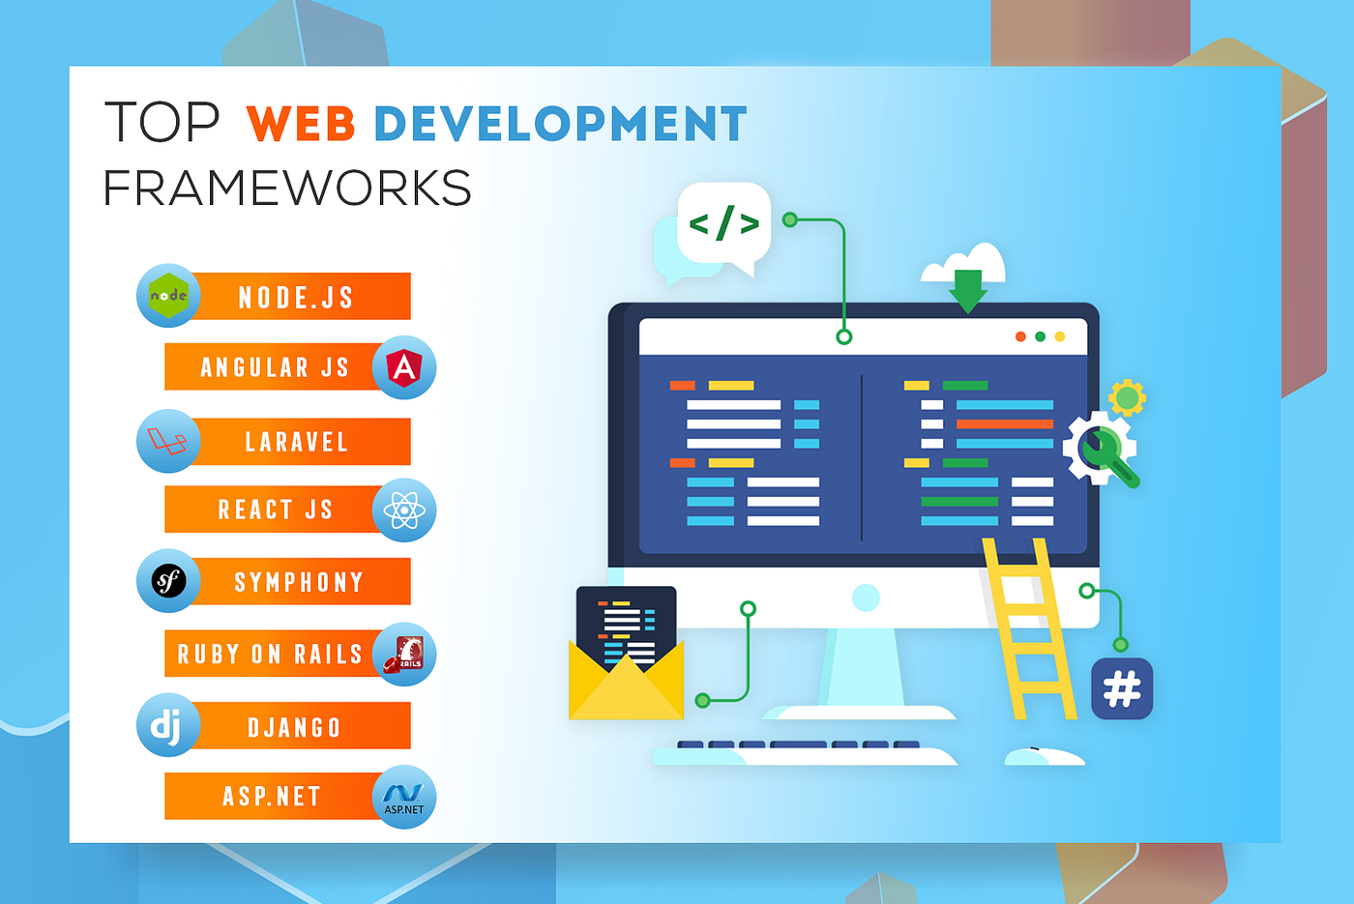
Frameworks in Full Stack Development
Frameworks streamline development processes and enhance productivity.
Frontend: React and Angular for building dynamic user interfaces.
Backend: Express (Node.js) and Django (Python) for efficient server-side development.
Frameworks provide tools and libraries to speed up development.

Slide 7
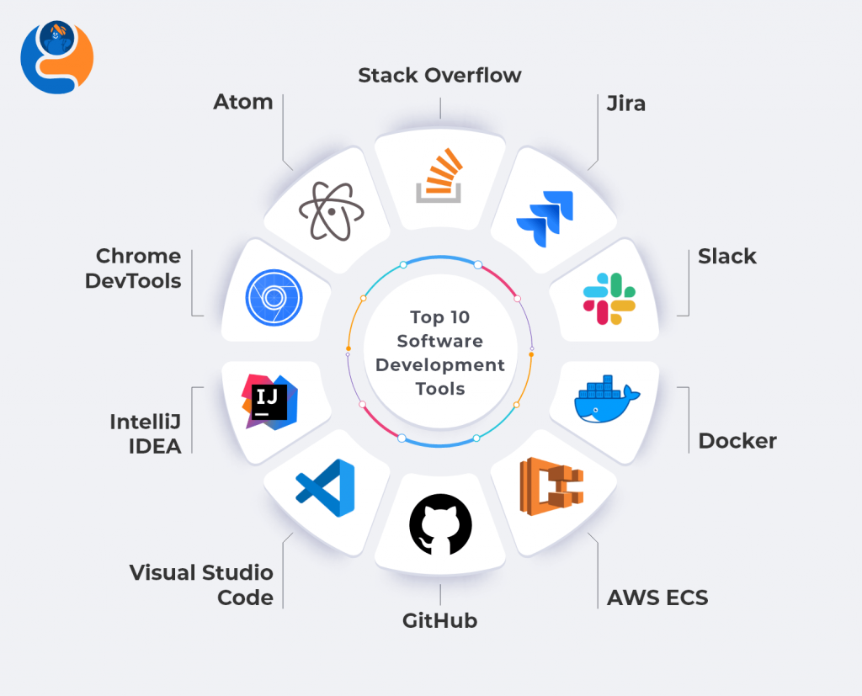
Development Tools and Environment
Essential tools facilitate the development workflow.
Git: Version control system for tracking changes in code.
Docker: Containerization tool for consistent development environments.
Code Editors: Tools like Visual Studio Code enhance coding efficiency.
These tools help manage projects effectively.

Slide 8
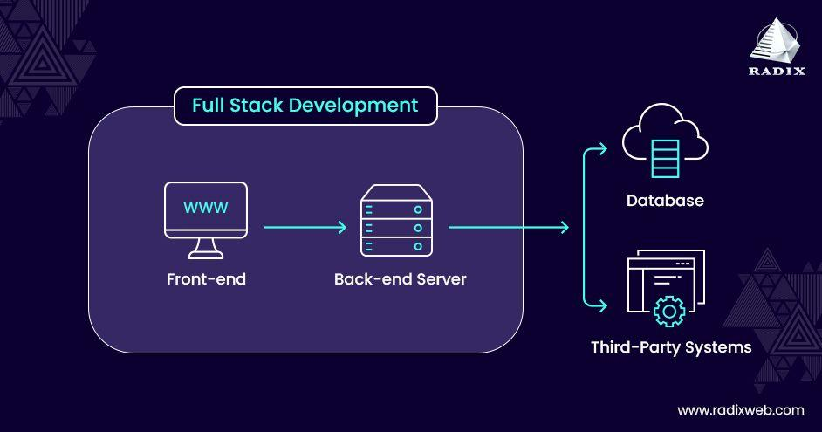
The Development Workflow
A typical workflow in full stack development includes:
Planning: Defining project scope and requirements.
Coding: Writing the code for both frontend and backend.
Testing: Ensuring functionality and fixing bugs.
Deployment: Launching the application for users.
Following a structured workflow leads to successful projects.

Slide 9

Responsive Design and User Experience
Responsive design ensures applications work on various devices.
Importance: Enhances user experience and accessibility.
Tools: Frameworks like Bootstrap help create responsive layouts.
Principles: Focus on usability and intuitive navigation.
Good design is key to user satisfaction.

Slide 10
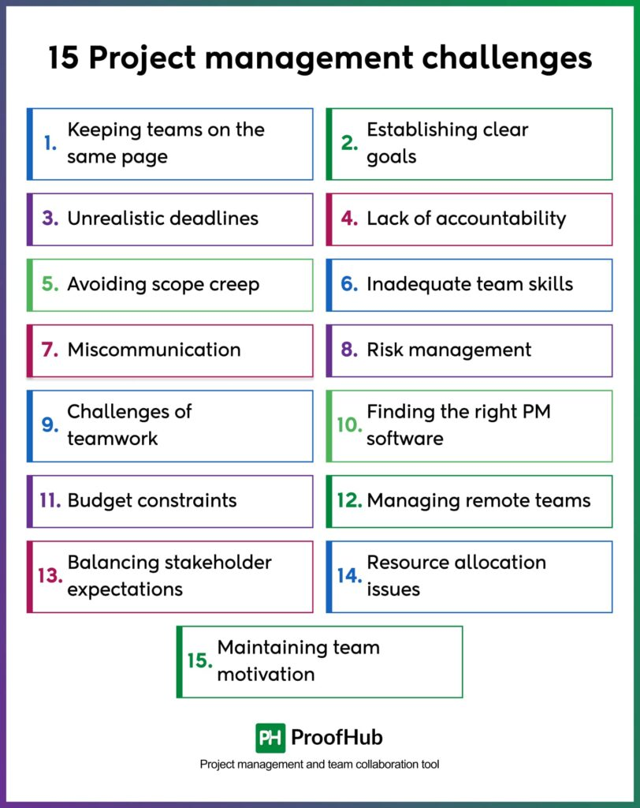
Challenges in Full Stack Development
Common challenges include:
Time Management: Balancing multiple tasks and deadlines.
Technology Stack Selection: Choosing the right tools and technologies.
Debugging Issues: Identifying and fixing errors in code.
Awareness of these challenges helps in better project management.

Slide 11
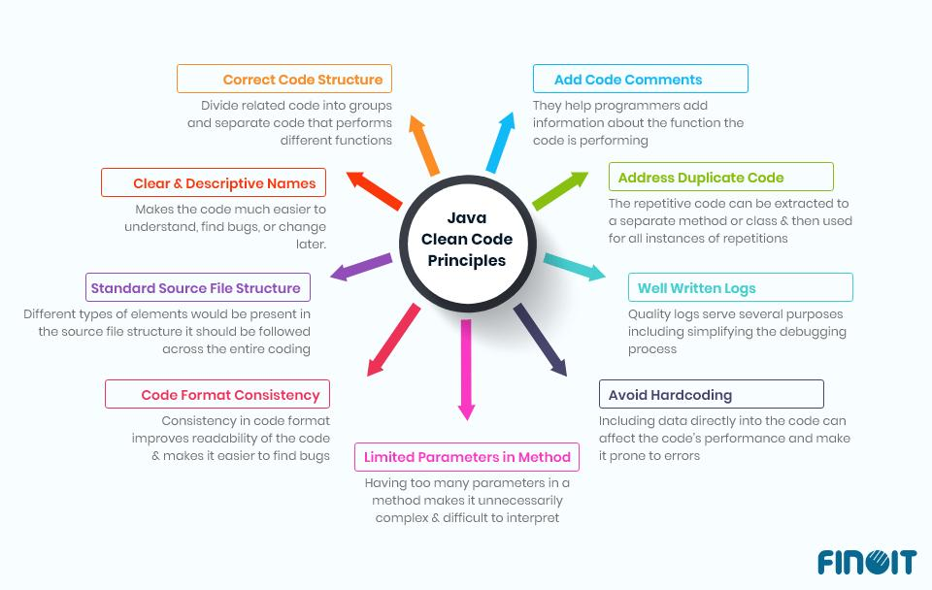
Best Practices in Full Stack Development
Adopting best practices leads to successful outcomes.
Clean Coding Principles: Write readable and maintainable code.
Version Control: Use Git for collaboration and tracking changes.
Documentation: Keep clear documentation for future reference.
These practices enhance collaboration and project quality.

Slide 12
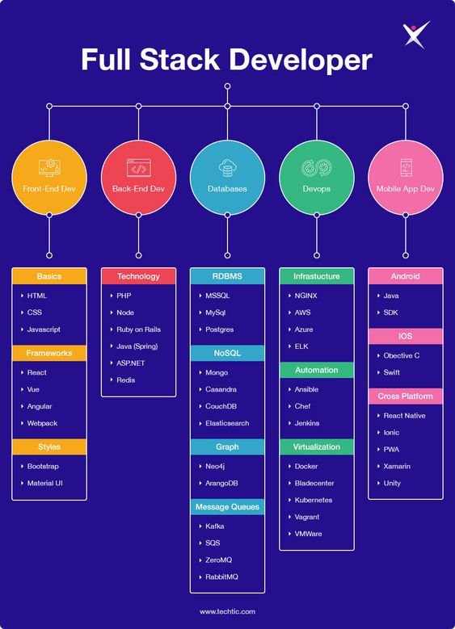
Real-World Applications of Full Stack Development
Full stack technologies drive a multitude of widely-used applications:
Social Media Platforms: Facebook, Twitter, Instagram, and TikTok.
E-commerce Sites: Amazon, eBay, and Shopify.
Content Management Systems: WordPress, Joomla, and Drupal. These examples highlight the transformative power of full stack development.

Slide 13

Careers in Full Stack Development
Career opportunities are abundant in this field:
Full Stack Developer: Handles both frontend and backend tasks.
Frontend Developer: Specializes in user interface development.
Backend Developer: Focuses on server-side logic and database management.
Skills in both areas are highly sought after.

Slide 14

Future Trends in Full Stack Development
Emerging trends are shaping the future of development:
Serverless Architecture: Reduces the need for server management.
AI Integration: Enhances applications with intelligent features.
Staying updated with trends is crucial for developers.

Slide 15
Recap of Key Points
Let's summarize what we've covered:
Full stack development encompasses both frontend and backend.
Key technologies include HTML, CSS, JavaScript, Node.js, and databases.
Best practices and tools improve the development process.
Career opportunities are diverse and growing.
Understanding these aspects is essential for success in the field.

Slide 16
Conclusion and Q&A
In conclusion, full stack development is vital for creating modern web applications. It combines various technologies and practices for effective development. I'm happy to answer any questions you may have! Thank you for your attention!

