Slide 1
A/B testing done properly: from sample size to a ship decision
Power analysis, health checks, frequentist and Bayesian tests, CUPED and sequential testing
Mohamed Moin Peer | MSc Data Analytics, Queen's University Belfast
Notes:
Hello, I'm Mohamed Moin Peer, an MSc Data Analytics graduate from Queen's University Belfast. This project is an A/B testing toolkit and a case study. Companies like Amazon, Booking and every e-commerce site decide what to change on their website by running experiments. Many of those experiments are analysed badly, and the result is decisions based on noise. I built a toolkit that covers the whole process, from planning the sample size to a clear ship or don't-ship decision, and I tested it on five experiments where I know the true answer. About 25 minutes plus a demo of the calculator. (~1 minute)

Slide 2
Most A/B test mistakes are not about maths
Too small
Peeking
Underpowered tests miss real effects, then get read as 'no effect'
Checking daily and stopping at p < 0.05 inflates false wins
Slicing
Broken split
Testing many segments guarantees some 'significant' noise
Tracking bugs bias the groups; the result means nothing
Notes:
Here are the four classic mistakes. Running a test that's too small to detect the effect you care about, then concluding 'no effect'. Peeking at the dashboard every day and stopping when it looks good. Slicing results into segments until one looks significant. And trusting a test where the traffic split is broken. None of these is advanced statistics. They're process failures, and they produce confident, wrong decisions. My toolkit is built to prevent each one. (~1.5 minutes)

Slide 3
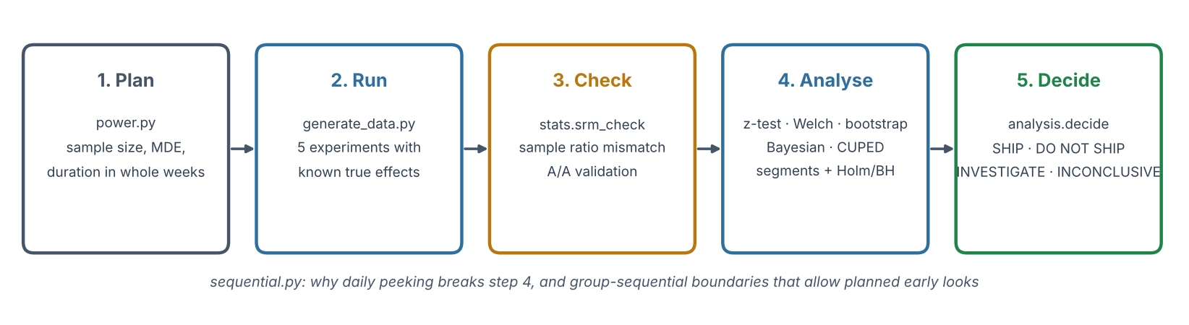
The toolkit: plan, run, check, analyse, decide
Built for checking
Five synthetic experiments for a fictional retailer, Lagan Living, each with a known true effect. If the toolkit's decision matches the truth, the method works.
Notes:
The toolkit follows the life of an experiment. Plan: how many visitors and how many days. Run: here, five synthetic experiments. Check: is the traffic split healthy, and do the tests behave as they should. Analyse: several complementary methods. Decide: explicit rules that turn the numbers into a decision anyone can audit. A separate module shows why daily peeking breaks the analysis, and how to look early safely. (~1.5 minutes)

Slide 4
Plan before you launch
Sample size, minimum detectable effect, duration
Notes:
First, planning. (~0.5 minutes)

Slide 5
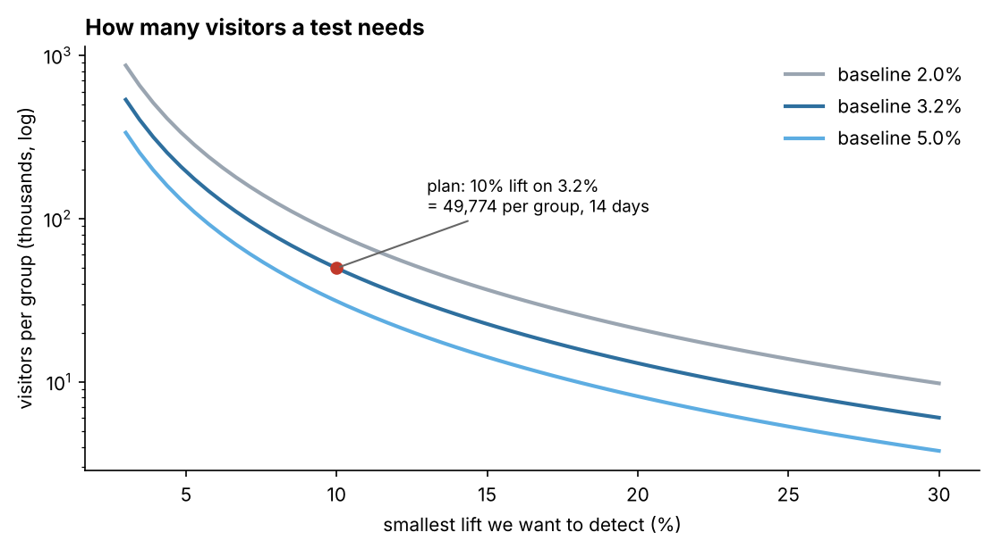
Detecting +10% on a 3.2% conversion rate needs 49,774 visitors per group
49,774
visitors per group
14 days
at 7,143 visitors a day
Rule of thumb
Half the effect size needs about four times the visitors.
python -m ab_toolkit plan --baseline 0.032 --mde 0.10 --daily 7143
Notes:
Before a test starts you decide the smallest improvement worth detecting, called the minimum detectable effect. For Lagan Living, conversion is 3.2% and the team cares about a 10% relative lift, to 3.52%. With the standard 5% significance level and 80% power, that needs 49,774 visitors per group. At about 7,000 visitors a day, that's 14 days, and I always round up to whole weeks so every weekday is equally represented. The chart shows how quickly the sample size grows for small effects: halving the effect roughly quadruples the visitors needed. The numbers are checked against statsmodels in the tests. (~2 minutes)

Slide 6
Five experiments
Each one teaches a different lesson
Notes:
Now the five experiments. (~0.5 minutes)

Slide 7
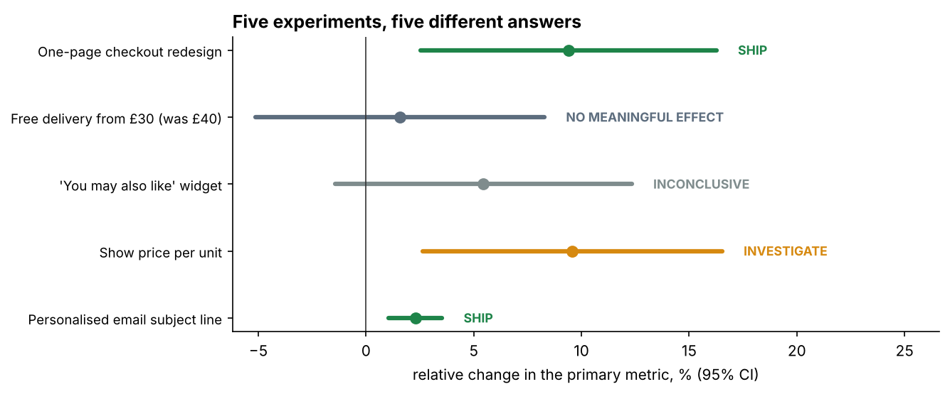
Five experiments, five different answers
Experiment | Decision
Checkout redesign | SHIP
Free delivery £30 | NO MEANINGFUL EFFECT
Recommendations widget | INCONCLUSIVE
Unit price display | INVESTIGATE
Email subject line | SHIP
Checked against the truth
All five decisions match the effects built into the data, including the broken test.
Notes:
Here's the summary. Each line is one experiment's main metric with its 95% confidence interval, coloured by the decision. The checkout redesign and the email both ship. Free delivery shows no meaningful effect. The recommendation widget is inconclusive. Unit price display looks like a clear win, but it's orange: investigate, because the traffic split is broken. I'll go through each, because each teaches a different lesson. Importantly, all five decisions match the truth I built into the data. (~1.5 minutes)

Slide 8
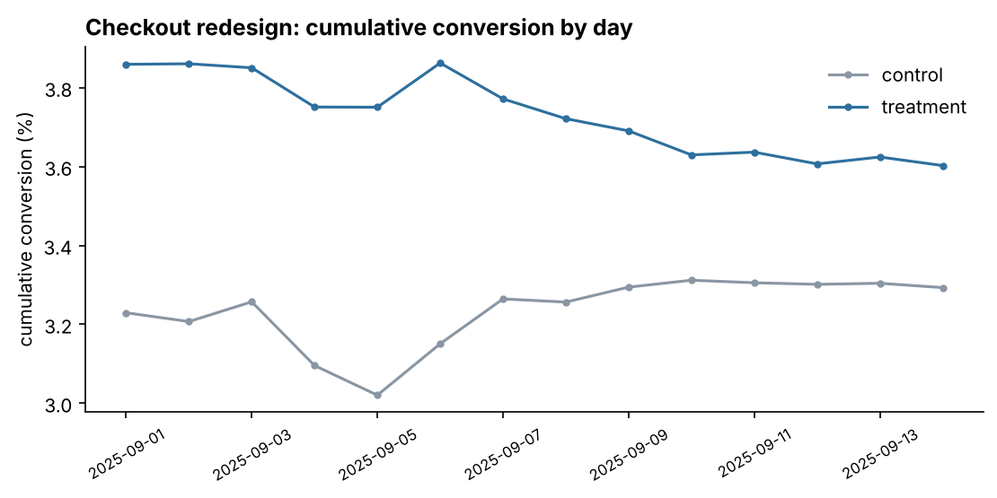
Checkout redesign: +9.4% conversion, ship it
+9.4%
conversion (true effect +10%)
p = 0.0073
two-proportion z-test
99.6%
Bayesian P(new is better)
Notes:
The one-page checkout. Conversion rose from 3.29% to 3.60%, a relative lift of 9.4%, with a p-value of 0.0073. The confidence interval runs from about +2.5% to +16%, so it's clearly positive. The Bayesian analysis agrees: a 99.6% probability that the new checkout is better. The guardrail, the return rate, didn't get worse. The chart shows cumulative conversion by day: the gap is there from early on and stays. The true effect I built in was +10%, so the estimate is close. Decision: ship. (~2 minutes)

Slide 9
Free delivery from £30: not the win it looks like
Metric | Change | p-value
Conversion rate | +1.6% | 0.64
Revenue per visitor | −2.3% | 0.60
Average order value | −3.8% | 0.23
Return rate (guardrail) | +16% (n.s.) | 0.23
Truth built into the data
+6% conversion, −5% basket size. The test was sized for +10%, so a 6% lift was always hard to see.
Decision: no meaningful effect
Lesson
The CI rules out the +10% we planned for. Revenue per visitor shows no gain. Not worth the delivery cost.
Judge price and delivery changes on revenue per visitor, not conversion alone. Bootstrap handles the skewed revenue.
Notes:
Lowering the free-delivery threshold from £40 to £30. The built-in truth: conversion up 6%, but basket size down 5%, because people no longer add items to reach £40. The test measured conversion +1.6%, not significant. Crucially, the confidence interval rules out the 10% lift we planned for, so the decision is 'no meaningful effect' rather than 'we don't know'. Revenue per visitor, which is what the business really cares about, went down 2.3%, also not significant. Lesson: never judge a pricing or delivery change on conversion alone; look at revenue per visitor, which captures the trade-off. And notice the true 6% lift was below what the test was sized for: a test can only find what it was designed to find. (~2 minutes)

Slide 10
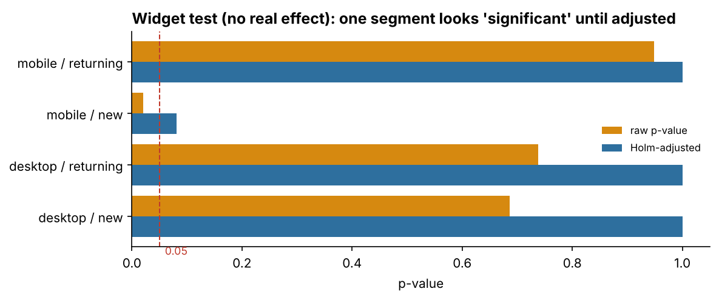
Recommendations widget: a segment "win" that is pure noise
p = 0.02
mobile / new: raw
p = 0.08
after Holm correction
Lesson
Four segments give about a 19% chance of at least one false 'win'. Adjust (Holm or Benjamini-Hochberg) and treat segments as ideas for the next test, not results.
Notes:
This widget has no real effect at all. Overall, the test isn't significant: p = 0.12. But a product manager slices the results by device and visitor type, and finds that mobile new visitors are up 19% with p = 0.02. That looks like a story. But with four segments, the chance of at least one false positive is about 19%. After a Holm correction for four comparisons, that p-value becomes 0.08, no longer significant. Since I know the true effect is zero, this is a textbook false discovery, caught. The toolkit always reports raw and adjusted p-values for segments. (~2 minutes)

Slide 11
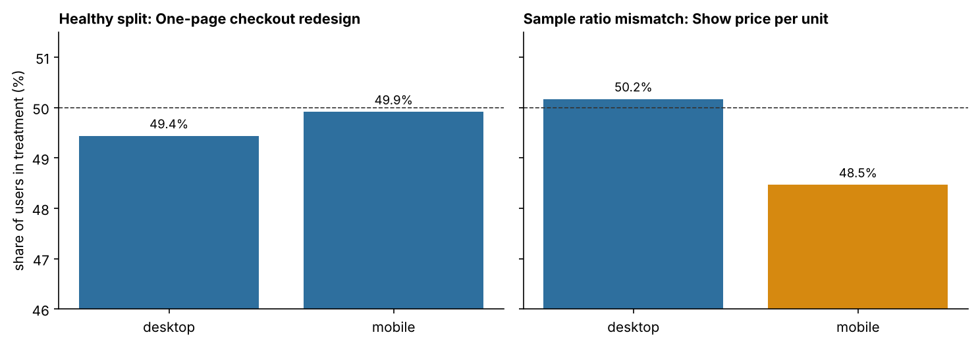
Unit price display: the result looks great, but the test is broken
+9.6%
apparent lift (true +3%)
p = 1.5e-8
sample ratio mismatch
Decision: INVESTIGATE
Users who did not buy were lost from the treatment group, so its conversion rate is inflated. Fix the tracking and re-run. Never analyse the metrics until the split passes.
Notes:
This one is the most important. The headline result looks excellent: conversion up 9.6%, p below 0.01. But the first thing I check is the traffic split. We designed 50/50; we got 50.9% / 49.1%. That sounds small, but with nearly 100,000 users a chi-square test gives p = 1.5 × 10⁻⁸: this didn't happen by chance. Splitting by device shows the cause: mobile treatment users are missing. In my data a bot-filter bug dropped some mobile treatment visitors who didn't buy, which makes the treatment look better than it is. The true effect is only 3%. So the decision is 'investigate': fix the tracking and rerun. Sample ratio mismatch is reportedly found in a meaningful share of tests at large companies, and checking it takes one line. (~2.5 minutes)

Slide 12
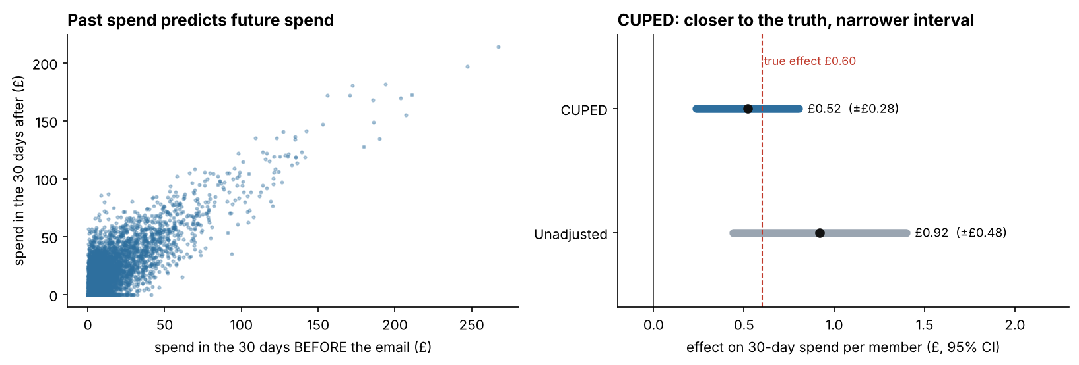
Email subject line: CUPED cuts the noise by 64.8%
64.8%
40.7%
£0.52
variance removed
narrower confidence interval
CUPED estimate (true £0.60)
Notes:
The fifth experiment is an email to 40,000 loyalty members, measuring spend over the next 30 days. Spend is very noisy, because some members spend far more than others. But we know how much each member spent before the email, and past spend predicts future spend strongly, as the left chart shows. CUPED uses that: it subtracts the predictable part of each person's spend, so only the noise that matters remains. That removed 64.8% of the variance and made the confidence interval 40.7% narrower. Equivalent to running the test with almost three times as many people. (~2 minutes)

Slide 13
CUPED also fixed a lucky imbalance
 | Effect per member | 95% CI
Unadjusted | £0.92 | £0.44 to £1.40
CUPED | £0.52 | £0.24 to £0.80
Truth (built in) | £0.60 | —
Chance imbalance
Treatment members already spent £0.47 more before the email (p = 0.04).
Why it matters
The unadjusted estimate would overstate the revenue gain by about 50%. CUPED gives a tighter and more accurate number from the same data.
Requirement
The covariate must be measured before randomisation, so the treatment cannot affect it.
Notes:
There's a second benefit. Before the email was even sent, the treatment group happened to spend £0.47 more on average than control, purely by chance (p = 0.04). The unadjusted comparison inherits that luck: it says the email added £0.92 per member, about 50% more than the true £0.60. CUPED adjusts for pre-period spend, and its estimate is £0.52, much closer to the truth. Both versions say 'ship', but if you were using the estimate to forecast revenue, the unadjusted number would overpromise by half. (~1.5 minutes)

Slide 14
Peeking, and how to look early safely
Sequential testing
Notes:
Now the most common mistake in practice. (~0.5 minutes)

Slide 15
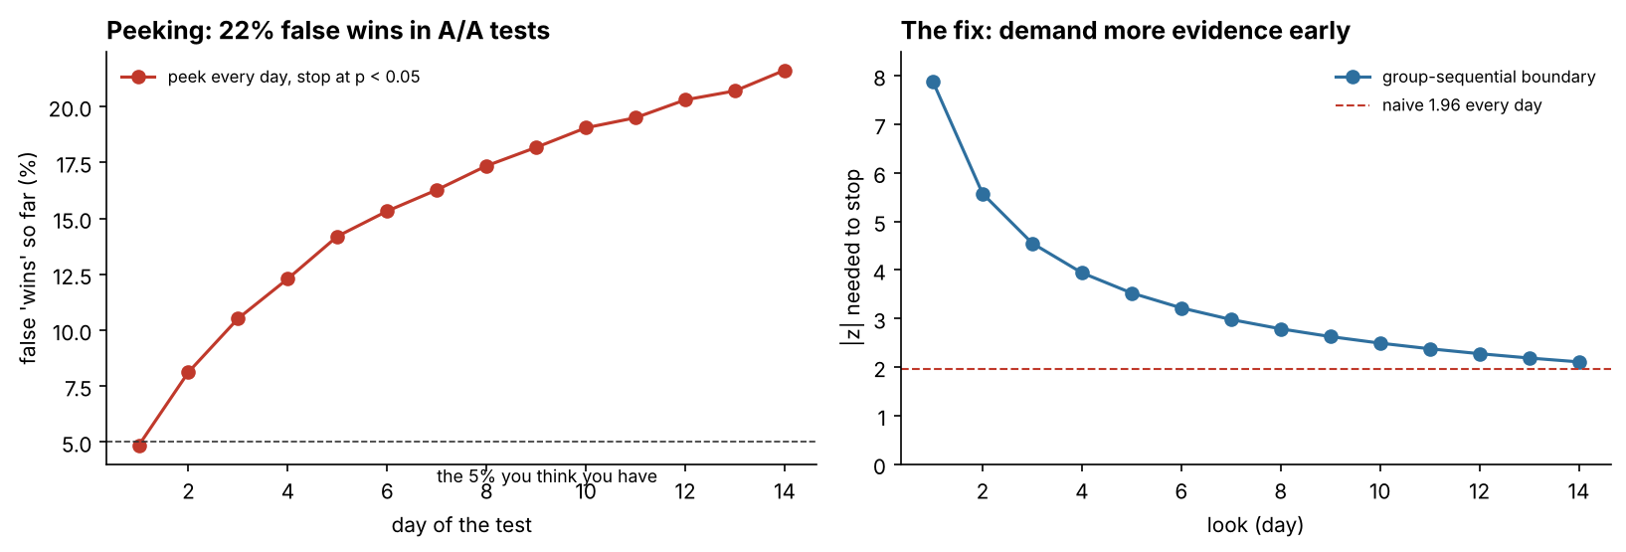
Peeking every day: 21.6% false wins instead of 5%
21.6%
4.8%
day 10.7
false wins if you peek daily
with group-sequential boundaries
average stop with a real +10% effect
Notes:
Everyone watches the dashboard. The danger is stopping as soon as p drops below 0.05. I simulated 4,000 A/A tests, where both groups are identical, over 14 days. If you only look at the end, 4.9% come out 'significant', as promised. If you look every day and stop at the first p < 0.05, 21.6% do. That's more than four times the error rate you think you have. The fix, on the right, is a group-sequential design: you plan your looks in advance and demand much stronger evidence early. On day one you'd need a z of about 7.9; by day 14, about 2.1. That brings false wins back to 4.8%. (~2.5 minutes)

Slide 16
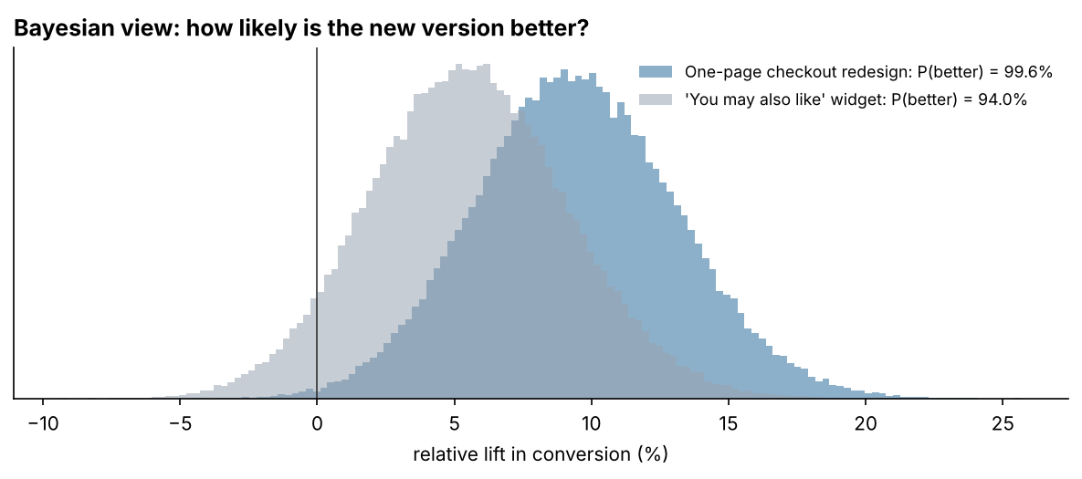
Bayesian view: useful, but not a shortcut
99.6%
checkout: P(better)
94.0%
widget (no real effect): P(better)
Lesson
P(better) > 90% is not a safe shipping rule on its own. Pair it with an interval and a planned minimum effect.
Notes:
The toolkit also gives a Bayesian answer, which business people often find easier: 'what is the probability the new version is better?'. For the checkout, it's 99.6%. But look at the grey distribution: the widget, which has no real effect, still gets 94.0%. A rule like 'ship if P(better) > 90%' would have shipped a useless widget. That's why my decision rules use confidence intervals compared with the effect we planned for, and the Bayesian number is reported alongside, not used alone. (~1.5 minutes)

Slide 17
Decision rules anyone can audit
# | Condition | Decision
1 | Sample ratio mismatch (p < 0.001) | INVESTIGATE
2 | A guardrail metric significantly worse | DO NOT SHIP
3 | Primary metric significantly up | SHIP
4 | Primary metric significantly down | DO NOT SHIP
5a | Not significant; CI rules out the planned effect | NO MEANINGFUL EFFECT
5b | Not significant; CI still includes it | INCONCLUSIVE
Each experiment gets a report
Hypothesis, pre-registered plan, health check, results for primary, secondary and guardrail metrics, Bayesian check, adjusted segments, then the decision and the reason.
Notes:
Statistics only help if they lead to a consistent decision. These are the rules, applied in order. If the traffic split fails, investigate; nothing else matters. If a guardrail metric got significantly worse, don't ship. If the primary metric is significantly up, ship; significantly down, don't. If it's not significant, look at the confidence interval: if it rules out the effect we planned for, there's no meaningful effect; if it doesn't, the test is inconclusive. Writing rules down before the test is what stops people from reinterpreting results to fit what they hoped. (~2 minutes)

Slide 18
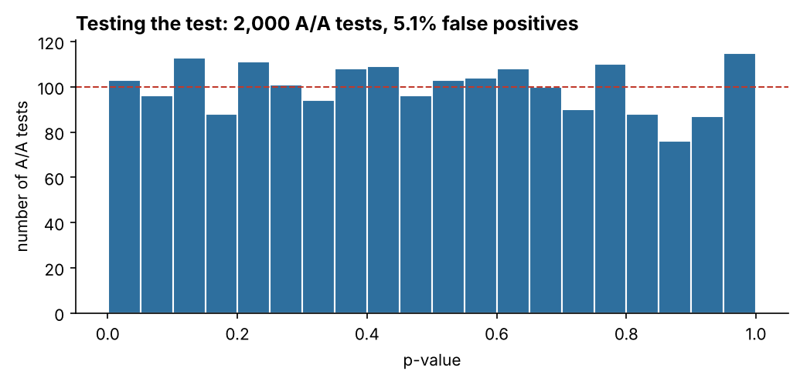
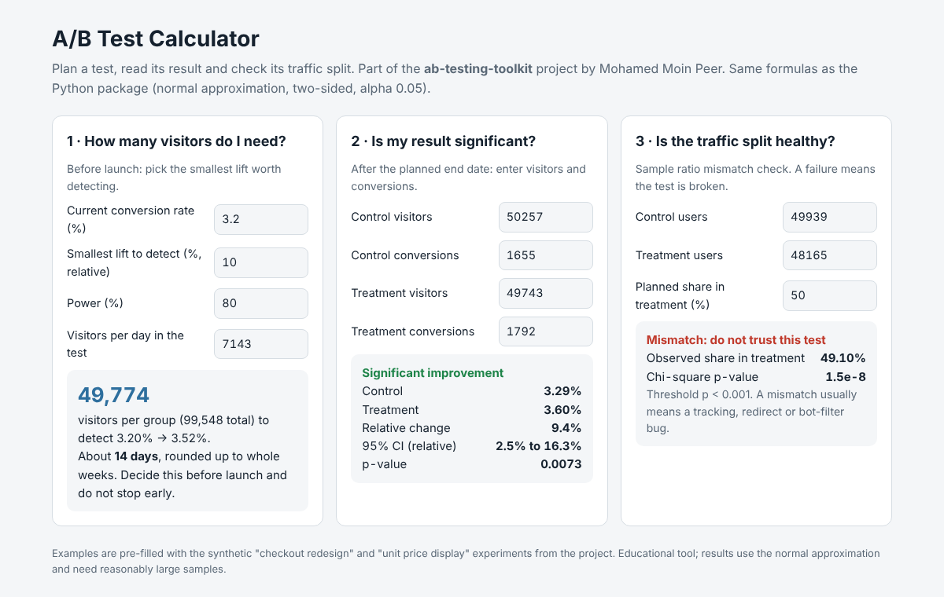
Testing the test, and a calculator anyone can use
24 tests
Sample size vs statsmodels · z-test, Welch, Holm, BH vs reference libraries · decisions vs truth · peeking simulation
Notes:
Two things that make the toolkit trustworthy. On the left: I ran the z-test on 2,000 simulated A/A tests. 5.1% came out significant, matching the 5% it should, and the p-values are spread evenly, which is what a correct test does. There are 24 automated tests, many comparing my functions with statsmodels and SciPy. On the right: a browser calculator for sample size, significance and the traffic-split check, using the same formulas. It's a single HTML file that can be published with GitHub Pages, so a recruiter or a product manager can use it without installing anything. (~2 minutes)

Slide 19
What I learned
1. Check the split first
2. Plan the effect size
The best-looking result came from the broken test
It separates 'no effect' from 'too small to tell'
3. Distrust slicing and peeking
4. Use pre-period data
Both multiply false wins; adjust or plan for them
CUPED: 64.8% less variance, a more accurate estimate
Notes:
Four lessons. One: check the split before anything else. The most convincing result in this project came from the broken test. Two: plan the effect size first. Without it, a non-significant result can't distinguish 'no effect' from 'too small to tell'. Three: be suspicious of segments and dashboards; both multiply your chances of fooling yourself. Four: use the data you already have. CUPED gave the power of a much bigger test for free. (~1.5 minutes)

Slide 20
Limitations and next steps
Limitations
Next steps
Synthetic, cleaner than reality
No novelty effects or interference
User-level metrics only
Equally spaced looks; flat Bayesian prior
Delta method for ratio metrics
Alpha-spending for flexible looks
Model-based heterogeneous effects
Run on a real event table via SQL
Notes:
Limitations: synthetic data, which is cleaner than real experiments; no novelty effects, no interference between users; user-level metrics only, so per-session ratio metrics would need the delta method; and boundaries calibrated for equally spaced looks. Next steps: the delta method for ratio metrics, alpha-spending functions for flexible looks, heterogeneous treatment effects with proper models rather than segment slicing, and connecting the toolkit to a real event table with SQL. (~1.5 minutes)

Slide 21
Demo and questions
python -m ab_toolkit all → outputs/reports/ · web/index.html
github.com/MOIN-PEER/ab-testing-toolkit | Thank you
Notes:
For the demo I run 'python -m ab_toolkit all' and open one experiment report, the unit-price one, to show the health check stopping the analysis. Then I open the browser calculator: plan a test, paste in the checkout result, and run the SRM check on the broken test. Thank you, I'm happy to take questions. (~3 minutes including demo)

