Slide 1
Cohort analysis: who stays, what they're worth, and what's next
Retention, lifetime value, unit economics and sBG forecasting for a subscription business
Mohamed Moin Peer | MSc Data Analytics, Queen's University Belfast
Notes:
Hello, I'm Mohamed Moin Peer, an MSc Data Analytics graduate from Queen's University Belfast. This project is a cohort analysis for a fictional UK meal-kit subscription. Subscription businesses live or die by retention, so I'll show how long customers stay, what they're worth compared with what they cost to acquire, the effect of a price rise and a product change, and a statistical model that forecasts retention for new customers from just a few months of data. About 25 minutes. (~1 minute)

Slide 2
A subscription business is only as good as its retention
How long do they stay?
What are they worth?
Which offers and channels?
Retention by signup cohort and on average
Contribution vs acquisition cost, payback month
First-box offers and five acquisition channels
What happened when…?
What's next?
Is the maths right?
The price rise and the new onboarding flow
Forecast young cohorts with an sBG model
SQL = pandas; 16 tests
Notes:
Acquiring a meal-kit customer costs anywhere from a few pounds to nearly sixty, and the first box is often discounted or free. So a customer only becomes profitable after several months. The questions are: how long do customers stay; which channels and offers bring customers worth having; what did the price rise cost; did the new onboarding work; and can we predict how new customers will behave before we have a year of data? (~1.5 minutes)

Slide 3
The data: 17,818 subscribers and 134,773 boxes
17,818
134,773
£5.9m
36
subscribers
boxes delivered
revenue
monthly cohorts
Three tables
Built-in effects (known truth)
customers: signup month, channel, plan, first-box offer, cancellation month
orders: one row per box, list price, revenue, add-ons
marketing_spend: spend and new customers by channel and month
Customers differ in churn risk
'First box free' cliff after month 0
Onboarding improvement from Sep 2024
£3 price rise in Apr 2025
Notes:
The data is synthetic, for a fictional company called Crate and Co: three years of subscribers, every box delivered with any add-ons, and monthly marketing spend by channel. I built several effects into it so the analysis has a known truth to find: customers differ in how likely they are to leave; a 'first box free' offer brings in people who leave straight away; channels differ; a new onboarding flow from September 2024 reduces churn; and a £3 price rise in April 2025 causes a spike in cancellations. (~1.5 minutes)

Slide 4
Retention by cohort
The cohort table, and what it hides
Notes:
First, retention. (~0.5 minutes)

Slide 5
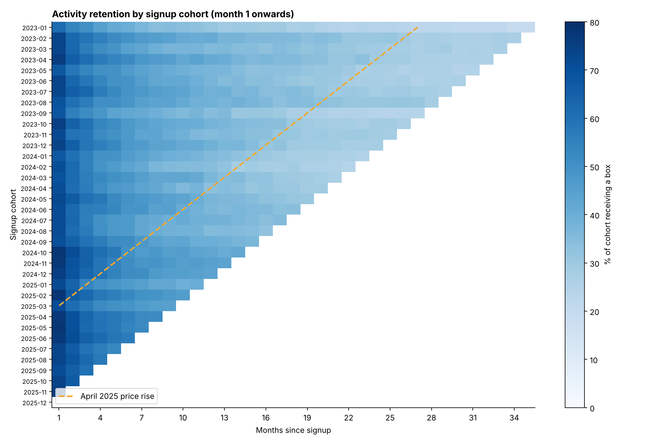
Reading a cohort heatmap
Along a row
One cohort followed over time
Down a column
Cohorts compared at the same age
Diagonal
A calendar event, like the April 2025 price rise
Notes:
This is the core view. Each row is a signup month, each column is months since signup, and the colour is the share of that cohort receiving a box. Read along a row to follow one group of customers over time; read down a column to compare cohorts at the same age. The bottom-right triangle is empty because those months haven't happened yet. The orange dashed diagonal marks April 2025: a calendar event hits every cohort in the same month, so it shows up as a diagonal rather than a column. (~2 minutes)

Slide 6
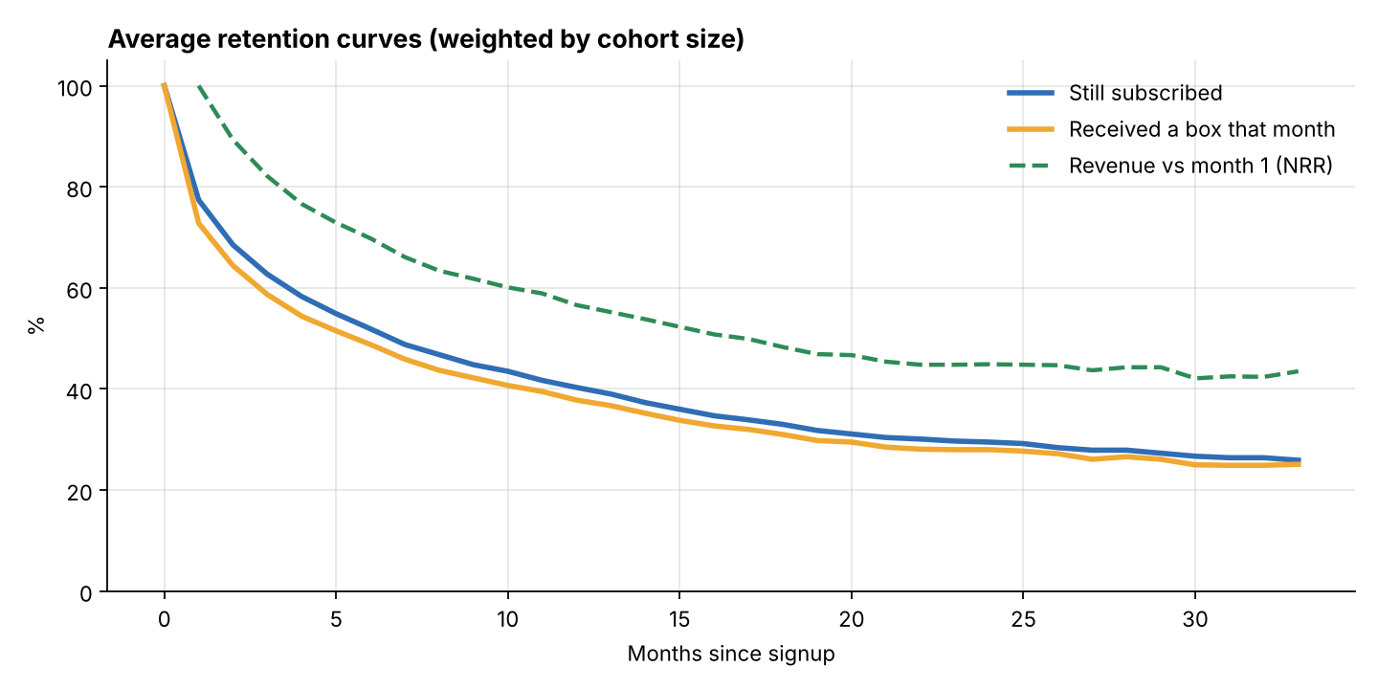
40.3% are still subscribed after a year, and the curve flattens
Month | Still subscribed
1 | 77.4%
3 | 62.7%
6 | 51.9%
12 | 40.3%
24 | 29.5%
Two definitions
'Still subscribed' (not cancelled) vs 'received a box' (pauses count as inactive): always say which one you mean.
Notes:
Averaging across cohorts, weighted by size: 77.4% are still subscribed after month 1, 62.7% after three months, 40.3% after a year and 29.5% after two years. The curve is steep at first then flattens: the customers likely to leave go early, and the ones who stay are increasingly loyal. That shape matters for forecasting later. The green dashed line is revenue relative to month 1. It stays above customer retention, 56.6% at month 12, because loyal customers buy more add-ons. (~2 minutes)

Slide 7
The same matrix in SQL, checked against pandas
WITH cohort_size AS (
SELECT signup_month, COUNT(*) AS customers
FROM customers GROUP BY signup_month
),
activity AS (
SELECT c.signup_month,
(CAST(substr(o.order_month,1,4) AS INT)
- CAST(substr(c.signup_month,1,4) AS INT)) * 12
+ (CAST(substr(o.order_month,6,2) AS INT)
- CAST(substr(c.signup_month,6,2) AS INT)) AS age,
o.customer_id
FROM orders o JOIN customers c USING (customer_id)
)
SELECT a.signup_month, a.age,
ROUND(100.0 * COUNT(DISTINCT a.customer_id)
/ s.customers, 1) AS retention_pct
FROM activity a JOIN cohort_size s USING (signup_month)
GROUP BY a.signup_month, a.age;
Verified
A test compares every observed cell of the SQL and pandas matrices. Match: true.
Second query
ltv_by_channel.sql: 12-month revenue per customer and CAC by channel
Notes:
Many analyst roles run cohort analysis in SQL, so I wrote the retention matrix in SQL too, using common table expressions and month arithmetic on the order and signup dates. The project loads the CSVs into an in-memory SQLite database and runs the query; a test then checks the SQL result matches the pandas result in every observed cell. They match exactly. A second query computes 12-month revenue per customer and acquisition cost by channel. (~1.5 minutes)

Slide 8
Offers and channels
Retention and unit economics by segment
Notes:
Next, which customers are worth acquiring. (~0.5 minutes)

Slide 9
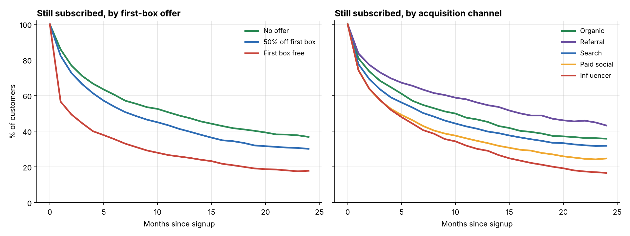
"First box free" customers leave: 56.6% stay past month 1
So what?
Free boxes buy sign-ups, not customers. Referral and organic customers are the most loyal.
Notes:
The left chart splits retention by the first-box offer. Customers who got their first box free drop sharply straight after it: only 56.6% are still subscribed after month 1, against 85.9% with no offer. Half-price first boxes are much closer to no offer. On the right, by channel: referral and organic customers stay longest, influencer and paid social customers leave fastest. (~2 minutes)

Slide 10
Unit economics: a free box loses money before it starts
First-box offer | First box | After 3 months | After 12 months
No offer | £14.34 | £48.53 | £122.82
50% off first box | −£6.14 | £26.64 | £91.46
First box free | −£26.61 | −£4.41 | £37.07
£123
£37
Contribution
Box + add-ons − 65% × (box list price + add-ons).
A free box still costs 65% of its list price.
no offer, 12 months
first box free, 12 months
Notes:
To value customers I use contribution: revenue minus the cost of the food and delivery, assuming a 35% margin. A free box still costs money, so a free-box customer starts at minus £27. After twelve months, a free-box customer has contributed £37 on average, against £123 for a customer with no offer, less than a third. That's before marketing costs. (~1.5 minutes)

Slide 11
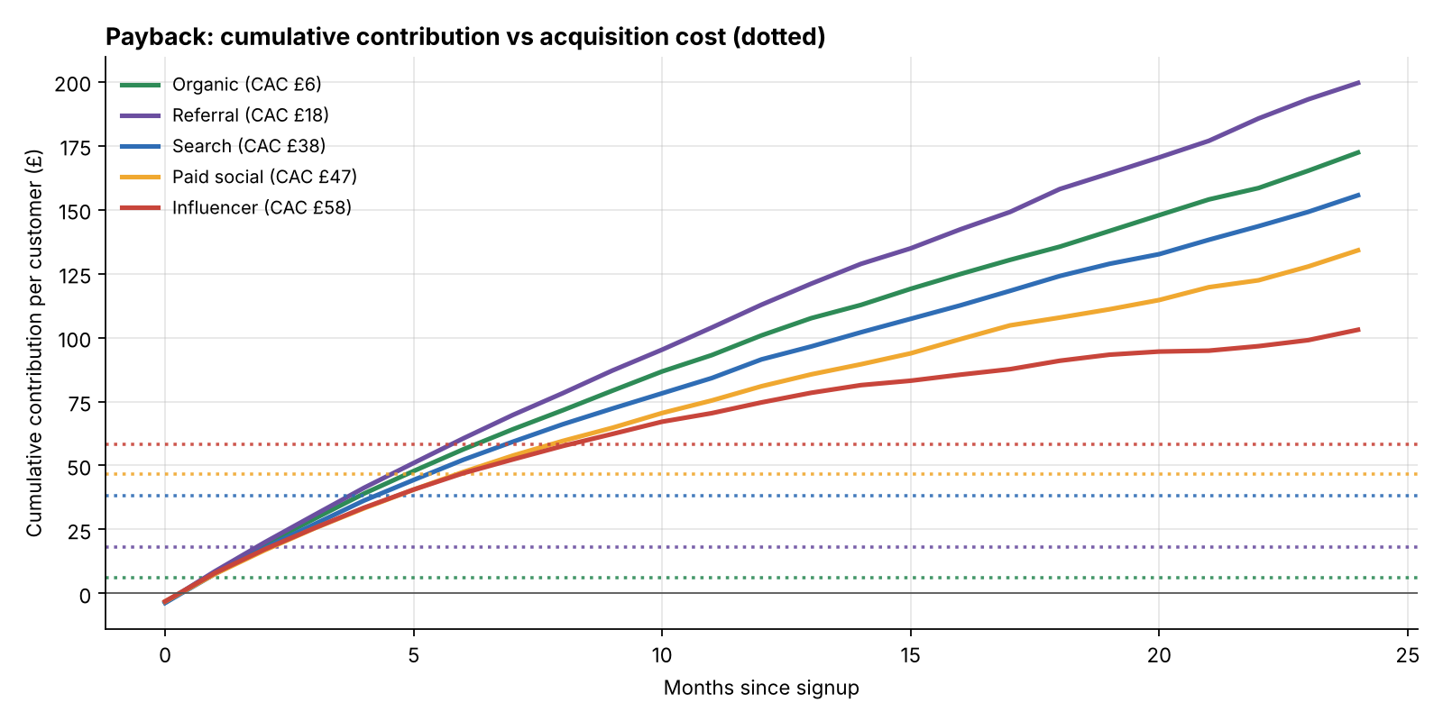
Influencer customers take 9 months to pay back; referrals take 2
Channel | CAC | Payback
Organic | £6 | month 1
Referral | £18 | month 2
Search | £38 | month 5
Paid social | £47 | month 6
Influencer | £58 | month 9
Payback month
The first month when cumulative contribution per customer exceeds the cost of acquiring them.
Notes:
Now add acquisition cost. Each line is cumulative contribution per customer by channel; the dotted line of the same colour is that channel's acquisition cost. Payback is where they cross. Organic and referral customers pay back within two months. Influencer customers cost £58 each and take 9 months, and since many leave before then, a lot of them never pay back. (~2 minutes)

Slide 12
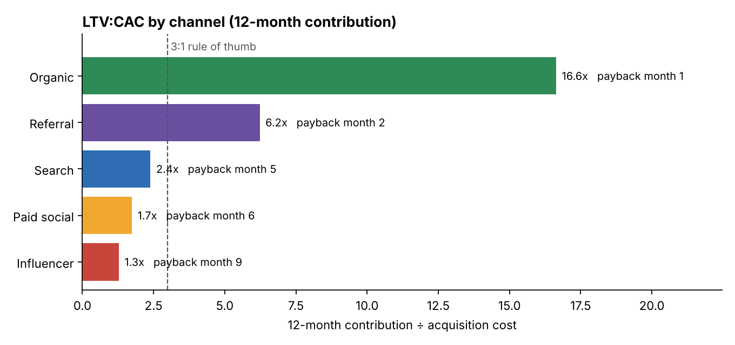
LTV:CAC: influencer and paid social are below 3:1
Recommendation
Shift budget from influencer to referral incentives and search.
Stop 'first box free'; use 50% off.
Caveat
12-month LTV is conservative (customers keep paying after a year); the sBG model later projects further.
Notes:
A common rule of thumb is that lifetime value should be at least three times acquisition cost. Using 12-month contribution, organic is 16.64 times, referral 6.23, search 2.39, paid social 1.74 and influencer just 1.28. Influencer is also the channel the business has been growing fastest. My recommendation is to shift budget from influencer towards referral incentives and search. (~1.5 minutes)

Slide 13
What happened when…
The April 2025 price rise and the September 2024 onboarding
Notes:
Now two events: a price rise and an onboarding change. (~0.5 minutes)

Slide 14
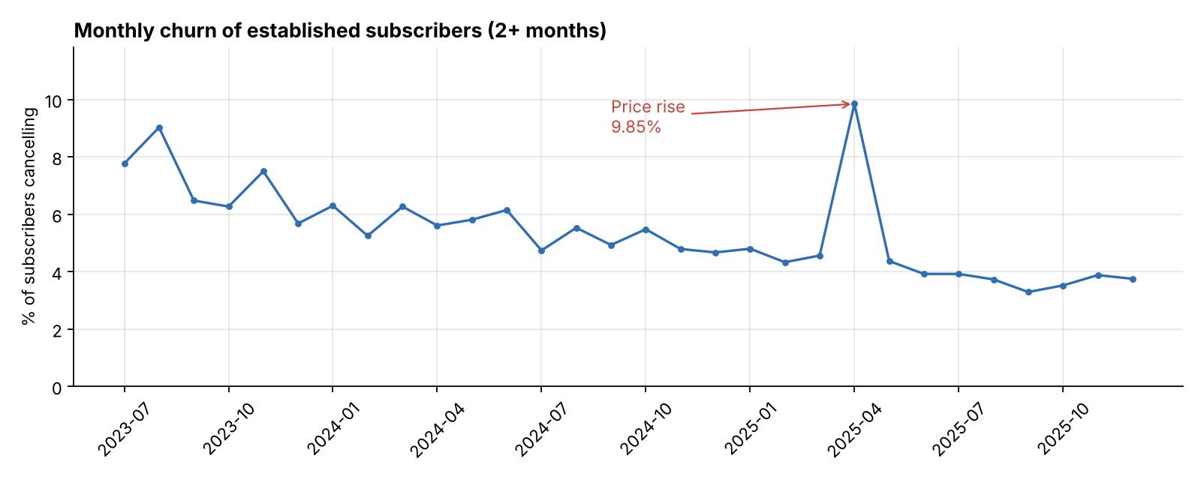
The price rise doubled churn for one month: ~293 extra cancellations
9.85%
churn in Apr 2025
4.93%
typical month
Cohort vs calendar effects
Cohort effects (who joined, how) show in rows; calendar effects (prices, outages, seasons) hit everyone at once and show as diagonals.
Notes:
To measure a calendar event, I switch from the cohort view to churn by calendar month among established subscribers, excluding brand-new customers so first-box effects don't dominate. Normally about 4.93% of established subscribers cancel each month. In April 2025, when the £3 price rise landed, it jumped to 9.85%: roughly 293 extra cancellations. Then it returned to normal. The rise still increased revenue per box, but next time I'd pair it with a loyalty offer for long-standing customers. (~2 minutes)

Slide 15
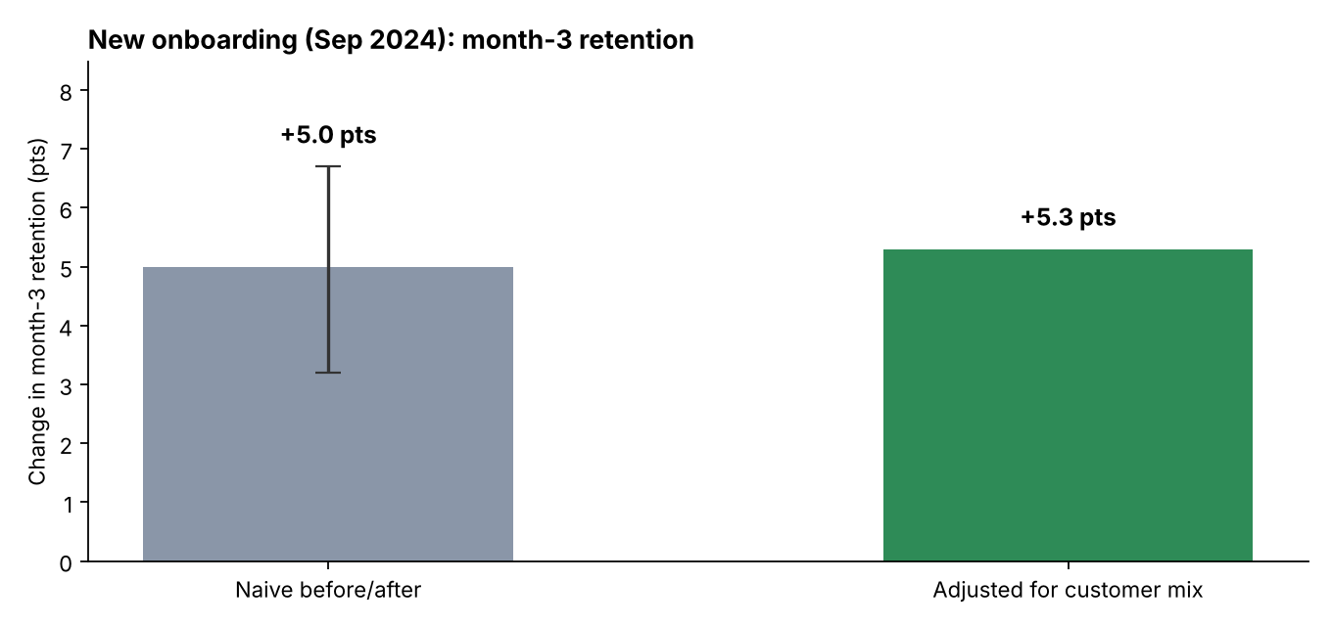
The new onboarding added about 5.3 points of month-3 retention
 | Before | After
Customers | 5,177 | 7,132
Month-3 retention | 60.4% | 65.4%
Influencer share | 19.6% | 24.2%
Adjusted model
Logistic regression with channel, offer, plan, season.
OR 1.275 (95% CI 1.181–1.376)
Caveat
Before/after is not a randomised experiment. Keep the new flow, and A/B test the next change.
Notes:
A new onboarding flow launched for customers signing up from September 2024. I compared month-3 retention for the 12 months of cohorts before and after. The simple comparison shows plus 5 points, which is statistically significant. But the customer mix changed: influencer customers, who churn more, rose from 19.6% to 24.2%. So I ran a logistic regression controlling for channel, offer, plan and season: the adjusted effect is plus 5.3 points, odds ratio 1.275, confidence interval 1.181 to 1.376. One honest caveat: this is a before-and-after study, not a randomised test, so something else that changed at the same time could contribute. Next time, A/B test it. (~2.5 minutes)

Slide 16
Forecasting retention
The shifted-beta-geometric model
Notes:
Finally, forecasting: how will a brand-new cohort behave? (~0.5 minutes)

Slide 17
Why a constant churn rate gets it badly wrong
Constant churn (geometric)
Shifted-beta-geometric
Everyone cancels with the same probability p each month.
S(t) = (1 − p)^t → heads to zero too fast.
Each customer has their own p, and p ~ Beta(a, b).
S(t) = B(a, b + t) / B(a, b) → flattens like real data.
def neg_log_lik(log_params, lifetimes, censored):
a, b = np.exp(log_params)
churned = betaln(a + 1, b + lifetimes - 1) - betaln(a, b) # cancelled at month t
alive = betaln(a, b + lifetimes) - betaln(a, b) # still subscribed (censored)
return -np.where(censored, alive, churned).sum()
minimize(neg_log_lik, x0=np.log([1, 3]), args=(life, cens), method="Nelder-Mead")
Notes:
If you assume every customer has the same monthly churn rate, you predict retention falling by the same percentage every month, which drops towards zero. But real curves flatten, because customers differ: the high-risk ones leave early and the survivors are loyal. The shifted-beta-geometric model, from Fader and Hardie, captures this. Each customer has their own monthly cancellation probability, and those probabilities follow a Beta distribution with two parameters, a and b. I estimate them by maximum likelihood using SciPy, including customers who are still subscribed, which is called censoring. (~2 minutes)

Slide 18
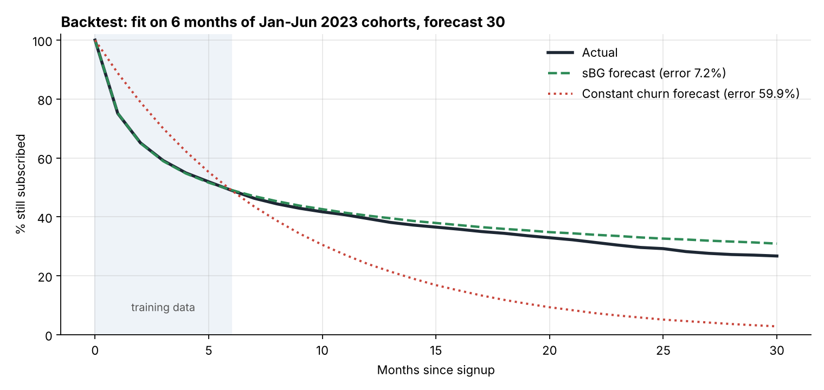
Backtest: 6 months of data forecast 2 years with 7.2% error
7.2%
sBG error (months 7-30)
59.9%
constant-churn error
Use
Project LTV for young cohorts and new channels months earlier than waiting for the data.
Notes:
To test it honestly, I pretended it was mid-2023: I fitted the model on only the first six months of the January to June 2023 cohorts, then forecast months 7 to 30 and compared with what actually happened. The sBG forecast, dashed green, tracks the actual curve closely, with an average error of 7.2%. The constant-churn forecast, dotted red, has 59.9% error. That means the business can project the lifetime value of a new cohort, or a new channel, after just a few months. A unit test also checks the fitting code recovers known parameters from simulated data. (~2 minutes)

Slide 19
Segment projections: two-year outlook by offer
Offer | a | b | Month-1 churn | Projected month 12 | Projected month 24 | Expected months (of 24)
50% off first box | 0.39 | 1.93 | 16.6% | 44.3% | 34.7% | 12.15
First box free | 0.30 | 0.42 | 41.6% | 28.6% | 23.3% | 8.27
No offer | 0.32 | 2.06 | 13.6% | 51.3% | 41.9% | 13.67
Forward-looking LTV
Limitation
Expected months subscribed × contribution per active month, available after a few months of data.
The free-box cliff after month 0 is sharper than the model's smooth curve: fit that segment from month 1, or add a 'one-and-done' share.
Notes:
Fitting the model separately by offer gives a projected two-year outlook. Free-box customers have a much higher churn rate at the start, a over a plus b of about 42% in month 1, and are projected to stay about 8.27 months out of the first 24, against 13.67 with no offer. Multiply expected months by contribution per month and you have a forward-looking LTV. One limitation: the free-box cliff after month 0 is sharper than the model's smooth shape, so the model is a little optimistic in month 1 for that segment. (~1.5 minutes)

Slide 20
16 tests, and recommendations
1
Stop 'first box free'
Use 50% off instead: far better retention and 2.5x the 12-month contribution
2
Rebalance channels
From influencer (1.3x) to referral (6.2x) and search (2.4x)
3
Keep the new onboarding
+5 points at month 3; A/B test the next change
4
Price rises with care
Pair with a loyalty offer for long-standing customers
5
Forecast early
Use sBG to judge new cohorts and channels after a few months
pytest → 16 passed (data, cohort definitions, SQL = pandas, sBG, payback, z-test, onboarding)
Notes:
Sixteen tests cover the data, including a regression test for the 'None' category being read as missing, which happened to me in an earlier project, plus the cohort definitions, the SQL matching pandas, the sBG model recovering known parameters, payback, and the two-proportion test against a known value. Recommendations: stop free first boxes; move budget from influencer to referral and search; keep the new onboarding and A/B test the next change; pair price rises with loyalty offers; and use the sBG model to evaluate new channels early. (~2 minutes)

Slide 21
Limitations and next steps
Limitations
Next steps
Synthetic data
Assumed 35% margin; no fulfilment cost differences
12-month LTV is conservative
Onboarding effect is observational
A/B test future changes
Cohort forecasts feeding the marketing budget
Beta-discrete-Weibull for the free-box cliff
Run the SQL on a real warehouse, refreshed monthly
Notes:
Limitations: synthetic data; a 35% margin assumption; 12-month LTV is conservative; the onboarding result is observational. Next steps: A/B testing for future changes; cohort-level forecasts feeding a budget model; a richer model such as the beta-discrete-Weibull for the free-box cliff; and connecting the SQL to a real warehouse with a scheduled refresh. (~1.5 minutes)

Slide 22
Demo and questions
python -m cohort_analysis all → outputs/interactive/cohort_dashboard.html
github.com/MOIN-PEER/cohort-analysis | Thank you
Notes:
For the demo I run 'python -m cohort_analysis all', then open the interactive dashboard in a browser: hover over the heatmap to read any cohort, toggle channels on the retention and contribution charts, and finally show the backtest chart. Thank you, happy to take questions. (~3 minutes including demo)

