Slide 1
Forecasting demand for every product in every store, and what it is worth
Back-tested LightGBM forecasts, prediction ranges and newsvendor stock decisions
Mohamed Moin Peer | MSc Data Analytics, Queen's University Belfast
Notes:
Hello, I'm Mohamed Moin Peer, an MSc Data Analytics graduate from Queen's University Belfast. I also work at Tesco, so I see every day what happens when a store has too much bread or not enough milk. This project forecasts daily sales for every product in every store of a grocery chain, four weeks ahead. It tests the forecasts honestly on data the models never saw, and then turns them into stock orders to measure what better forecasting is worth in waste, empty shelves and profit. About 25 minutes plus a short demo. (~1 minute)

Slide 2
Every order is a bet: too much is wasted, too little is a lost sale
How accurate?
Better than today?
Daily forecasts, 4 weeks ahead, for 300 store-product series
Compared with last week's sales and other simple methods
How sure?
What is it worth?
Prediction ranges, not just a single number
Waste, availability and profit when stock is ordered from the forecast
Notes:
A grocery store orders thousands of products every day. For short-life food, ordering too much means waste: bread and strawberries go in the bin or are reduced to clear. Ordering too little means an empty shelf, a lost sale and a customer who might shop elsewhere next time. Many stores still order based on what they sold last week. So the business questions are: how accurately can we forecast demand per product, per store, per day; how should those forecasts become orders; and what is the gain in money, waste and availability? (~1.5 minutes)

Slide 3
The data: 324,550 store-product-days for a fictional chain
10
30
3 years
£21.4m
stores in Northern Ireland
products, 10 categories
of daily sales, 2023–2025
revenue
Tables
Synthetic, with known truth
sales: units, price, promotion flag, stockout flag, store closed
products: price, cost, shelf life
weather: daily temperature by store
calendar: NI bank holidays
Every effect is generated by code with known strength, so the model can be checked against the truth. Real data would be messier.
Notes:
The data is synthetic. Harbour Fresh is a fictional chain of ten stores across Northern Ireland, from Belfast to Enniskillen, selling thirty everyday products over three years. That's 324,550 rows of daily sales, with prices, promotions, temperature by store, Northern Ireland bank holidays and store closures. I generated it in code with realistic effects built in, so I know the truth and can check whether the model found it. I say this clearly whenever I show the project: the results demonstrate method, not facts about a real business. (~1.5 minutes)

Slide 4
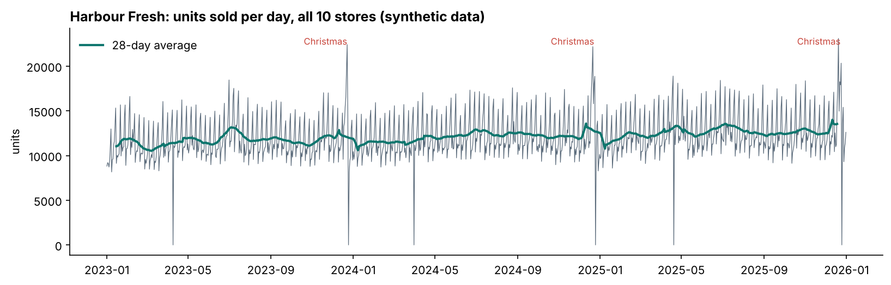
Three years of daily sales: weekly rhythm, Christmas peaks, closures
Christmas Day and Easter Sunday: stores closed (NI rules)
Notes:
This is total units per day across the chain. The weekly pattern is the zig-zag. Christmas shows as a sharp spike and then a drop to zero on Christmas Day, when the stores are closed. The other drops to zero are Easter Sundays: in Northern Ireland, large shops can't open on Easter Sunday, a local detail that a model has to know about or it will forecast normal sales for a closed store. There's also gentle growth of about three percent a year. (~1.5 minutes)

Slide 5
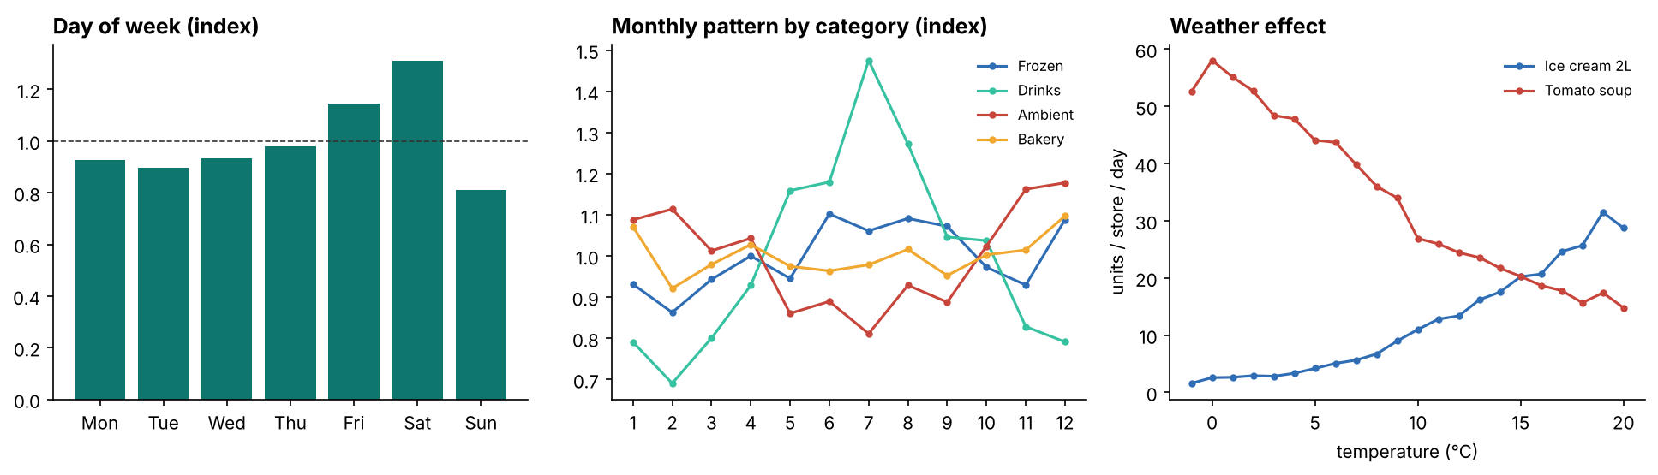
What drives demand
Day of week
Season
Weather
Saturday +30%, Sunday −20%
Drinks peak in July, soup in winter
Ice cream up, soup down when warm
Notes:
Three drivers. On the left, day of week: Saturday is the busiest day; Sunday is the quietest because Sunday trading in Northern Ireland is limited to 1 to 6 pm. In the middle, seasonality differs by category: drinks peak in July, soup and other ambient goods in winter, and bakery rises at Christmas. On the right, weather: ice cream sales rise sharply above about 10 degrees, while soup falls as it gets warmer. A good model needs all of these, plus promotions, which I'll come to. (~2 minutes)

Slide 6
Method
Features → models → back-test → stock decisions
Notes:
Now how the forecasts are built and tested. (~0.5 minutes)

Slide 7
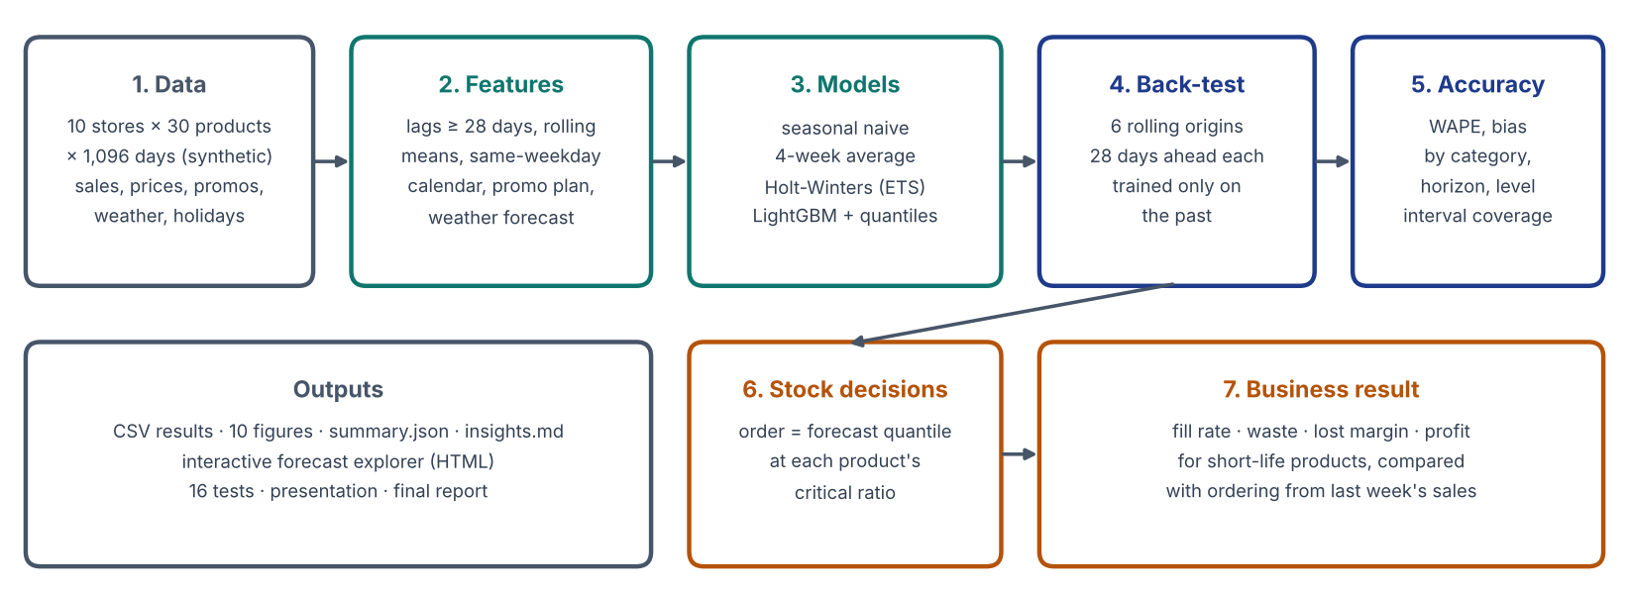
The pipeline
Notes:
Here's the whole pipeline. Data goes into features, features into four forecasting methods, and every method goes through the same back-test, so the comparison is fair. The accuracy results come out on the right. The forecasts then feed a stock-ordering simulation that measures the business result. Everything runs with one command and takes about five minutes on a laptop. (~1 minute)

Slide 8
Features: only what you would really know on the day you forecast
History (≥ 28 days old)
Known in advance
Cleaning
Lags 28–56 and 364 days
Rolling means 7, 28, 91 days
Same-weekday average
Chain average for the product
Calendar, NI holidays, Christmas and Easter countdown
Promotion plan, discount, price
Store closures
Weather forecast
Stockout days removed from history: sales on those days understate demand
Closed days forecast as zero
def test_no_future_leakage():
# multiply all sales after 1 June by 3 ... every history feature before 29 June must be unchanged
assert np.allclose(features_before, features_after, equal_nan=True)
Notes:
Most forecasting mistakes in portfolios are leakage: accidentally using information from the future. My rule: each forecast is made on an origin date for the next 28 days, so every history-based feature uses data at least 28 days old. That means lags of 28 to 56 days and one year, rolling averages ending 28 days back, and the average of the same weekday. Things that are planned in advance are allowed for the target day: the calendar, holidays, promotions and prices, closures and a weather forecast. I add noise to the temperature that grows with the horizon, because a forecast three weeks out is less reliable. One more detail: days with a stockout are removed from the history, because those sales understate demand. And there is a test that changes future sales and checks that no earlier feature changes. (~2.5 minutes)

Slide 9
Four methods, from simple to machine learning
Method | How it works | Typical use
Seasonal naive | Same weekday last week | Store manager's rule of thumb
4-week average | Mean of the last 4 same weekdays, stockouts excluded | Simple replenishment systems
Holt-Winters (ETS) | Exponential smoothing with weekly seasonality, per series | Classical statistics benchmark
LightGBM | One gradient-boosted model for all 300 series (Tweedie) | Modern retail forecasting
+ quantile models | 10%, 50%, 75%, 90% forecasts | Ranges and order quantities
Why one global model?
300 series share patterns: Saturdays, Christmas, promotions. Training on all of them together lets low-volume products borrow strength from busy ones, and it is one model to maintain instead of 300.
Notes:
I compare four methods. The first two are what many stores really use: what we sold on the same day last week, and the average of the same weekday over the last four weeks. The third is Holt-Winters exponential smoothing, the classic statistical method, fitted separately for each of the 300 store-product series. The fourth is LightGBM, a gradient-boosted tree model. It's a single global model trained on all 300 series together, so a quiet product can learn from busy ones. I use a Tweedie objective, which suits sales counts with many low values and zeros, and four extra quantile models for the 10th, 50th, 75th and 90th percentiles, which give ranges and drive the stock decisions. (~2 minutes)

Slide 10
The back-test: six 28-day folds, each trained only on the past
Fold 1: forecast from Jul 14
Fold 2: forecast from Aug 11
Fold 3: forecast from Sep 8
Fold 4: forecast from Oct 6
Fold 5: forecast from Nov 3
Fold 6: forecast from Dec 1
light = training data (everything before the origin) dark = 28-day test period
WAPE
Also measured
Σ |forecast − actual| ÷ Σ actual
The retail standard; not distorted by low-volume days
Bias (over or under), by category, horizon, promotion, level of aggregation; range coverage
Notes:
To test honestly, I simulate using the system in real life. I pick an origin date, train only on data before it, forecast the next 28 days, and compare with what actually happened. Then I move forward four weeks and repeat, six times from July to December 2025. The last fold covers the run-up to Christmas, the hardest month. That gives 49,296 store-product-days of genuine out-of-sample forecasts. Days with a stockout are excluded from scoring, because true demand isn't known on those days. My main measure is WAPE: total absolute error divided by total sales. It's the standard in retail because it isn't distorted by low-volume days the way average percentage error is. (~2 minutes)

Slide 11
Results
Accuracy, ranges, and what the model learned
Notes:
Now the results. (~0.5 minutes)

Slide 12
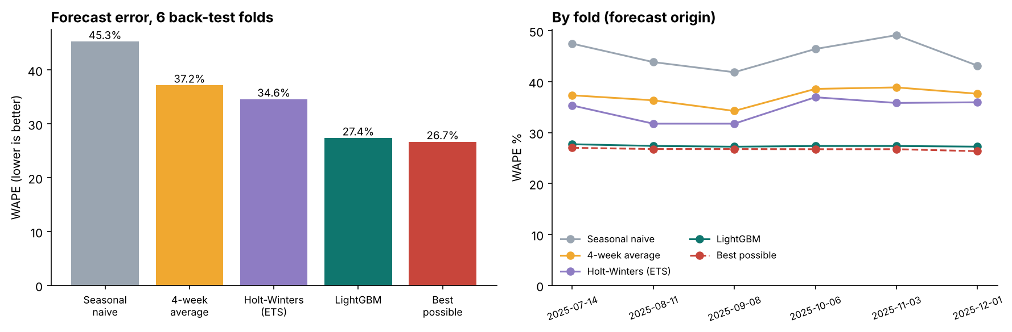
LightGBM: 27.4% error, against 45.3% for last week's sales
−39.5%
−20.8%
-1.3%
error vs last week's sales
error vs best baseline
LightGBM bias (nearly unbiased)
Notes:
Here are the headline results across all six folds. Last week's sales has 45.3% WAPE. The four-week average improves to 37.2%, Holt-Winters to 34.6%, and LightGBM to 27.4%. That's 39.5% less error than the naive method and 20.8% less than the best baseline. On the right, the ranking is the same in every fold, including the Christmas fold, so it isn't luck. Now the red bar, which I think is the most important number in the project. (~2 minutes)

Slide 13
How good can a forecast get? The floor is 26.7%
Forecast | WAPE | Gap to best
Seasonal naive | 45.3% | +18.6
4-week average | 37.2% | +10.5
Holt-Winters | 34.6% | +7.9
LightGBM | 27.4% | +0.7
Best possible | 26.7% | 0
Noise you cannot forecast
Average 40 loaves a day still means 33 one day and 47 the next. A perfect forecast of the average scores 26.7%.
Caveat
In this synthetic data the model sees every driver. Real data has unrecorded drivers, so expect a bigger gap.
Notes:
Because I generated the data, I know the true average demand for every product, store and day. If I use that as the forecast — a perfect model — the error is still 26.7%. That's because selling 40 loaves on average doesn't mean you sell exactly 40; one day it's 33, the next 47. That randomness can't be forecast. So LightGBM at 27.4% is within 0.7 points of the best possible. In real projects you don't know this floor, which is why people sometimes chase accuracy that doesn't exist. The honest caveat: in my synthetic data the model can see every driver; real data has drivers nobody records, so the gap would be larger. (~2 minutes)

Slide 14
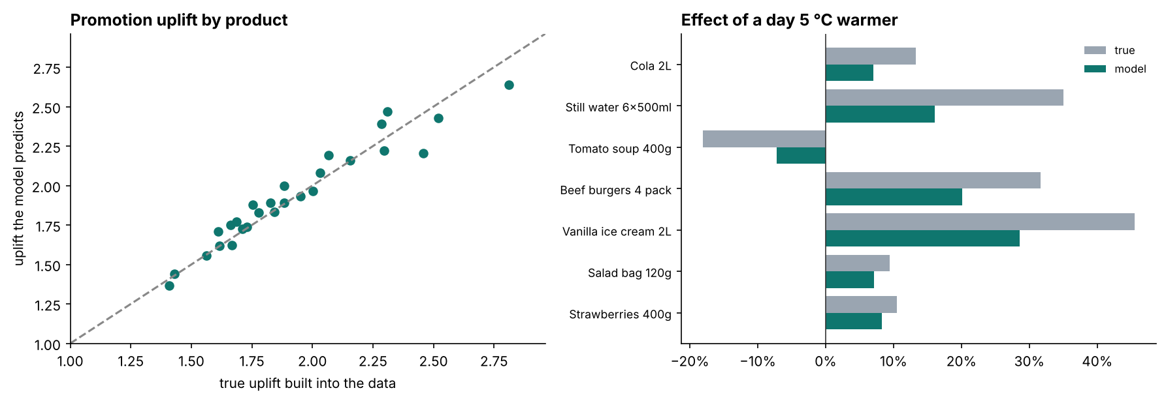
Promotions: the baselines miss them, LightGBM does not
Promotion days | WAPE | Bias
Seasonal naive | 48.8% | -41.1%
4-week average | 47.0% | -43.9%
Holt-Winters | 47.3% | -44.0%
LightGBM | 27.9% | -3.0%
Why it matters
Promotions are when demand is highest and shelves empty fastest. A forecast that is 40% too low on promotion days guarantees stockouts.
Notes:
Promotions are where simple methods fail. On promotion days, the baselines under-forecast by about 41 to 44 percent, because they only look at past sales and don't know a price cut is planned. That's exactly when a store runs out. LightGBM knows the promotion plan and the discount, and its bias on promotion days is only -3.0%. Its error on promotion days, 27.9%, is almost the same as on normal days. On the right I check what the model learned: for each product, the uplift the model predicts for its promotions against the true uplift built into the data. They line up closely along the diagonal. (~2 minutes)

Slide 15
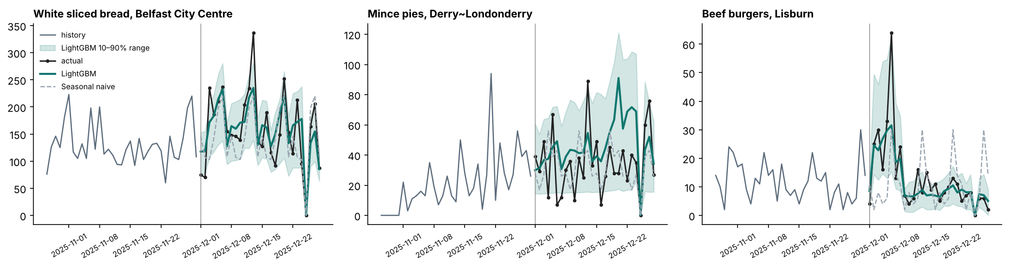
Three real examples from the Christmas fold
Bread
Mince pies
Burgers
Follows the Christmas build-up and closure
Hardest: two seasons of history, over-forecast mid-December
Promotion starts 2 Dec: LightGBM forecasts it; naive misses it
Notes:
Here are three real series from the December fold. The grey line is history, black is what actually sold, teal is LightGBM, the shaded band is its 10-to-90 percent range, and the dashed grey line is last week's sales. White bread in Belfast: LightGBM follows the Christmas build-up and the Christmas Day closure. Mince pies are hard: it's a seasonal product with only two Decembers of history, and the model over-forecasts mid-month. That's the hardest category. Burgers in Lisburn: a one-week promotion starts the day after the origin. LightGBM knows the promotion plan, so it forecasts the jump and the drop afterwards. Last week's sales misses the promotion completely, and then repeats a one-off busy Saturday every week. (~2 minutes)

Slide 16
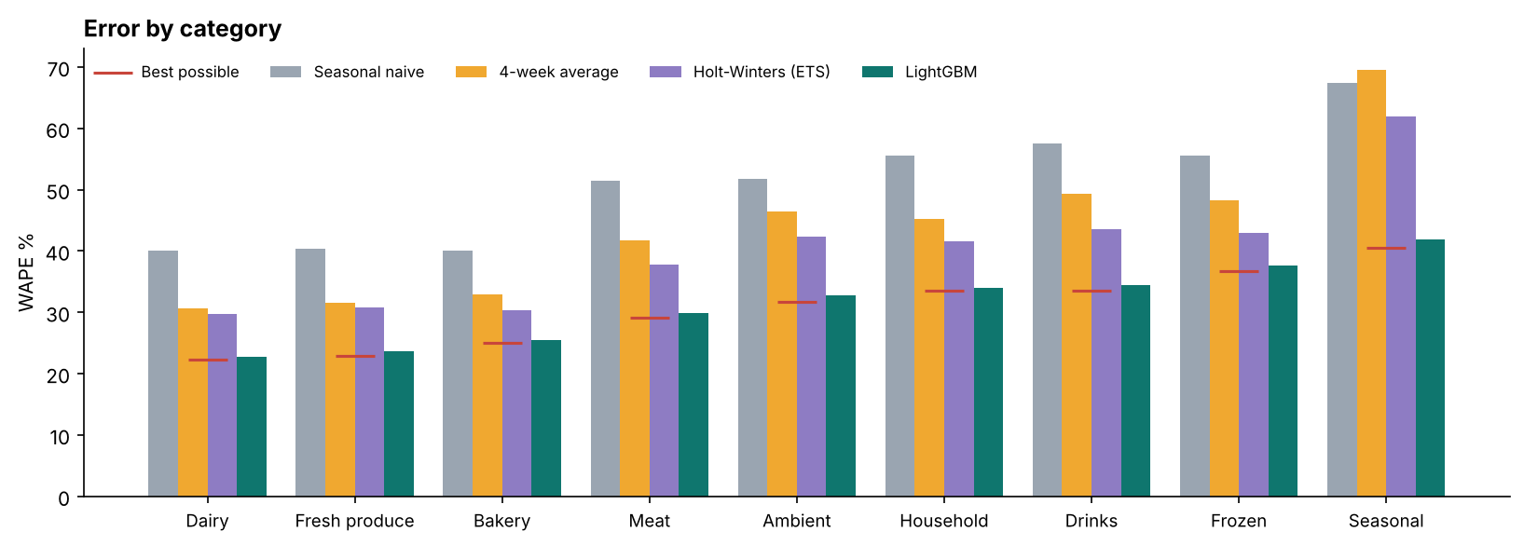
Error by category: from 22.8% (Dairy) to 41.8% (Seasonal)
Weather and seasonal lines are hardest
Notes:
Accuracy varies by category. Dairy, fresh produce and bakery are easiest: high volume and stable. Frozen, drinks and seasonal lines are hardest: lower volumes, strong weather effects and short seasons. The red markers are the best possible score for each category, and LightGBM is close to them everywhere. Every baseline is far above them. This tells a business where to focus: there's little left to gain on dairy, but weather-sensitive and seasonal ranges would benefit from better weather forecasts and more history. (~1.5 minutes)

Slide 17
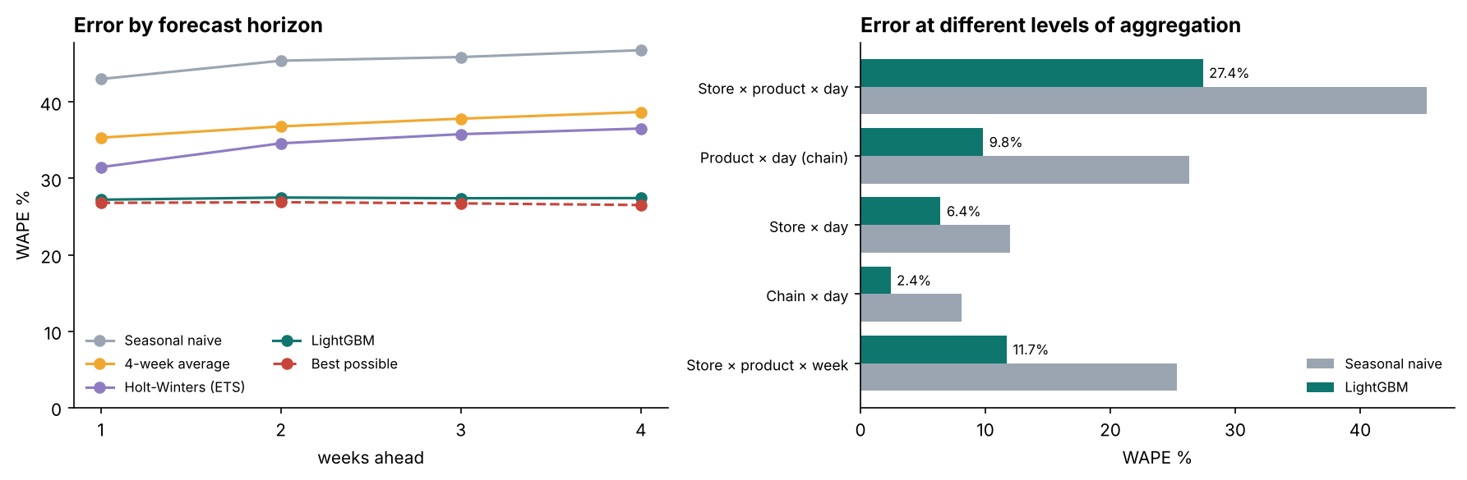
Errors cancel: 27.4% per product, 6.4% per store, 2.4% for the chain
Horizon
Aggregation
LightGBM stays flat over 4 weeks; baselines degrade
Staff on totals; stock per product with ranges
Notes:
Two more views. On the left, error by how far ahead we forecast: LightGBM is flat across all four weeks, while the baselines get worse further out. On the right, the level of aggregation. One product in one store on one day has 27.4% error. But add up all products for a store and the error falls to 6.4%, and for the whole chain to 2.4%, because over- and under-forecasts cancel. A weekly total per product per store is 11.7%. The practical lesson: plan staff and deliveries on totals, which are very accurate, and plan shelf stock per product, where you need ranges. (~2 minutes)

Slide 18
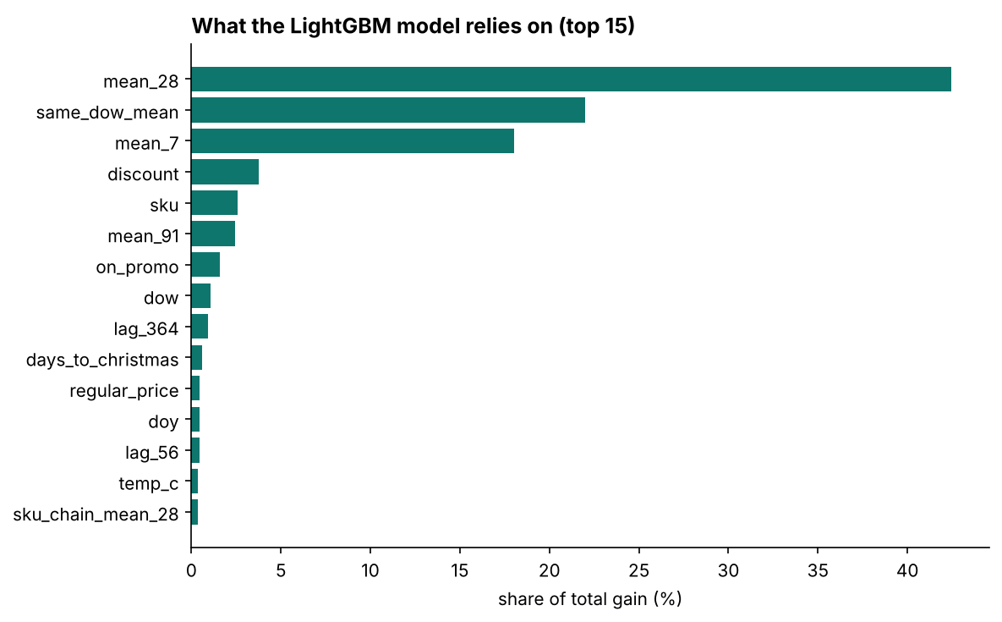
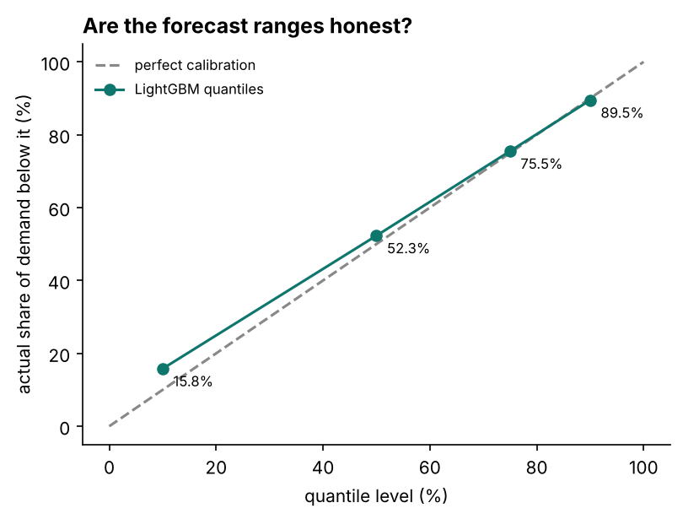
What the model relies on, and where it is wrong
Weather effect under-learned · ranges cover 76% (target 80%)
Notes:
The feature importance on the left shows the model relies mostly on recent demand levels: the 28-day average, the same-weekday average and the 7-day average. Then come the discount and the product. The weather chart on the promotions slide showed one weakness clearly: the model underestimates weather sensitivity by about a third. For ice cream, a day five degrees warmer should mean about 45% more sales; the model predicts about 29%. It attributes part of the effect to the time of year instead, because warm weather and summer go together. Interval calibration on the right: the 10–90% range contains 76% of actual demand, against a target of 80%. The 10th percentile is a little high. That matters for stock decisions, and it's my first next step. (~2 minutes)

Slide 19
From forecast to order
Waste, availability and profit
Notes:
Now the part a business cares about most. (~0.5 minutes)

Slide 20
Order the right quantile, not the average
critical ratio = underage / (underage + overage)
underage = price − cost + goodwill (20% of price)
overage = cost − salvage (20% of cost)
order = forecast quantile at the critical ratio
Product | Critical ratio
Soda farls 4 pack | 0.72
Salad bag 120g | 0.69
White sliced bread 800g | 0.67
Strawberries 400g | 0.62
Bananas (each) | 0.60
Chicken breast 600g | 0.55
Simulation
11 short-life products × 10 stores × 24 weeks
Demand = actual sales on non-stockout days
Compare 4 order policies on fill rate, waste and profit
Notes:
For a product that must sell within a few days, the best order isn't the average forecast. It's a quantile, chosen by the costs. This is the classic newsvendor problem. If I'm one unit short, I lose the margin plus some customer goodwill. If I'm one unit over, I lose the cost minus what I recover by reducing it to clear. The critical ratio, underage over underage plus overage, says which quantile to order. For bread it's about 0.67: order the 67th percentile of the demand forecast. For chicken, which is expensive to waste, it's about 0.55. I interpolate the model's quantiles to each product's ratio. I simulate this for the 11 products with a shelf life of seven days or less, in all ten stores, for all 24 test weeks. (~2.5 minutes)

Slide 21
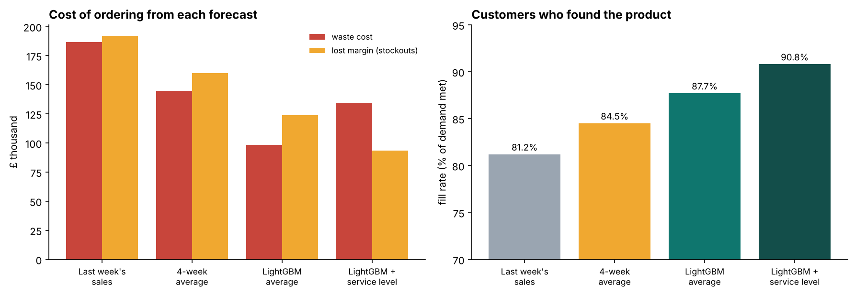
Ordering from LightGBM: +£156k profit, waste 20% to 11.6%
Policy | Fill | Waste | Profit
Last week | 81.2% | 20% | £533k
4-wk avg | 84.5% | 16.1% | £607k
LightGBM | 87.7% | 11.6% | £689k
Service lvl | 90.8% | 15.3% | £684k
Choice for the business
LightGBM average: highest booked profit. Service level: 90.8% availability and the lowest total cost once lost goodwill is counted (−41.7% vs naive).
Notes:
Here's the result. Ordering last week's sales gives a fill rate of 81.2%: almost one customer in five doesn't find the product. And 20% of what's ordered is wasted. Ordering from the LightGBM forecast raises fill rate to 87.7%, cuts waste to 11.6% and adds £156k of profit over 24 weeks for just 11 products. Ordering at the service level raises availability further, to 90.8%, with a bit more waste. Its booked profit is slightly lower than the average forecast, but once lost goodwill is counted it has the lowest total cost, 41.7% below the naive policy. Which policy to choose is a business decision about how much availability is worth. (~2.5 minutes)

Slide 22
Engineering: reproducible, tested, explorable
Data
closures, promotions, built-in effects, stockouts below demand
Features
no future leakage, stockouts blanked, calendar, promotion counter
Models
naive = last week, LightGBM beats naive, quantiles ordered, closed = 0
Inventory
critical ratios, quantile interpolation, sold + waste = ordered
pytest → 16 passed | python -m demand_forecasting all → everything in ~5 min
Notes:
A few engineering points. Everything regenerates from one command: the data, the six-fold back-test, ten figures, the result tables and an interactive explorer. There are 16 tests, including the leakage test, checks that the built-in effects are really in the data, that training excludes stockouts and future data, that the quantiles never cross, and that the inventory accounting balances. The interactive explorer is an HTML page where you choose any product in two stores and compare all four forecasts with the actual sales and the range. (~1.5 minutes)

Slide 23
What I learned
1. Beat simple baselines
2. Know the floor
Last week's sales is the bar to clear, and it is a real one
26.7% is the best possible; 27.4% is close
3. Decisions, not just accuracy
4. Find the weaknesses
The order quantity depends on costs: a quantile, not the average
Weather under-learned; ranges slightly narrow
Notes:
Four lessons. One: always compare with simple baselines. A model sounds impressive until you see what last week's sales would have done. Two: know the floor. Measuring the best possible error stopped me from chasing accuracy that doesn't exist, and told me where effort is still worth it. Three: accuracy is not the goal; decisions are. The service-level policy isn't the most accurate forecast, but it may be the best business choice, and that depends on costs, not error metrics. Four: look for what the model got wrong, not just the score. The weather under-estimate and the narrow ranges are exactly what I'd fix next. (~2 minutes)

Slide 24
Limitations and next steps
Limitations
Next steps
Synthetic data: every driver is visible
Ranges cover 76%, not 80%
Weather sensitivity under-learned
One model for all horizons (lags ≥ 28 days)
One-day newsvendor; no lead times or case sizes
Calibrate ranges (conformal prediction)
Separate models per forecast week
Weather interactions or monotonic constraints
Multi-day stock simulation with lead times
Apply to real store data
Notes:
Limitations: synthetic data, where the model sees every driver; ranges slightly too narrow; the weather effect is under-learned; one model for all horizons uses only history at least 28 days old; and the inventory model is a one-day newsvendor without lead times or case sizes. Next steps: calibrate the ranges with conformal prediction; separate models per forecast week, so short horizons use the latest sales; a weather-interaction feature or monotonic constraints; a multi-day inventory simulation with lead times; and, most of all, real data. (~2 minutes)

Slide 25
Demo and questions
python -m demand_forecasting all → outputs/interactive/forecast_explorer.html
github.com/MOIN-PEER/demand-forecasting | Thank you
Notes:
For the demo I open the interactive forecast explorer, choose white bread in Belfast City Centre to show the Christmas build-up and closure, then strawberries to show summer and weather effects, and mince pies to show the hardest case. Then I show the results folder with the insights file. Thank you, I'm happy to take questions. (~3 minutes including demo)

