Slide 1
Retail Sales ETL Pipeline and Data Warehouse
From messy till exports to a trusted star-schema warehouse
Mohamed Moin Peer | MSc Data Analytics, Queen's University Belfast
Notes:
Good morning everyone. My name is Mohamed Moin Peer. I recently completed an MSc in Data Analytics at Queen's University Belfast, and before that I worked for three years as an Associate Software Engineer at UST.
Today I will walk you through a project I built: an end-to-end ETL pipeline that takes messy retail sales exports and turns them into a trusted star-schema data warehouse with automated reporting. The talk is about 25 minutes: the problem, the architecture, each pipeline stage, testing, the results, and what I would do next. I will finish with a short live demo and take questions.
(~1 minute)

Slide 2
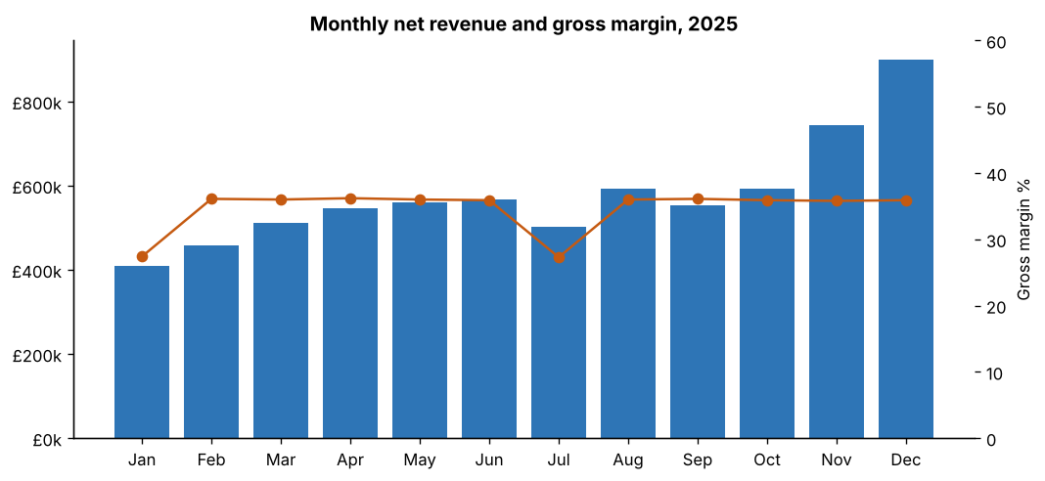
What this talk covers
1
The problem and the goals
2
Architecture and data model
3
Pipeline stages in detail
Every number in this talk comes from a real run of the pipeline.
4
Reliability and testing
5
Results, lessons and next steps
Notes:
Here is the plan. First, why this problem matters. Second, the data and the goals I set. Third, the architecture and each of the five stages: extract, validate, transform, load and report. Fourth, how I made it reliable: logging, retries, auditing and tests. Then the results of a real run, what I learned, and next steps. (~1 minute)

Slide 3
Raw sales exports cannot be trusted as they arrive
1
Duplicate scans
2
Missing or unknown keys
The same transaction ID appears twice, inflating revenue
Store IDs blank, product codes that do not exist
3
Impossible values
4
Messy text
31 February, negative or text quantities, £9,999.99 prices
Inconsistent capitals and trailing spaces in names
Notes:
Retailers export sales from their till systems every day or month, usually as CSV files. In practice those files are messy. A scanner reads the same item twice. A store ID is missing because a till was misconfigured. A date comes through as 31 February. Someone types 'two' instead of 2 in a quantity field. A price is keyed as 9,999.99.
If you load those files straight into a dashboard, revenue is overstated, store comparisons are wrong, and people stop trusting the numbers. The goal of this project is to make sure that never happens: every row is either proven clean or quarantined with a reason. (~1.5 minutes)

Slide 4
Goals and success criteria I set before writing code
1
2
3
4
5
Trustworthy
Reliable
Observable
Portable
Tested
Every row is clean or quarantined with a reason
All-or-nothing load, safe to re-run
Logs, timings and a run-audit table
SQLite by default, PostgreSQL via one setting
Unit and end-to-end tests with pytest
Notes:
Before writing any code I wrote down what 'done' means. Trustworthy: no bad row reaches the warehouse, and every rejected row has a reason. Reliable: if the run fails half way, the warehouse is not left half-loaded, and running it twice gives the same result. Observable: I can see what each run did. Portable: it runs on a laptop with zero setup using SQLite, but switches to PostgreSQL by changing one setting. And tested: automated tests prove each rule works. (~1.5 minutes)

Slide 5
The data: one year of synthetic sales for a UK retail chain
12
60
110,076
~3%
stores across the UK and NI
products in 6 categories
raw rows in 12 monthly files
rows with injected problems
Files: sales_2025_01.csv to sales_2025_12.csv, plus products.csv and stores.csv
Built-in seasonality: November and December peaks, January and July sale discounts
Generated by generate_data.py with a fixed random seed, so results are reproducible
Notes:
Because I could not use real company data, I wrote a generator that creates a realistic year of sales for a fictional UK chain: 12 stores from Belfast to London, 60 products across 6 categories, with Christmas peaks and January and July sales. It produces 12 monthly files, about 110,000 rows in total.
Crucially, about 3% of rows are deliberately corrupted with the problems we just saw, so the pipeline has something real to catch. I want to be clear that the data is synthetic: the business numbers show the reporting works, but the engineering is the point of this project. (~1.5 minutes)

Slide 6
Architecture and data model
Five stages, one warehouse, one audit trail
Notes:
Let me now show how the pipeline is put together. (~0.5 minutes)

Slide 7
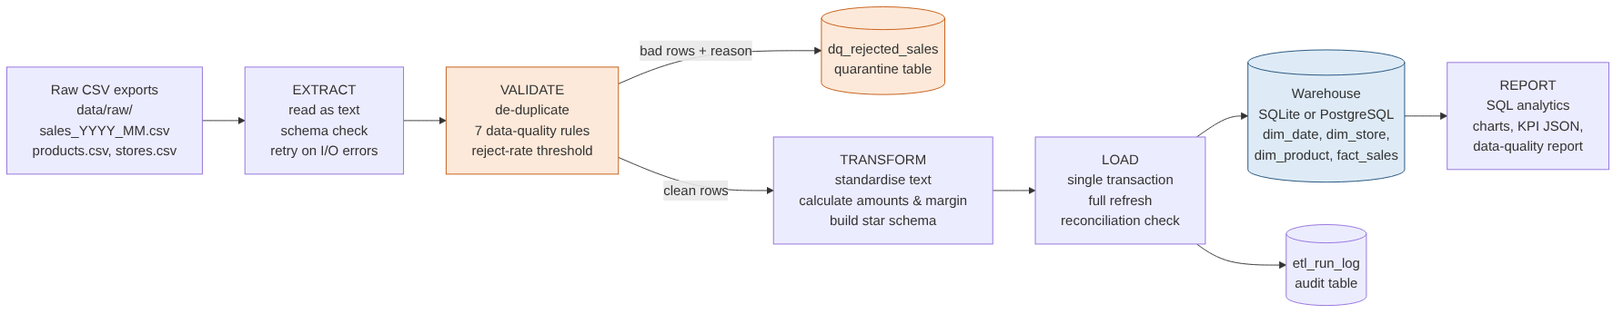
Five stages turn raw files into a trusted warehouse
One Python module per stage: extract.py, validate.py, transform.py, load.py, analytics.py
pipeline.py orchestrates the run, times each stage and writes the audit record
Notes:
This is the whole system on one slide. Raw CSVs land in data/raw. Extract reads them and checks the columns. Validate removes duplicates and applies seven data-quality rules: clean rows go forward, bad rows go to a quarantine table together with the reason. Transform builds the star schema and calculates the money fields. Load writes everything inside one database transaction and then reconciles the totals. Report runs SQL queries and creates charts and a data-quality report. Every run is recorded in an audit table. Each stage is its own Python module, which makes it easy to test and change. (~2 minutes)

Slide 8
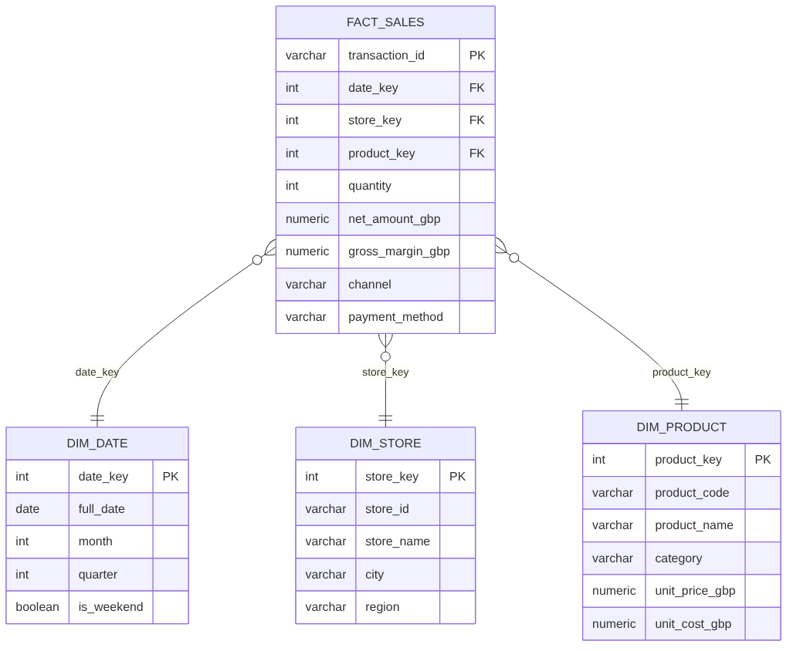
A star schema keeps reporting queries simple and fast
Why a star schema
Simple joins for analysts, fast aggregations, and it is the shape BI tools such as Power BI expect.
Integrity built in
Primary and foreign keys, CHECK quantity > 0, and indexes on every join key.
Notes:
For the warehouse I chose a star schema, the standard design for analytics. In the middle is fact_sales: one row per transaction with the measures, quantity, net amount and margin. Around it are three dimensions: date, store and product. Analysts can then answer most questions with a simple join and a GROUP BY, for example revenue by region by month.
I used surrogate integer keys, primary and foreign keys, a CHECK that quantity is positive, and indexes on the join columns. The same DDL file runs on both SQLite and PostgreSQL. (~2 minutes)

Slide 9
The pipeline stage by stage
Extract, validate, transform, load, report
Notes:
Now let me go into each stage and the decisions behind it. (~0.5 minutes)

Slide 10
Extract reads everything as text, so bad values cannot crash it
1
Read as text
2
Schema check
3
Retry and lineage
dtype=str for every column. Bad values are handled in validation, not by crashing the read.
Each file must contain all 10 expected columns, or the run stops with a clear error naming the file.
Reads retry with exponential backoff (1s, 2s, 4s). Every row keeps its source_file name.
extract.py · read_csv() is wrapped in @retry(attempts=3, backoff_seconds=1.0)
Notes:
The extract step finds every monthly file and reads it. One important decision: I read every column as text. If pandas tried to convert 'two' to a number at read time the whole run would crash. Reading as text means types are enforced later, in validation, where a bad value becomes a rejected row instead of a crash.
It also checks that each file has the required columns, records which file each row came from for traceability, and wraps file reads in a retry decorator with exponential backoff, which matters when files sit on a network drive. (~1.5 minutes)

Slide 11
Seven validation rules, and every rejection keeps its reason
Rule | Fails when
missing_store_id | Store ID is blank
unknown_store_id | Store not in the reference list
unknown_product_code | Product not in the reference list
invalid_quantity | Not a number, zero or negative
invalid_datetime | Wrong format or impossible date
price_out_of_range | Missing, zero, or above £500
invalid_discount | Below 0% or above 90%
Quarantine, not delete
Bad rows go to dq_rejected_sales with every reason they failed.
Stop a broken batch
If more than 10% of rows fail, nothing is loaded and the run is marked FAILED.
Notes:
This is the heart of the project. First, duplicates on transaction ID are removed, keeping the first. Then seven rules run on every row. Importantly, a row can fail several rules and all reasons are recorded, separated by semicolons. Rejected rows are never silently dropped; they go to the dq_rejected_sales table and a CSV, so the business can fix them at source.
There is also a safety threshold: if more than 10% of rows fail, the run stops before loading anything, because that usually means the export itself is broken, for example a changed file format. (~2 minutes)

Slide 12
The pipeline caught 3,543 problem rows in the 2025 data
110,076
rows extracted
2.23%
reject rate (threshold 10%)
106,533
clean rows loaded
Notes:
Here is what validation found on the latest run. 1,086 duplicate transactions were removed and 2,457 rows were rejected, a reject rate of 2.23%, comfortably under the 10% threshold. The biggest categories were invalid quantities, which in a real business are often returns keyed incorrectly, and missing store IDs. Without this step, revenue would have been overstated and some sales would have pointed at stores and products that do not exist. (~1.5 minutes)

Slide 13
Transform standardises text and calculates every money field once
Gross
Discount
Net
Cost
Margin
quantity × unit price
gross × discount %
gross − discount
quantity × unit cost
net − cost
Text standardised: trimmed store names, lower-case payment method and channel
Amounts rounded to pence; one definition of revenue and margin for every report
Surrogate keys link facts to the date, store and product dimensions
Notes:
Transform does two things. It cleans text, trimming spaces and lower-casing categorical fields such as payment method, so 'Card ' and 'card' are counted together. And it calculates the money fields once, in one place, with rounding to pence: gross amount is quantity times price, the discount, net amount, cost using the product's unit cost, and gross margin. Calculating these in the pipeline rather than in every report means everyone uses the same definition of revenue and margin. (~1.5 minutes)

Slide 14
Load is all-or-nothing, safe to re-run, and checked afterwards
1
One transaction
2
Idempotent
3
Reconciled
Schema rebuild and all inserts commit together, or not at all.
Full refresh: the same input always gives the same warehouse. Proved by a test that runs twice.
Database row count and £ total must match the transform output. Latest run: 106,533 rows, £6.94m.
load.py · with engine.begin() as conn: → schema.sql → dims → fact_sales → reconcile()
Notes:
Loading is where pipelines often corrupt data, so I was careful here. The whole load happens inside one database transaction: if anything fails, nothing is committed and the old warehouse stays intact. Tables load in foreign-key order: dimensions first, then facts. The design is a full refresh, so running the pipeline twice gives exactly the same result; I have a test that proves that.
After loading, a reconciliation step queries the database and checks the row count and the total net revenue match what was transformed, to the penny. If they do not match, the run fails. (~2 minutes)

Slide 15
Reporting runs plain SQL against the warehouse
Query | Answers
monthly_revenue | Revenue, margin and volume by month
store_performance | Store league table
category_mix | Revenue, margin, discount by category
top_products | Top 10 products
hourly_pattern | Trading by hour, weekday vs weekend
channel_payment | Channel and payment split
Outputs every run
outputs/tables: 6 CSV results
outputs/charts: 6 PNG charts
kpi_summary.json
data_quality_report.md
rejected_rows.csv
Notes:
The reporting layer is deliberately simple: six SQL files in sql/analytics. The pipeline runs each one against the warehouse, saves the result as a CSV, and draws charts with matplotlib. It also writes a KPI summary as JSON, which another system or a dashboard could read, and a data-quality report in Markdown. Keeping the logic in SQL means an analyst can read and change it without touching Python. (~1.5 minutes)

Slide 16
Reliability and testing
Logging, retries, auditing and 19 automated tests
Notes:
Next, how I made sure the pipeline can be trusted to run unattended. (~0.5 minutes)

Slide 17
Every run leaves a trail: logs, timings and an audit record
1
Structured logs
2
Audit table
3
Config, not code
Console plus rotating file. Start, finish and duration of every stage; counts for every rule.
etl_run_log stores one row per run: status, counts, timings and any error message.
Database URL, thresholds and retries come from .env. No hard-coded secrets.
logs/pipeline.log · SELECT * FROM etl_run_log · .env.example
Notes:
A pipeline that runs at 6am with nobody watching has to explain itself. Logs go to the console and to a rotating file. Each stage logs its start, finish and duration, and each validation rule logs how many rows it flagged. Every run, successful or failed, writes a row to etl_run_log: run ID, timestamps, status, rows extracted, rejected and loaded, and the error message if it failed. Configuration comes from environment variables or a .env file, so no settings or passwords are hard-coded. (~1.5 minutes)

Slide 18
19 automated tests prove the rules, the maths and the whole run
12
Validation
Each rule, duplicates, multiple reasons, threshold
3
Transform
Amounts to the penny, text cleaning, date dimension
2
Utilities
Retry succeeds after failures, then gives up
2
End to end
Full run, no orphans, audit log, idempotent re-run
pytest: 19 passed in ~4 seconds
Notes:
I wrote 19 tests with pytest. Unit tests check that each of the validation rules rejects the right rows with the right reason, that duplicates are removed once, and that the reject threshold stops a bad batch. Transform tests check the money calculations to the penny. Utility tests check the retry logic. And two end-to-end tests generate a small dataset, run the full pipeline into a temporary database, and check there are no orphan rows, the audit log says SUCCESS, and that running twice gives identical results. The whole suite runs in about 4 seconds. (~2 minutes)

Slide 19
Results
What a full run produces
Notes:
Now the results of the latest run. (~0.5 minutes)

Slide 20
A full year processed and reconciled in about 5 seconds
106,533
£6.94m
34.8%
clean transactions loaded
net revenue
gross margin
Passed
~5s
19 / 19
reconciliation: rows and £ match
end-to-end runtime
tests passing
Notes:
On the latest run, 110,076 rows came in from 12 files. 1,086 duplicates were removed and 2,457 rows were quarantined, so 106,533 clean transactions were loaded. Reconciliation passed: the database total matched to the penny. The total net revenue was £6.94 million at a 34.8% gross margin, and the whole run took around 5 seconds on a laptop. (~1.5 minutes)

Slide 21
Revenue peaks in November and December; margin dips in sale months
December peak
£900k, 13% of the year
Sale-month margin
January 27.4% and July 27.3% vs about 36% in other months
Notes:
This chart comes straight from the monthly_revenue query. Revenue builds through the year and peaks in December at about 13% of the annual total. The margin line drops to about 27% in January and July, which are the sale months with deeper discounts. As I said, these patterns come from the assumptions I built into the generator, so the point is that the reporting correctly surfaces them, not that this is real market insight. (~1.5 minutes)

Slide 22
London and Belfast lead the stores; Electronics leads the categories
Notes:
Two more views from the warehouse. On the left, the top six stores by revenue, led by London Oxford Street and Belfast City Centre. On the right, revenue by category: Electronics brings in the most revenue, while Beauty has the highest margin percentage. In a real business these are the questions a commercial team would ask the warehouse every week, and each one is a single SQL query. (~1.5 minutes)

Slide 23
What I learned, and the honest limitations
Lessons
Limitations
Validation rules and quarantine are most of the value
Transactional, idempotent loads prevent half-loaded warehouses
Tests made it safe to refactor quickly
Synthetic data: insights are illustrative only
Full refresh will not scale to very large volumes
No scheduler or alerting yet
Notes:
Three lessons. First, validation is most of the work: the clever part of a pipeline is deciding what counts as bad data and what to do with it. Second, making the load transactional and idempotent removes a whole class of production problems. Third, tests gave me confidence to refactor.
And the honest limitations: the data is synthetic, so the business insights are illustrative. The full refresh is fine for a year of data but would be slow for billions of rows. And there is no scheduler yet; it runs on demand. (~1.5 minutes)

Slide 24
Next steps to take it closer to production
1
Incremental loads
Only process new files via a file-registry table
2
SCD type 2
Keep history when stores or products change
3
Orchestration
Daily schedule and failure alerts (Airflow / Prefect)
4
Data contracts
Declarative checks with Great Expectations
5
Power BI
Self-service dashboard on the warehouse
Notes:
If I continued, these are the next steps, in priority order. Incremental loading, so only new monthly files are processed, using a file registry table. Type-2 slowly changing dimensions, so if a store changes region, history stays correct. Orchestration with Airflow or Prefect on a daily schedule with alerts on failure. Declarative data contracts with a tool like Great Expectations. And a Power BI dashboard on top of the warehouse for the business users. (~1.5 minutes)

Slide 25
Live demo and questions
python -m retail_etl all → pytest → outputs/
Thank you | github.com/<your-username>/retail-sales-etl-pipeline
Notes:
To finish, a two-minute live demo. In VS Code I run 'python -m retail_etl all'. You can see the log: each file read, each rule's count, the reconciliation passing, and the run finishing in a few seconds. Then I run pytest, 19 tests passing. Finally I open outputs/reports/data_quality_report.md and the rejected_rows.csv to show a quarantined row and its reason.
Thank you for listening. I am happy to take any questions. The code, report and this presentation are on my GitHub. (~3 minutes including demo, then Q&A)

